Slide 1
Crud Operation in Laravel
Lecture Content
Database Setup in Laravel
How to create controller in Laravel
How to create Models in Laravel
How to create Migrations in Laravels
Routes In Laravel
Fetching data from database in Laravel
Passing data to view
Csrf token in Laravel
Inserting ,updating and deleting data from database

Slide 2
Database Setup in Laravel
Setup Database with App
Setup database with your downloaded/installed laravel app. So, you need to find the .env file and setup database details as follows:
DB_CONNECTION=mysql
DB_HOST=127.0.0.1
DB_PORT=3306
DB_DATABASE=database-name
DB_USERNAME=database-user-name
DB_PASSWORD=database-password

Slide 3
Controllers in Laravel
Controller creation cmd in Laravel
Php artisan make:controller controllerName
Controllers can group related request handling logic into a single class. For example, a UserController class might handle all incoming requests related to users, including showing, creating, updating, and deleting users. By default, controllers are stored in the app/Http/Controllers directory.

Slide 4
Models Operation in Laravel
Models creation cmd in Laravel
Php artisan make:model modelName
v
Introduction
Laravel includes Eloquent, an object-relational mapper (ORM) that makes it enjoyable to interact with your database. When using Eloquent, each database table has a corresponding "Model" that is used to interact with that table. In addition to retrieving records from the database table, Eloquent models allow you to insert, update, and delete records from the table as well.

Slide 5
Migration
Migrations are a type of version control for your database. They allow a team to modify the database schema and stay up to date on the current schema state. Migrations are typically paired with the Schema Builder to easily manage your application's schema.

Slide 6
Migration 3-Steps Process
1. Create File
D:\xampp\htdocs\myproject> php artisan make:migration create_students_table
2. Add fields in File
3. Execute File
D:\xampp\htdocs\myproject> php artisan migrate

Slide 7
Migration Code
public function up()
{
Schema::create(‘students', function (Blueprint $table) {
$table->id();
$table->string('name');
$table->string('email');
$table->string('address');
$table->timestamps();
});
}

Slide 8
Routes in Laravel
In Laravel, all requests are mapped with the help of routes. Basic routing routes the request to the associated controllers. This chapter discusses routing in Laravel.
Routing in Laravel includes the following categories −
Basic Routing
Route parameters
Named Routes
.

Slide 9
Routes in Laravel
Basic Routing
All the application routes are registered within the routes/web.php file. This file tells Laravel for the URIs it should respond to and the associated controller will give it a particular call. The sample route for the welcome page can be seen as shown in the screenshot given below −

Slide 10
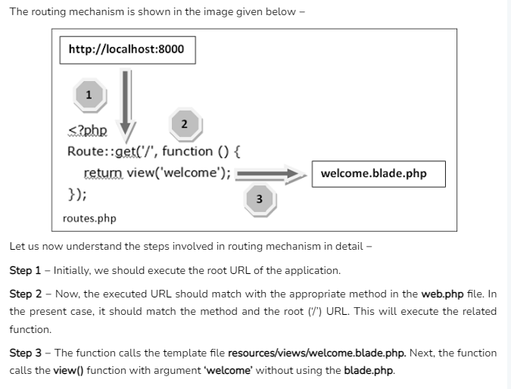
Routes in Laravel
Basic Routing
All the application routes are registered within the routes/web.php file. This file tells Laravel for the URIs it should respond to and the associated controller will give it a particular call. The sample route for the welcome page can be seen as shown in the screenshot given below −

Slide 11
Routes in Laravel
Parameterized Routes
Required Parameters
These parameters are those which should be mandatorily captured for routing the web application.
For example, it is important
to capture the user’s identification number from the URL. This can be possible by defining route parameters as shown below −
Route::get(‘/ID/{id}',function($id) { echo 'ID: '.$id; });

Slide 12
Routes in Laravel
Named Routes
Named routes allow a convenient way of creating routes. The chaining of routes can be specified using name method onto the route definition. The following code shows an example for creating named routes with controller −
Route::get('user/profile', 'App\Http\Controllers\UserController@showProfile')->name('profile');
The user controller will call for the function showProfile with parameter as profile. The parameters use name method onto the route definition.

Slide 13
Passing Data into View Laravel
Laravel provides different ways to pass data to a view. We can pass data directly from routes or through the controller.
Here are some of the ways we can pass data to the view:
Using with()
Using compact()

Slide 14
Passing Data into View
Using with(): The ‘with()’ is a method to pass individual form of data and is used with the ‘view’ helper function.
Example:
Write the below code in the ‘web.php’ file.
Route::get('/', function () {
$articleName = ‘Article 1’;
return view('gfg')->with('articleName', $articleName)->
with('articlePublished', 'On GeeksforGeeks');
});
As you can see in the above code, we have to specify an arrow ‘->’ and then use the ‘with()’ method with ‘view()’ helper function. And we can specify one or more ‘with()’ depending on the requirement and use case.

Slide 15
Passing Data into View
Create and write the below code in the ‘gfg.blade.php’ file in ‘resources/views’ directory.
<!DOCTYPE html>
<html>
<head>
<title>Passing Data into view</title>
</head>
<body>
<h1>My Article</h1>
<p>{{ $articleName }}</p>
<p>{{ $articlePublished }}</p>
</body>
</html>
Here we have used double curly brackets ‘{{ }}’ which is to escape HTML elements. In that, we have specified the name of the key, as a PHP variable, that we passed in the ‘view’ helper function.

Slide 16
Passing Data into View
Using compact(): The ‘compact()’ is a PHP function that can be used for creating an array with variable and there value. Here the name on the variable is the key and the variable content is the value.
Note: Comment or delete any previous route in the ‘web.php’ file in ‘routes’ directory.
Example:
Write the below code in the ‘web.php’ file.
Route::get('/', function () {
$articleName = ['Article 1','Article 2'];
$articlePublished = 'On GeeksforGeeks';
return view('gfg', compact('articleName',
'articlePublished'));
});
In view(), the first parameter is the name of the view and second is where we have to specify the ‘compact()’ function

Slide 17
Passing Data into View
Create and write the below code in the ‘gfg.blade.php’ file in ‘resources/views’ directory.
<!DOCTYPE html>
<html>
<body>
<h1>My Article</h1>
@foreach ($articleName as $article)
<li>{{ $article }}</li>
@endforeach
<p>{{ $articlePublished }}</p>
</body>
</html>
Here we have used double curly brackets ‘{{ }}’ which is to escape HTML elements. In that, we have specified the name of the key, as a PHP variable, that we passed in the ‘view’ helper function.

Slide 18
Passing Data into View
Create and write the below code in the ‘gfg.blade.php’ file in ‘resources/views’ directory.
<!DOCTYPE html>
<html>
<body>
<h1>My Article</h1>
@foreach ($articleName as $article)
<li>{{ $article }}</li>
@endforeach
<p>{{ $articlePublished }}</p>
</body>
</html>
Here we have used double curly brackets ‘{{ }}’ which is to escape HTML elements. In that, we have specified the name of the key, as a PHP variable, that we passed in the ‘view’ helper function.

Slide 19
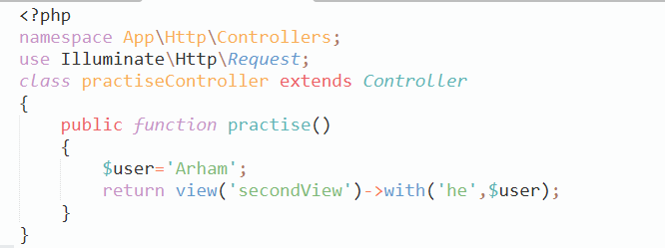
Passing Data into View
Using Controller Class: Passing data using controller class is easy and is the right way.
Note: Both Compact and view can be used to transmit data from controller to view
Example:
We first have to create a controller class by running the command below on the command line.
php artisan make:controller practiseController

Slide 20
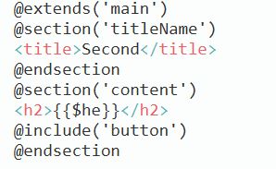
Passing Data into View
Accessing view in Controller Class

Slide 21
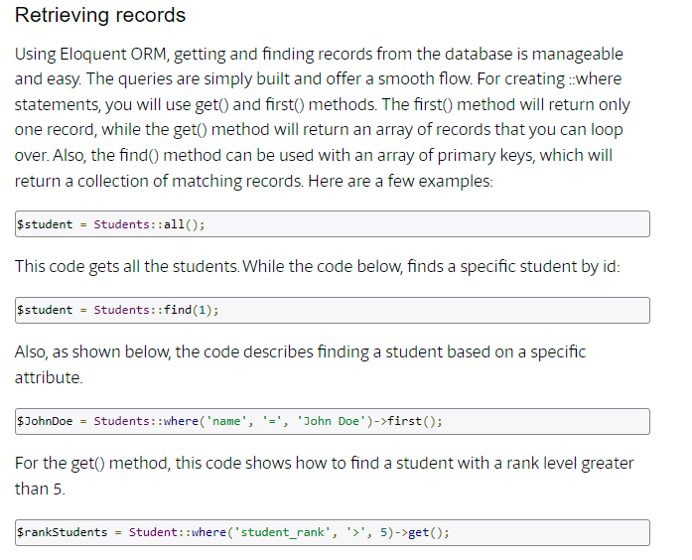
Applying Query with Models

Slide 22
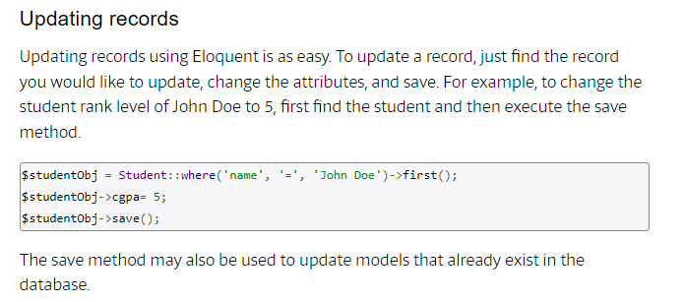
Applying Query with Models

Slide 23
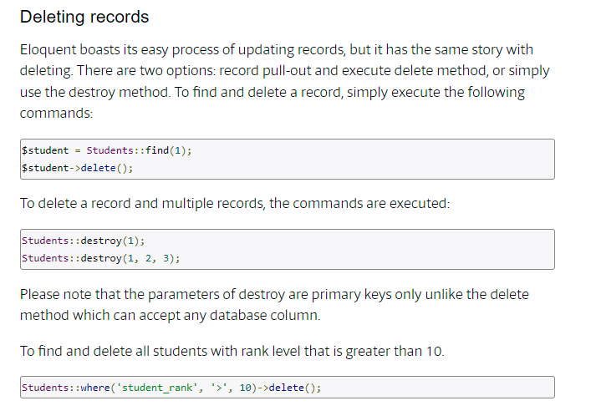
Applying Query with Models

Slide 24
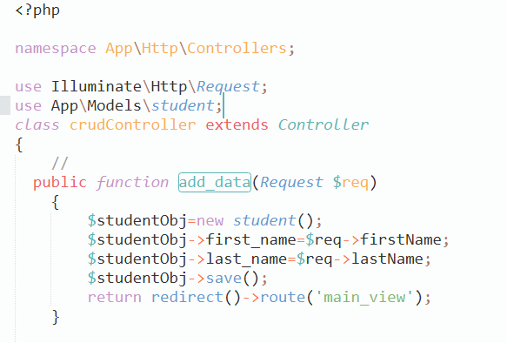
Applying Query with Models(Insert)

Slide 25
CSRF in Laravel
Cross-Site Request Forgery (CSRF) is a type of attack that performed by the attacker to send requests to a system with the help of an authorized user who is trusted by the system.
Laravel provides protection with the CSRF attacks by generating a CSRF token. This CSRF token is generated automatically for each user. This token is nothing but a random string that is managed by the Laravel application to verify the user requests.
How to Use: This CSRF token protection can be applied to any HTML form in Laravel application by specifying a hidden form field of CSRF token. The requests are validated automatically by the CSRF VerifyCsrfToken middleware.
There are three different ways in which you can do this.
@csrf
csrf_field()
csrf_token()
Link :
https://www.geeksforgeeks.org/laravel-csrf-protection/#:~:text=Cross%2DSite%20Request%20Forgery%20(CSRF,generated%20automatically%20for%20each%20user.

