Slide 1
Web Engineering
Lecture 5

Slide 2
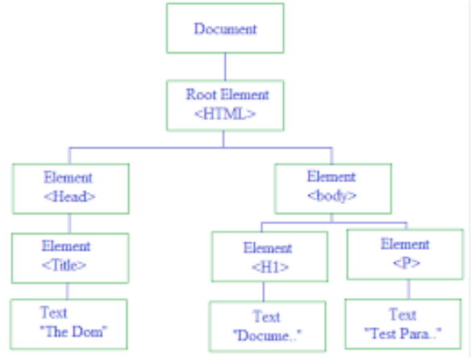
Document Object Model

Slide 3
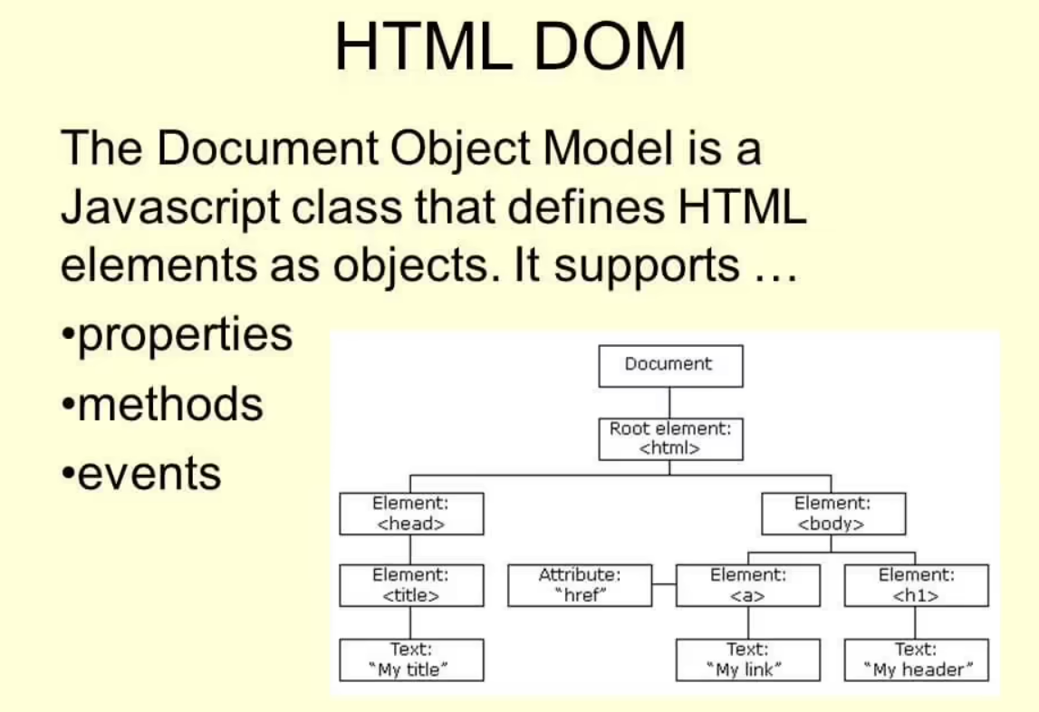
Document Object Model

Slide 4
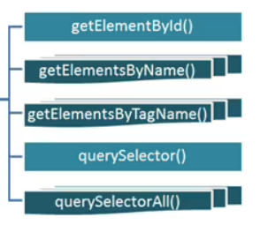
Document Object Model Methods

Slide 5
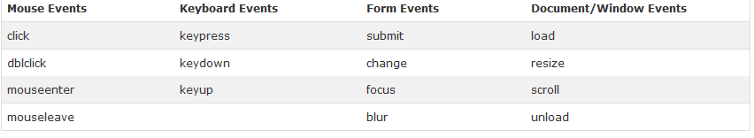
What are Events?
All the different visitor's actions that a web page can respond to are called events.
n event represents the precise moment when something happens. Examples: moving a mouse over an element, selecting a radio button, clicking on an element

Slide 6
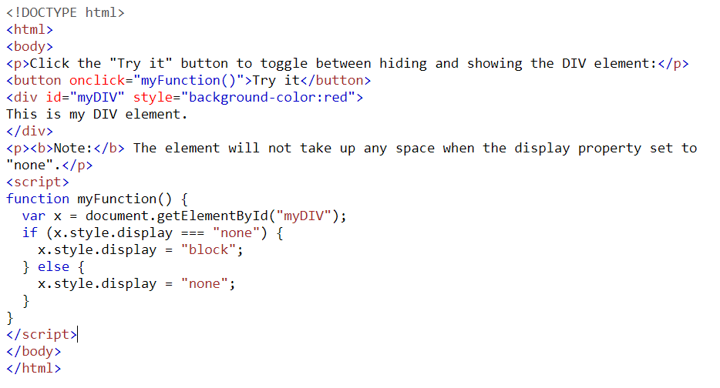
JavaScript Example?

Slide 7
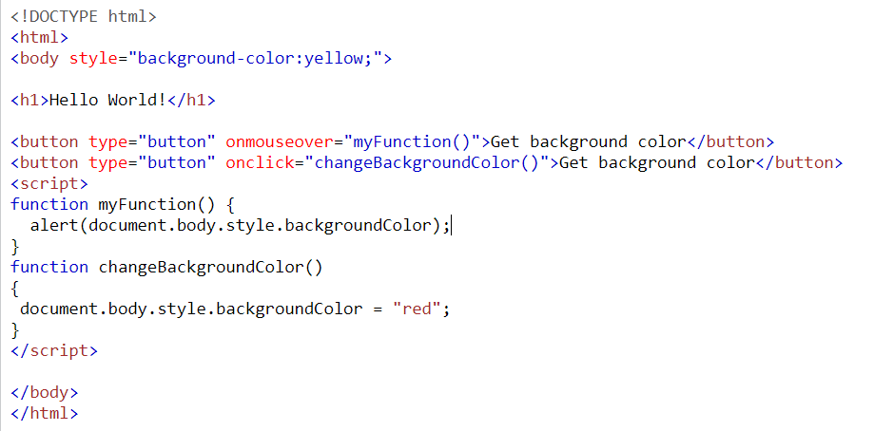
JavaScript Example?

Slide 8
JavaScript Form Validation

Slide 9
What is Ajax?
AJAX stands for Asynchronous JavaScript And XML
Allows web pages or parts of them to be updated asynchronously
Based on XML HTTP request object (AKA XHR)
Requires basic understanding of:
(X)HTML – displaying the data/Dynamic content
CSS – styling the data
JavaScript – manipulating the DOM
XML / JSON – received / sent data format (also HTML & text)

Slide 10
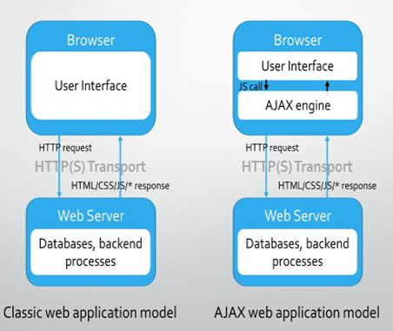
How Ajax Work.

Slide 11
Ajax - Usage Areas
Auto-complete search textboxes
Cascading dropdown list boxes
Real-time - Continuous data refresh (long polling, chat systems…)
Immediate forms validation feedback
Conditional display / dynamic content
Auto save user information (Google Docs, Facebook)
Ratings, voting & other instant actions

Slide 12
Ajax – Example … HTML Part
<!DOCTYPE html> <html> <body> <div id="demo"> <h2>Let AJAX change this text</h2> <button type="button" onclick="loadDoc()">Change Content</button> </div> </body> </html>
The HTML page contains a <div> section and a <button>.
The <div> section is used to display information from a server.
The <button> calls a function (when clicked).

Slide 13
Ajax - Example
function loadDoc() { var xhttp = new XMLHttpRequest(); xhttp.onreadystatechange = function() { if (this.readyState == 4 && this.status == 200) { document.getElementById("demo").innerHTML = this.responseText; } }; xhttp.open("GET", "ajax_info.txt", true); xhttp.send(); }

Slide 14
Ajax - Example
function loadDoc() { var xhttp = new XMLHttpRequest(); xhttp.onreadystatechange = function() { if (this.readyState == 4 && this.status == 200) { document.getElementById("demo").innerHTML = this.responseText; } }; xhttp.open("GET", "ajax_info.txt", true); xhttp.send(); }
The contents of ajax_info.txt:
<h1>AJAX</h1> <p>AJAX is not a programming language.</p> <p>AJAX is a technique for accessing web servers from a web page.</p> <p>AJAX stands for Asynchronous JavaScript And XML.</p>

Slide 15
Advantage of Ajax
Better interactivity & responsiveness
Impressive UX
Reduced connections to the web server (partial rendering)
Reduced bandwidth
Its “cool” ☺

Slide 16
Disadvantage of Ajax
The back and refresh button are rendered useless
Bookmarking is useless (HTML 5 History API to the rescue)
Requires JavaScript to be enabled on browsers
SEO & analytics unfriendly
Screen readers unfriendly – affects accessibility
Callbacks can lead to complex code
Network latency may break usability

Slide 17
Making AJAX requests with raw JavaScript
GET or POST?
GET is faster and simpler than POST
Use POST in these cases:
A cached file is not an option (update a file or database on the server)
Sending a large amount of data to the server (POST has no size limitations)
Sending user input (which can contain unknown characters)

Slide 18
Ajax – Send Request
xhttp.open("GET", "ajax_info.txt", true); xhttp.send();
Open - (method, url, async)Specifies the type of request method: - the type of request: GET or POST url: - the server (file) location async: - true (asynchronous) or false (synchronous)send()Sends the request to the server (used for GET)send(string)Sends the request to the server (used for POST)

Slide 19
Get/Post Request
xhttp.open("GET", "demo_get.php", true); xhttp.send();
xhttp.open("POST", "demo_post.php", true); xhttp.send();

Slide 20
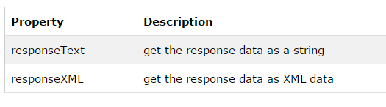
AJAX - Server Response
To get the response from a server, use the responseText or responseXML property of the XMLHttpRequest object.
document.getElementById("demo").innerHTML = xhttp.responseText;

