Slide 1
Forms,CSS

Slide 2
The id and class Selectors
In addition to setting a style for a HTML element, CSS allows you to specify your own selectors called "id" and "class".
The id Selector
The id selector is used to specify a style for a single, unique element.
The id selector uses the id attribute of the HTML element, and is defined with a "#".
The style rule below will be applied to the element with id="para1":
Example
#para1 { text-align:center; color:red; }

Slide 3
The class Selector
The class selector is used to specify a style for a group of elements. Unlike the id selector, the class selector is most often used on several elements.
This allows you to set a particular style for any HTML elements with the same class.
The class selector uses the HTML class attribute, and is defined with a "."
In the example below, all HTML elements with class="center" will be center-aligned:
Example
.center
{
text-align:center;
}
In the example below, all p elements with class="center" will be center-aligned:
Example
p.center {text-align:center;}

Slide 4
body { background-image:url('img_tree.png'); background-repeat:no-repeat; background-position:top right; } in short it can be written as:
body {background:#ffffff url('img_tree.png') no-repeat top right;}

Slide 5
body {color:blue;} h1 {color:#00ff00;} h2 {color:rgb(255,0,0);}
h1 {text-align:center;} p.date {text-align:right;} p.main {text-align:justify;}
a{
text-decoration:none;
}
p.uppercase {text-transform:uppercase;} p.lowercase {text-transform:lowercase;} p.capitalize {text-transform:capitalize;}
p {
text-indent:50px;}

Slide 6
Font Family
The font family of a text is set with the font-family property.
The font-family property should hold several font names as a "fallback" system. If the browser does not support the first font, it tries the next font.
p{font-family:"Times New Roman", Times, serif;}

Slide 7
p.normal {font-style:normal;} p.italic {font-style:italic;} p.oblique {font-style:oblique;}
h1 {font-size:40px;} h2 {font-size:30px;} p {font-size:14px;}

Slide 8
Set Font Size With Em
To avoid the resizing problem with Internet Explorer, many developers use em instead of pixels.
The em size unit is recommended by the W3C.
1em is equal to the current font size. The default text size in browsers is 16px. So, the default size of 1em is 16px.
The size can be calculated from pixels to em using this formula: pixels/16=em
Example
h1 {font-size:2.5em;} /* 40px/16=2.5em */ h2 {font-size:1.875em;} /* 30px/16=1.875em */ p {font-size:0.875em;} /* 14px/16=0.875em */

Slide 9
td { height:50px; vertical-align:bottom; }
td { padding:15px; }
table, td, th { border:1px solid green; } th { background-color:green; color:white; }
table, th, td { border: 1px solid black; }
table,th, td { border: 1px solid black; }

Slide 10
Forms
Forms add the ability to web pages to not only provide the person viewing the document with dynamic information but also to obtain information from the person viewing it, and process the information.
Objectives:
Upon completing this section, you should be able to
Create a FORM.
Add elements to a FORM.
Define CGI (Common Gateway Interface).
The common gateway interface (CGI) is a standard way for a Web server to pass a Web user's request to an application program and to receive data back to forward to the user. This method or convention for passing data back and forth between the server and the application is called the common gateway interface (CGI).
Describe the purpose of a CGI Application.
Specify an action for the FORM.
Forms work in all browsers.
Forms are Platform Independent.

Slide 11
Forms
To insert a form we use the <FORM></FORM> tags. The rest of the form elements must be inserted in between the form tags.
<HTML> <HEAD>
<TITLE> Sample Form</TITLE>
</HEAD>
<BODY BGCOLOR=“FFFFFF”>
<FORM ACTION =“ http://www.example.com/formtest.php”>
<P> First Name: <INPUT TYPE=“TEXT” NAME=“fname” MAXLENGTH=“50”> </P>
<P> <INPUT TYPE=“SUBMIT” NAME=“fsubmit1” VALUE=“Send Info”> </P>
</FORM>
</BODY> </HTML>

Slide 12
<FORM> element attributes
ACTION: is the URL of the CGI (Common Gateway Interface) program that is going to accept the data from the form, process it, and send a response back to the browser.
METHOD: GET (default) or POST specifies which HTTP method will be used to send the form’s contents to the web server. The CGI application should be written to accept the data from either method.
NAME: is a form name used by VBScript or
JavaScripts.
TARGET: is the target frame where the response page will show up.

Slide 13
Form Elements
Form elements have properties: Text boxes, Password boxes, Checkboxes, Option(Radio) buttons, Submit, Reset, File, Hidden and Image.
The properties are specified in the TYPE Attribute of the HTML element <INPUT></INPUT>.

Slide 14
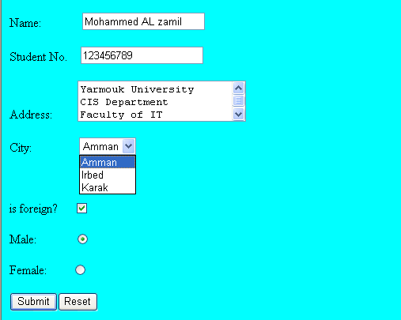
Sami Ali
Al al-Bayt University

Slide 15
Form Elements
<INPUT> Element’s Properties
TYPE= Type of INPUT entry field.
NAME = Variable name passed to CGI application
VALUE= The data associated with the variable name to be passed to the CGI application
CHECKED= Button/box checked
SIZE= Number of visible characters in text field
MAXLENGHT= Maximum number of characters accepted.

Slide 16

Text Box
Text boxes: Used to provide input fields for text, phone numbers, dates, etc.
<INPUT TYPE= " TEXT " >
Browser will display
Textboxes use the following attributes:
TYPE: text.
SIZE: determines the size of the textbox in characters. Default=20 characters.
MAXLENGHT : determines the maximum number of characters that the field will accept.
NAME: is the name of the variable to be sent to the CGI application.
VALUE: will display its contents as the default value.

Slide 17
Example on Text Box
<TITLE>Form_Text_Type</TITLE>
</HEAD> <BODY>
<h1> <font color=blue>Please enter the following bioData</font></h1>
<FORM name="fome1" Method= " POST " Action= " URL " >
First Name: <INPUT TYPE="TEXT" NAME="FName"
SIZE="15" MAXLENGTH="25"><BR>
Last Name: <INPUT TYPE="TEXT" NAME="LName"
SIZE="15" MAXLENGTH="25"><BR>
Nationality: <INPUT TYPE="TEXT" NAME="Country"
SIZE="25" MAXLENGTH="25"><BR>
The Phone Number: <INPUT TYPE="TEXT" NAME="Phone"
SIZE="15" MAXLENGTH="12"><BR>
</FORM> </BODY> </HTML>

Slide 18
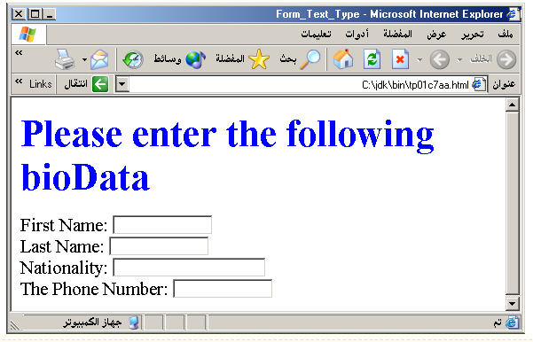
Output

Slide 19
Password
Password: Used to allow entry of passwords.
<INPUT TYPE= "PASSWORD">
Browser will display
Text typed in a password box is starred out in the browser
display.
Password boxes use the following attributes:
TYPE: password.
SIZE: determines the size of the textbox in characters.
MAXLENGHT: determines the maximum size of the password in characters.
NAME: is the name of the variable to be sent to the CGI application.
VALUE: is usually blank.

Slide 20
Example on Password Box
<HTML><HEAD>
<TITLE>Form_Password_Type</TITLE></HEAD>
<BODY>
<h1> <font color=red>To Access, Please
enter:</font></h1>
<FORM name="fome2" Action= "actionform.php" method="POST">User Name: <INPUT TYPE="TEXT" Name="FName"
SIZE="15" MAXLENGTH="25"><BR>
Password: <INPUT TYPE="PASSWORD"
NAME="PWord" value=" SIZE="15"
MAXLENGTH="25"><BR>
</FORM></BODY> </HTML>

Slide 21
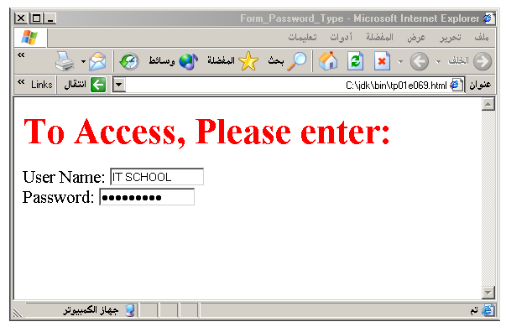
Output

Slide 22
Hidden
Hidden: Used to send data to the CGI application that you don’t want the web surfer to see, change or have to enter but is necessary for the application to process the form correctly.
<INPUT TYPE= "HIDDEN">
Nothing is displayed in the browser.
Hidden inputs have the following attributes:
TYPE: hidden.
NAME: is the name of the variable to be sent to the CGI application.
VALUE: is usually set a value expected by the CGI application.

Slide 23
Check Box
Check Box: Check boxes allow the users to select more than one option.
<INPUT TYPE="CHECKBOX">
Browser will display
Checkboxes have the following attributes:
TYPE: checkbox.
CHECKED: is blank or CHECKED as the initial
status.
NAME: is the name of the variable to be sent to the
CGI application.
VALUE: is usually set to a value.

Slide 24
<HTML> <HEAD><TITLE>CheckBoxType</TITLE> </HEAD>
<BODY>
<h1> <font color=green>Please check one of the following</font></h1>
<FORM name="fome3" Action="url" method="get">
<font color=red> Select Country: </font><BR>
jordan:<INPUT TYPE="CheckBox" Name="country" CHECKED><BR>
Yemen<INPUT TYPE="CheckBox" Name="country"><BR>
Qatar:<INPUT TYPE="CheckBox" Name="country"><BR> <BR>
<font color=blue>Select Language:</font><BR>
Arabic:<INPUT TYPE="CheckBox" Name="language" CHECKED><BR> English:<INPUT TYPE="CheckBox" Name="language"><BR>
French:<INPUT TYPE="CheckBox" Name="language"> <BR></FORM> </BODY></HTML>

Slide 25
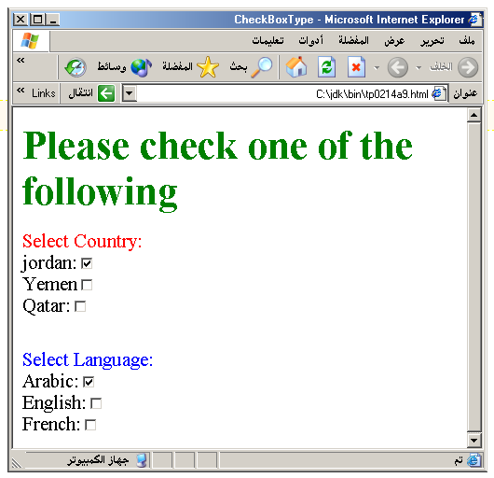
Output

Slide 26
Radio Button
Radio Button: Radio buttons allow the users to select
only one option.
<INPUT TYPE="RADIO">
Browser will display
Radio buttons have the following attributes:
TYPE: radio.
CHECKED: is blank or CHECKED as the initial status. Only one radio button can be checked
NAME: is the name of the variable to be sent to the CGI application.
VALUE: usually has a set value.

Slide 27
<HTML> <HEAD><TITLE>CheckBoxType</TITLE> </HEAD>
<BODY>
<h1> <font color=green>Please check one of the following</font></h1>
<FORM name="fome3" Action="url" method="get">
<font color=red> Select Country: </font><BR>
jordan:<INPUT TYPE= "RADIO" Name="country" CHECKED><BR>
Yemen<INPUT TYPE="RADIO " Name="country"><BR>
Qatar:<INPUT TYPE="RADIO" Name="country"><BR> <BR>
<font color=blue>Select Language:</font><BR>
Arabic:<INPUT TYPE="RADIO" Name="language" CHECKED><BR> English:<INPUT TYPE=" RADIO " Name="language"><BR>
French:<INPUT TYPE=" RADIO " Name="language"> <BR></FORM> </BODY></HTML>

Slide 28
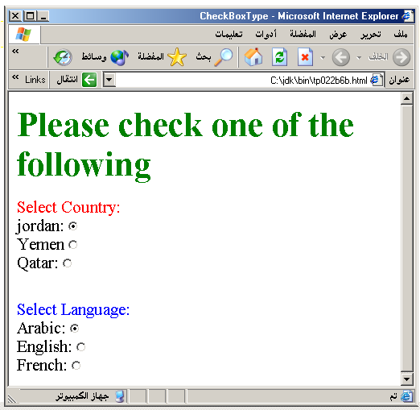

Slide 29
<HTML><HEAD>
<TITLE>RADIOBox</TITLE> </HEAD>
<BODY>
Form #1:
<FORM>
<INPUT TYPE="radio" NAME="choice" VALUE="one"> Yes.
<INPUT TYPE="radio" NAME="choice" VALUE="two"> No.
</FORM>
<HR color=red size="10" >
Form #2:
<FORM>
<INPUT TYPE="radio" NAME="choice" VALUE="three" CHECKED> Yes.
<INPUT TYPE="radio" NAME="choice" VALUE="four"> No.
</FORM>
</BODY></HTML>

Slide 30
Push Button
Push Button: This element would be used with
JavaScript to cause an action to take place.
<INPUT TYPE="BUTTON">
Browser will display
Push Button has the following attributes:
TYPE: button.
NAME: is the name of the button to be used in scripting.
VALUE: determines the text label on the button.

Slide 31
<DIV align="center"><BR><BR>
<FORM>
<FONT Color=red>
<h1>Press Here to see a baby crying:<BR>
<INPUT TYPE="button" VALUE="PressMe"><BR><BR>
<FONT Color=blue>
Click Here to see a baby shouting:<BR>
<INPUT TYPE="button" VALUE="ClickMe" > <BR><BR>
<FONT Color=green>
Hit Here to see a baby eating:<BR>
<INPUT TYPE="button" VALUE="HitME" > <BR><BR>
<FONT Color=yellow>
</FORM></DIV>

Slide 32
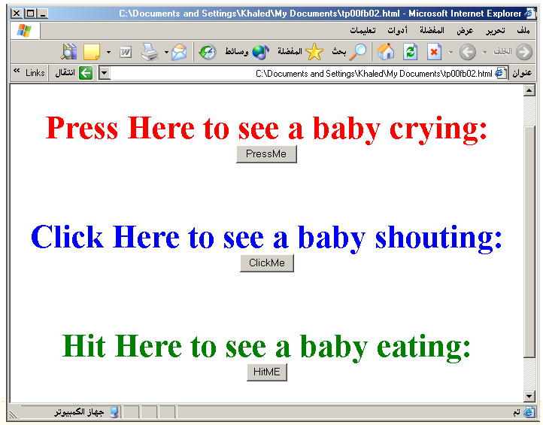

Slide 33
Submit Button
Submit: Every set of Form tags requires a Submit button. This is the element causes the browser to send the names and values of the other elements to the CGI Application specified by the ACTION attribute of the FORM element.
<INPUT TYPE=“SUBMIT”>
The browser will display
Submit has the following attributes:
TYPE: submit.
NAME: value used by the CGI script for processing.
VALUE: determines the text label on the button, usually Submit Query.

Slide 34
<FORM Action="URL" method="get">
First Name: <INPUT TYPE="TEXT" Size=25 name="firstName"><BR>
Family Name: <INPUT TYPE="TEXT" Size=25 name="LastName"><BR>
<BR>
<FONT Color=red>
Press Here to submit the data:<BR>
<INPUT TYPE="submit" VALUE="SubmitData " >
</FORM>

Slide 35
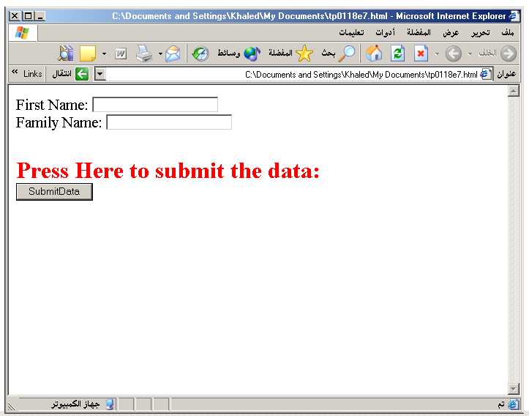

Slide 36
Reset Button
Reset: It is a good idea to include one of these for each form where users are entering data. It allows the surfer to clear all the input in the form.
<INPUT TYPE="RESET">
Browser will display
Reset buttons have the following attributes:
TYPE: reset.
VALUE: determines the text label on the button, usually Reset.

Slide 37
<FORM Action="URL" method="get">
First Name: <INPUT TYPE="TEXT" Size=25 name="firstName"> <BR>
Family Name: <INPUT TYPE="TEXT" Size=25 name="LastName"><BR>
<BR>
<FONT Color = red>
<STRONG><font size=5>Press Here to submit the data:</font></STRONG><BR>
<INPUT TYPE="submit" VALUE="SubmitData">
<INPUT TYPE="RESET" VALUE="Reset">
</FORM>

Slide 38
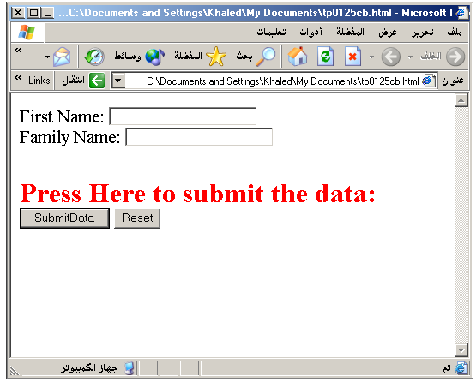

Slide 39
Image Submit Button
Image Submit Button: Allows you to substitute an image for the standard submit button.
<INPUT TYPE="IMAGE" SRC="jordan.gif">
Image submit button has the following attributes:
TYPE: Image.
NAME: is the name of the button to be used in scripting.
SRC: URL of the Image file.

Slide 40
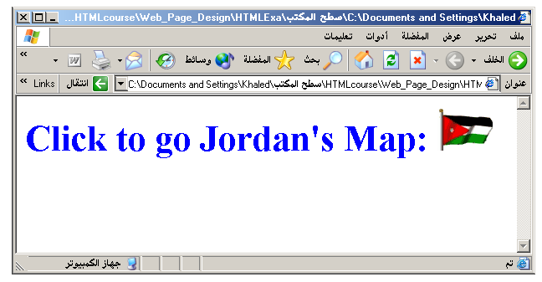
<form> <H1><font color=blue> Click to go Jordan’s Map: <INPUT TYPE="IMAGE" SRC="jordan.gif"> </form>

Slide 41

File
File Upload: You can use a file upload to allow surfers to upload files to your web server.
<INPUT TYPE= "FILE">
Browser will display
File Upload has the following attributes:
TYPE: file.
SIZE: is the size of the text box in characters.
NAME: is the name of the variable to be sent to the
CGI application.
MAXLENGHT: is the maximum size of the input in the
textbox in characters.

Slide 42
<BODY bgcolor=lightblue>
<form>
<H3><font color=forestgreen>
Please attach your file here to for uploading to
My <font color =red>SERVER...<BR>
<INPUT TYPE="File" name="myFile" size="30">
<INPUT TYPE="Submit" value="SubmitFile">
</form>
</BODY>

Slide 43
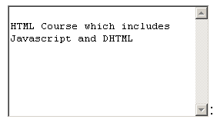
Other Elements used in Forms
<TEXTAREA></TEXTAREA>: is an element that allows for free form text entry.
Browser will display
Textarea has the following attributes:
NAME: is the name of the variable to be sent to the CGI application.
ROWS: the number of rows to the textbox.
COLS: the number of columns to the textbox.

Slide 44
<BODY bgcolor="lightblue">
<form>
<TEXTAREA COLS="40" ROWS="20" Name="comments" >
From observing the apathy of those
about me during flag raising I
concluded that patriotism if not
actually on the decline is at least
in a state of dormancy.
Written by Khaled Al-Fagih
</TEXTAREA>:
</form>
</BODY>

Slide 45
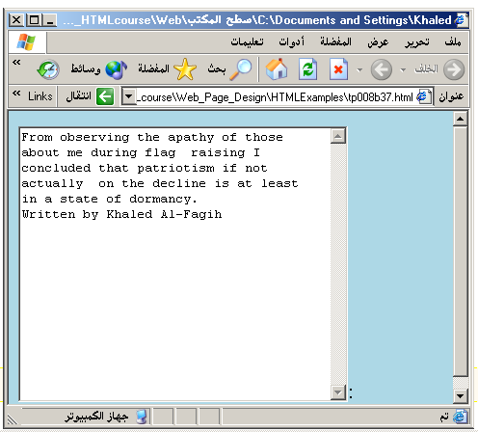

Slide 46
Other Elements used in Forms
The two following examples are <SELECT></SELECT> elements, where the attributes are set differently.
The Select elements attributes are:
NAME: is the name of the variable to be sent to the CGI application.
SIZE: this sets the number of visible choices.
MULTIPLE: the presence of this attribute signifies that the user can make multiple selections. By default only one selection is allowed.

Slide 47
<BODY bgcolor="lightblue">
<form>
Select the cities you have visited:
<SELECT name="list" size="5">
<option> London</option>
<option> Tokyo</option>
<option> Paris</option>
<option> New York</option>
<option> LA</option>
<option> KL</option>
</SELECT>
</form>
</BODY>

Slide 48
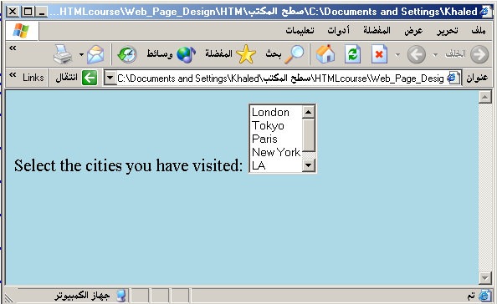

Slide 49
Other Elements used in Forms
Drop Down List:
Name: is the name of the variable to be sent to the CGI application.
Size: 1.

Slide 50

Other Elements used in Forms
List Box:
Name: is the name of the variable to be sent to the CGI application.
SIZE: is greater than one.

Slide 51
Other Elements used in Forms
Option
The list items are added to the <SELECT> element by inserting <OPTION></OPTION> elements.
The Option Element’s attributes are:
SELECTED: When this attribute is present, the option is selected when the document is initially loaded. It is an error for more than one option to be selected.
VALUE: Specifies the value the variable named in the select element.

Slide 52
</HEAD>
<BODY>
<h2><font color="blue">What type of Computer do you have?</font><h2>
<FORM>
<SELECT NAME="ComputerType" size= "4" >
<OPTION value="IBM" selected=" "> IBM</OPTION>
<OPTION value="INTEL"> INTEL</OPTION>
<OPTION value=" Apple"> Apple</OPTION>
<OPTION value="Compaq"> Compaq</OPTION>
</SELECT>
</FORM></BODY></HTML>

Slide 53
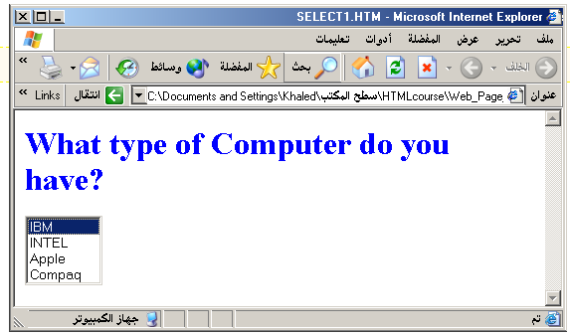

Slide 54
<HEAD> <TITLE>SELECT with Mutiple </TITLE> </HEAD>
<BODY>
<h2><font color=blue>What type of Computer do you have?</font><h2>
<FORM>
<SELECT NAME="ComputerType" size= "5" multiple=" ">
<OPTION value="IBM" > IBM</OPTION>
<OPTION value="INTEL"> INTEL</OPTION>
<OPTION value=" Apple"> Apple</OPTION>
<OPTION value="Compaq" selected= " " > Compaq</OPTION>
<OPTION value=" other"> Other</OPTION>
</SELECT>
</FORM></BODY></HTML>

Slide 55
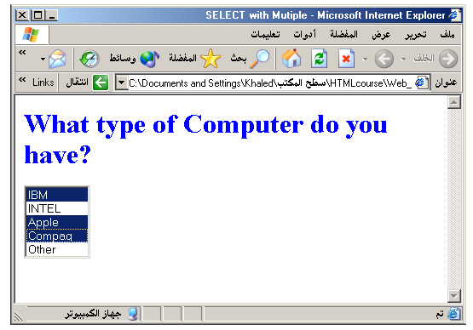

Slide 56
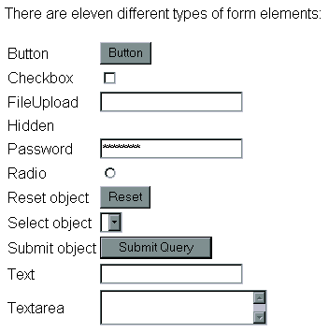

Slide 57
<marquee> tag
The HTML <marquee> tag is used for scrolling piece of text or image displayed either horizontally across or vertically down your web site page depending on the settings.
<!DOCTYPE html> <html> <head> <title>HTML marquee Tag</title> </head> <body>
<marquee>This is basic example of marquee</marquee>
<marquee direction="up">The direction of text will be from bottom to top.</marquee>
<marquee direction="right">The direction of text will be from left to right.</marquee>
<marquee direction="down">The direction of text will be from top to bottom.</marquee>
<marquee direction="left">The direction of text will be from right to left.</marquee> </body> </html>

Slide 58

CSS :hover Selector
a:hover { background-color: yellow; }
<!DOCTYPE html>
<html>
<head>
<style>
a:hover {
background-color: yellow;
}
</style>
</head>
<body>
<a href="http://www.google.com ">www.google.com</a>
<a href="http:// www.facebook.com ">www.facebook.com</a>
<p><b>Note:</b> The :hover selector style links on mouse-over.</p>
</body>
</html>

