Slide 1
What’s Responsive Web Design?
Responsive web design is an approach to web design aimed at allowing desktop webpages to be viewed in response to the size of the screen or web browser one is viewing with.
Important points:
● CSS Media Queries
● Fluid Grids
● Flexible Media
Notes:
You can start building your responsive website by creating an HTML document based on Bootstrap framework. You can choose to create a set of Bootstrap framework files or use the existing files. Once the document is created, you can add Bootstrap components such as accordions and carousels using the Insert panel in Dreamweaver.

Slide 2
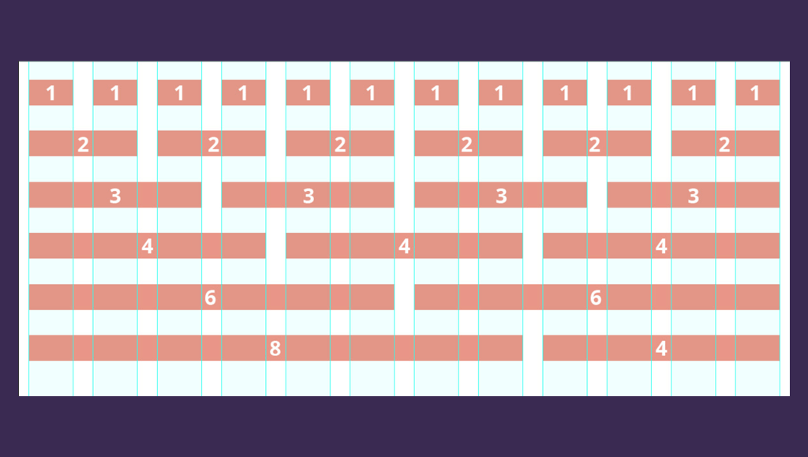
Bootstrap Grid
Notes:
Bootstrap's grid system is responsive, and the columns will re-arrange depending on the screen size: If you do not want to use all 12 columns individually, you can group the columns together to create wider columns. On a big screen it might look better with the content organized in three columns, but on a small screen it would be better if the content items were stacked on top of each other. Make sure that the sum adds up to 12 or fewer (it is not required that you use all 12 available columns).

Slide 3
Bootstrap Grid Classes
The Bootstrap grid system has four classes:
xs (for phones - screens less than 575px wide)
.col- (extra small devices - screen width less than 576px)
.col-sm- (small devices - tablets - screen width equal to or greater than 576px)
.col-md- (medium devices - small laptops - screen width equal to or greater than 768px)
.col-lg- (large devices - laptop & desktops - screen width equal to or greater than 992px)
.col-xl- (xlarge devices - laptops & desktops - screen width equal to or greater than 1200px)
Notes:
The Bootstrap 4 grid system has five classes:

Slide 4
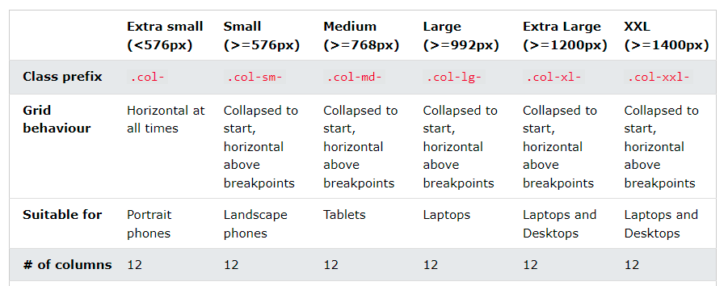
Bootstrap Grid Examples
Notes:
So, to create the layout you want, create a container (<div class="container">). Next, create a row (<div class="row">). Then, add the desired number of columns (tags with appropriate .col-*-* classes). Note that numbers in .col-*-* should always add up to 12 for each row.

Slide 5
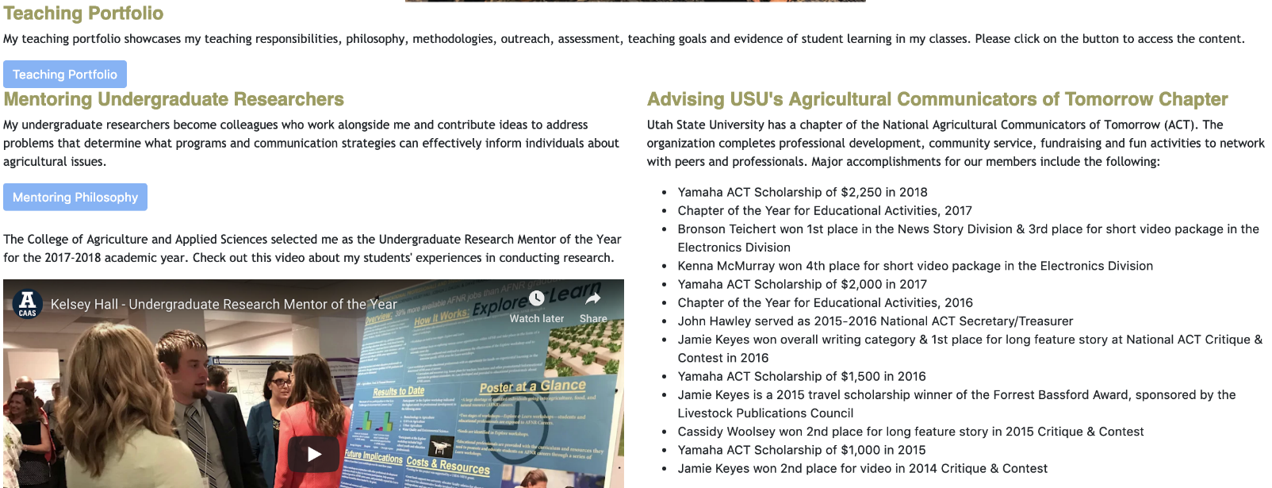
Bootstrap Grid - Example
How many columns are in each section of this website?

Slide 6
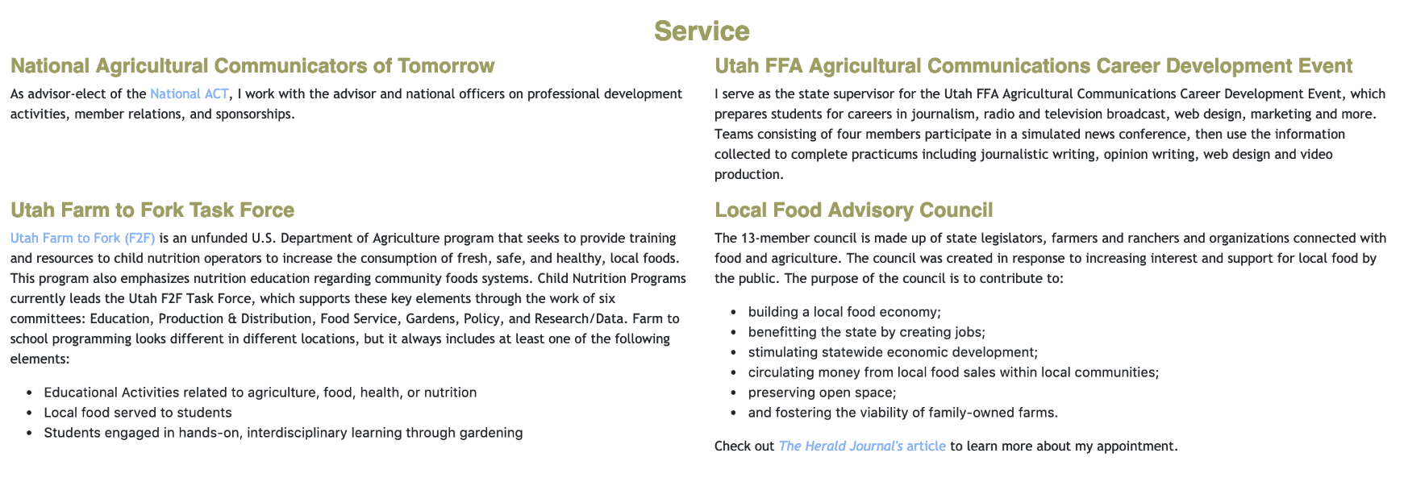
Bootstrap Grid - Example
How many columns are in each section of this website?

Slide 7

Bootstrap Grid - Example
How many columns are in each section of this website?

Slide 8
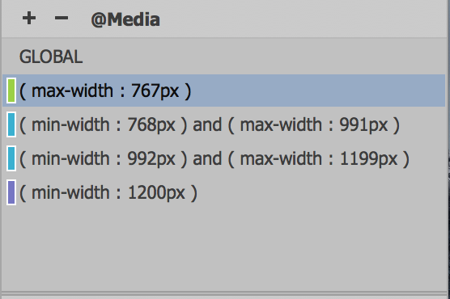
CSS Media Queries
Media Queries is a CSS panel allowing content rendering to adapt to conditions such as screen resolution.
@Media
Notes:
A media query is a newer CSS development that enables the webpage to interactively determine what formatting to use based on not only what kind of device (media type) is displaying the page but also on what dimensions and orientation it’s using. Once the browser knows the type or size of the device it has encountered, it reads the media query to know how to format the webpage and content. Its process is as fluid and continuous as a precision dance routine, even allowing the visitor to switch orientations during a session and have the page and content adapt seamlessly without other intervention. The key to this ballet is the creation of style sheets optimized for specific browsers, specific devices, or both.
In this image, you can see a list of media queries for a variety of screen sizes and applications.

Slide 9
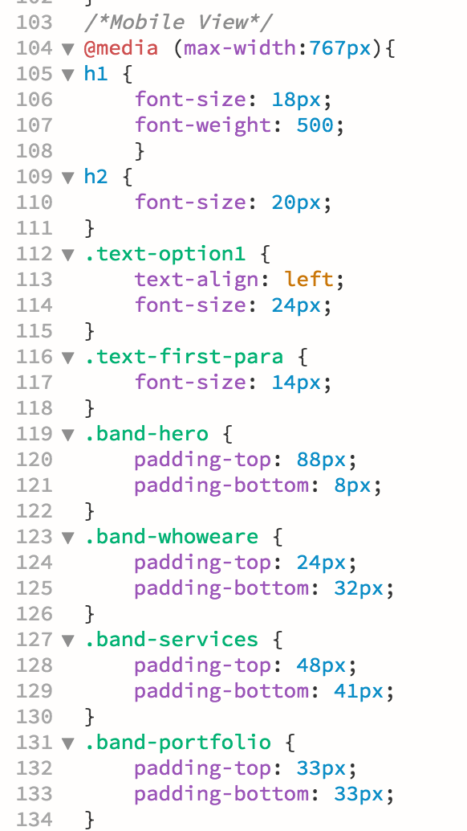
Media Query Syntax
Requires specific syntax to work properly in browser
Notes:
Like the CSS it controls, a media query requires a specific syntax to work properly in the browser. It consists of one or more media types and one or more expressions, or media features, which a browser must test as true before it applies the styles it contains. Currently, Dreamweaver supports 22 media features.
You can create media queries in a variety of ways. For example, they can be designed to work exclusively—by completely resetting the existing styling—or in tandem—by inheriting some styles and modifying specifications only as necessary. The latter method requires less CSS code and is typically more efficient. We will favor that method in the upcoming exercises.

Slide 10
Questions?

