Slide 1
Polymorphism
25 / 04 / 2016

Slide 2
Pointers : Base & Derived Classes
A pointer to a derived class object is type-compatible with a pointer to its base class object.
However, such pointers can only access the members of base class, and not those of the derived classes.
class Shape{
protected:
int width, height;
public:
Shape (int a, int b) : width(a), height(b) {}
};
class Rect: public Shape{
public:
Rect(int a,int b) : Shape(a,b) {}
int area() { return width*height; }
};
Int main() {
Shape* ptrShp = new Rect(1,2);
cout<< ptrShp -> width; // Allowed.
ptrShp->area() ; // Not possible! }

Slide 3
Pointers : Base & Derived Classes
In order for the pointer of base class to be able to access the member of derived classes, we need to use the concept of virtual functions.
Modify the code of Shape class to include :-
virtual int area () {
return 0;
}
Note the use of keyword virtual and the function signatures have to be identical.
Virtual member is a member function that can be redefined in a derived class.

Slide 4
Pointers : Base & Derived Classes
Now if area() is accessed using pointer then it will resolve correctly.
Shape* ptrShp = new Shape(4,5);
Rect r1(2,3);
cout << ptrShp->area(); // displays 0
ptrShp = &r1;
cout << r1->area(); // displays 6
Without use of keyword virtual with the area() function inside the Shape class, it would be statically linked, at time of compilation, to the version inside the Shape class.
In that case area() will always print 0 as it’s output.

Slide 5
Using Virtual Functions
We can achieve the most powerful and flexible ways to implement the "one interface, multiple methods“.
We can create a class hierarchy that moves from general to specific (base to derived).
We can define all common features and interfaces in a base class.
Specific actions can be implemented only by the derived class.
We can add new features easily.

Slide 6
Polymorphism
Polymorphism means that a call to a member function will cause a different function to be executed depending on the type of object that invokes the function.
Polymorphism is closely linked with inheritance ,virtual functions and pointers.
It basically refers to run-time / dynamic binding of functions with the pointer to objects.
Implements : “Is-A” relationship.
A class that declares or inherits a virtual function is called a polymorphic class.

Slide 7
Types of Polymorphism
Compile time polymorphism
Operator & Function overloading.
Legality of a member function invocation is checked at compile time.
It makes the programs faster.
Templates are used to simplify function overloading.
Run-time polymorphism
Virtual functions.
Address of member function is determined during execution, based on dynamic type of object.
Example – run-time binding of abstract type pointers to concrete type functions.
Greater flexibility and higher level of abstraction.

Slide 8
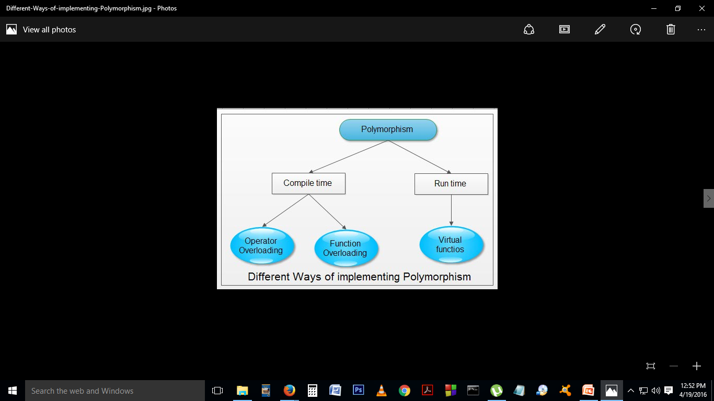

Slide 9
Early vs. Late Binding
“Early binding refers to events that occur at compile time.”
Early binding occurs when all information needed to call a function is known at compile time.
Examples :
function calls ,overloaded function calls, and overloaded operators.

Slide 10
Early vs. Late Binding
Dynamic binding occurs at run-time and is also called late-binding.
“Late binding refers to function calls that are not resolved until run time.”
Late binding can make for somewhat slower execution times.
Example:
virtual functions

Slide 11
Polymorphism
Pure virtual functions - If the base class function does not have any meaningful implementation, then the function declaration can be modified as under :-
virtual int area () = 0 ;
Such functions are called pure virtual functions.
Abstract base classes
“A class that contains at least one pure virtual function then it is said to be abstract class.”
No objects of an abstract class be created.
Abstract class constitutes an incomplete type that is used as a foundation for derived. classes.
However, pointers of this class can be declared and can access all members of such classes.

Slide 12
Pure Virtual Functions
When a virtual function is made pure, any derived class must provide its definition.
If the derived class fails to override the pure virtual function, a compile-time error will result.
NOTE:
When a virtual function is declared as pure, then all derived classes must override it.

Slide 13
Polymorphism
Polymorphism can be really useful, when the programmer has to determine the flow of a program based on user choice.
It is possible for a member of an abstract base class to use the pointer this to access virtual members, even though base class itself has no implementation for the function.
We can access area() of derived classes from base class function calcArea() :-
void calcArea() { cout << this->area() << '\n'; }

Slide 14
Templates
Foundation of generic programming - creating a generic class or a function.
C++ library containers like vectors and iterators, algorithms, are examples of generic programming and have been developed using template concept.
Example:-
There is a single definition of a container, such as vector, but we can define many different kinds of vectors
vector <int> myIntVect;
vector <string> myStringVect;

Slide 15
Function Templates
Functions that can operate with generic types.
Achieved using template parameters.
A template parameter is a special kind of parameter that can be used to pass a data type as argument just as we pass values to functions.
Syntax :-
template <class type>
retType funcName(paramList) {
// body of function …………
}

Slide 16
Function Templates
Example:-
template <typename T>
T Max (T a, T b) {
return a < b ? b:a;
}
Max <int> (3,4);
Max <double> (3.3, 5.4);
Here T is the template parameter.
It represents a type that has not yet been specified, but that can be used in the function as if it were a regular data type .
We are using T as – return type and data type of parameters.
When compiler encounters call to a template function, it uses the template to automatically generate a function replacing each appearance of T by the type passed as the actual template parameter (int / double in this case) and then calls it.

Slide 17
Class templates
Templates are a way of making classes more abstract.
Possible to define the behavior of the class without actually knowing what data-type will be handled by the operations of the class.
In essence, this is what is known as generic programming .

Slide 18
Class templates
Allows classes to have members that use template parameters as types.
When defining a function as a member of a templated class, it is necessary to define it as a templated function
Syntax :-
template <class T>
class myClass {
T id;
public:
myClass(T param) { id = param; }
};
Syntax for declaring objects of templated class is :-
myClass<int> myInt(10);

Slide 19
Class templates
If the func is not defined in-line then the syntax is slightly different.
Syntax :-
template <class T>
class myClass {
T id;
public:
myClass(T param) : id{param} {}
T getVal();
};
template <class T>
T myclass<T> : getVal () { return id;}

Slide 20
Class templates
If a particular data-type for a template function requires a different implementation, then we could define a template specialization.
Syntax :-
template <class T>
class myClass {
T var;
public:
myClass(T param) : var{param} {}
T incr() { return var++;}
};
template <>
class myClass <char> {
char var;
public:
myClass(char param) : var{param} {}
char upper() { char tmp; if (var >=‘a’ && var <=‘z’) return var+=‘A’-’a’;}
};

Slide 21
Class templates
For the preceding code fragment :-
template<> : means for the following templated function , all types are known and no template params are required.
Note the use of character specialization parameter <char> after the class name in the second case.
The specialization parameter , identifies the data type for which the special class definitions is to be utilzed.
We must define all members of the class, including those identical to the generic template class – As in this case the constructor of the class.

Slide 22
C++ Standard Library
C++ Standard Library
Standard Function Library
General-purpose, stand-alone functions that are not part of any class.
Inherited from C – I/O, Time-Date, Mathematical, etc.
Object Oriented Class Library
Collection of classes.
C++ I/O class.
String and Numeric classes.
STL – containers, algorithms, iterators.
Exception handling mechanisms.

Slide 23
Standard Template Library
C++ STL
Set of C++ template classes.
Provides general-purpose classes and functions that implement many popular and commonly used algorithms and data structures like vectors, lists, queues, and stacks.
Have a rich set of pre-defined functions.
Components
Containers : Vectors, Lists, etc.
Iterators : Allows to step through the elements.
Algorithms : Allows sorting, searching, etc of container contents

Slide 24
Vectors : Standard Library
Vector is a template class - replacement for the good old C-style arrays.
Advantages :-
Same syntax
Automatically handles its own storage requirements as it grows.
Syntax :-
#include <vector> // include directive.
using namespace std;
vector <int> myVect; // declaration.
OR
std::vector<int> anotherVect ; // namespace std not used.

Slide 25
What is vector <T> v ?
A template class that will wrap an array of variables of type T.
Vector will store the variables in a contiguous memory area.
Each element can be accessed using v[0], v[1], etc.
Problems with usage of array:-
Static array : can’t use a variable as it’s size.
Dynamic array : ensure dealloc of memory in end.
Both : when the array grows too big to fit into the initially assigned memory, you have to implement logic, to allocate a new block of memory and then copy all the array elements into this bigger space.

Slide 26
What is vector<T> v ?
Vector takes care of all the above problems :-
You can use a variable to declare size of a vector.
You donot have to deallocate memory after using it.
As the number of elements outgrow the original size, the vector will reallocate memory and copy the contents, transparently.
Additionally, it will provide a number of useful methods that will help us access and manipulate the members of the vector.
Example :-
int size =10; // or you may take input from user.
vector <int> myVect(size); // var used to declare size.
for(unsigned int i=0; i<myVect.size(); ++i){
myVect[i] = i; // we used the size() method
}
// NO NEED TO FREE MEMORY.

Slide 27
Vectors : Standard Library
Wrapper class :-
Vector class overloads – [] operator .
Vector class also implements function at( int position).
How does vector handle size issues ?
C-style arrays ( can only grow upto sizeOfArray) :-
cin >> sizeOfArray;
int *sizeOfArray = new int[sizeOfArray];
Vectors (can grow infinitely): -
vector <int> myVect; int input = 0;
while ( input != -1) {
cin>>input;
myVect.push_back(input);
}

Slide 28
Vectors : Standard Library
How does vector handle size issues ?
Vector class has
Control sequence – internal name for the array.
Allocated size for storing the array.
If the allocated size becomes small, then the vector will allocate larger memory, and copy the contents into the new loc.
This means :-
Vector can grow infinitely – only limited by system memory.
Vector can slow down programs due to this copying action.

Slide 29
Vectors : Standard Library
We can reserve a certain amount of memory when declaring vectors :-
vector <int> myVect;
myVect.reserve(20); // vector elements not intialized.
The following syntax, declares and initialzes a vector of 10 integers to 0:-
vector <int> myVect(10);
// A vector with 10 elements is created.
// Integer constructor called 10 times.

Slide 30
Vectors : Standard Library
Methods :-
myVector.capacity(); // number of elements vector can hold.
myVector.size(); // number of elements stored in it.
myVector.resize(int sz, int ele);
// if vector.size() < sz, it will preserve old elements and
// blank spaces will be initialised with ele’s upto the new sz.
// if vector.size()> sz, rest of elements are discarded.
// if vector has capacity < sz , it will be realloc to INCR.
// if vector has capacity > sz , it wont SHRINK!

Slide 31
Vectors : Standard Library
Methods :-
myVector.push_back (value);
// adds an element to end of vector, also resizes it if required.
myVector.at(index);
// returns the element stored at index position.
myVector.size();
// returns the number of elements in the vector, as unsigned int.
myVector.clear();
// removes all elements in the vector
myVector.empty();
// returns bolean value , if vector is empty.

Slide 32
Vectors : Standard Library
Methods :-
myVector.begin();
// reads vector from first element.
// returns an iterator to the start of the vector.
myVector.end();
// only use to check if vector end is reached.
// DONOT attempt to DEREFERENCE it!
// returns an iterator to the end of the vector.
myVector.insert(myVector.begin()+integer, newValue);
// inserts new value at the specified position.
myVector.erase(myVector.begin()+integer);
// deletes element at specified position.

Slide 33
Vector : Iterator
Provide a means for accessing data stored in container classes
An iterator is used to move thru the elements of an STL container (vector, list, set, map, ...) in a similar way to array indexes or pointers.
Vectors iterators are usually implemented as pointers.
The * operator dereferences an iterator (ie, is used to access the element an iterator points to) .
++ (and -- for most iterators) increments to the next element.
Vectors can also be accessed using subscripts.
Syntax:-
class_name<template_parameters>::iterator name ;

Slide 34
Vector : Iterator
Example :
vector<int>::iterator myIntVectorIterator;
Different containers support different types of iterator.
There are different classes of iterators, each with slightly different properties. Eg : - Iterators for input /reading ; output/writing data in the container; random access iterator (allows maths).
Accessing elements of a vector :-
Call begin function to get an iterator;
Use ++ to step through the objects
Access each object with the * operator ("*iterator“)
Stop iterating when the iterator equals the container's end iterator.
Iterators don’t support bound checking.
Different containers support different types of Iterators!

Slide 35
Vector : Iterator
Code :-
vector<int> vec;
// enter five elements in the vector.
for(int i = 0; i < 5; i++){
vec.push_back(i);
}
// get an iterator to step through the vector.
vector<int>::iterator v = vec.begin();
// use iterator to display the contents of vector.
while( v != vec.end()) {
cout << "value of v = " << *v << endl;
v++;
}
VECTOR CLASS SUPPORTS A RANDOM ITERATOR.

Slide 36
Static members : Class
Also known as a class variable – only one common variable for all the objects of the class.
Syntax : - static int totalStudents;
Initialization must be done outside the class. Why ?
int Student:: totalStudents = 0;
The same value is shared by all the objects and any one can access / modify the static var.
It can be accessed either using the class name or any object of the class. Example –
cout << Student.totalStudents;
cout << cse2016.totalStudents;
Even member functions can be declared static. They can only access static vars of a class.

Slide 37
Const : Objects and Functions
If an object is declared as constant, it has read-only access to the member vars.
Example :-
const Student myStudent;
myStudent.id=2016; // Error! Even if id declared public
cout<< myStudent.id; // Permitted.
Member functions of a const object can only be called if they are themselves specified as const members.
void displayStudent( ) const { cout <<id; cout<<name;}
Member functions declared const:-
Cannot modify non-static member vars.
Cannot call non-constant member functions.
A NON-CONST OBJECT CAN ACCESS BOTH CONST AND NON-CONST MEMBER VARS AND FUNCTIONS.

Slide 38
Const : Objects and Functions
Most functions taking classes as parameters actually take them by const reference, and thus, these functions can only access their const members.
Such objects cannot then access non const member functions of the class.
So it is a common practice to overload all non-const member functions as under –
void displayStudent( ) { cout <<id; cout<<name;}
void displayStudent( ) const { cout <<id; cout<<name;}
Note , the above functions are overloaded only due to use of const.
A NON-CONST OBJECT CAN ACCESS BOTH CONST AND NON-CONST MEMBER VARS AND FUNCTIONS.

