Slide 1


DEPARMENT OF COMPUTER
SCIENCE AND ENGINEERING

Slide 2


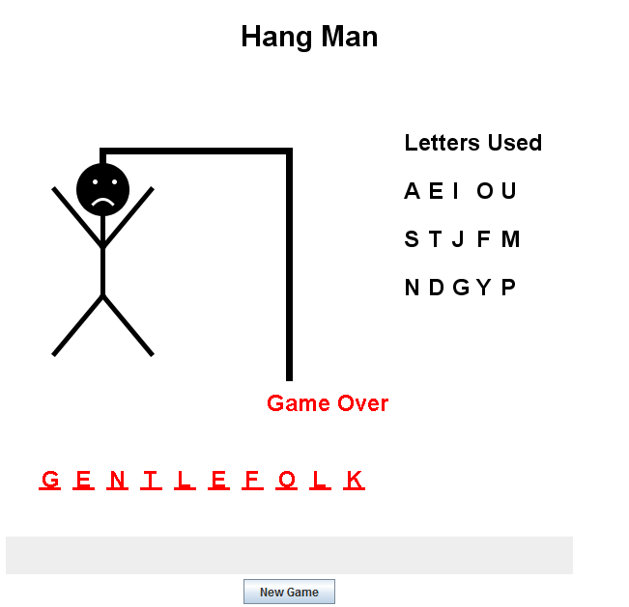
JAVA PROJECT GROUP-7
CSE 220
PROJECT TITLE

Slide 3
GROUP MEMBERS
Student Id name
201514029 Fatema Binte Alam
201514030 Maria Afnan Pushpo
201514046 Syeda Nusraht Khaledur

Slide 4

Hangman is a word or phase guessing game where one player thinks of it and tries to guess it by suggesting letters , within a certain number of guesses. If the suggested letter or number does not occur in the word, the other player draws one element of a hanged manstick figure or bodypart as a tallymark.

Slide 5


At first we’ll scan for input of a secret word from File which is a string.
Then we’ll make a char array which stores up to random characters by levels and check to run the program if the length is less than the character array.
Taking character input we’ll match and print the characters.
Add guess to guesses so far look for guess in secret if it matches the guess in secret then put it in dashes where it belongs output good guess otherwise (not there) and output how many bodyparts are left graphically.
If all the letters matched with secret word and bodyparts are left then output is wins otherwise loses.
The game will also lose if there doesn’t left any bodypart before the matched letters.

Slide 6

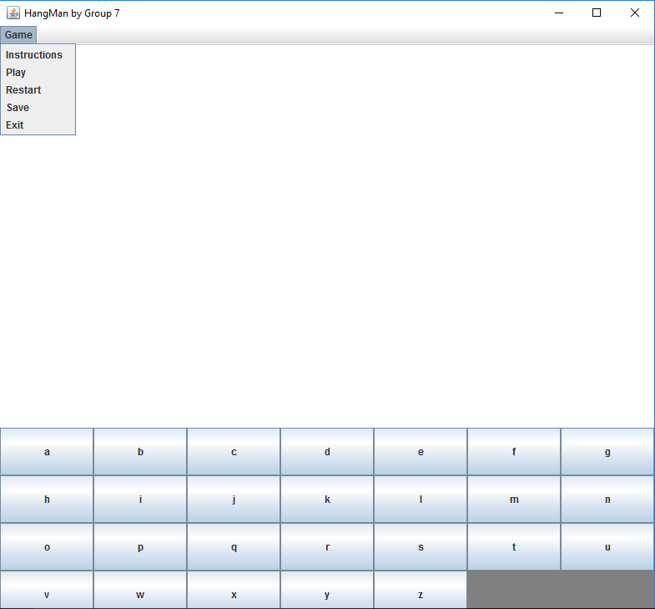


Slide 7

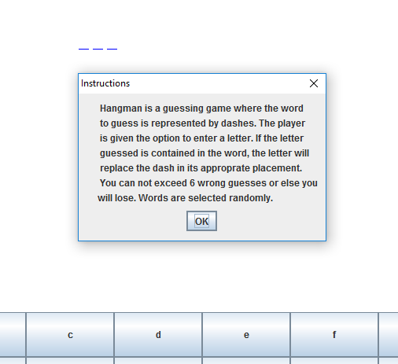

Slide 8

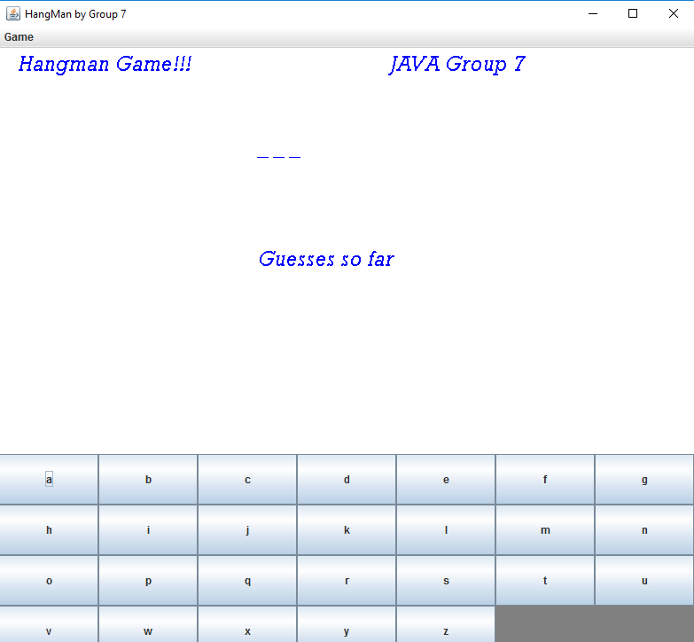



Slide 9
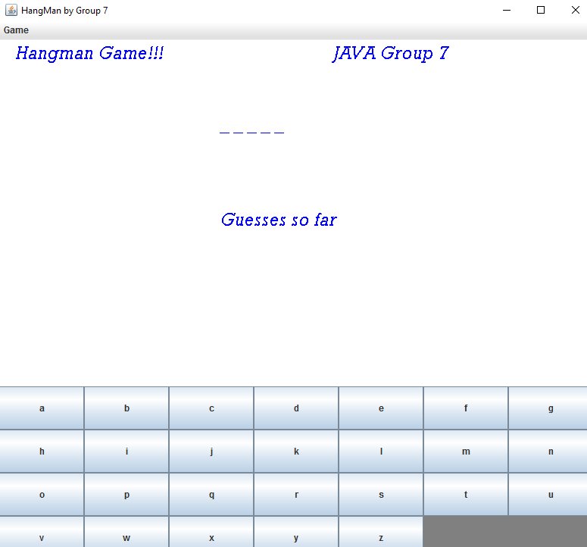




Slide 10
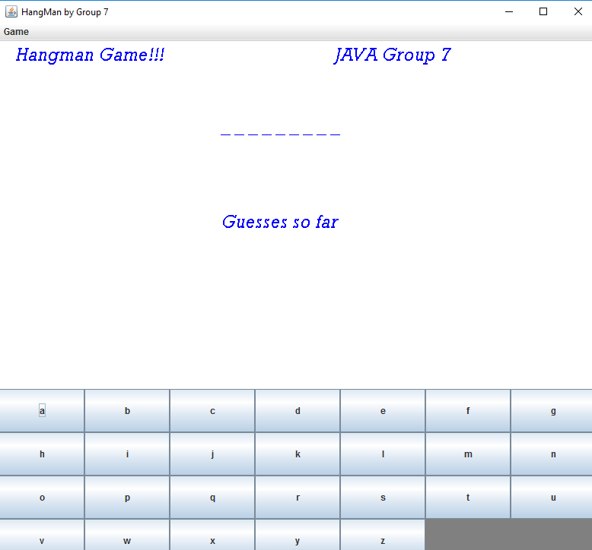


Slide 11

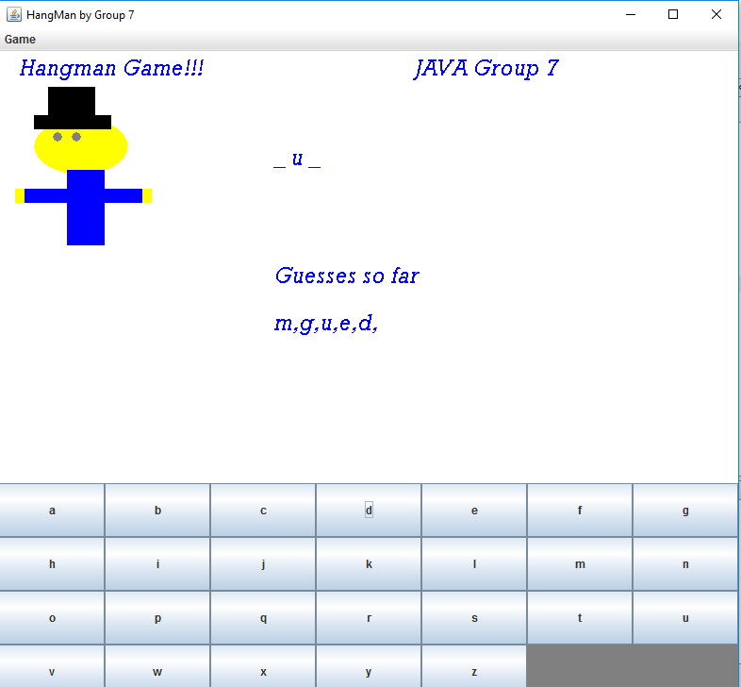

Slide 12

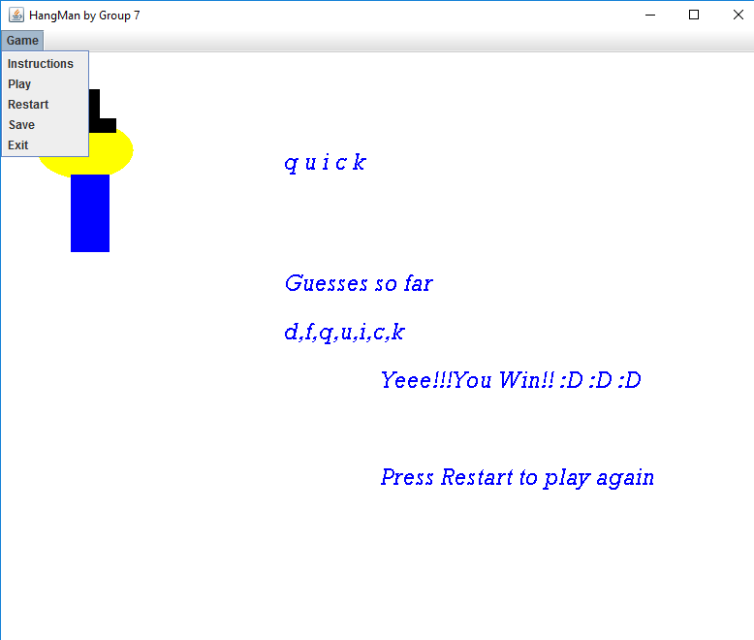

Slide 13

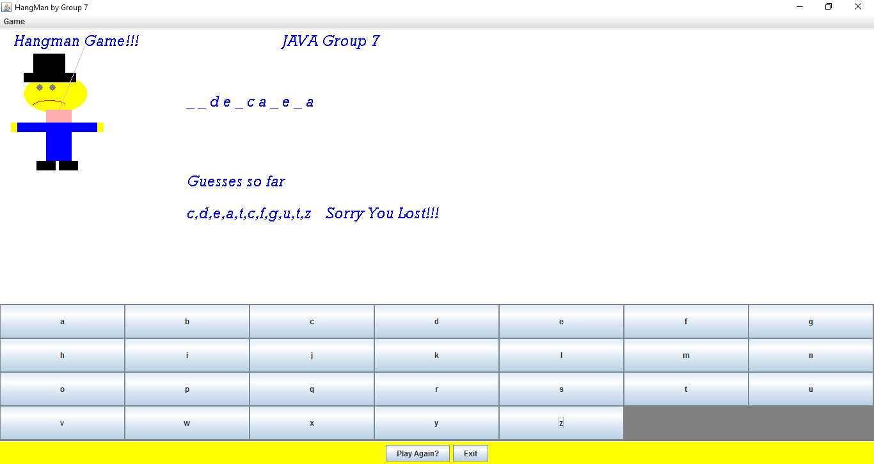

Slide 14


