Slide 1
Introduction to Matlab
CSE-318

Slide 2
What is Matlab?
Matlab is basically a high level language which has many specialized toolboxes for making things easier for us
Provide interactive environment for numerical computation, visualization and programming.
Developed by MathWorks

Slide 3
MATLAB- Matrix Laboratory
Typical Uses:
Math and Computation
signal processing and Communications
Data Acquisition
Modeling, Simulation and Prototyping
Data analysis, exploration and visualization
Scientific and Engineering graphics
Application development, including graphical user interface building

Slide 4
What are we interested in?
MatLab is too broad for our purposes in this course.
The features we are going to require is
MatLab
m-files
Command
Line
mat-files
functions
Series of build in commands and math functions

Slide 5
MatLab
The MATLAB environment is command oriented somewhat like UNIX.
A prompt appears on the screen and a MATLAB statement can be entered.
When the <ENTER> key is pressed, the statement is executed, and another prompt appears.
If a statement is terminated with a semicolon ( ; ), no results will be displayed.
Otherwise results will appear before the next prompt.

Slide 6
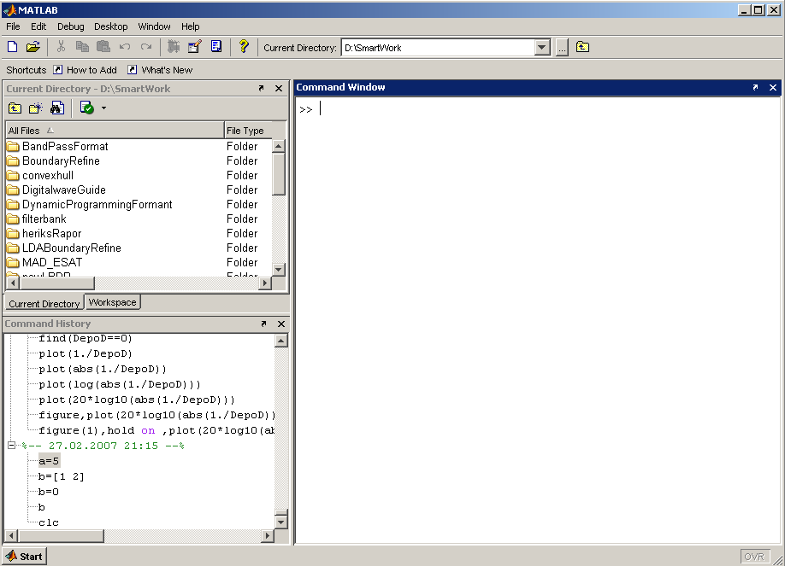
MatLab Screen
Command Window
  type commands
Current Directory
  View folders and m-files
Workspace
  View program variables
  Double click on a variable
  to see it in the Array Editor
Command History
  view past commands
  save a whole session
  using diary

Slide 7
Variables
  Must start with a letter
  May contain only letters, digits, and the underscore “_”
  MatLab is case sensitive.
  MATLAB variables are created with an assignment statement. The syntax of variable assignment is-
  variable name = a value (or an expression)
  - where expression is a combination of numerical values, mathematical operators, variables, and function calls

Slide 8
Variables
No need for types. i.e.,
All variables are created with double precision unless specified and they are matrices.
After these statements, the variables are 1x1 matrices with double precision
int a;
double b;
float c;
Example:
>>x=5;
>>x1=2;

Slide 9
>> x=[1 2 3]
x =
1 2 3
>> x=[1,2,3]
x =
1 2 3
>> x=[1
2
3
4];
>> x=[1;2;3;4]
x =
1
2
3
4
When defining variables, a space or comma separates elements on a row.
A newline or semicolon forces a new row; these 2 statements are equivalent.
NB. you can break definitions across multiple lines.

Slide 10
Array, Matrix
a vector x = [1 2 5 1]
x =
1 2 5 1
a matrix x = [1 2 3; 5 1 4; 3 2 -1]
x =
1 2 3
5 1 4
3 2 -1
transpose y = x’ y =
1 5 3
2 1 2
3 4 -1

Slide 11
Long Array, Matrix
t = start : end
t =1:10
t =
1 2 3 4 5 6 7 8 9 10
k =2:-0.5:-1
k =
2 1.5 1 0.5 0 -0.5 -1
x = [1:4; 5:8]
x =
1 2 3 4
5 6 7 8
k = start : increment : end

Slide 12
Generating Vectors from functions
zeros(M,N) MxN matrix of zeros
ones(M,N) MxN matrix of ones
rand(M,N) MxN matrix of uniformly distributed random
numbers on (0,1)
x = zeros(1,3)
x =
0 0 0
x = ones(1,3)
x =
1 1 1
x = rand(1,3)
x =
0.9501 0.2311 0.6068

Slide 13
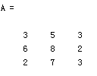


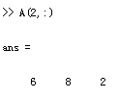

Matrix Index
The matrix indices begin from 1 (not 0 (as in C))
The matrix indices must be positive integer
Given:
A(-2), A(0)
Error: ??? Subscript indices must either be real positive integers or logicals.
A(4,2)
Error: ??? Index exceeds matrix dimensions.

Slide 14
Concatenation of Matrices
x = [1 2], y = [4 5], z=[ 0 0]
A = [ x y]
1 2 4 5
B = [x ; y]
1 2
4 5
C = [x y ;z]
Error:
??? Error using ==> vertcat CAT arguments dimensions are not consistent.

Slide 15
Operators (arithmetic)
+ addition
- subtraction
* multiplication
/ division
^ power
‘ complex conjugate transpose

Slide 16
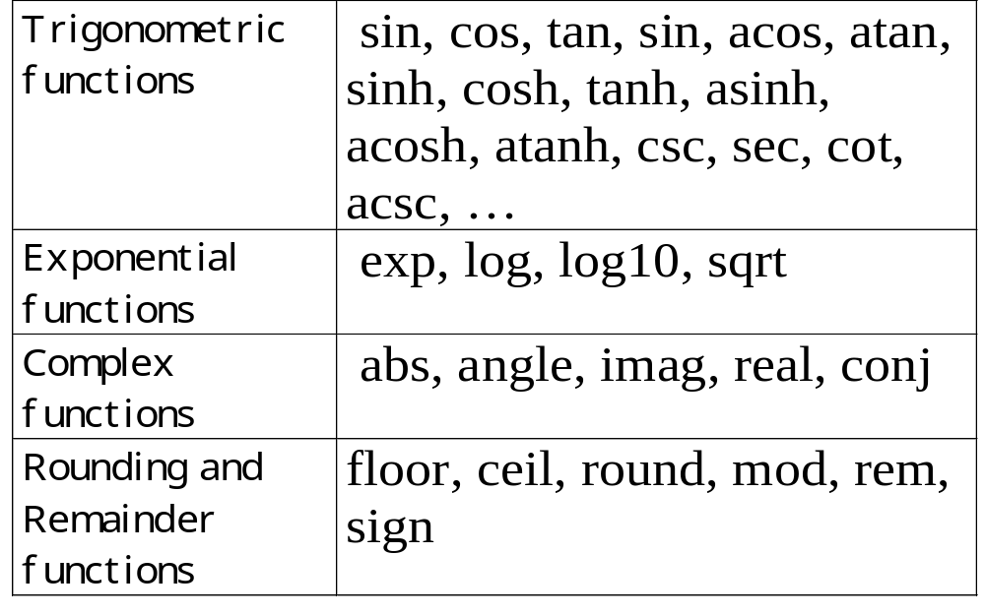
Built-in Functions

Slide 17
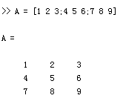
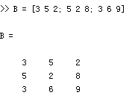
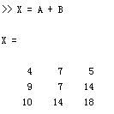
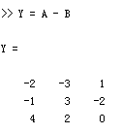
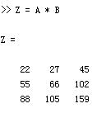
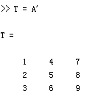
Matrices Operations
Given A and B:
Addition
Subtraction
Product
Transpose

Slide 18
Operators (Element by Element)
.* element-by-element multiplication
./ element-by-element division
.^ element-by-element power

Slide 19
The use of “.” – “Element” Operation
A = [1 2 3; 5 1 4; 3 2 1]
A =
1 2 3
5 1 4
3 2 -1
b = x .* y
b=
3 8 -3
c = x . / y
c=
0.33 0.5 -3
d = x .^2
d=
1 4 9
x = A(1,:)
x=
1 2 3
y = A(3 ,:)
y=
3 4 -1
K= x^2
Erorr:
??? Error using ==> mpower Matrix must be square.
B=x*y
Erorr:
??? Error using ==> mtimes Inner matrix dimensions must agree.

Slide 20
Input and Output
>> x=input('please enter a number')
please enter a number100
x =
100
>> fprintf('%d',x)
100

Slide 21
Operators (relational, logical)
== Equal to
~= Not equal to
< Strictly smaller
> Strictly greater
<= Smaller than or equal to
>= Greater than equal to
& And operator
| Or operator

Slide 22
Flow Control
if
for
while
break
….

Slide 23
Control Structures
Some Dummy Examples
if ((a>3) & (b==5))
Some Matlab Commands;
end
if (a<3)
Some Matlab Commands;
elseif (b~=5)
Some Matlab Commands;
end
if (a<3)
Some Matlab Commands;
else
Some Matlab Commands;
end
If Statement Syntax
if (Condition_1)
Matlab Commands
elseif (Condition_2)
Matlab Commands
elseif (Condition_3)
Matlab Commands
else
Matlab Commands
end

Slide 24
Control Structures
Some Dummy Examples
for i=1:100
Some Matlab Commands;
end
for j=1:3:200
Some Matlab Commands;
end
for m=13:-0.2:-21
Some Matlab Commands;
end
for k=[0.1 0.3 -13 12 7 -9.3]
Some Matlab Commands;
end
For loop syntax
for i=Index_Array
Matlab Commands
end

Slide 25
Control Structures
While Loop Syntax
while (condition)
Matlab Commands
end
Dummy Example
while ((a>3) & (b==5))
Some Matlab Commands;
end

Slide 26
Example
x=ceil(10*rand(1,1));
y=input(‘Guess my number between 1 and 10:’);
if(x==y)
‘you are right’
elseif(x>y)
‘No,my number is smaller’
else
‘No,my number is greater’
end

Slide 27
Another example:
x=ceil(10*rand(1,1));
sum=0;
for y=1:x
sum=sum+y;
end
Task:
Output the summation of each content of a matrix

Slide 28
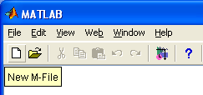
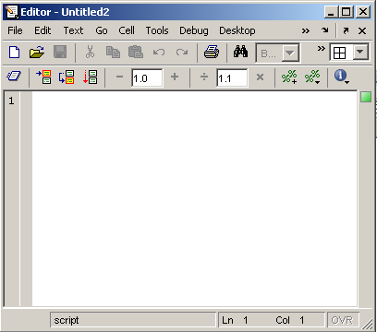
Use of M-File
Click to create a new M-File
Extension “.m”
A text file containing script or function or program to run

Slide 29
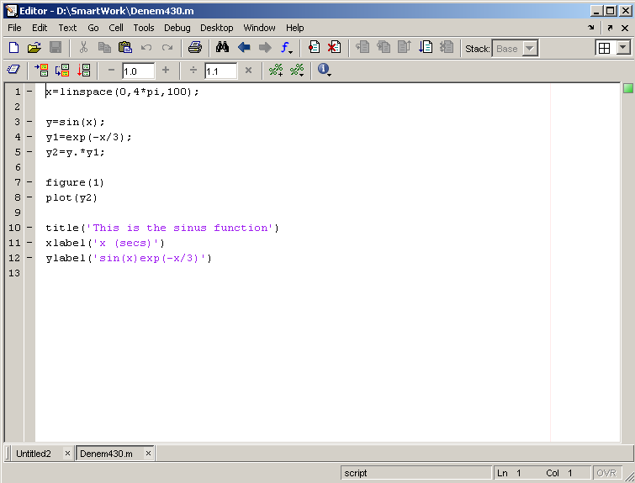
Use of M-File
Save file as Denem430.m
If you include “;” at the
end of each statement,
result will not be shown
immediately

Slide 30
Notes:
“%” is the neglect sign for Matlab (equaivalent of “//” in C). Anything after it on the same line is neglected by Matlab compiler.
Sometimes slowing down the execution is done deliberately for observation purposes. You can use the command “pause” for this purpose
pause %wait until any key
pause(3) %wait 3 seconds

Slide 31
Useful Commands
The two commands used most by Matlab
users are
>>help functionname
>>lookfor keyword

Slide 32
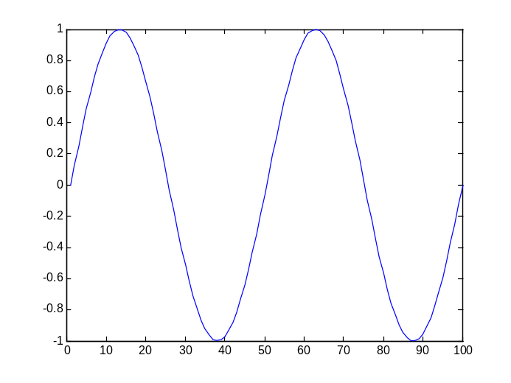
Basic Task: Plot the function sin(x) between 0≤x≤4π
Create an x-array of 100 samples between 0 and 4π.
Calculate sin(.) of the x-array
Plot the y-array
>>x=linspace(0,4*pi,100);
>>y=sin(x);
>>plot(y)

Slide 33
Plot the function e^{-x/3}sin(x) between 0≤x≤4π
Create an x-array of 100 samples between 0 and 4π.
Calculate sin(.) of the x-array
Calculate e^{-x/3} of the x-array
Multiply the arrays y and y1
>>x=linspace(0,4*pi,100);
>>y=sin(x);
>>y1=exp(-x/3);
>>y2=y*y1;

Slide 34
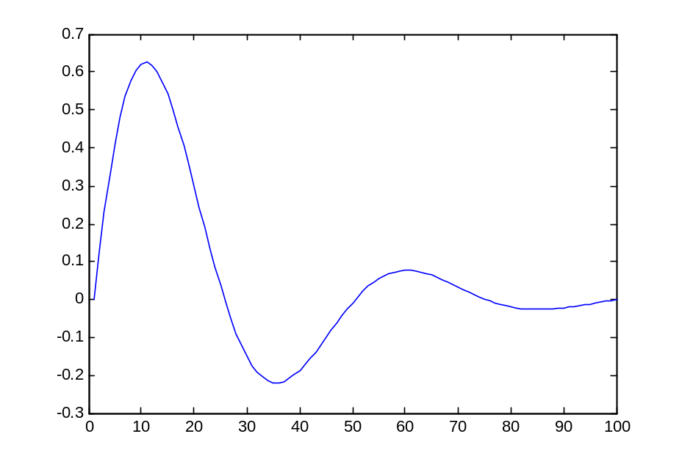
Plot the function e^{-x/3}sin(x) between 0≤x≤4π
Multiply the arrays y and y1 correctly
Plot the y2-array
>>y2=y.*y1;
>>plot(y2)

Slide 35
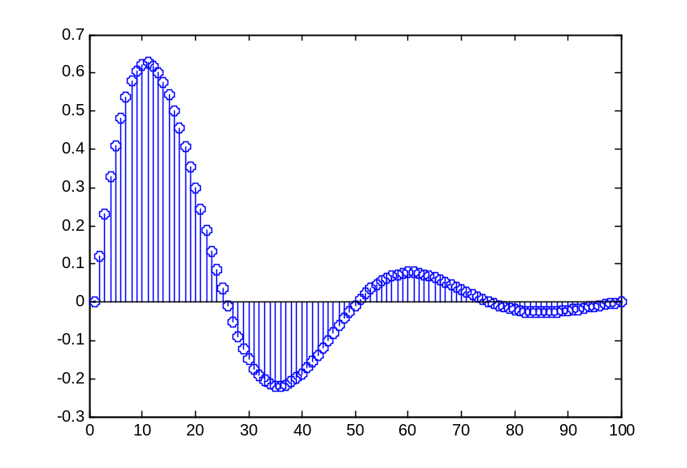
Display Facilities
plot(.)
stem(.)
Example:
>>x=linspace(0,4*pi,100);
>>y=sin(x);
>>plot(y)
>>plot(x,y)
Example:
>>stem(y)
>>stem(x,y)

Slide 36
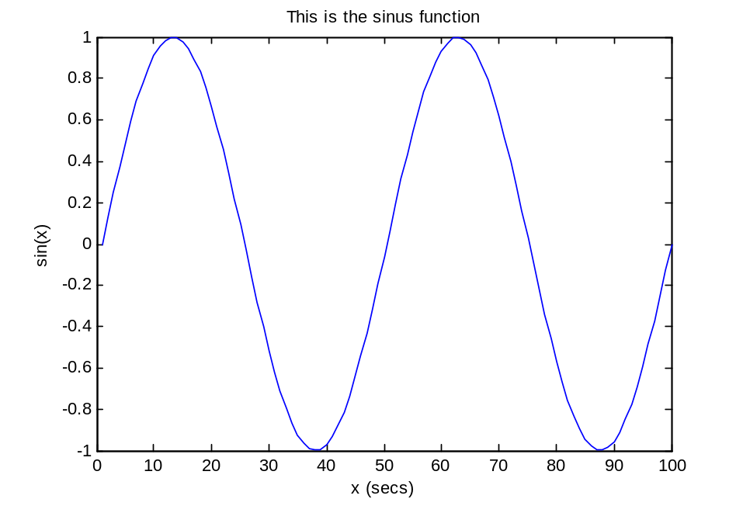
Display Facilities
title(.)
xlabel(.)
ylabel(.)
>>title(‘This is the sinus function’)
>>xlabel(‘x (secs)’)
>>ylabel(‘sin(x)’)

Slide 37
Thank You…

