Slide 1

CSE-444
Military Institute of Science and Technology
Pattern Recognition Sessional (Project proposal) Group-02

Slide 2
Group members:
Jannatul Maowa Shaila (201514013)
Fatema Binte Alam (201514029)
Md Shafiqul Alam Shawon (201514038)
Syed Abdullah Rahman (201514044)
Syeda Nusraht Khaledur (201514046)

Slide 3
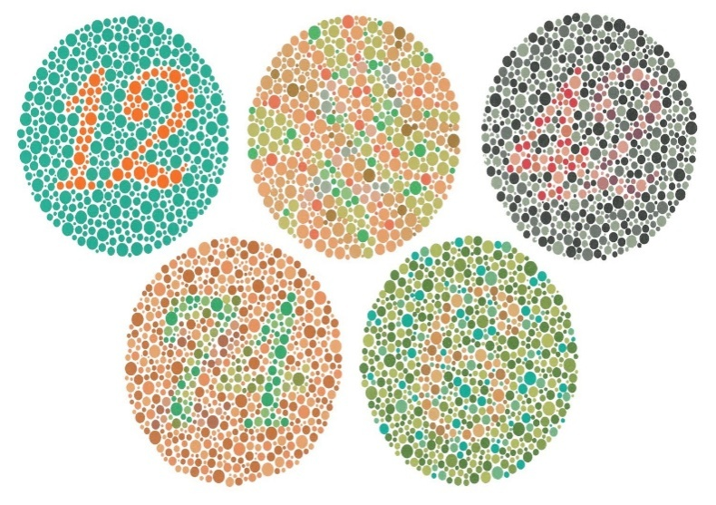
Objectives
Color recognition for color blind people
colored images will be taken as input and it will produce the percentage of the basic colors (R-red,G-green and B-blue).
It will inform the color blind about the real color of that object.
It will also give the necessary details by the combination of the colors in percentages.
RGB Color Recognition for color blind using K-nearest neighbor classification algorithm.

Slide 4
Algorithm
We used K-means algorithms.
Let X = {x1,x2,x3,……..,xn} be the set of data points and V = {v1,v2,…….,vc} be the set of centers.
1) Randomly select ‘c’ cluster centers.
2) Calculate the distance between each data point and cluster centers.
3) Assign the data point to the cluster center whose distance from the cluster center is minimum of all the cluster centers.
4) Recalculate the new cluster center using: Vi = 1/ci * sumations[j=1 to ci] (Xj) where, ‘ci’ represents the number of data points in ith cluster.
5) Recalculate the distance between each data point and new obtained cluster centers.
6) If no data point was reassigned then stop, otherwise repeat from step 3.

Slide 5
Dataset
Dataset used for our project is image (png ,jpg )files.

Slide 6
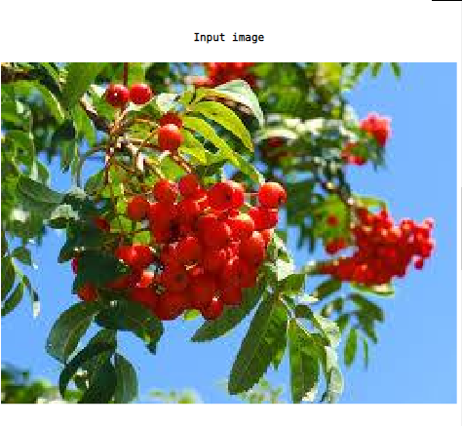
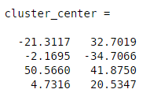
Result
Through our project we able to separate R,G,B colors from different images. Example Output from our project is given below:

Slide 7
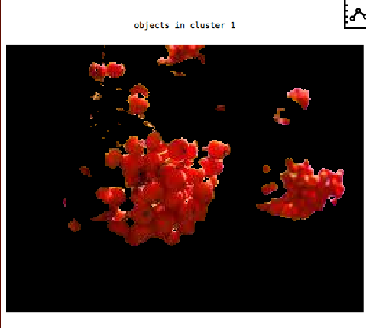
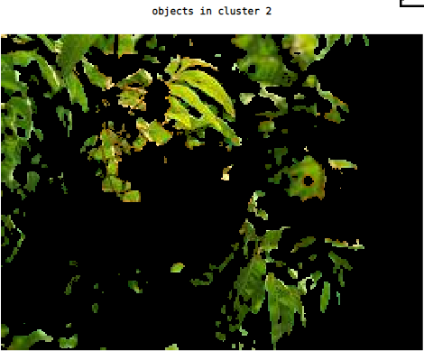
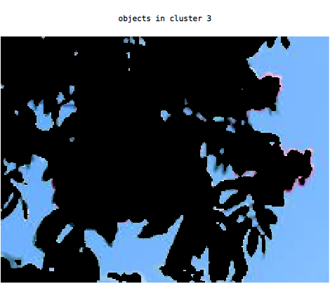
Cont…
Fig:Red color ditection
Fig:Green color ditection
Fig:Blue color ditection

Slide 8
Limitations
1. We can’t cluster RGB colors perfectly whenever there is color near to RGB in our image.
For example : if there is magenta and violate color in our image both of them are cluster in blue class .
2. It takes too match time to run our program as we use Eucladian approach to find the distance among 2 points

Slide 9
Future work
We will try to make our code more accurate to find out RGB colors from any image.
Will try to implement another way to find out distances among points so that
We can get our desire result in less time.

Slide 10


