Slide 1
Copyright © The McGraw-Hill Companies, Inc. Permission required for reproduction or display.
Chapter Eleven
Baseband Digital Transmission

Slide 2
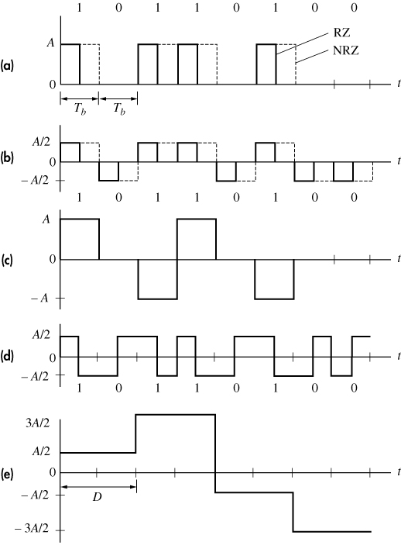
Copyright © The McGraw-Hill Companies, Inc. Permission required for reproduction or display.
Binary PAM formats (a) unipolar RZ & NRZ (b) polar RZ & NRZ (c) bipolar NRZ (d) split-phase Manchester (e) polar quaternary NRZ
Figure 11.1-1

Slide 3
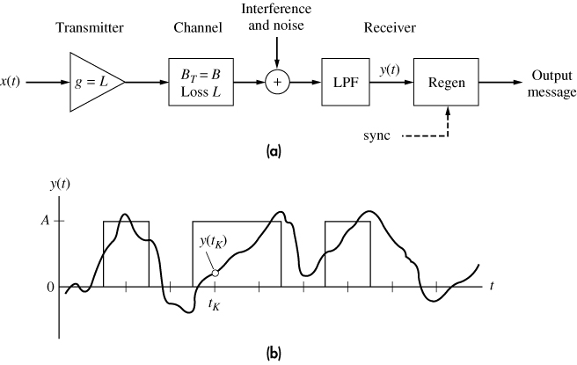
Copyright © The McGraw-Hill Companies, Inc. Permission required for reproduction or display.
(a) Baseband transmission system (b) signal-plus-noise waveform
Figure 11.1-2

Slide 4
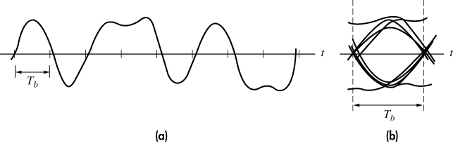
Copyright © The McGraw-Hill Companies, Inc. Permission required for reproduction or display.
(a) Distorted polar binary signal (b) eye pattern
Figure 11.1-3

Slide 5
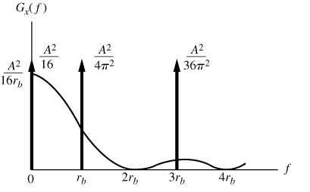
Copyright © The McGraw-Hill Companies, Inc. Permission required for reproduction or display.
Power spectrum of unipolar binary RZ signal
Figure 11.1-5

Slide 6
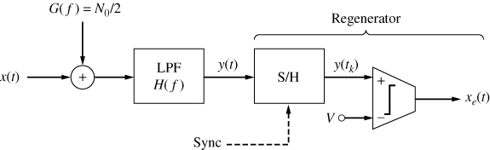
Copyright © The McGraw-Hill Companies, Inc. Permission required for reproduction or display.
Baseband binary receiver
Figure 11.2-1

Slide 7
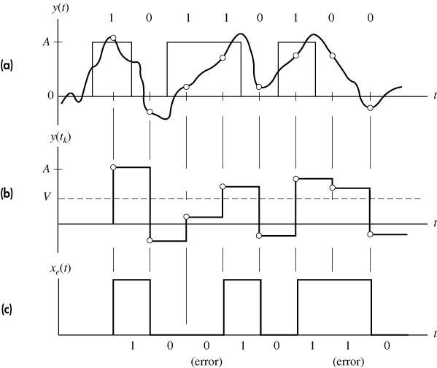
Copyright © The McGraw-Hill Companies, Inc. Permission required for reproduction or display.
Regeneration of a unipolar signal (a) signal plus noise (b) S/H output (c) comparator output
Figure 11.2-2

Slide 8
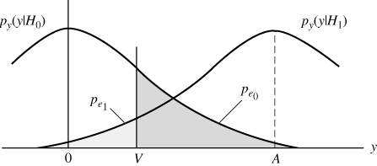
Copyright © The McGraw-Hill Companies, Inc. Permission required for reproduction or display.
Conditional PDFs with decision threshold and error probabilities
Figure 11.2-3

Slide 9
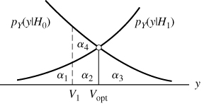
Copyright © The McGraw-Hill Companies, Inc. Permission required for reproduction or display.
Threshold regions for conditional PDFs
Figure 11.2-4

Slide 10
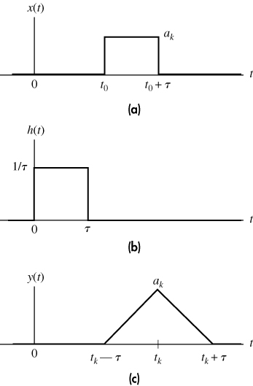
Copyright © The McGraw-Hill Companies, Inc. Permission required for reproduction or display.
Matched filtering with rectangular pulses (a) received pulse (b) impulse response (c) output pulse
Figure 11.2-6

Slide 11
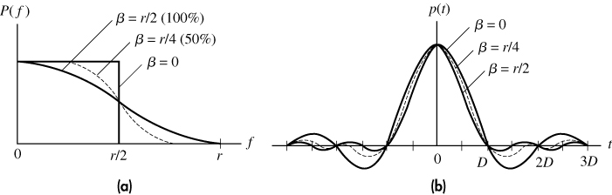
Copyright © The McGraw-Hill Companies, Inc. Permission required for reproduction or display.
Nyquist pulse shaping (a) spectra (b) waveforms
Figure 11.3-1

Slide 12
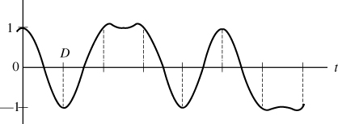
Copyright © The McGraw-Hill Companies, Inc. Permission required for reproduction or display.
Baseband waveform for 10110100 with β = r/2
Figure 11.3-2

Slide 13
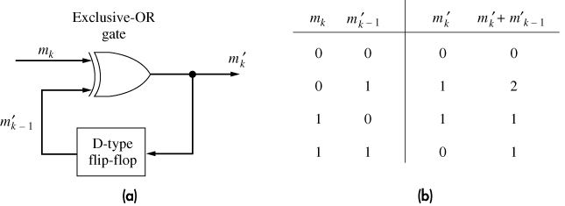
Copyright © The McGraw-Hill Companies, Inc. Permission required for reproduction or display.
(a) Digital precoder for duobinary signaling (b) truth table
Figure 11.3-9

Slide 14
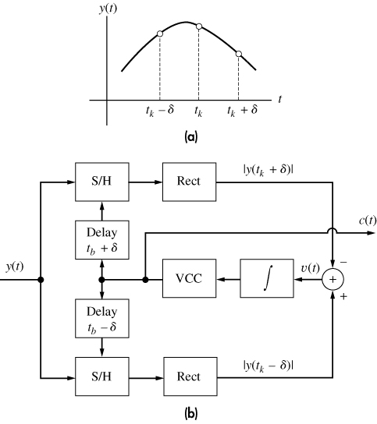
Copyright © The McGraw-Hill Companies, Inc. Permission required for reproduction or display.
Early-late bit synchronization (a) waveform (b) block diagram
Figure 11.4-4

Slide 15
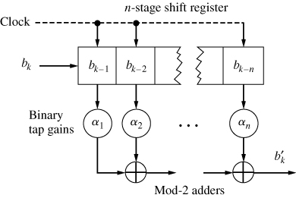
Copyright © The McGraw-Hill Companies, Inc. Permission required for reproduction or display.
Tapped shift register
Figure 11.4-5

Slide 16
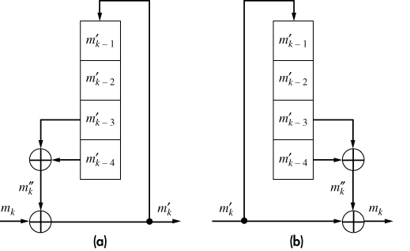
Copyright © The McGraw-Hill Companies, Inc. Permission required for reproduction or display.
(a) Binary scrambler (b) unscrambler
Figure 11.4-6

Slide 17
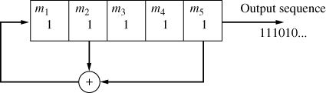
Copyright © The McGraw-Hill Companies, Inc. Permission required for reproduction or display.
Shift register sequence generator with [5,2] configuration
Figure 11.4-7

Slide 18
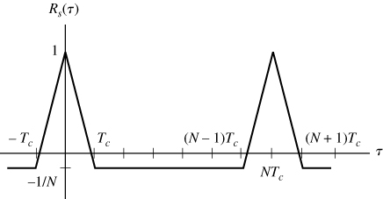
Copyright © The McGraw-Hill Companies, Inc. Permission required for reproduction or display.
Autocorrelation of a PN sequence
Figure 11.4-8

