Slide 1

Algorithm Analysis
and Design
ETCS-301
Dr. Deepak Gupta
Computer Science & Engineering
Maharaja Agrasen Institute of Technology, Delhi (GSIPU)
Email: drdeepakgupta.cse@gmail.com, deepakgupta@mait.ac.in

Slide 2
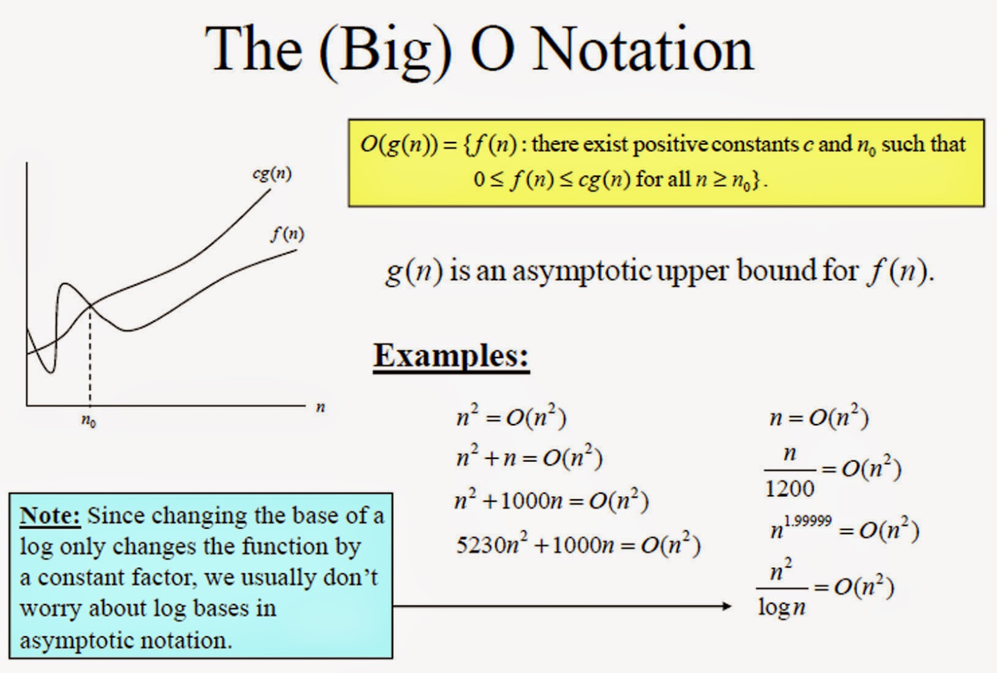

Slide 3
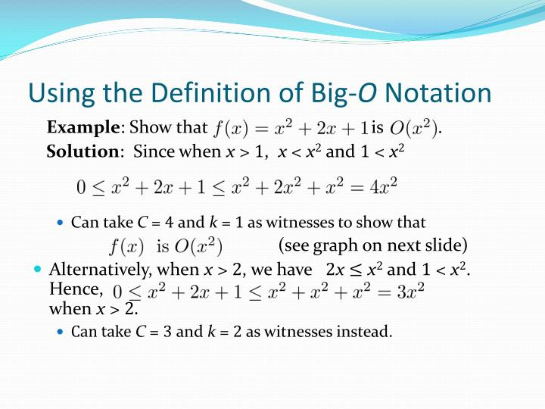

Slide 4
Q. F(n) = n³ + 5n² + 12n + 20
Find Big Oh notation with c and n₀
Solution: For all n>=20
F(n) <= n³ + 5n² + 12n + n
F(n) <= n³ + 5n² + 13n
For all n²>=13n i.e. n>=13
F(n) <= n³ + 5n² + n²
F(n) <= n³ + 6n²
For all n³>=6n² i.e. n>=6
F(n) <= n³ + n³
F(n) <= 2n³
Hence c=2, n₀=6, O(n³)
Q. F(n) = 4n⁷ + 7n⁵ + n + 11
Find Big Oh notation with c and n₀

Slide 5
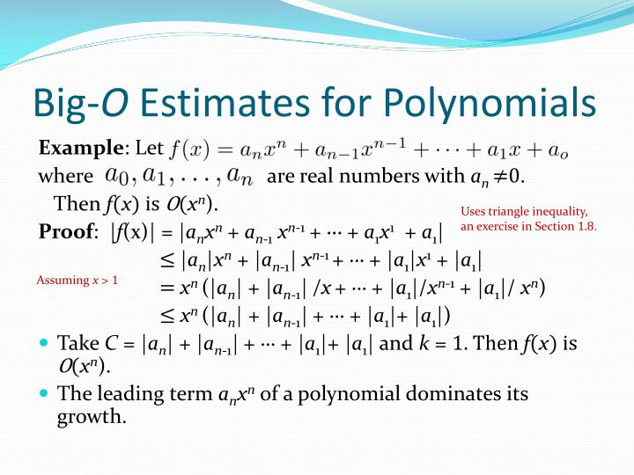

Slide 6
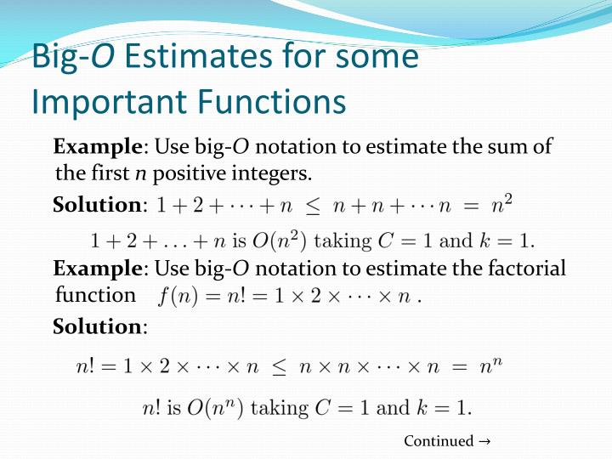

Slide 7
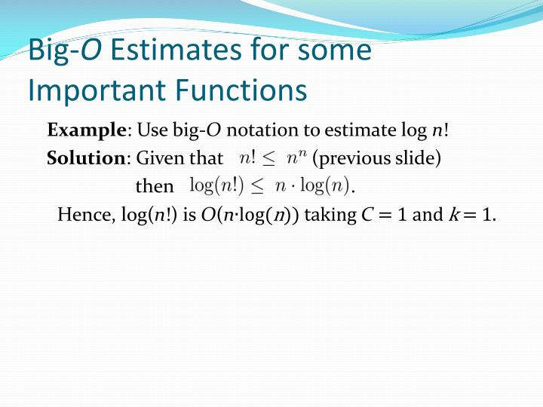

Slide 8
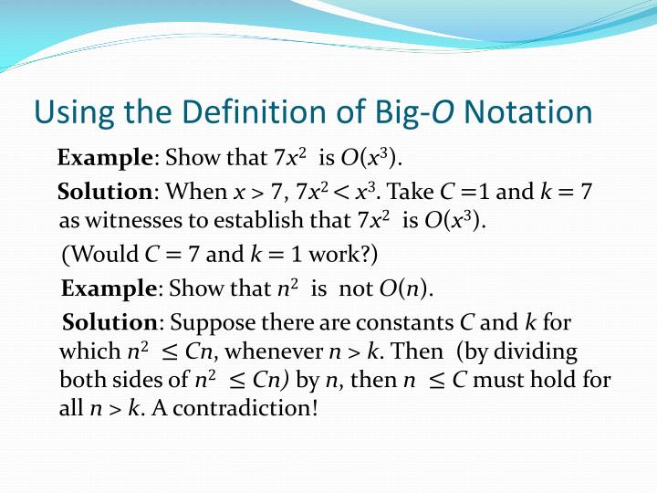

Slide 9
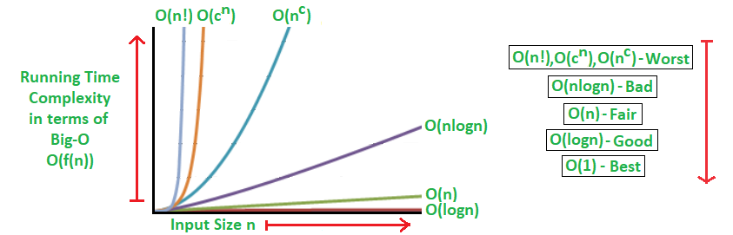

Slide 10
Omega (Ω)
It is used in Computer Science to describe the performance or complexity of an algorithm. Omega specifically describes the best-case scenario, and can be used to describe the execution time required or the space used (e.g. in memory or on disk) by an algorithm.
F(n) = Ω (g(n)), represents the minimum time g(n) for the given function F(n) which satisfies the conditions i.e. c>0, n>=n0.
F(n) >= c*g(n) for all c>0 and n>=n0.
It is also known as asymptotically lower bound.

Slide 11
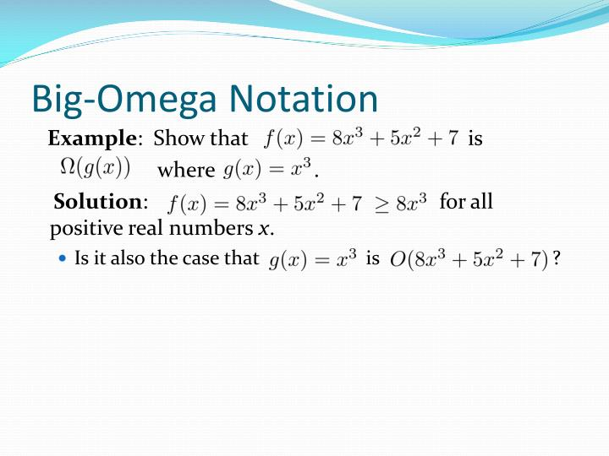

Slide 12
Theta (θ)
It is used in Computer Science to describe the performance or complexity of an algorithm. Theta specifically describes the average-case scenario, and can be used to describe the execution time required or the space used (e.g. in memory or on disk) by an algorithm.
F(n) = θ (g(n)), represents the average time g(n) for the given function F(n) which satisfies the conditions i.e. c1>0, c2>0, n>=n0.
c1*g(n) <= F(n) <= c2*g(n) for all c1>0, c2>0 and n>=n0.
It is also known as asymptotically tight bound.

Slide 13
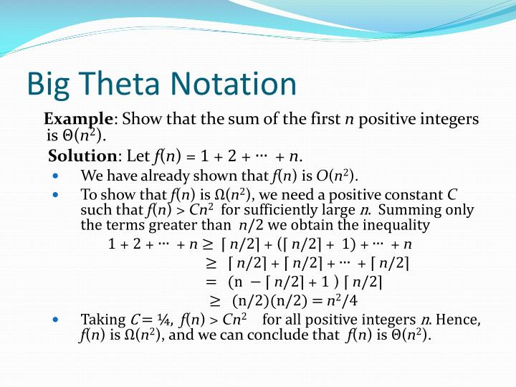

Slide 14
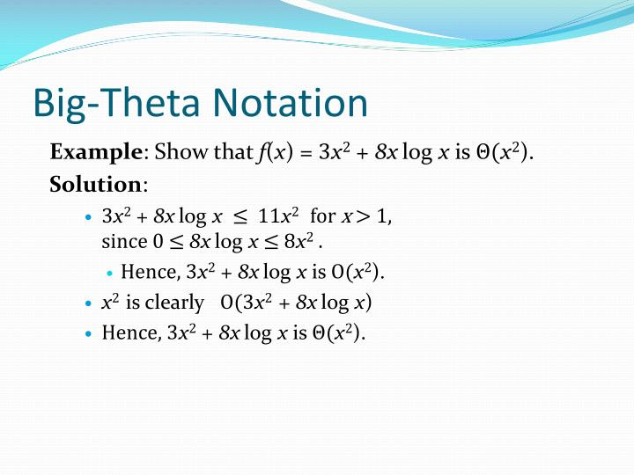

Slide 15
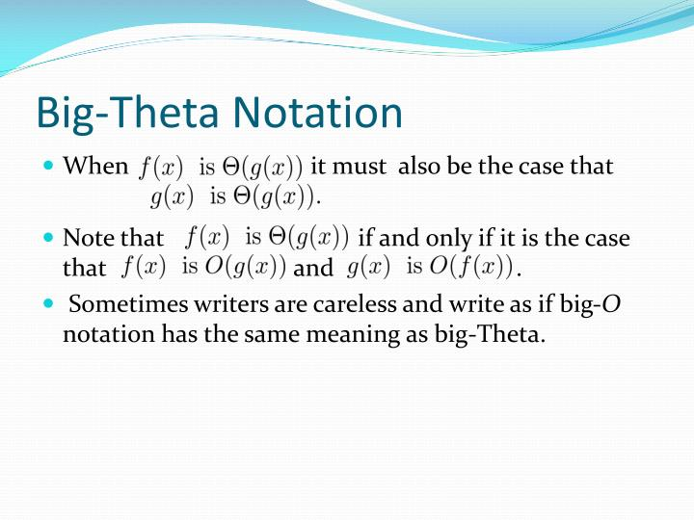

Slide 16
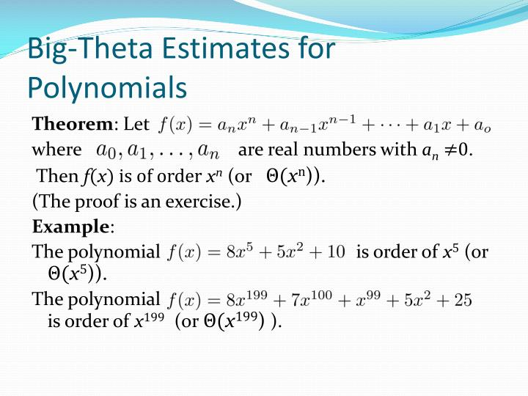

Slide 17
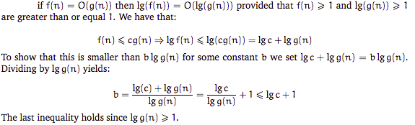
Properties
Let f(n) and g(n) be asymptotically positive functions
(a)
(b)
(c)

Slide 18
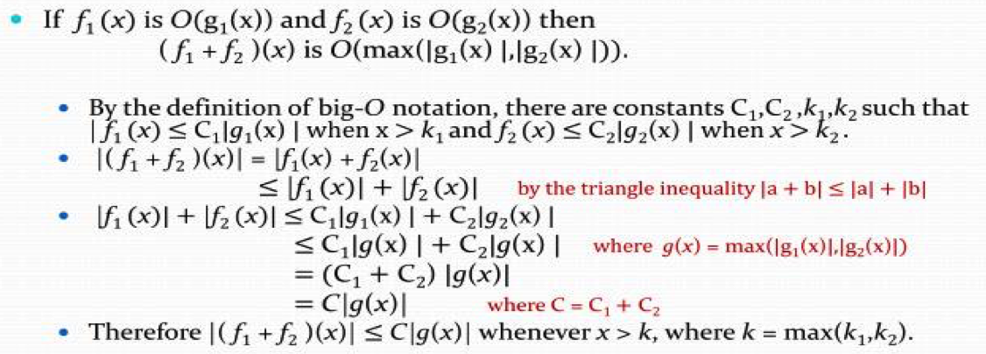
(d)
(e)
(f)

Slide 19


