Slide 1
Algorithm Analysis
and Design
ETCS-301
Dr. Deepak Gupta
Computer Science & Engineering
Maharaja Agrasen Institute of Technology, Delhi (GSIPU)
Email: drdeepakgupta.cse@gmail.com, deepakgupta@mait.ac.in

Slide 2
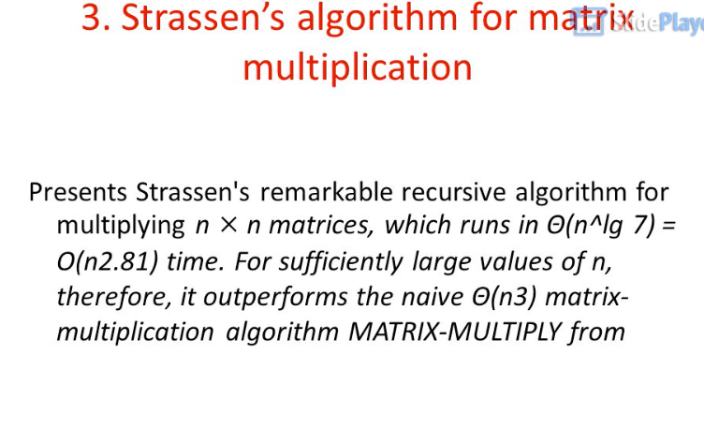

Slide 3
Conventional Matrix Multiplication
Brute-force algorithm
    c₀₀ c₀₁ a₀₀ a₀₁ b₀₀ b₀₁
    = *
    c₁₀ c₁₁ a₁₀ a₁₁ b₁₀ b₁₁
    a₀₀ * b₀₀ + a₀₁ * b₁₀ a₀₀ * b₀₁ + a₀₁ * b₁₁
    =
    a₁₀ * b₀₀ + a₁₁ * b₁₀ a₁₀ * b₀₁ + a₁₁ * b₁₁
8 multiplications
Efficiency class in general: Θ (n³)
4 additions

Slide 4
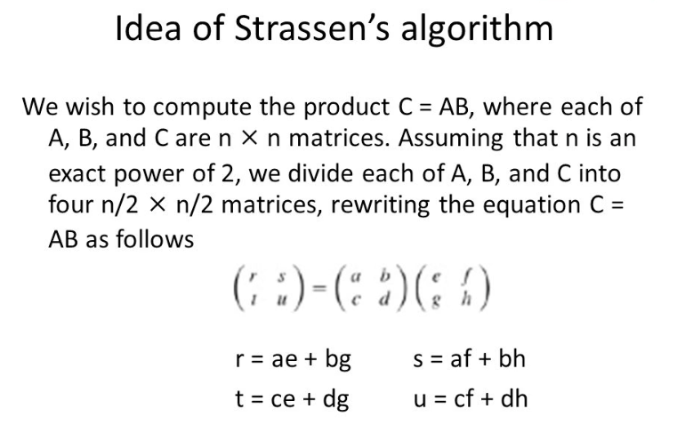

Slide 5
Strassen’s Matrix Multiplication
Let us see how we can apply Strassen’s idea for multiplying two n×n matrices
Let A and B be two n×n matrices where n is a power of 2
A₀₀ A₀₁
A₁₀ A₁₁
B₀₀ B₀₁
B₁₀ B₁₁
C₀₀ C₀₁
C₁₀ C₁₁
=
Each block is (n/2)×(n/2)
E.g., In Strassen’s
method,
M₁ = (A₀₀+A₁₁)*(B₀₀+B₁₁)
M₂ = (A₁₀+A₁₁)*B₀₀
etc.
You can treat blocks
as if they were numbers
to get the C = A*B

Slide 6
Strassen’s Matrix Multiplication
How do we multiply two 2×2 matrices ?
2
3 4
3 5
1 4
5 13
13 31
How many multiplications
and additions did we need?
=
8 mults and 4 adds
V. Strassen in 1969 found out, he can
do the above multiplication in the following
way:
m₁+m₄-m₅+m₇ m₃+m₅
m₂+m₄ m₁+m₃-m₂+m₆
a₀₀ a₀₁
a₁₀ a₁₁
b₀₀ b₀₁
b₁₀ b₁₁
c₀₀ c₀₁
c₁₀ c₁₁
=
=
m₁ = (a₀₀+a₁₁)*(b₀₀+b₁₁)
m₂ = (a₁₀+a₁₁)*b₀₀
m₃ = a₀₀*(b₀₁-b₁₁)
m₄ = a₁₁*(b₁₀-b₀₀)
m₅ = (a₀₀+a₀₁)*b₁₁
7 mults
18 adds/subs
m₆ = (a₁₀-a₀₀)*(b₀₀+b₀₁)
m₇ = (a₀₁-a₁₁)*(b₁₀+b₁₁)

Slide 7
Strassen’s Matrix Multiplication
ALGORITHM Strassen(A, B, n)
//Input: A and B are n×n matrices
//where n is a power of two
//Output: C = A*B
if n = 1
return C = A*B
else
Partition A = and B =
where the blocks A_{ij} and B_{ij} are (n/2)-by-(n/2)
M1 <- Strassen(A₀₀+A₁₁, B₀₀+B₁₁, n/2)
M2 <- Strassen(A₁₀+A₁₁, B₀₀, n/2)
M3 <- Strassen(A₀₀, B₀₁-B₁₁, n/2)
M4 <- Strassen(A₁₁, B₁₀-B₀₀, n/2)
M5 <- Strassen(A₀₀+A₀₁, B₁₁, n/2)
M6 <- Strassen(A₁₀-A₀₀, B₀₀+B₀₁, n/2)
M7 <- Strassen(A₀₁-A₁₁, B₁₀+B₁₁, n/2)
C₀₀ <- M1+M4-M5+M7
C₀₁ <- M3+M5
C₁₀ <- M2+M4
C₁₁ <- M1+M3-M2+M6
return C =
A₀₀ A₀₁
A₁₀ A₁₁
B₀₀ B₀₁
B₁₀ B₁₁
C₀₀ C₀₁
C₁₀ C₁₁

Slide 8
Analysis of Strassen’s Algorithm
If n is not a power of 2, matrices can be padded with zeros.
Number of multiplications:
T(n) = 7T(n/2)+n^2, T(1) = 1
Solution: T(n) = 7^{log 2n} = n^{log 27} ≈ n^{2.807} vs. n³ of brute-force alg.
Algorithms with better asymptotic efficiency are known but they are even more complex and not used in practice.
What if we count both multiplications and additions?

Slide 9
Problems related to Divide & Conquer
What is Order Statistics?
Mean and Median?
Min-Max Problem?
Randomized QuickSort?
Subset Sum Problem?

Slide 10
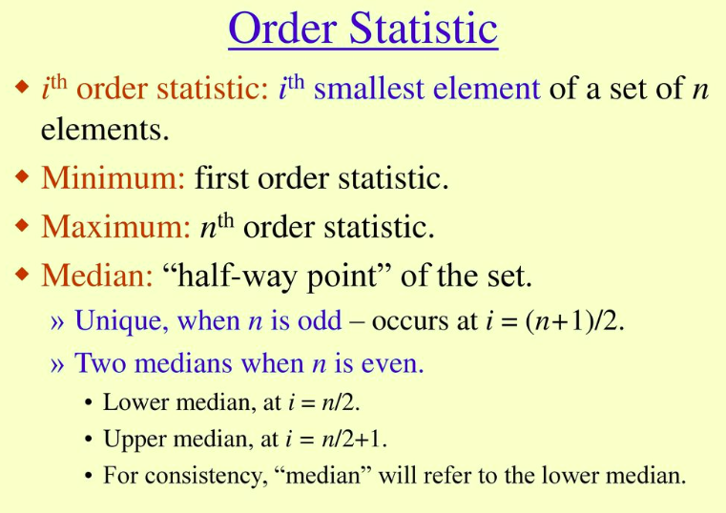

Slide 11
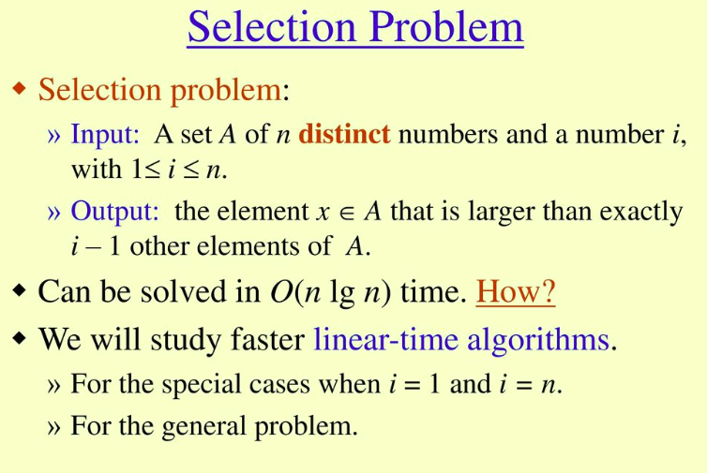

Slide 12
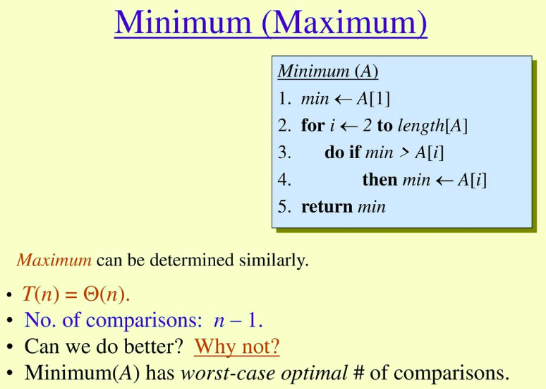

Slide 13
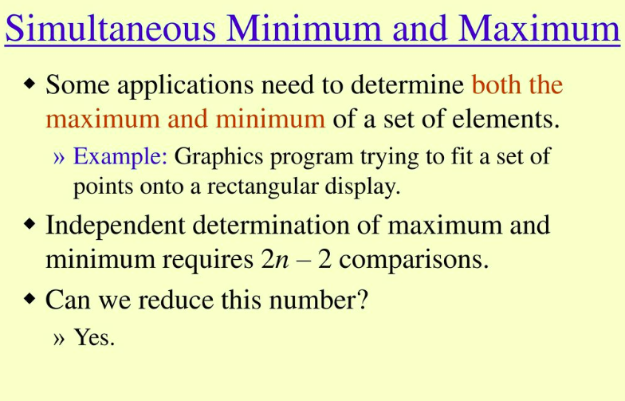

Slide 14
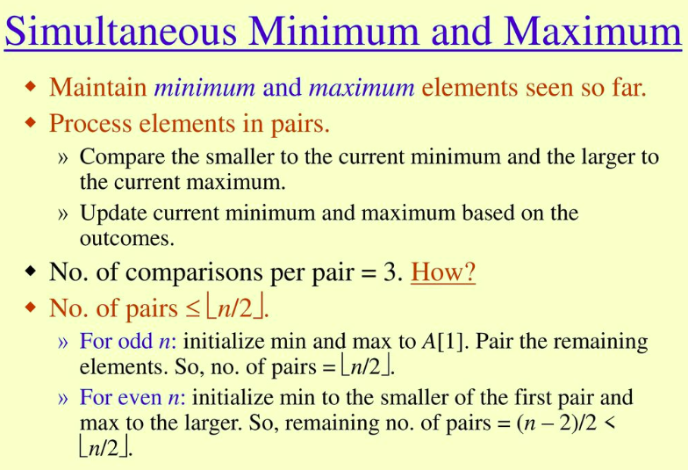

Slide 15
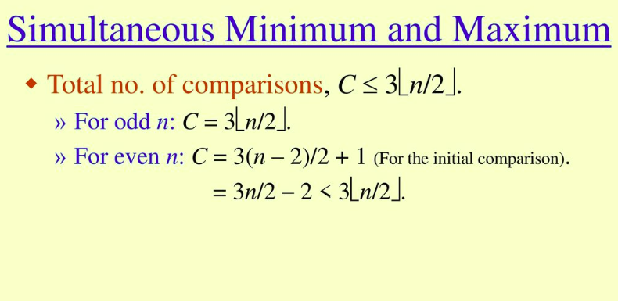

Slide 16
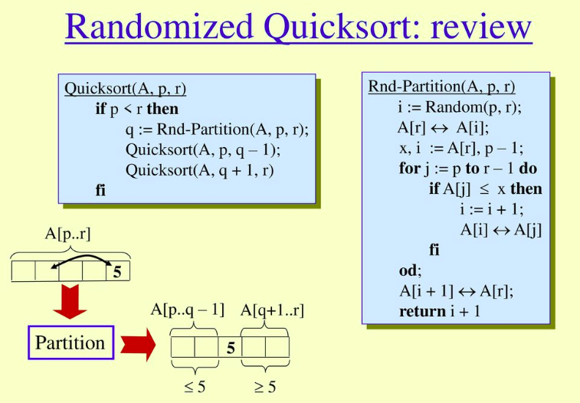

Slide 17
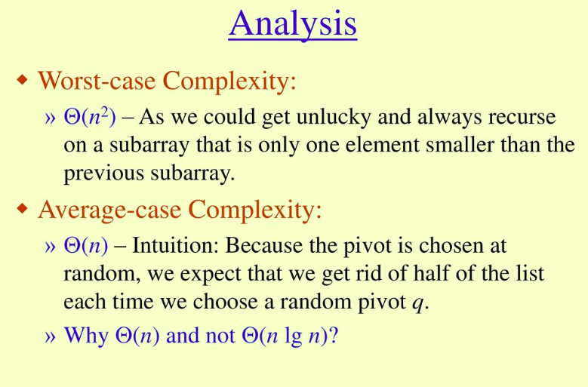

Slide 18
