Slide 1
Algorithm Analysis
and Design
ETCS-301
Dr. Deepak Gupta
Computer Science & Engineering
Maharaja Agrasen Institute of Technology, Delhi (GSIPU)
Email: drdeepakgupta.cse@gmail.com, deepakgupta@mait.ac.in

Slide 2
Data Structure for Disjoint Sets

Slide 3

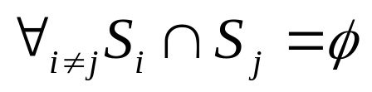
Disjoint Sets
Some applications require maintaining a collection of disjoint sets.
A Disjoint set S is a collection of sets
where
Each set has a representative which is a member of the set (Usually the minimum if the elements are comparable)

Slide 4
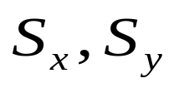
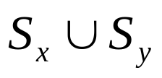
Disjoint Set Operations
Make-Set(x) – Creates a new set where x is it’s only element (and therefore it is the representative of the set). O(1) time.
Union(x,y) – Replaces by one of the elements of becomes the representative of the new set. O(log n) time.
Find(x) – Returns the representative of the set containing x O(log n) time

Slide 5
Applications
Equivalence Relations (e.g Connected Components)
Minimal Spanning Trees

Slide 6
Connected Components
Given a graph G we first preprocess G to maintain a set of connected components.
CONNECTED_COMPONENTS(G)
Later a series of queries can be executed to check if two vertexes are part of the same connected component
SAME_COMPONENT(U,V)

Slide 7
Connected Components
CONNECTED_COMPONENTS(G)
for each vertex v in V[G]
do MAKE_SET (v)
for each edge (u,v) in E[G]
do if FIND_SET(u) != FIND_SET(v)
then UNION(u,v)

Slide 8
Connected Components
SAME_COMPONENT(u,v)
return FIND_SET(u) ==FIND_SET(v)

Slide 9
Example
e
f
h
j
g
i
a
b
c
d

Slide 10
(b,d)
e
f
h
j
g
i
a
b
c
d

Slide 11
(e,g)
e
f
h
j
g
i
a
b
c
d

Slide 12
(a,c)
e
f
h
j
g
i
a
b
c
d

Slide 13
(h,i)
e
f
h
j
g
i
a
b
c
d

Slide 14
(a,b)
e
f
h
j
g
i
a
b
c
d

Slide 15
(e,f)
e
f
h
j
g
i
a
b
c
d

Slide 16
(b,c)
e
f
h
j
g
i
a
b
c
d

Slide 17
Result
e
f
h
j
g
i
a
b
c
d

Slide 18
Connected Components
During the execution of CONNECTED-COMPONENTS on a undirected graph G = (V, E) with k connected components, how many time is FIND-SET called? How many times is UNION called? Express you answers in terms of |V|, |E|, and k.

Slide 19
Solution
FIND-SET is called 2|E| times. FIND-SET is called twice on line 4, which is executed once for each edge in E[G].
UNION is called |V| - k times. Lines 1 and 2 create |V| disjoint sets. Each UNION operation decreases the number of disjoint sets by one. At the end there are k disjoint sets, so UNION is called |V| - k times.

Slide 20
Linked List implementation
We maintain a set of linked list, each list corresponds to a single set.
All elements of the set point to the first element which is the representative
A pointer to the tail is maintained so elements are inserted at the end of the list
a
b
c
d

Slide 21
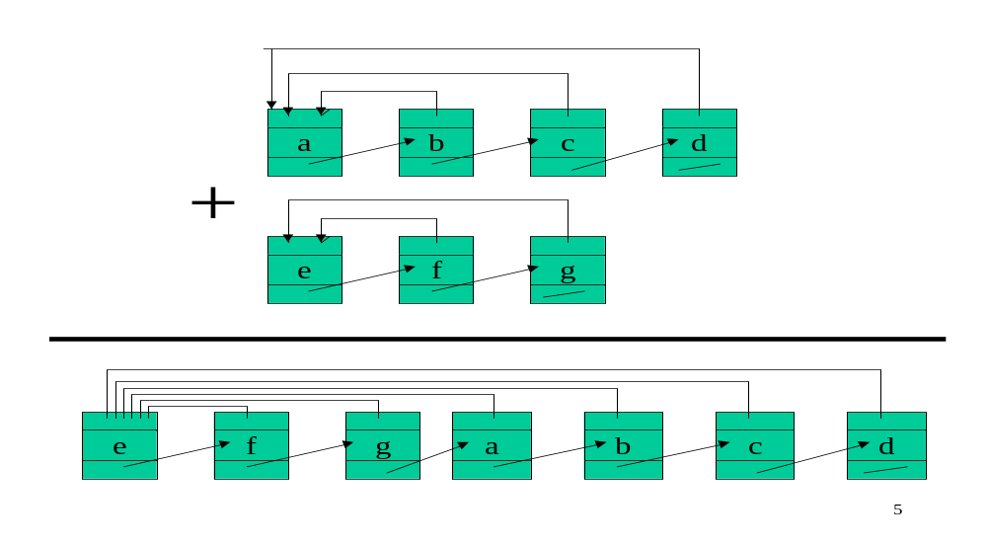
Union with linked lists

Slide 22
Disjoint-Set Forests
Maintain A collection of trees, each element points to it’s parent. The root of each tree is the representative of the set
We use two strategies for improving running time
  Union by Rank
  Path Compression
c
a
b
f
d

Slide 23
Make Set
MAKE_SET(x)
x

Slide 24
Find Set
FIND_SET(d)
c
a
b
f
d

Slide 25
Union
w
c
UNION(x,y)
link(x,y)
x
a
b
f
y
d
z
c
w
a
b
f
x
y
d
z

Slide 26
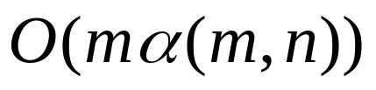
Analysis
In Union we attach a smaller tree to the larger tree, results in logarithmic depth.
Path compression can cause a very deep tree to become very shallow
Combining both ideas gives us (without proof) a sequence of m operations in

Slide 27
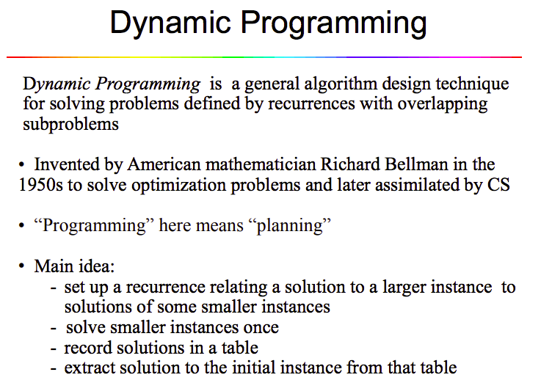

Slide 28
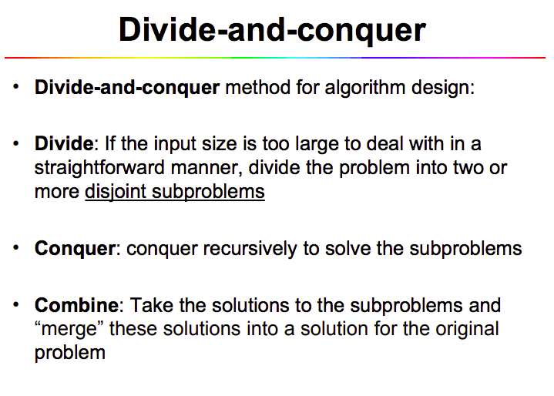

Slide 29
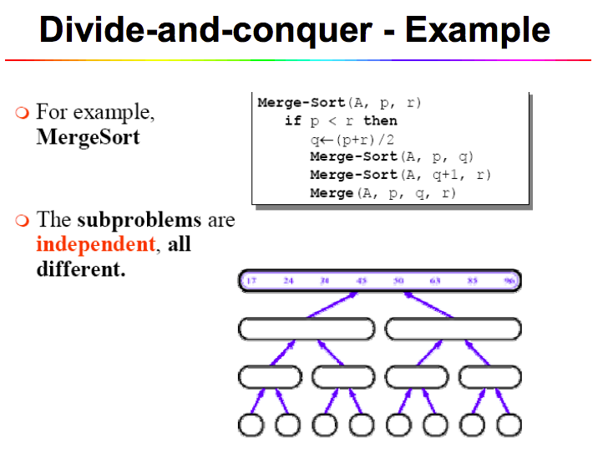

Slide 30
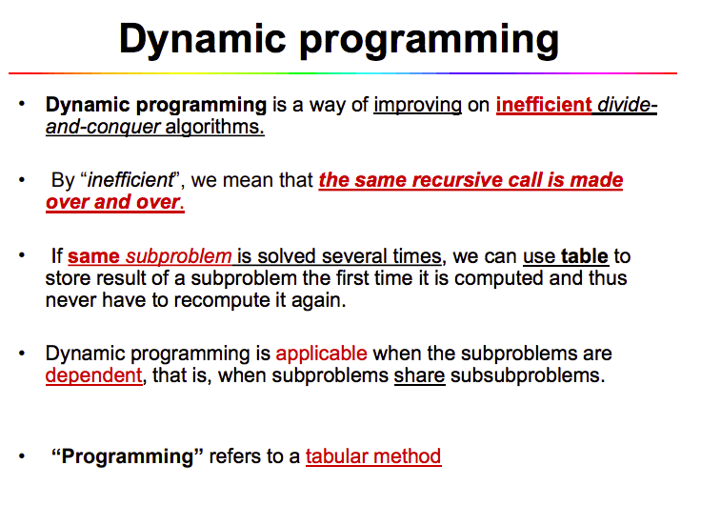

Slide 31
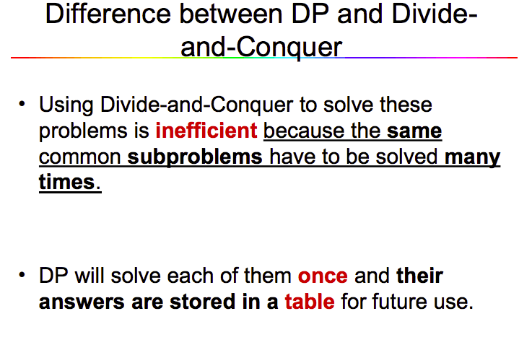

Slide 32
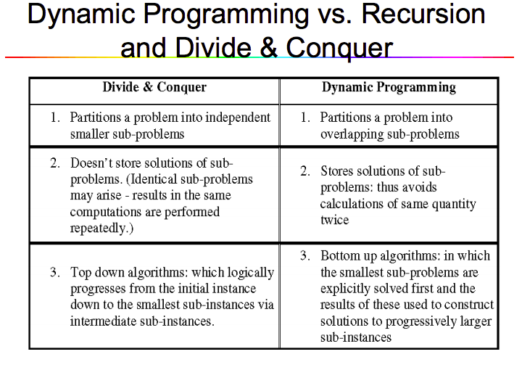

Slide 33
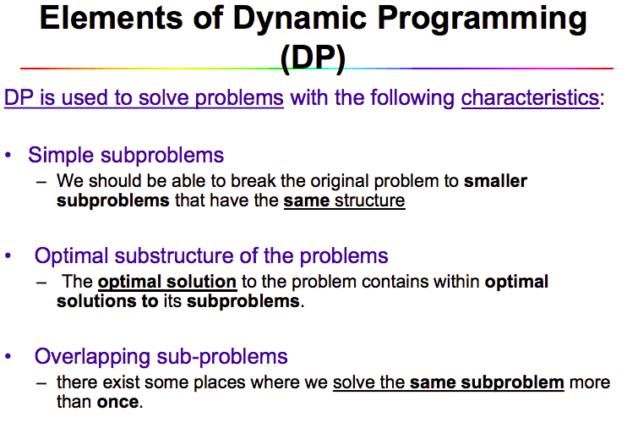

Slide 34
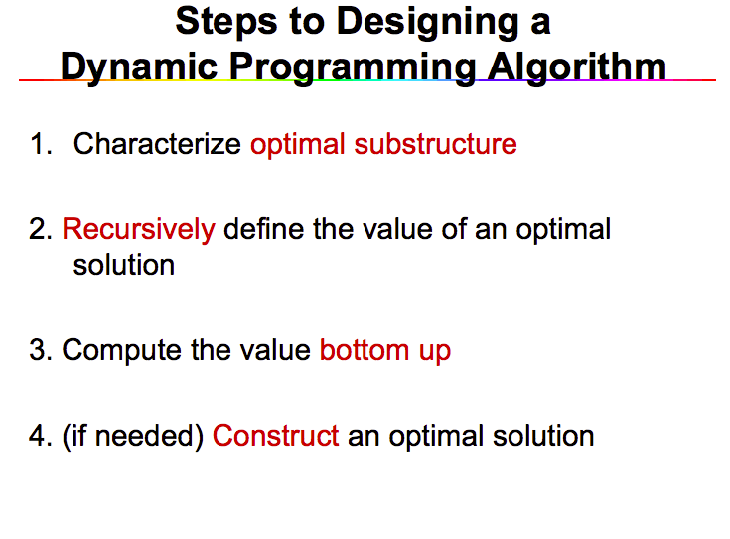

Slide 35
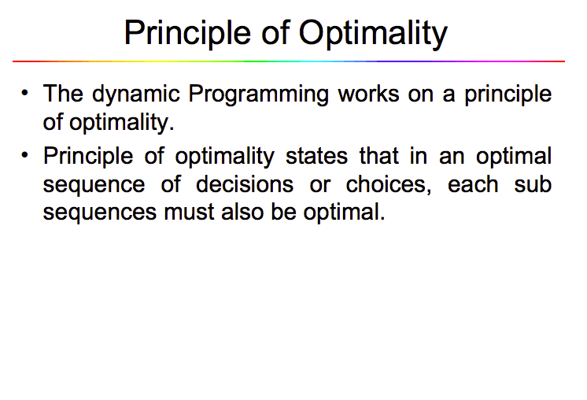

Slide 36
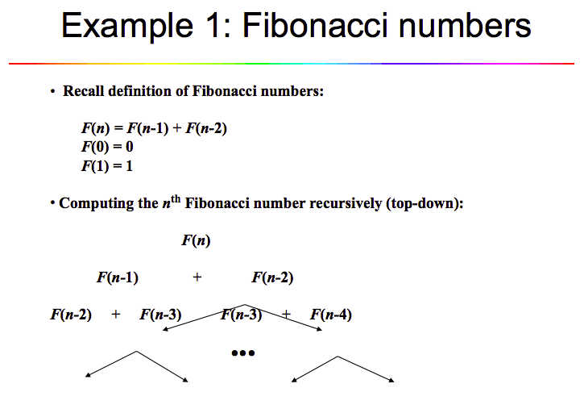

Slide 37
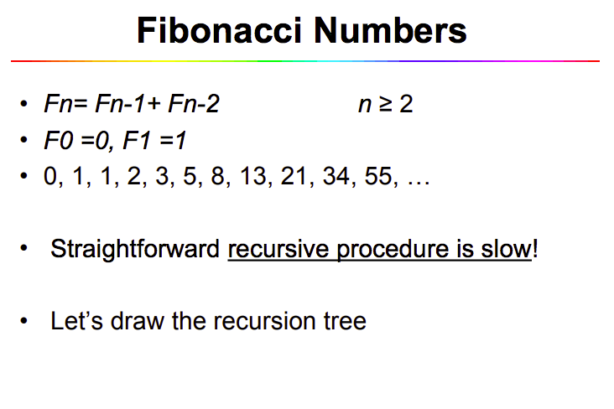

Slide 38
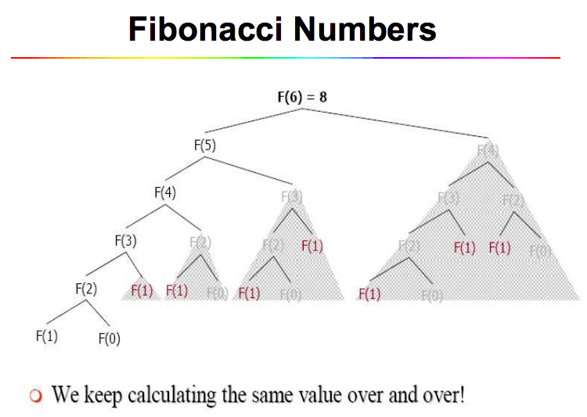

Slide 39
