Slide 1
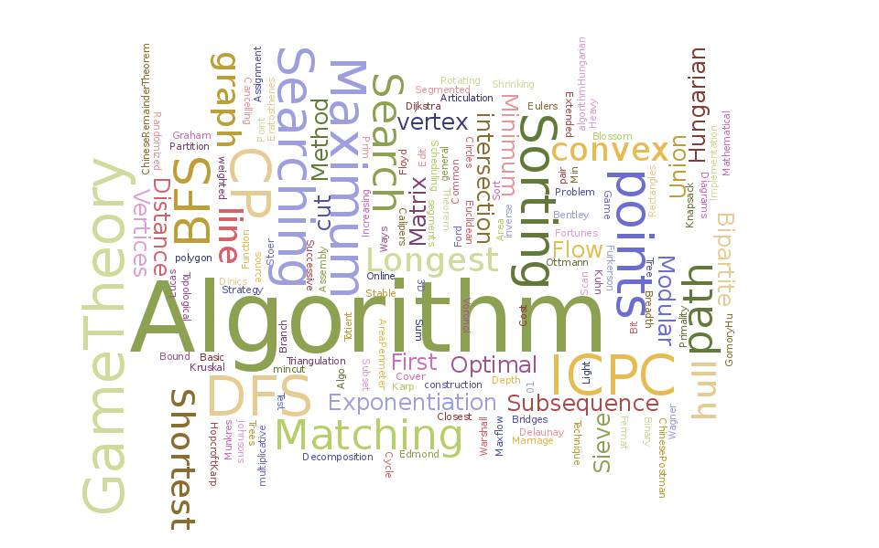
Algorithm Analysis
and Design
ETCS-301
Dr. Deepak Gupta
Computer Science & Engineering
Maharaja Agrasen Institute of Technology, Delhi (GSIPU)
Email: drdeepakgupta.cse@gmail.com, deepakgupta@mait.ac.in

Slide 2
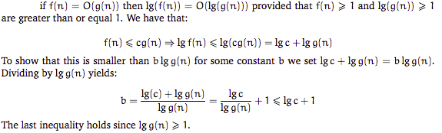
Properties
Let f(n) and g(n) be asymptotically positive functions
(a)
(b)
(c)

Slide 3
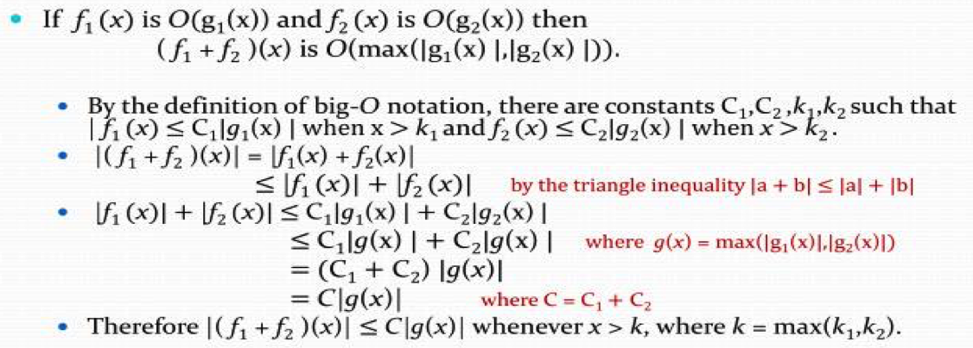
(d)
(e)
(f)

Slide 4
Little Oh and Little Omega
The variation of worst-case and best-case scenario.
F(n) = o(g(n)), represents the maximum time g(n) for the given function F(n) which satisfies the conditions i.e. c>0, n>=n0.
F(n) < c*g(n) for all c>0 and n>=n0.
It is also known as upper bound.
F(n) = w(g(n)), represents the minimum time g(n) for the given function F(n) which satisfies the conditions i.e. c>0, n>=n0.
F(n) > c*g(n) for all c>0 and n>=n0.
It is also known as lower bound.

Slide 5

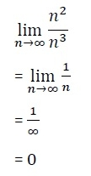
Little o Notations
Little o notation is used to describe an upper bound that cannot be tight. In other words, loose upper bound of f(n).
Let f(n) and g(n) are the functions that map positive real numbers. We can say that the function f(n) is o(g(n)) if for any real positive constant c,
there exists an integer constant n0 ≤ 1 such that f(n) > 0.
Mathematical Relation of Little o notation
Using mathematical relation, we can say that f(n) = o(g(n)) means,
Example on little o asymptotic notation
If f(n) = n² and g(n) = n³ then check whether f(n) = o(g(n)) or not.

Slide 6
Little ω asymptotic notation
f(n) has a higher growth rate than g(n) so main difference between Big Omega (Ω) and little omega (ω) lies in their definitions. In the case of Big Omega f(n)=Ω(g(n)) and the bound is 0<=cg(n)<=f(n), but in case of little omega, it is true for 0<=c*g(n)<f(n). The relationship between Big Omega (Ω) and Little Omega (ω) is similar to that of Big-Ο and Little o except that now we are looking at the lower bounds. Little Omega (ω) is a rough estimate of the order of the growth whereas Big Omega (Ω) may represent exact order of growth. We use ω notation to denote a lower bound that is not asymptotically tight.
And, f(n) ∈ ω(g(n)) if and only if g(n) ∈ ο((f(n)). In mathematical relation, if f(n) ∈ ω(g(n)) then,
lim f(n)/g(n) = ∞ n→∞

Slide 7
EXAMPLE
Prove that 4n + 6 ∈ ω(1) the little omega(ο) running time can be proven by applying limit formula given below.
if lim f(n)/g(n) = ∞ then functions f(n) is ω(g(n)) n→∞
here,we have functions f(n)=4n+6 and g(n)=1
lim (4n+6)/(1) = ∞ n→∞
and, also for any c we can get n₀ for this inequality 0 <= c*g(n) < f(n),
0 <= c*1 < 4n+6 Hence proved.

Slide 8
QUESTIONS
QUES 1: If f(n)=a_{m}n^{m}+a_{m-1}n^{m-1}+…….+a₁n+a₀, then prove f(n)=O(n^{m})
QUES 2: If f(n)=a_{m}n^{m}+a_{m-1}n^{m-1}+…….+a₁n+a₀ & a_{m} >0 then prove
f(n)=Ω (n^{m})
QUES 3. If f(n)=a_{m}n^{m}+a_{m-1}n^{m-1}+…….+a₁n+a₀ & a_{m} >0 then prove f(n)=Θ (n^{m})
QUES 4: Prove that lg(n!)=O(nlgn)
QUES 5:Is 2^{n+1}=O(2^{n})?

Slide 9
QUES 6. Arrange the following functions according to their complexities
2^{n} , n² , lg n ,n²lgn , nlg n , √ n, n,
Ques 7. What is the time, space complexity of following code:
int a = 0, b = 0;
for (i = 0; i < N; i++) {
a = a + rand();
}
for (j = 0; j < M; j++) {
b = b + rand();
}
Ques 8. What is the time complexity of following code:
int a = 0;
for (i = 0; i < N; i++) {
for (j = N; j > i; j--) {
a = a + i + j;
}
}

Slide 10
Ques 9. What is the time complexity of following code:
int i, j, k = 0;
for (i = n / 2; i <= n; i++) {
for (j = 2; j <= n; j = j * 2) {
k = k + n / 2;
}
}
Ques 10. What does it mean when we say that an algorithm X is asymptotically more efficient than Y? Options:
X will always be a better choice for small inputs
X will always be a better choice for large inputs
Y will always be a better choice for small inputs
X will always be a better choice for all inputs

Slide 11
RECURRENCE RELATIONS AND ITERATION METHOD

Slide 12
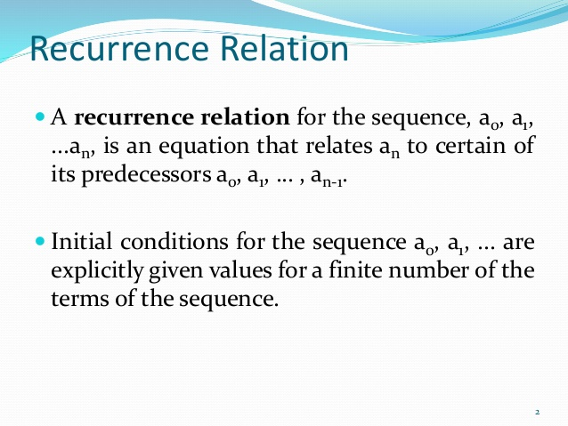

Slide 13
Recurrence relations
Many algorithms are recursive in nature. When we analyze them, we get a recurrence relation for time complexity. We get running time on an input of size n as a function of n and the running time on inputs of smaller sizes. For example in Merge Sort, to sort a given array, we divide it in two halves and recursively repeat the process for the two halves. Finally we merge the results.
Time complexity of Merge Sort can be written as
T(n) = 2T(n/2) + cn.
There are many other algorithms like Binary Search, Tower of Hanoi, etc. for which we can write recursive algorithms.

Slide 14
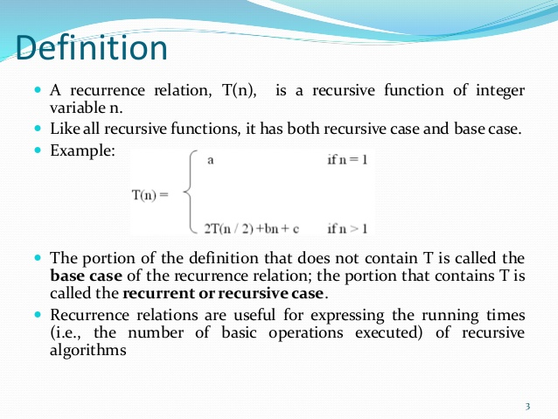

Slide 15
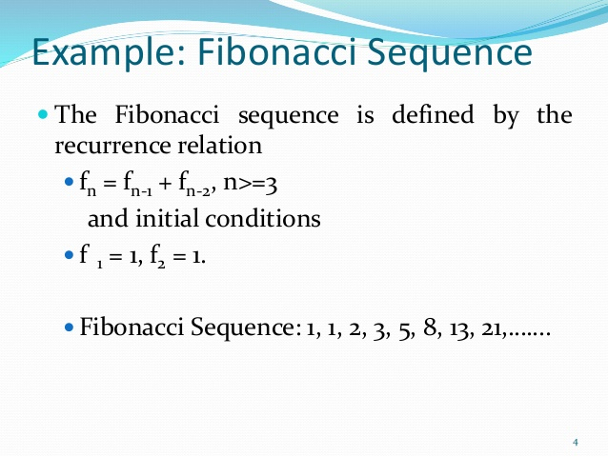

Slide 16
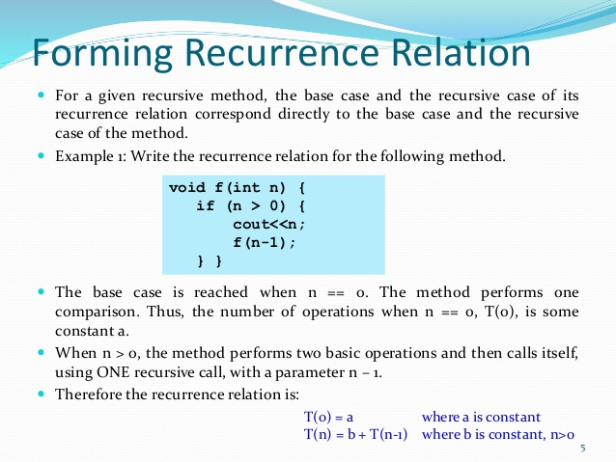

Slide 17
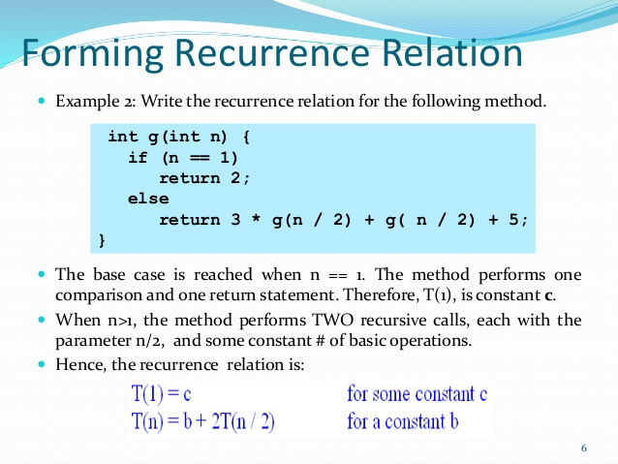

Slide 18
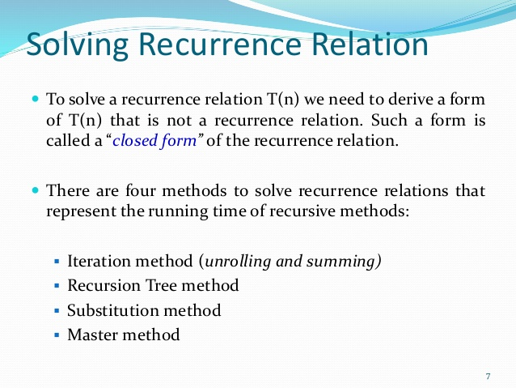

Slide 19
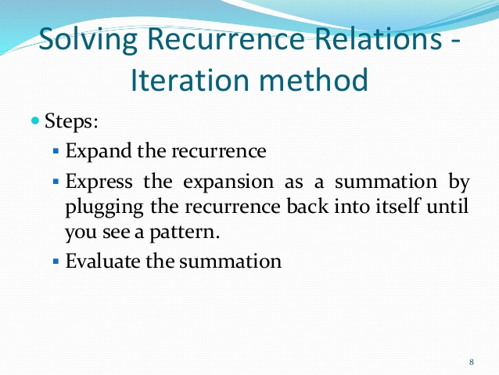

Slide 20
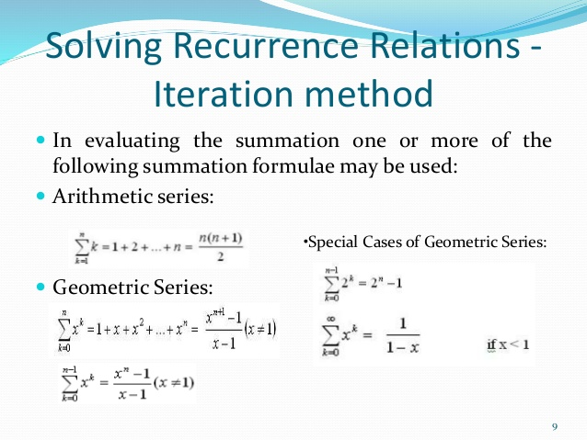

Slide 21
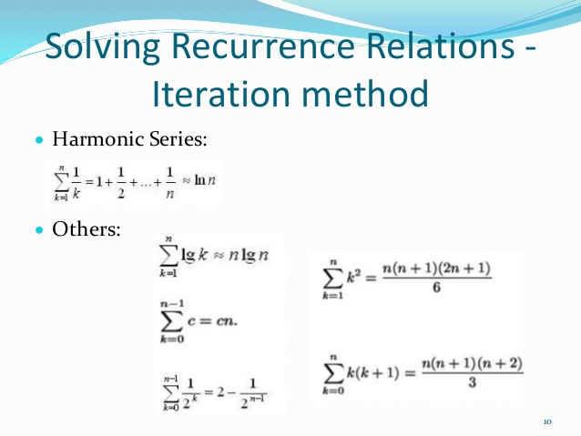

Slide 22
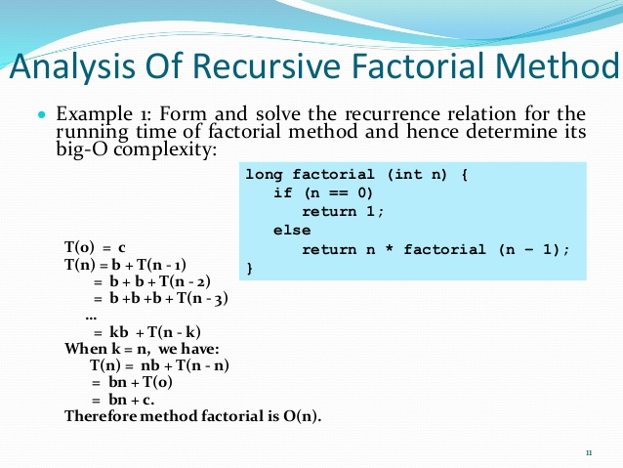

Slide 23
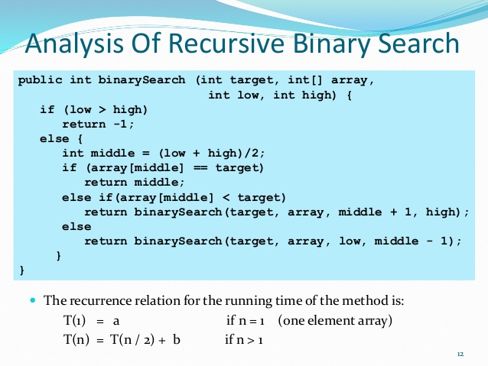

Slide 24
