Slide 1
Algorithm Analysis
and Design
ETCS-301
Dr. Deepak Gupta
Computer Science & Engineering
Maharaja Agrasen Institute of Technology, Delhi (GSIPU)
Email: drdeepakgupta.cse@gmail.com, deepakgupta@mait.ac.in

Slide 2
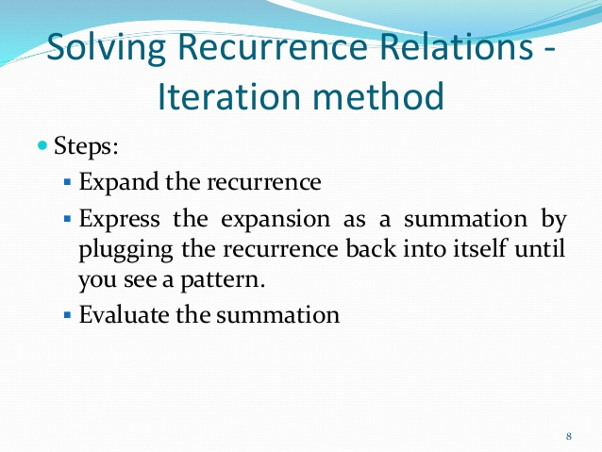

Slide 3
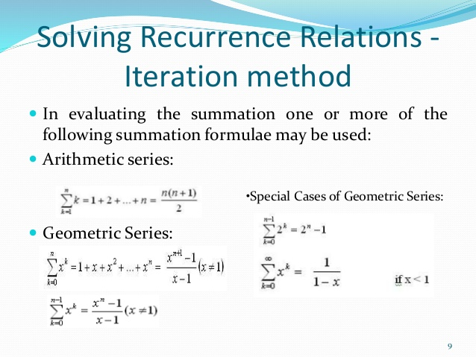

Slide 4
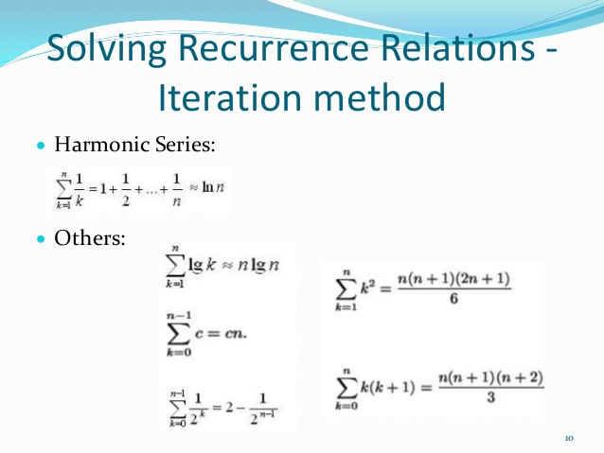

Slide 5
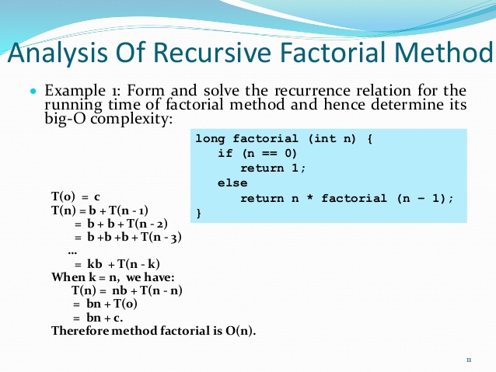

Slide 6
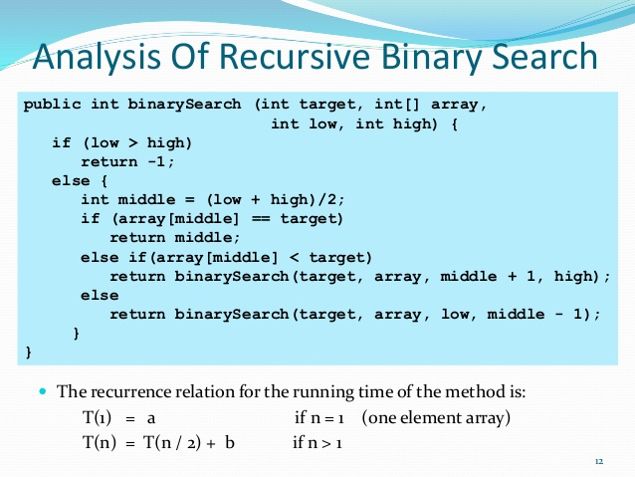

Slide 7
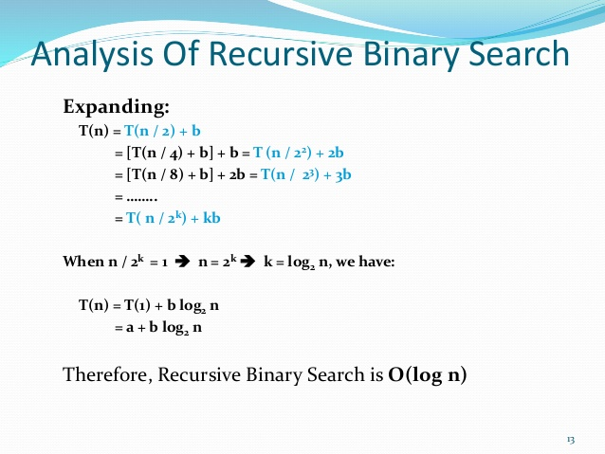

Slide 8
ITERATION METHOD
Consider the linear recurrence
a_{n} = a_{n−1} + 3, a₁ = 2.
Then
a_{n−1} = a_{n−2} + 3
a_{n−2} = a_{n−3} + 3
a_{n−3} = a_{n−4} + 3 and so on and so forth.
Therefore a_{n} = a_{n−1} + 3
= (a_{n−2} + 3) + 3
= a_{n−2} + 2 · 3
= (a_{n−3} + 3) + 6
= a_{n−3} + 3 · 3 = . . . = a₁ + 3(n − 1).
The last equality follows because a generic term is of the form
a_{n−i} + 3i, therefore when n − i = 1, i = n − 1.
By plugging the initial condition, we conclude a_{n} = 2 + 3(n − 1).

Slide 9
TOWER OF HANOI
Linear Recurrence relations are often useful to analyze algorithms, such as divide-and-conquer algorithms. We will illustrate this using the game of Hanoi tower.
In this game, the goal is to move n disks ranked from the largest at the bottom to the smallest on top from one post to another. The only permitted action is to remove the top disk from a post and drop it onto another post. The rule is that a larger disk can never lie above a smaller disk on any post. When n = 3 disks, the Hanoi tower game can be solved in 7 steps. But say one would like to know how many steps it would take to solve it for n = 50 disks, how could this be figured out?
The method is to derive a linear recurrence relation, and then to solve it. To find a linear recurrence relation, notice that to solve the Hanoi tower game for n = 3 disks, the following steps are done:
1. Solve a Hanoi tower game for n = 2 disks,
2. Move the largest disk,
3. Solve another Hanoi tower game for n = 2 disks. .
In fact, this is true in general, which yields the linear recurrence T_{n} = 2T_{n−1} + 1, where T_{n} denotes the number of steps for n disks.

Slide 10
TOWER OF HANOI
We solve this linear recurrence using Iteration method
Note that T_{n−1} = 2T_{n−2} + 1, T_{n−2} = 2 T_{n−3} + 1, T_{n−3} = 2T_{n−4} + 1, . . .
Then
T_{n} = 2 T_{n−1} + 1
= 2(2 T_{n−2} + 1)
= 4 T_{n−2} + 3
= 4(2 T_{n−3} + 1) + 3
= 8 T_{n−3} + 7
= 8(2T_{n−4} + 1) + 7
= 16T_{n−4}+ 15
𝑇_{𝑛} = 2 ^{𝑛} − 1

Slide 11
Let’s take another example
T(n) = 3T( n/4 +)+n .
We iterate it as follows:
T(n) = n + 3T( n/4 )
= n + 3 ( n/4 + 3T( n/16 ))
= n + 3( n/4 + 3( n/16 + 3T( n/64 )))
= n + 3 n/4 + 9 n/16 + 27T( n/64 ),
where n/4 /4 = n/16 and n/16 /4 = n/64
How far must we iterate the recurrence before we reach a boundary
condition? The ith term in the series is 3^{i} n/4^{i} .
The iteration hits n = 1 when n/4^{i} = 1 or, equivalently, when i exceeds
log₄ n. By continuing the iteration until this point,
we discover that the summation contains a decreasing geometric series:

Slide 12
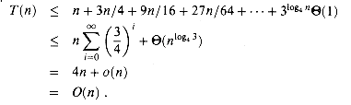
Here, we have used the identity 3^{log}₄ ^{n} = n^{log}₄³, and we have used the fact that log₄ 3 < 1 to conclude that (n^{log}₄³) = o(n).

Slide 13
QUESTIONS
QUES1 : Find the solution of following recurrences
(a) T(n)= T(n-1)+n if n>1
1 if n≤ 1
(b) T(n)= 2T(n/2)+2 if n>2
1 if n≤2

Slide 14
QUESTIONS
QUES 2: Consider the linear recurrence
a_{n} = 2 a_{n} ₋₁ − a_{n} ₋₂ with initial conditions a₁ = 3, a₀ = 0.
Solve it using the iteration method
QUES 3: What is the solution of the recurrence relation
an = a_{n−1} + 2a_{n−2} with a₀ = 2 and a₁ = 7?

Slide 15
RECURSIVE TREE METHOD

Slide 16
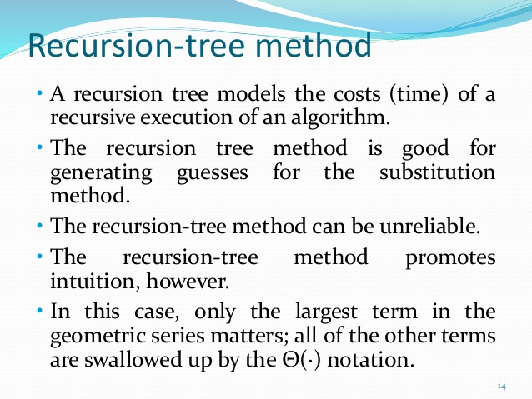

Slide 17
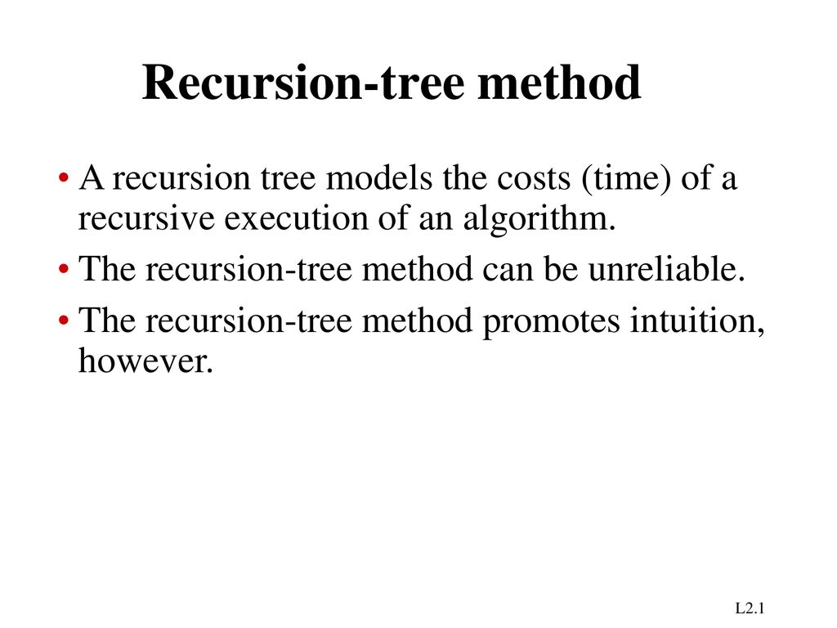

Slide 18
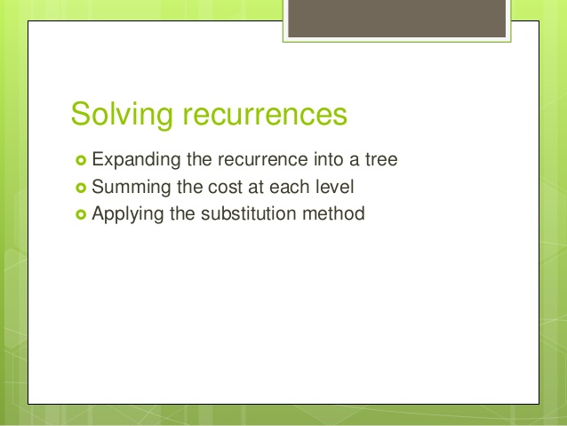

Slide 19
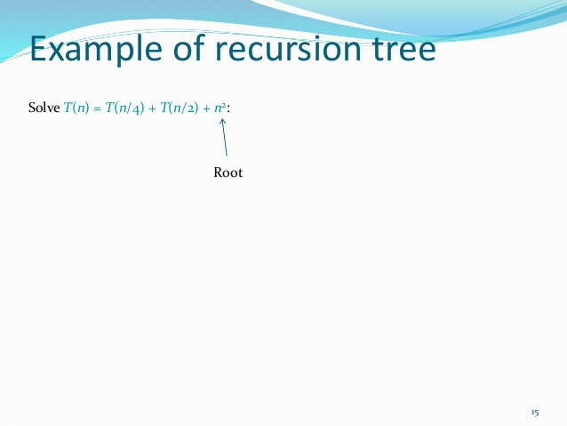

Slide 20
Example of recursion tree
Solve T(n) = T(n/4) + T(n/2) + n²:
n²
T(n/4)
T(n/2)

Slide 21
Example of recursion tree
Solve T(n) = T(n/4) + T(n/2) + n²:
n²
(n/4)²
(n/2)²
T(n/16)
T(n/8)
T(n/8)
T(n/4)

Slide 22
Example of recursion tree
Solve T(n) = T(n/4) + T(n/2) + n²:
n²
(n/4)²
(n/2)²
(n/16)²
(n/8)²
(n/8)²
(n/4)²
…
Θ(1)

Slide 23
Example of recursion tree
Solve T(n) = T(n/4) + T(n/2) + n²:
n²
(n/4)²
(n/2)²
(n/16)²
(n/8)²
(n/8)²
(n/4)²
…
Θ(1)

Slide 24
Example of recursion tree
Solve T(n) = T(n/4) + T(n/2) + n²:
n²
(n/4)²
(n/2)²
(n/16)²
(n/8)²
(n/8)²
(n/4)²
…
Θ(1)

Slide 25
Example of recursion tree
Solve T(n) = T(n/4) + T(n/2) + n²:
n²
(n/4)²
(n/2)²
(n/16)²
(n/8)²
(n/8)²
(n/4)²
…
…
Θ(1)

Slide 26
Example of recursion tree
Solve T(n) = T(n/4) + T(n/2) + n²:
n²
(n/4)²
(n/2)²
(n/16)²
(n/8)²
(n/8)²
(n/4)²
…
…
Θ(1)
Total =
= Θ(n²)
geometric series

Slide 27
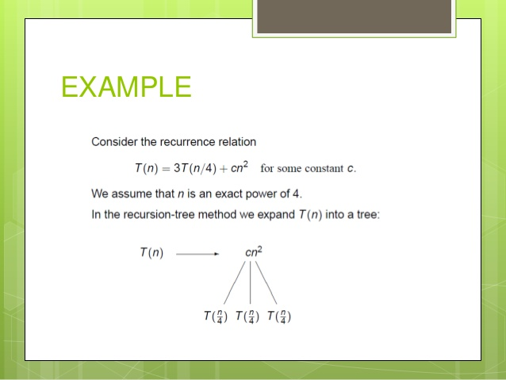

Slide 28
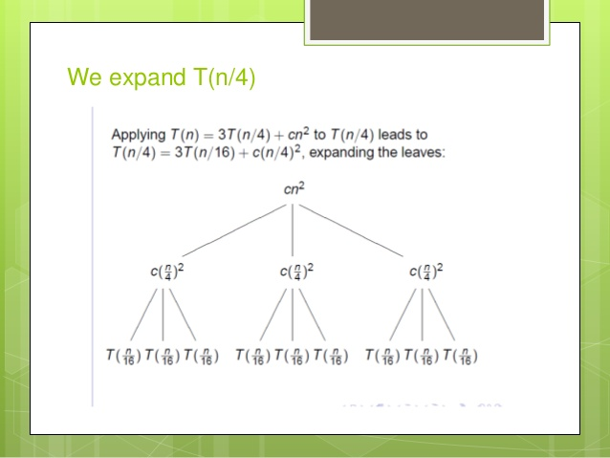

Slide 29
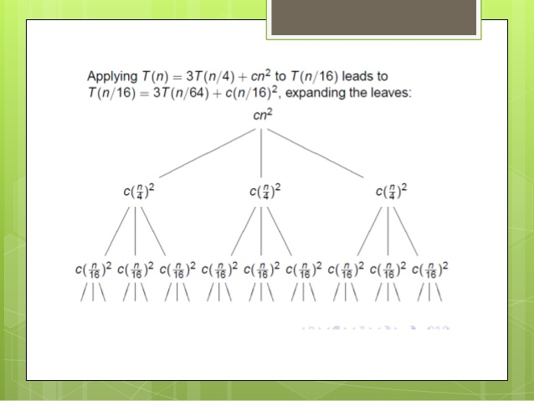

Slide 30
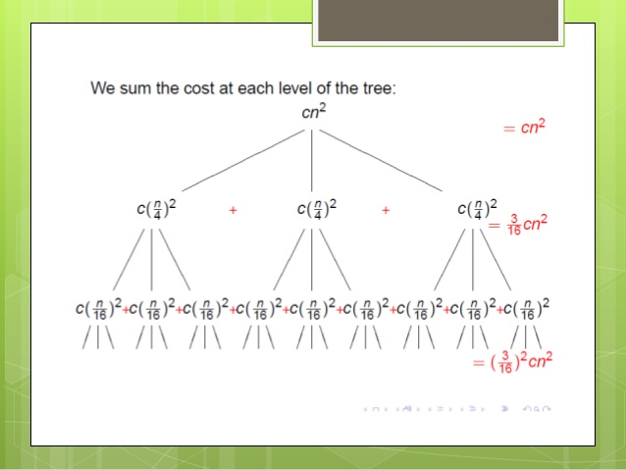

Slide 31
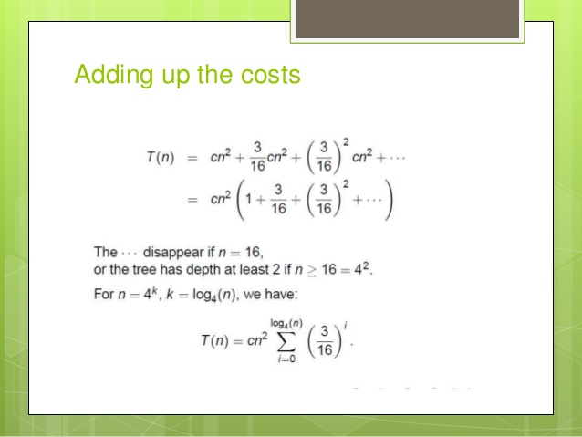

Slide 32
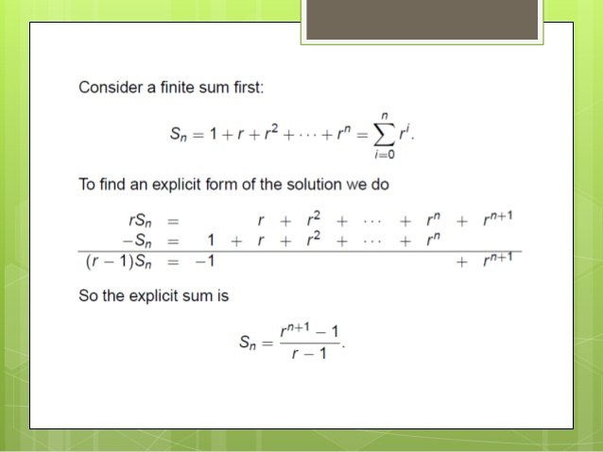

Slide 33
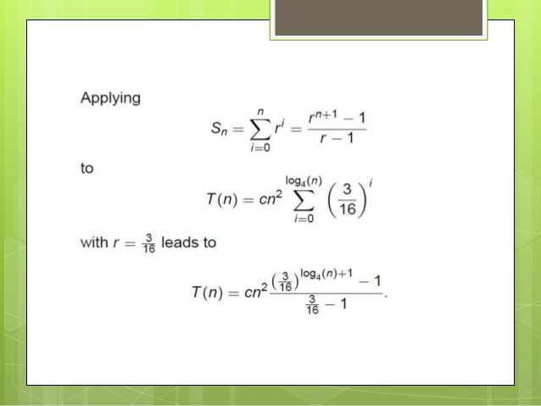

Slide 34
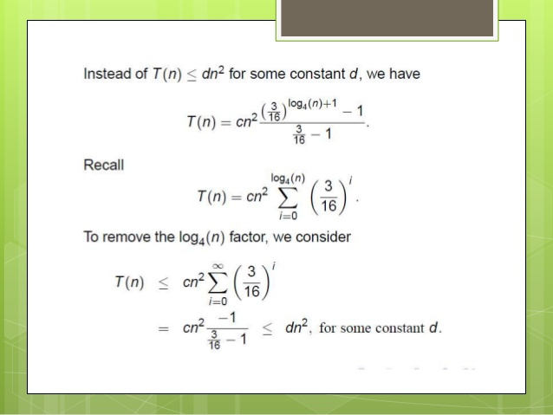

Slide 35
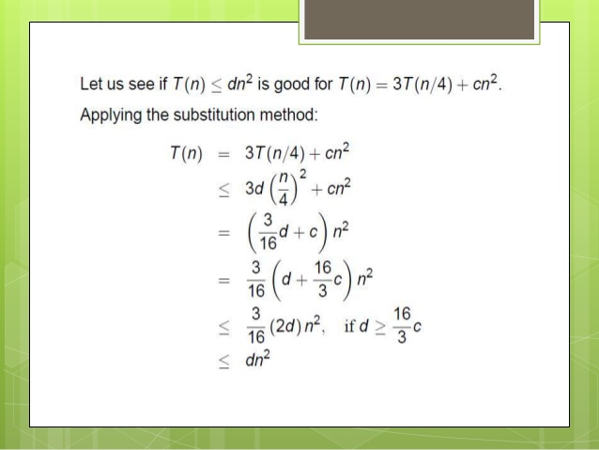

Slide 36
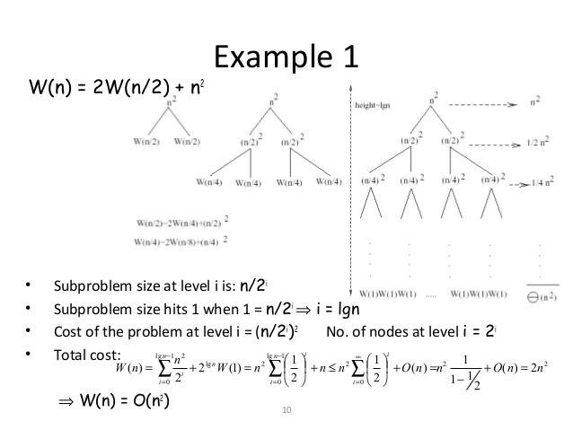

Slide 37
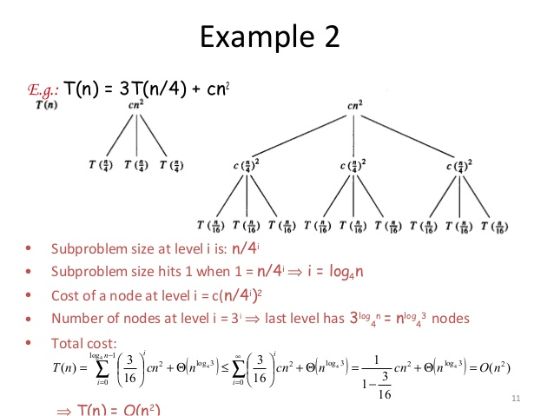

Slide 38
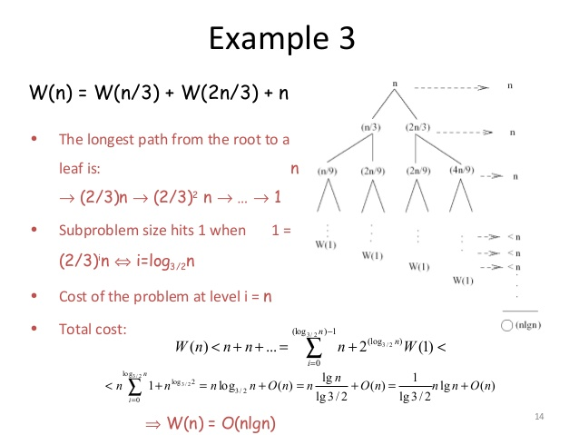

Slide 39
Ques. Use a recursion tree to determine a good asymptotic upper bound on the recurrence
T(n)=3T(⌊n/2⌋)+n.
Solution: The subproblem size for a node at depth I n/2^{i}.
Thus, the tree has lgn+1 levels and 3 ^{lgn} =n^{lg3} leaves.
The total cost over all nodes at depth i, for i = 0, 1, 2, …,lgn−1, is n3^{i}(n/2^{i})=(3/2)^{i}n.
T(n)​=n+3/2​n+(3/2​)²n+⋯+(3/2​)^{lgn−1}n+Θ(n^{lg3})
lgn−1
= ∑ ​(3/2​)^{i}n+Θ(n^{lg3})
i=0
(3/2)^{lgn}​-1
= ------------- n +Θ(n^{lg3})
(3/2)-1
=2[(3/2)^{lgn}−1]n+Θ(n^{lg3})
=2[n^{lg(3/2)}−1]n+Θ(n^{lg3})
=2[n^{lg3−lg2}−1]n+Θ(n^{lg3})
=2[n^{lg3−1+1}−n]+Θ(n^{lg3})
=O(n^{lg3} ).​

Slide 40
Ques. Use a recursion tree to determine a good asymptotic upper bound on the recurrence
T(n)=4T(n/2+2)+n.
Solution. The subproblem size for a node at depth i is n/2^{i}.
Thus, the tree has lgn+1 levels and 4^{lgn}=n² leaves.
The total cost over all nodes at depth i for i = 0, 1, 2, ,…,lgn−1, is 4^{i}(n/2^{i}+2)=2^{i}n+2⋅4^{i}.
lgn−1
T(n)​= ∑​ (2^{i}n+2⋅4^{i})+Θ(n²)
i=0
lgn−1 lgn−1
=∑​ 2^{i}n+ ∑​ 2⋅4^{i}+Θ(n²)
i=0 i=0
= 2^{lgn}−1​ n +2 4^{lgn}−1 ​+Θ(n²)
2−1 4−1
=(2^{lgn}−1)n+3/2​(4^{lgn}−1)+Θ(n²)
=(n−1)n+2/3​(n²−1)+Θ(n²)
​ = Θ(n²)

Slide 41
Ques. Use a recursion tree to determine a good asymptotic upper bound on the recurrence
T(n)=2T(n−1)+1.
Solution. The subproblem size for a node at depth i is n - i.
Thus, the tree has n levels and 2^{n−1} leaves.
The total cost over all nodes at depth i, for i = 0, 1, 2 ,…,n−1, is 2^{i}.
n−1
T(n)​= ∑​ 2^{i}
i=0
2^{n}−1
=
2−1
​ =2^{n}−1
=Θ(2^{n}).​

Slide 42
Ques. Use a recursion tree to give an asymptotically tight solution to the recurrence
T(n)=T(αn)+T((1−α)n)+cn, where α is a constant in the range 0 < α<1, and c > 0 is also a constant.
Solution. We can assume that 0 < α≤1/2, since otherwise we can let β=1−α and solve it for β.
Thus, the depth of the tree is nlog _{1/α}​ n and each level costs cn. And let's guess that the leaves are Θ(n),
log _{1/α} n
T(n)​ =∑ ​ ​cn+Θ(n)
i=0
=cnlog _{1/α} n+Θ(n)
=Θ(nlgn).​

Slide 43
QUESTIONS
QUES 1. T(n)=T(9n/10)+n
QUES 2. T(n) = T(άn) + T(1-ά) +n

