Slide 1
Algorithm Analysis
and Design
ETCS-301
Dr. Deepak Gupta
Computer Science & Engineering
Maharaja Agrasen Institute of Technology, Delhi (GSIPU)
Email: drdeepakgupta.cse@gmail.com, deepakgupta@mait.ac.in

Slide 2
Solving Recurrences using Recursion Tree Method
Here while solving recurrences, we divide the problem into
subproblems of equal size.
For e.g., T(n) = a T(n/b) + f(n) where a > 1 ,b > 1 and f(n) is a given
function .
F(n) is the cost of splitting or combining the sub problems.
n
T n/b
T n/b

Slide 3
1) T(n) = 2T(n/2) + n
The recursion tree for this recurrence is :
n
n/2 n/2 n
log₂ n
:
:
:
n
T n/2
T n/2
n/2²
n/2²
n/2²
n/2²
1
1
1
1
1
1
1

Slide 4
When we add the values across the levels of the recursion tree, we get a value of n for every level.
We have n + n + n + …… log n times
= n (1 + 1 + 1 + …… log n times)
= n (log₂ n)
= Ɵ (n log n)
T(n) = Ɵ (n log n)

Slide 5
II.
Given : T(n) = 2T(n/2) + 1
Solution : The recursion tree for the above recurrence is
1 1 2
log n 4
1
:
:
:

Slide 6
Now we add up the costs over all levels of the recursion tree, to determine the cost for the entire tree :
We get series like
1 + 2 + 2² + 2³ + …… log n times which is a G.P.
[ So, using the formula for sum of terms in a G.P. :
a + ar + ar² + ar³ + …… + ar ^{n – 1} = a( r ^{n} – 1 )
r – 1 ]
= 1 (2^{log} ^{n} – 1)
2 – 1
= n – 1
= Ɵ (n – 1) (neglecting the lower order terms)
= Ɵ (n)

Slide 7
III.
Given : T(n) = T(n/3) + T(2n/3) + n
Solution : The recursion tree for the above recurrence is
n
n/3 2n/3 n
log₃ n log_{3/2} n
n
1 n/3^{i}
:
:
:
n
n/3
2n/3
n
3²
2 n
3 3
1 2n
3 3
n .
(3/2)²

Slide 8
When we add the values across the levels of the recursion tree , we get a value of n for every level.
Since the shortest path from the root to the leaf is
n → n → n → n → …. 1
3 3² 3³
we have 1 when n = 1
3^{i}
=> n = 3^{i}
Taking log₃ on both the sides
=> log₃ n = i
Thus the height of the shorter tree is log₃ n
T(n) > n log₃ n … A

Slide 9
Similarly, the longest path from root to the leaf is
n → 2 n → 2 ² n → … 1
3 3
So rightmost will be the longest
when 2 ^{k} n = 1
3
or n = 1
(3/2)^{k}
=> k = log_{3/2} n
T(n) < n log_{3/2} n … B
Since base does not matter in asymptotic notation , we guess
from A and B
T(n) = Ɵ (n log₂ n)

Slide 10
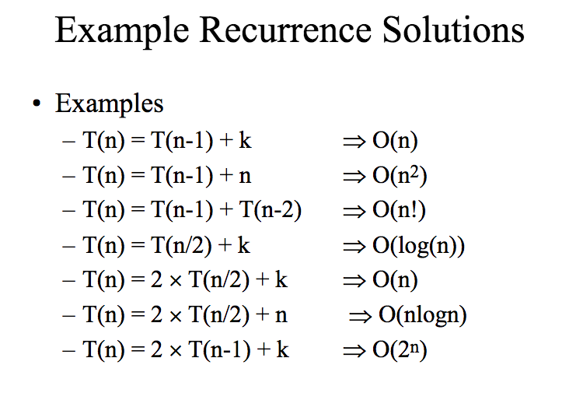

Slide 11
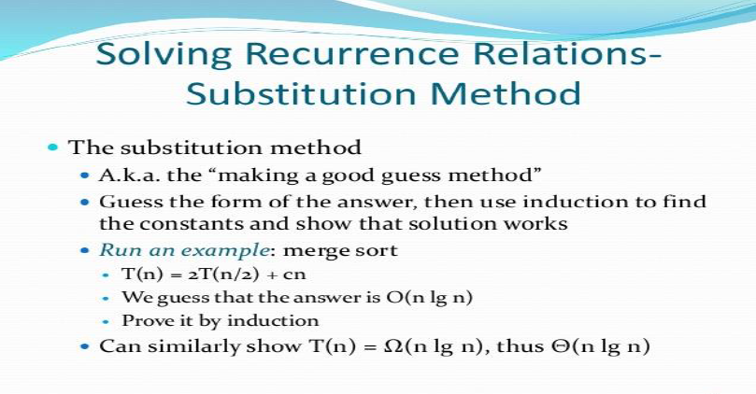

Slide 12
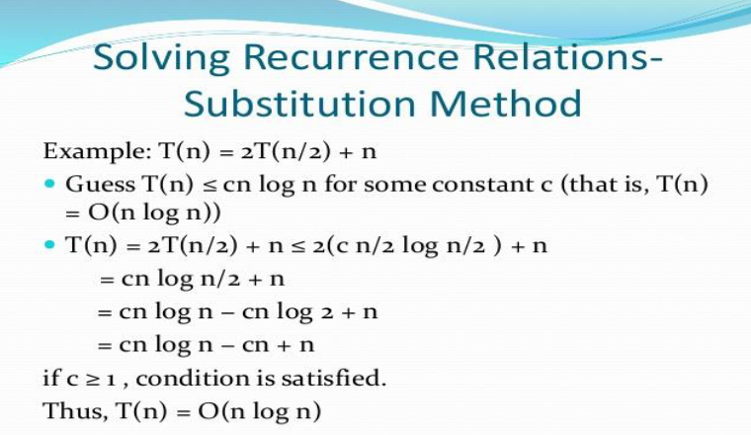

Slide 13
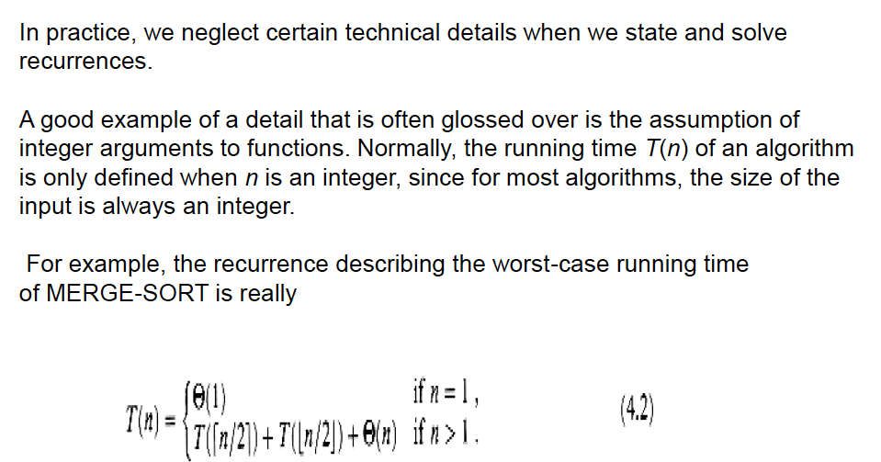

Slide 14
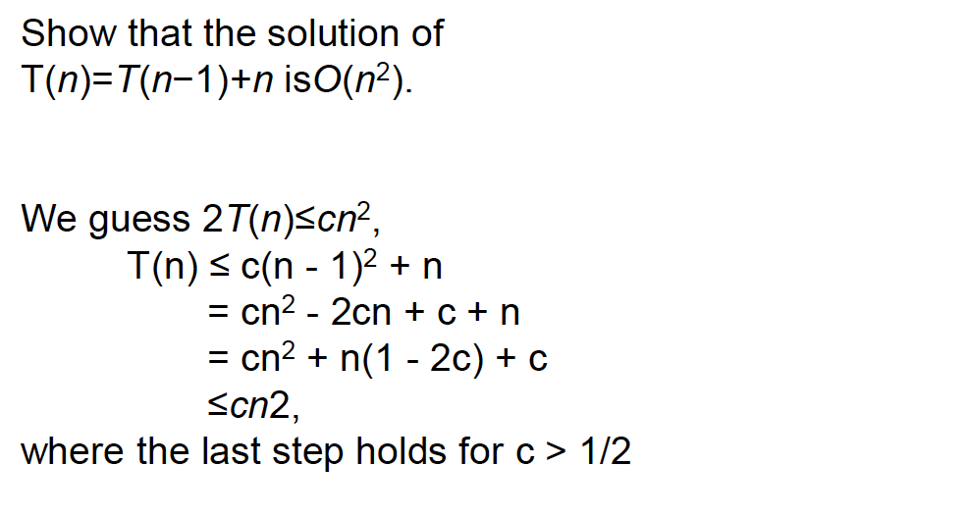

Slide 15
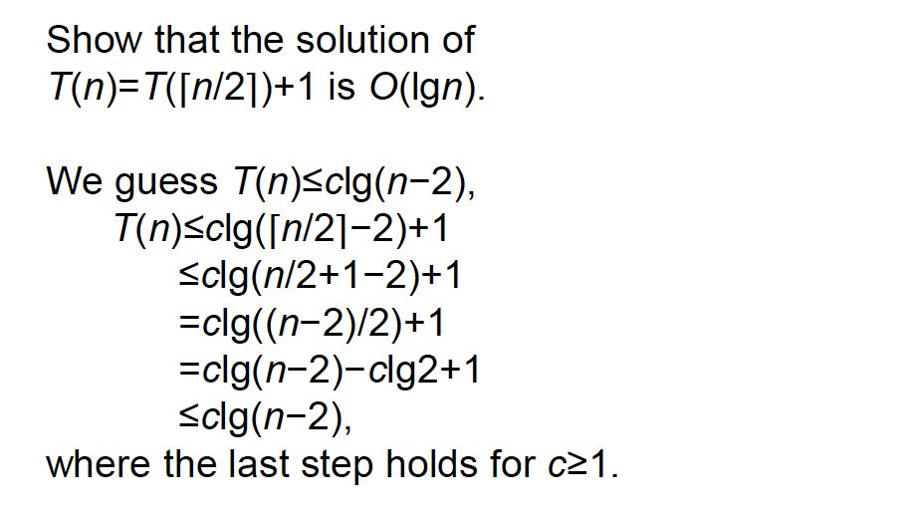

Slide 16
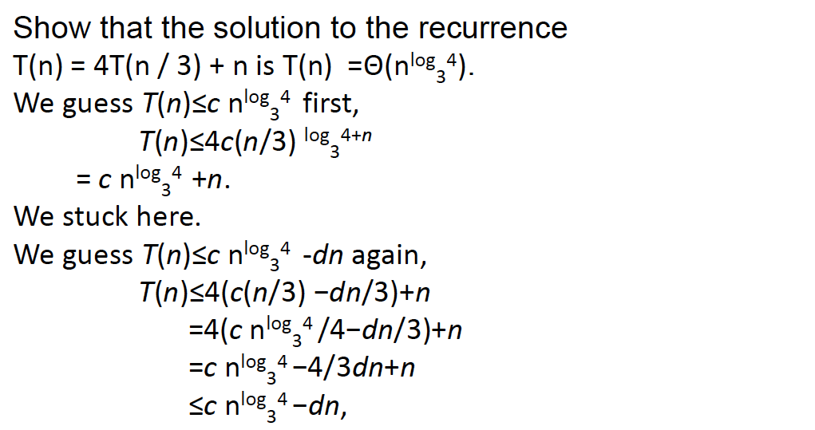

Slide 17
