Slide 1
Algorithm Analysis
and Design
ETCS-301
Dr. Deepak Gupta
Computer Science & Engineering
Maharaja Agrasen Institute of Technology, Delhi (GSIPU)
Email: drdeepakgupta.cse@gmail.com, deepakgupta@mait.ac.in

Slide 2
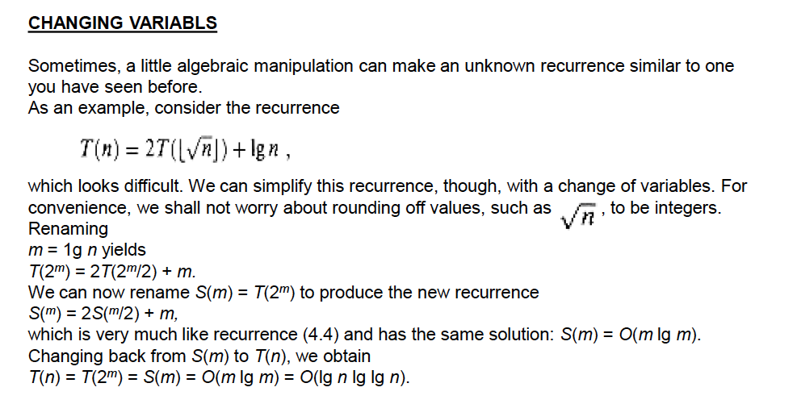

Slide 3
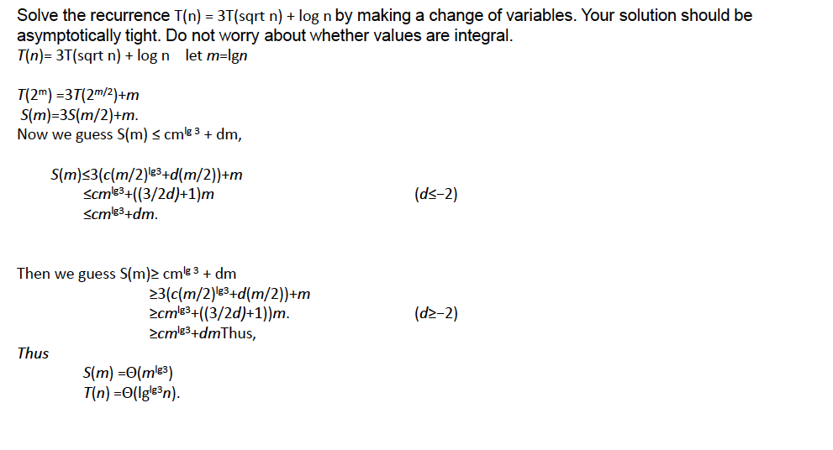

Slide 4
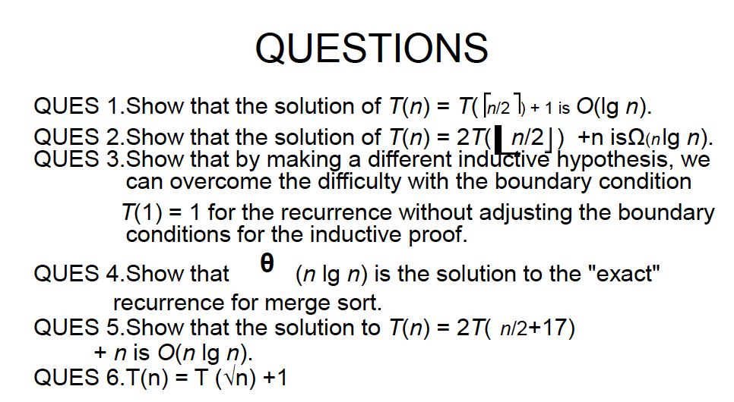

Slide 5
The Master Theorem
Given: a divide and conquer algorithm
  An algorithm that divides the problem of size n into a subproblems, each of size n/b
  Let the cost of each stage (i.e., the work to divide the problem + combine solved subproblems) be described by the function f(n)
Then, the Master Theorem gives us a cookbook for the algorithm’s running time:

Slide 6
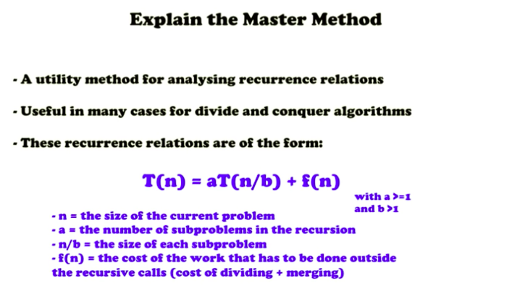

Slide 7
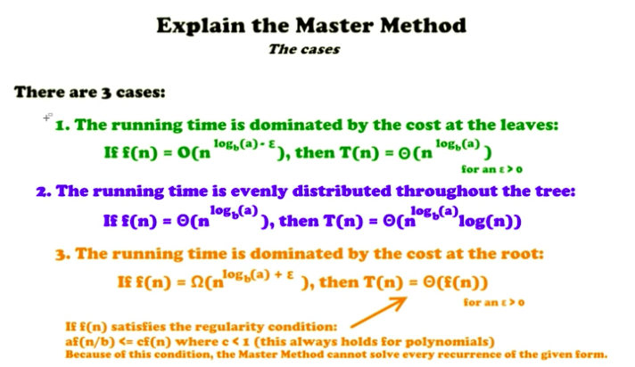

Slide 8
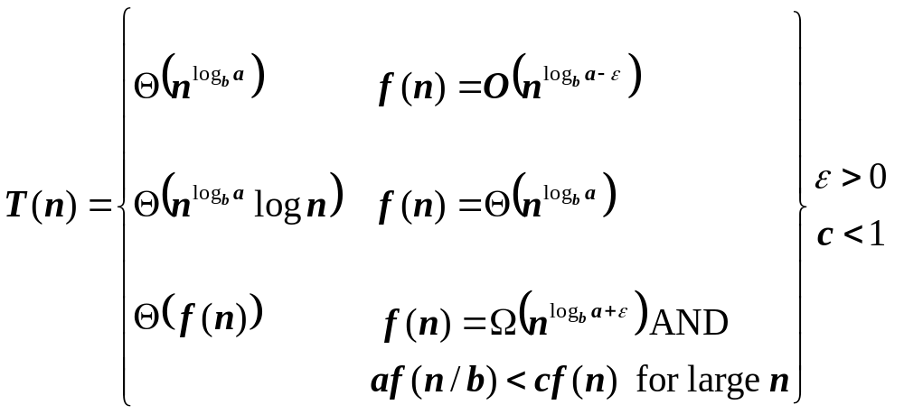
The Master Theorem
if T(n) = aT(n/b) + f(n) then

Slide 9
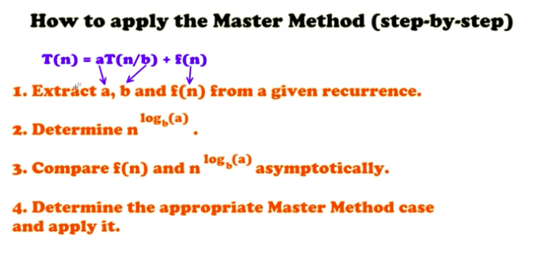

Slide 10
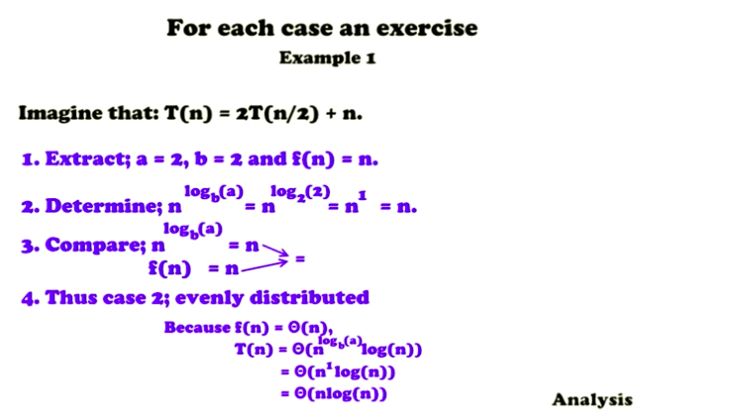

Slide 11
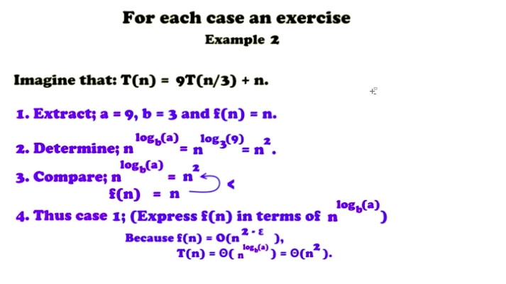

Slide 12
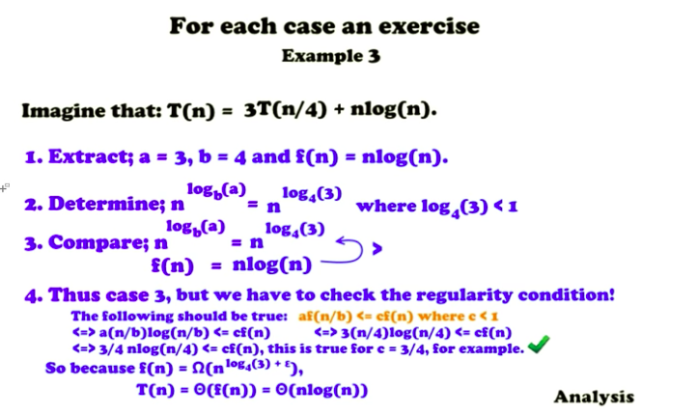

Slide 13
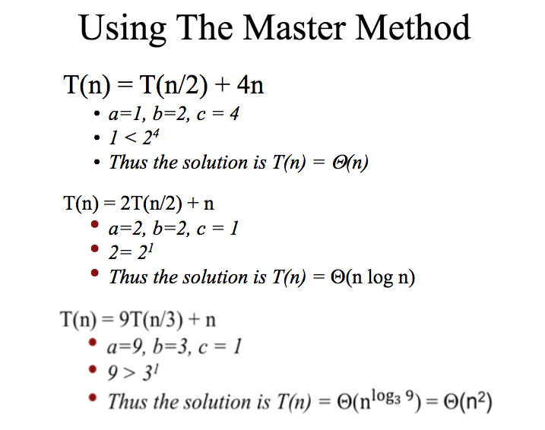

Slide 14
More Examples of Master’s Theorem
T(n) = 3T(n/5) + n
T(n) = 2T(n/2) + n
T(n) = 2T(n/2) + 1
T(n) = T(n/2) + n
T(n) = T(n/2) + 1

Slide 15
When Master’s Theorem cannot be applied
T(n) = 2T(n/2) + n/ logn

Slide 16
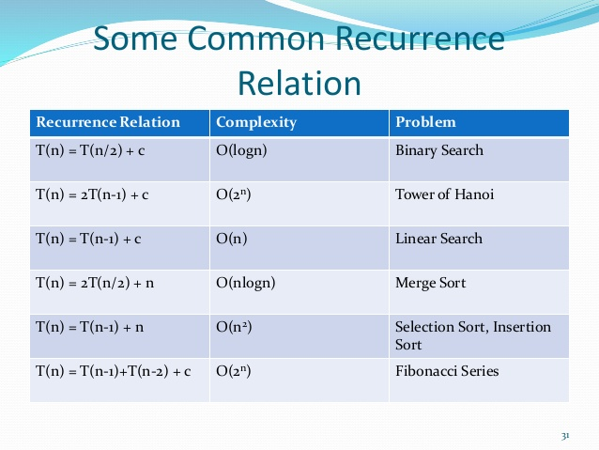

Slide 17
QUESTIONS
Solve the following recurrence relations:
a) T(n) = 3T(n/2) + n ²
b) T(n) = 16T(n/4) + n
c) T(n) = 2T(n/4) + n ^{0.51}
d) T(n) = 3T(n/4) + n log n
e) T(n) = 4T(n/2) + n / log n
f) T(n) = 7 T(n/3) + n ²

