Slide 1
Algorithm Analysis
and Design
ETCS-301
Dr. Deepak Gupta
Computer Science & Engineering
Maharaja Agrasen Institute of Technology, Delhi (GSIPU)
Email: drdeepakgupta.cse@gmail.com, deepakgupta@mait.ac.in

Slide 2
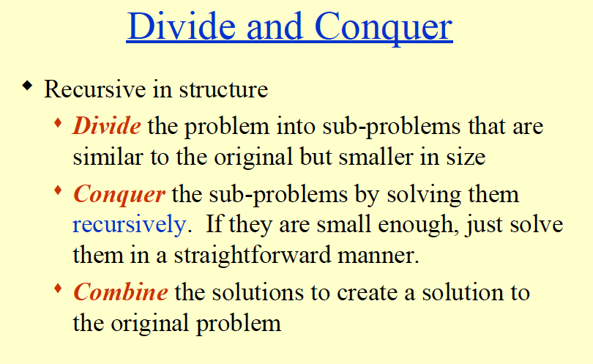

Slide 3
Divide-and-Conquer Technique (cont.)
a problem of size n
(instance)
subproblem 1
of size n/2
subproblem 2
of size n/2
a solution to
subproblem 1
a solution to
subproblem 2
a solution to
the original problem
It general leads to a recursive algorithm!

Slide 4
Divide and Conquer (contd.)
In “politics” divide and rule (latin: divide et impera) is a combination of political, military, and economic strategy of gaining and maintaining power by breaking up larger concentrations of power into chunks that individually have less power than the one who is implementing the strategy. (read more on wiki: “Divide and rule”)

Slide 5


Divide and Conquer (contd.)
Let us add n numbers using divide and conquer technique
a₀ + a₁ + …… + a_{n-1}
Is it more efficient than brute force ?
Let’s see with an example

Slide 6
Div. & Conq. (add n numbers)
0 | 1 | 2 | 3 | 4 | 5 | 6 | 7 | 8 | 9
2 | 10 | 3 | 5 | 7 | 1 | 6 | 10 | 1 | 3
0 | 1 | 2 | 3 | 4
0 | 1 | 2 | 3 | 4
2 | 10 | 3 | 5 | 7
1 | 6 | 10 | 1 | 3
# of additions
is same as in
brute force,
needs stack
for recursion…
2 | 10
3 | 5 | 7
1 | 6
10 | 1 | 3
12
3
5 | 7
7
10
1 | 3
Bad!
not all divide
and conquer
works!!
12
4
15
14
27
21
Could be efficient
for parallel processors though….
48

Slide 7
Div. & Conq. (contd.)
Usually in div. & conq., a problem instance of size n is divided into two instances of size n/2
More generally, an instance of size n can be divided into b instances of size n/b, with a of them needing to be solved
Assuming that n is a power of b (n = b^{m}), we get
  T(n) = aT(n/b) + f(n)
  Here, f(n) accounts for the time spent in dividing an instance of size n into subproblems of size n/b and combining their solution
  For adding n numbers, a = b = 2 and f(n) = 1
general divide-and-conquer
recurrence

Slide 8
Divide-and-Conquer Examples
Sorting: mergesort and quicksort
Matrix multiplication: Strassen’s algorithm
Binary tree traversals
Binary search
Multiplication of large integers
Closest-pair and convex-hull algorithms

Slide 9
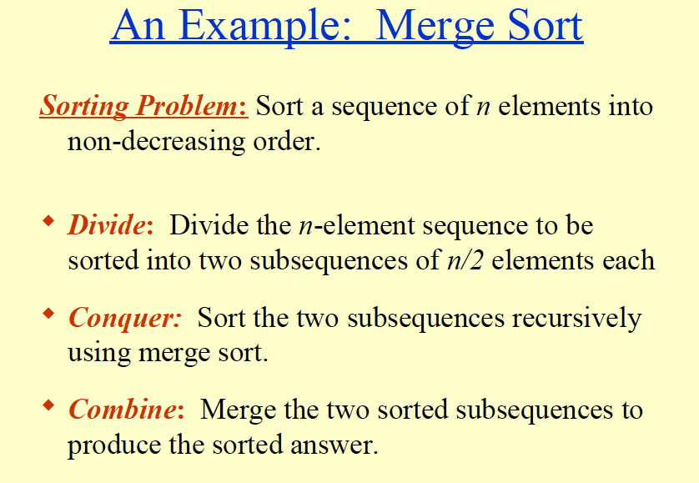

Slide 10
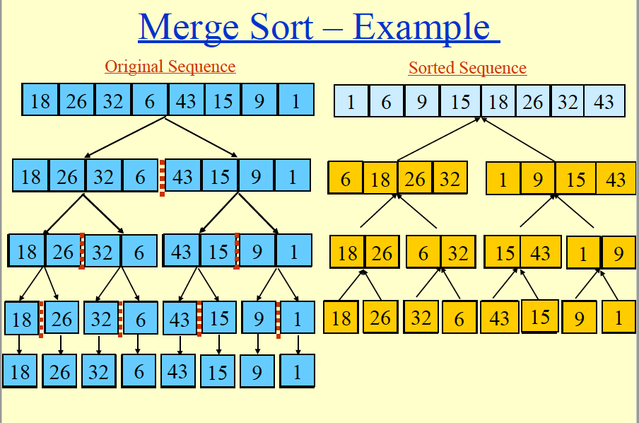

Slide 11
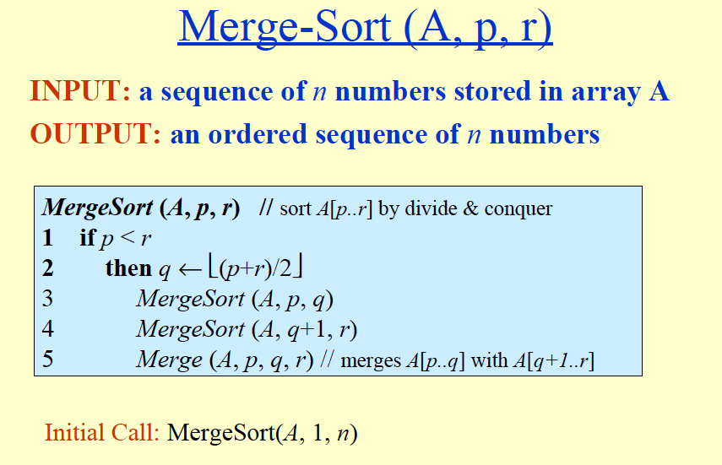

Slide 12
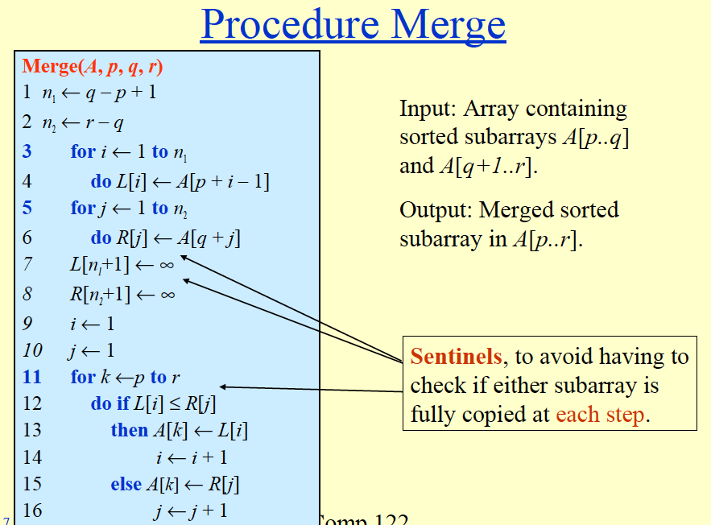

Slide 13
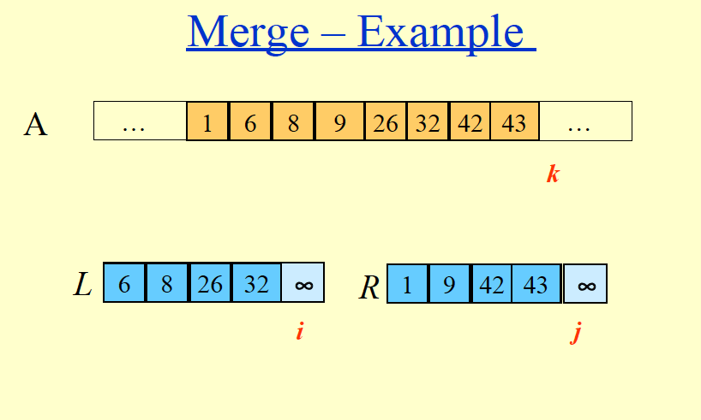

Slide 14
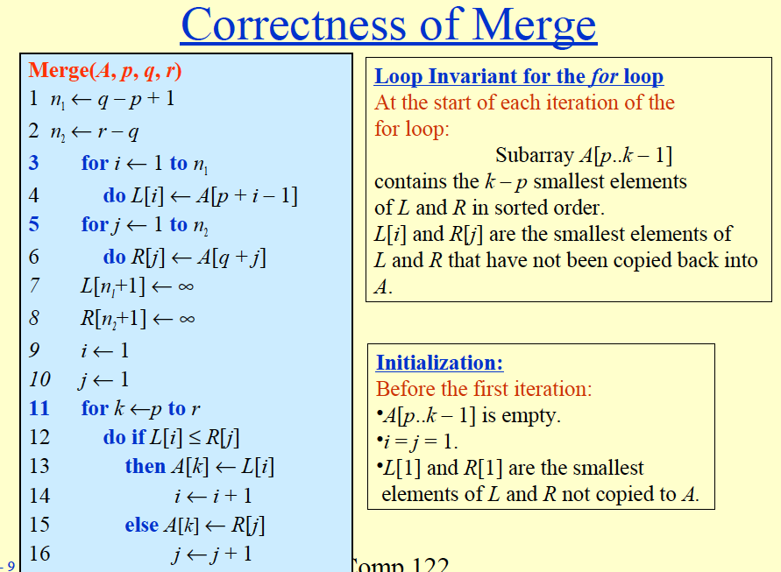

Slide 15
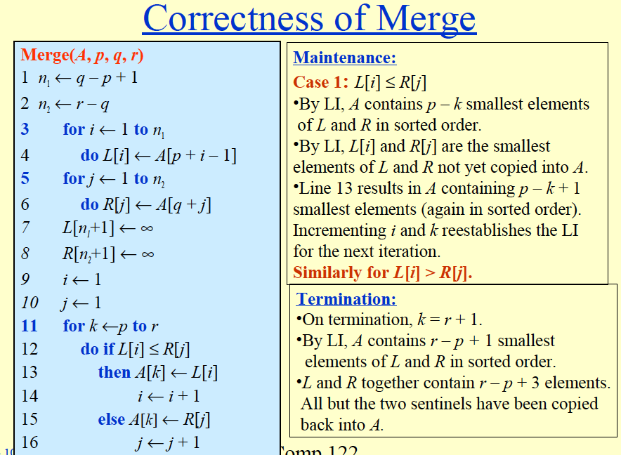

Slide 16
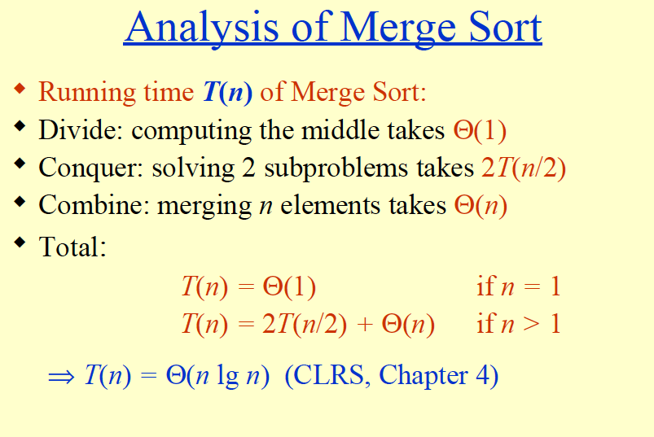

Slide 17
