Slide 1
Algorithm Analysis
and Design
ETCS-301
Dr. Deepak Gupta
Computer Science & Engineering
Maharaja Agrasen Institute of Technology, Delhi (GSIPU)
Email: drdeepakgupta.cse@gmail.com, deepakgupta@mait.ac.in

Slide 2
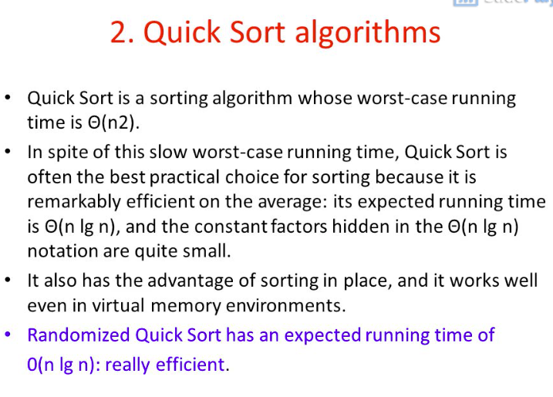

Slide 3
Quicksort (contd.)
A[0]…A[n-1]
A[0]…A[s-1] A[s] A[s+1]…A[n-1]
all are ≤ A[s]
all are ≥ A[s]
Notice:
In Mergesort
all work is in
combining the
partial solutions.
In Quicksort all
work is in dividing
the problem,
Combining does not require any work!
A[s] is in it’s
final position
Now continue working with
these two parts

Slide 4
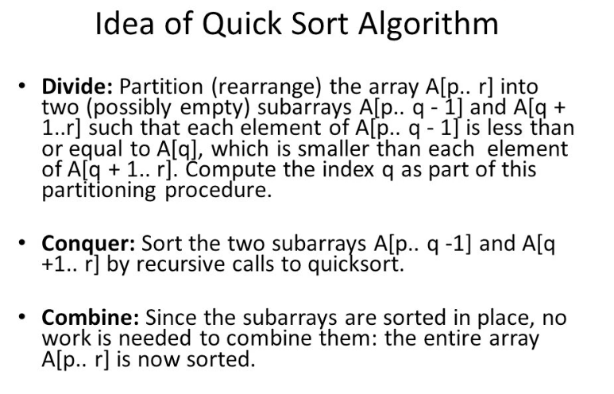

Slide 5
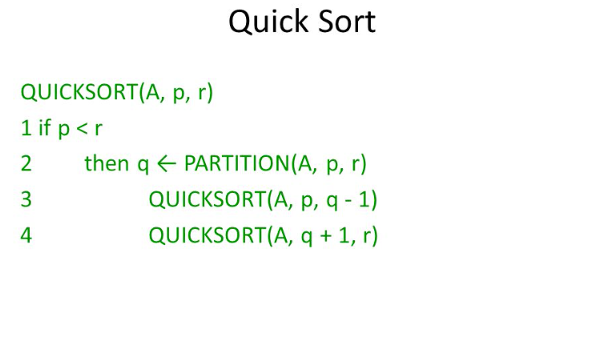

Slide 6
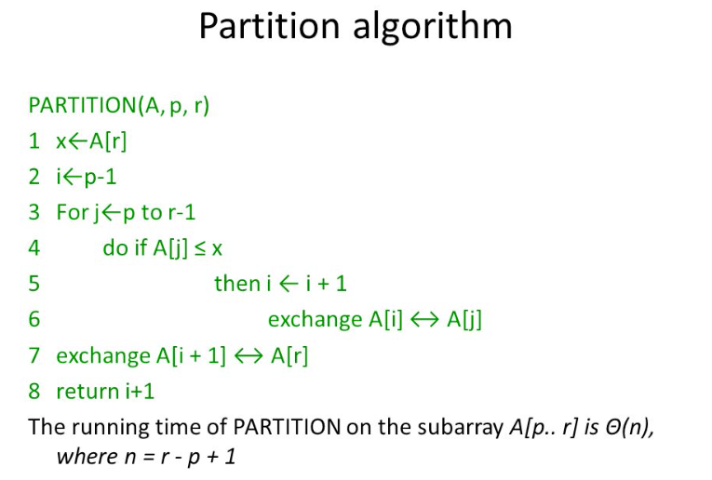

Slide 7
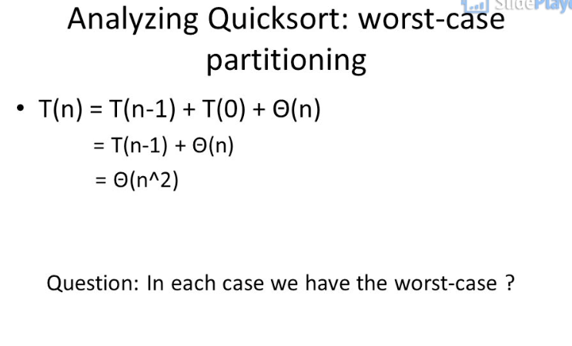

Slide 8
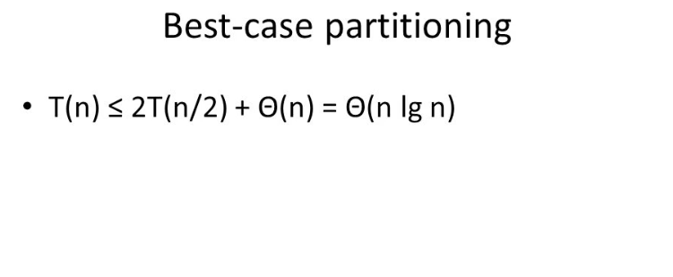

Slide 9
