Slide 1
Algorithm Analysis
and Design
ETCS-301
Dr. Deepak Gupta
Computer Science & Engineering
Maharaja Agrasen Institute of Technology, Delhi (GSIPU)
Email: drdeepakgupta.cse@gmail.com, deepakgupta@mait.ac.in

Slide 2
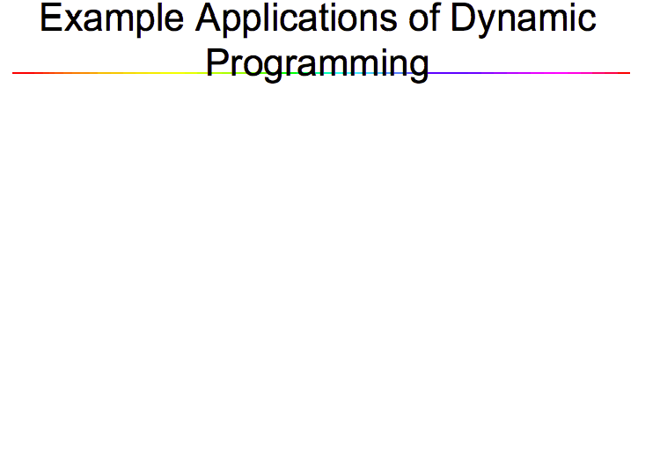

Slide 3
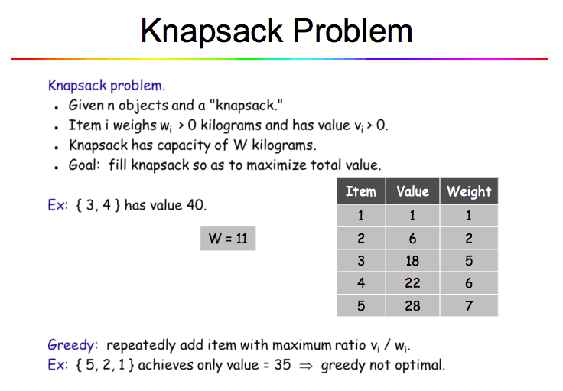

Slide 4
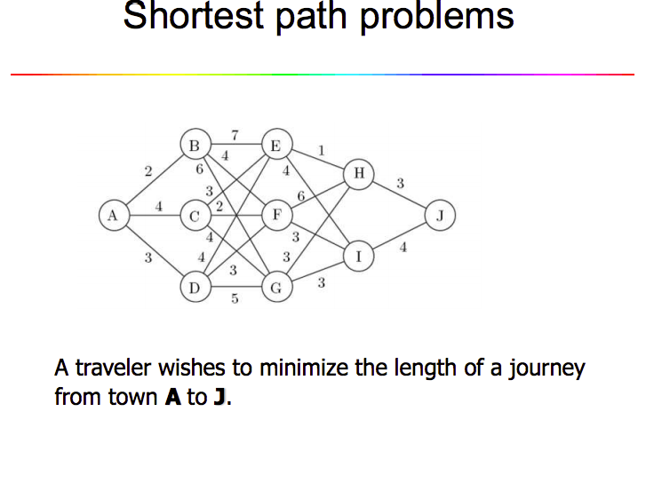

Slide 5
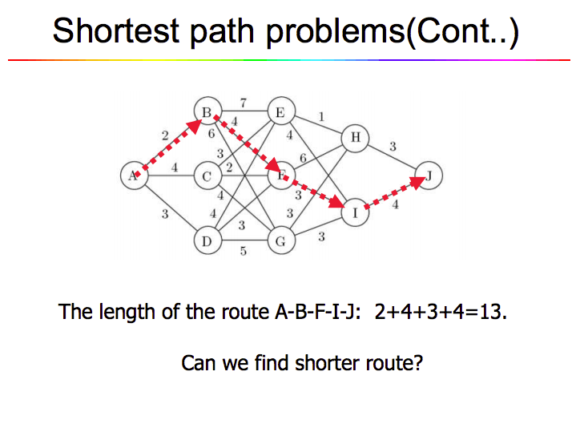

Slide 6
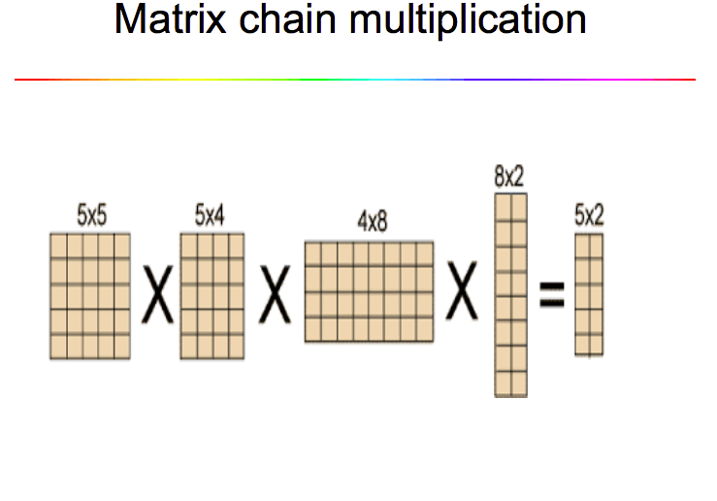

Slide 7
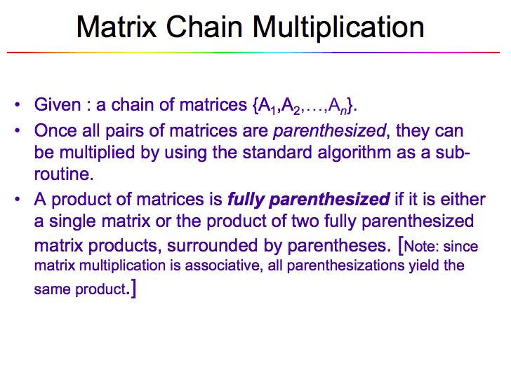

Slide 8
MATRIX-MULTIPLY(A, B)
if columns[A] ≠ rows[B]
then error “incompatible dimensions”
else for i ← 1 to rows[A]
do for j ← 1 to columns[B]
do C[i, j] = 0
for k ← 1 to columns[A]
do C[i, j] ← C[i, j] + A[i, k] B[k, j]
rows[A] ⋅cols[A] ⋅cols[B]
multiplications
k
j
cols[B]
j
cols[B]
i
*
=
i
k
A
B
C
rows[A]
rows[A]

Slide 9
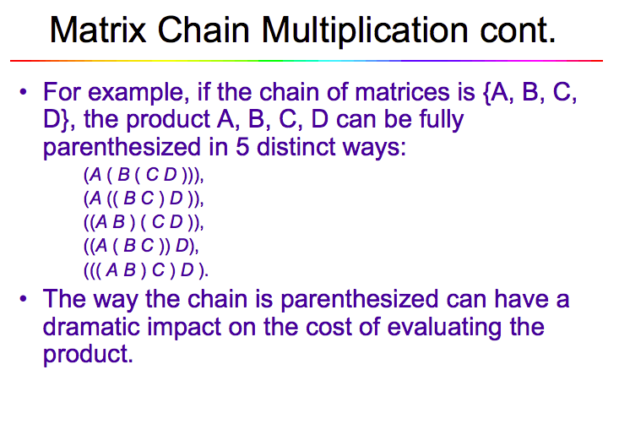

Slide 10
Example
A₁ ⋅ A₂ ⋅ A₃
A₁: 10 x 100
A₂: 100 x 5
A₃: 5 x 50
1. ((A₁ ⋅ A₂) ⋅ A₃): A₁ ⋅ A₂ = 10 x 100 x 5 = 5,000 (10 x 5)
((A₁ ⋅ A₂) ⋅ A₃) = 10 x 5 x 50 = 2,500
Total: 7,500 scalar multiplications
2. (A₁ ⋅ (A₂ ⋅ A₃)): A₂ ⋅ A₃ = 100 x 5 x 50 = 25,000 (100 x 50)
(A₁ ⋅ (A₂ ⋅ A₃)) = 10 x 100 x 50 = 50,000
Total: 75,000 scalar multiplications
one order of magnitude difference!!

Slide 11
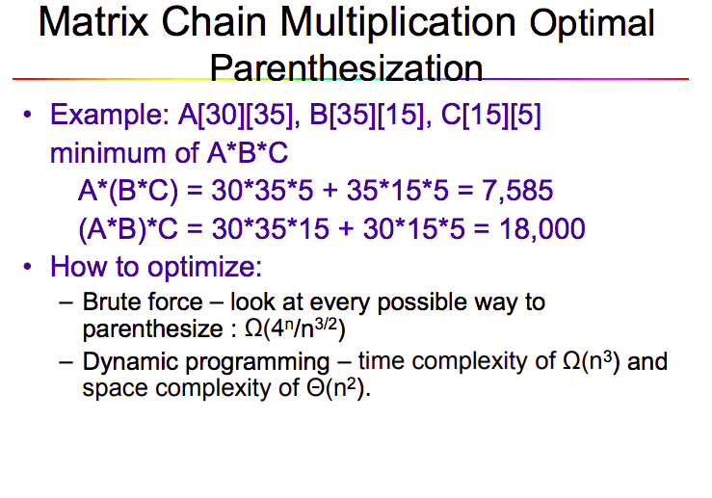

Slide 12
Matrix-Chain Multiplication:
Problem Statement
Given a chain of matrices ⟨A₁, A₂, …, A_{n}⟩, where A_{i} has dimensions p_{i-1}x p_{i}, fully parenthesize the product A₁ ⋅ A₂ ⋅⋅⋅ A_{n} in a way that minimizes the number of scalar multiplications.
A₁ ⋅ A₂ ⋅⋅⋅ A_{i} ⋅ A_{i+1} ⋅⋅⋅ A_{n}
p₀ x p₁ p₁ x p₂ p_{i-1} x p_{i} p_{i} x p_{i+1} p_{n-1} x p_{n}

