Slide 1
Algorithm Analysis
and Design
ETCS-301
Dr. Deepak Gupta
Computer Science & Engineering
Maharaja Agrasen Institute of Technology, Delhi (GSIPU)
Email: drdeepakgupta.cse@gmail.com, deepakgupta@mait.ac.in

Slide 2
Longest Common Subsequence
Given two sequences
X = ⟨x₁, x₂, …, x_{m}⟩
Y = ⟨y₁, y₂, …, y_{n}⟩
find a maximum length common subsequence (LCS) of X and Y
E.g.:
X = ⟨A, B, C, B, D, A, B⟩
Subsequences of X:
  A subset of elements in the sequence taken in order
⟨A, B, D⟩, ⟨B, C, D, B⟩, etc.

Slide 3
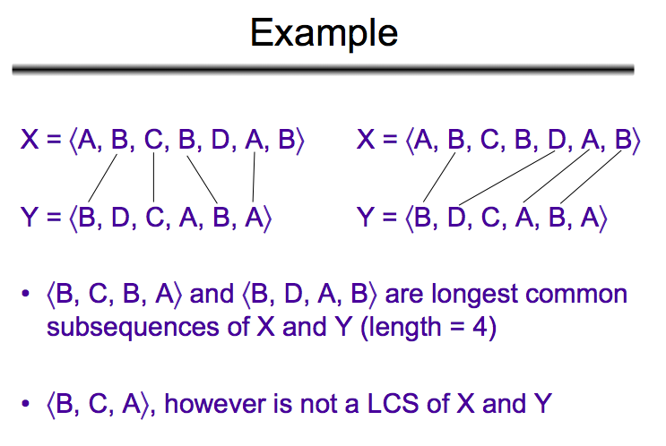

Slide 4
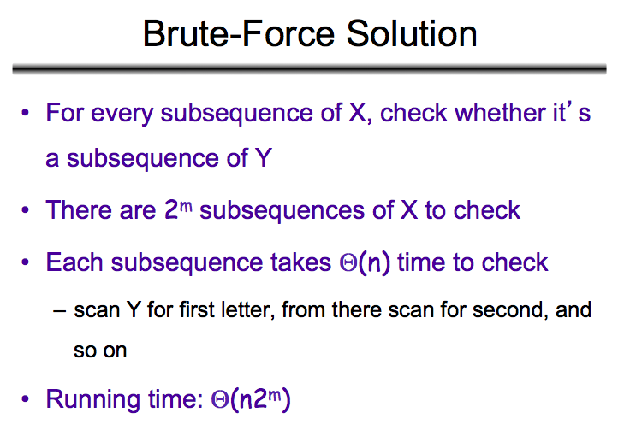

Slide 5
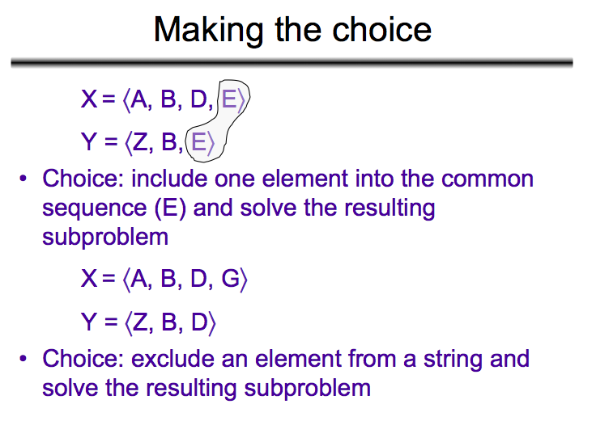

Slide 6
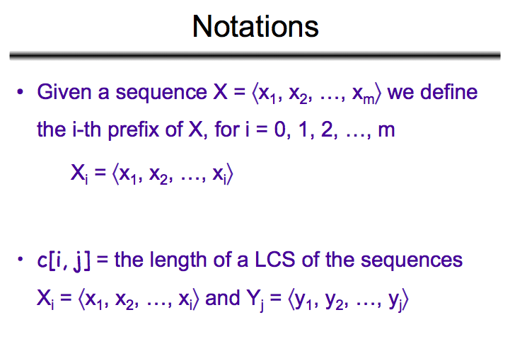

Slide 7
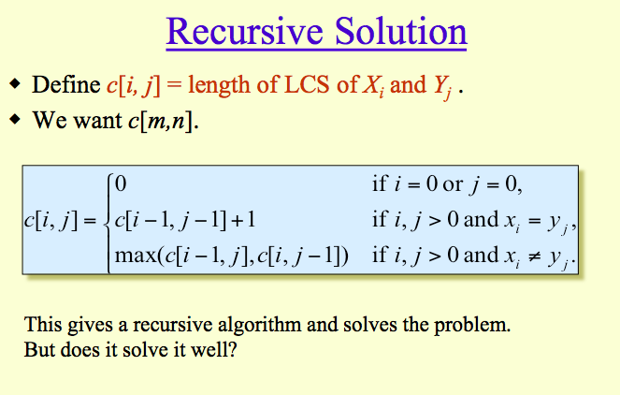

Slide 8
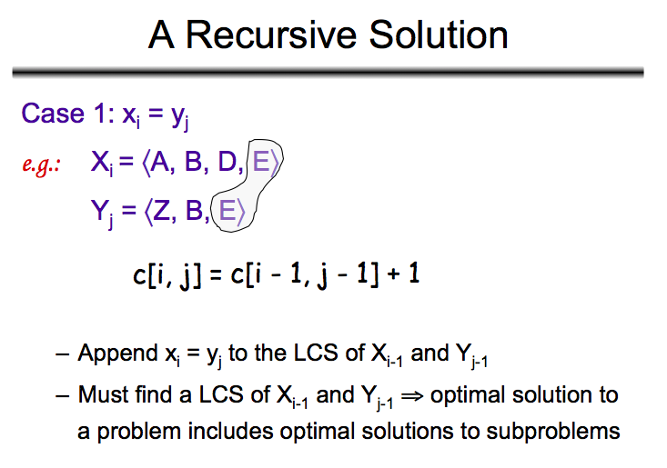

Slide 9
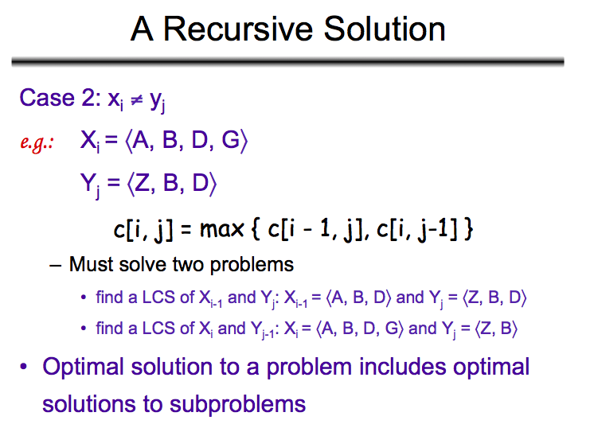

Slide 10
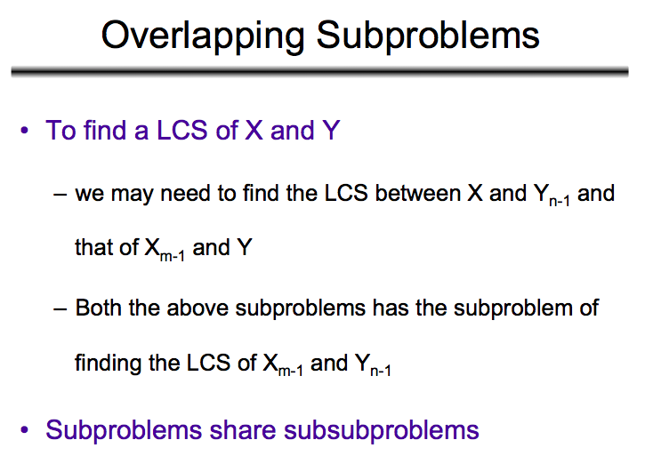

Slide 11
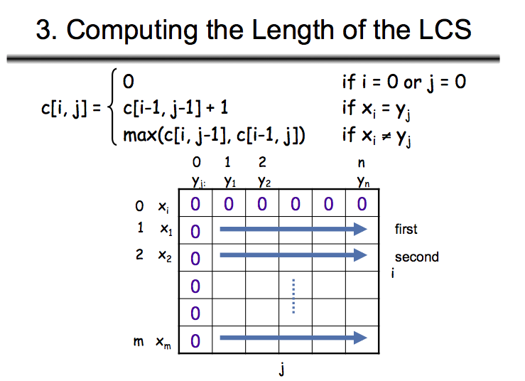

Slide 12
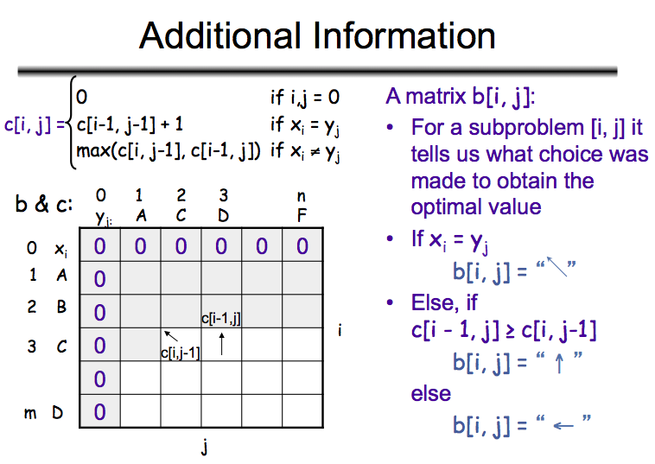

Slide 13
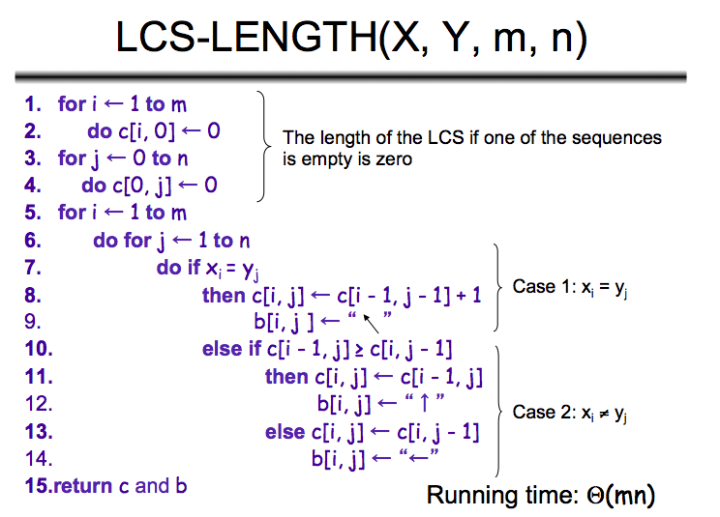

Slide 14
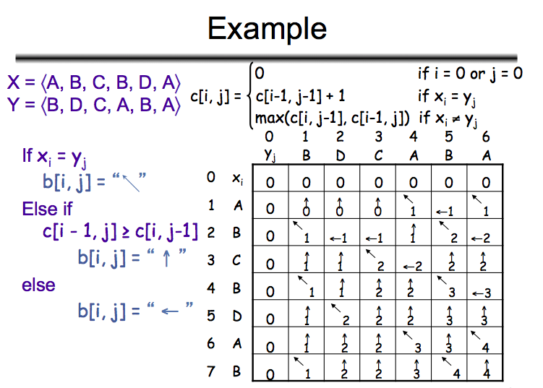

Slide 15
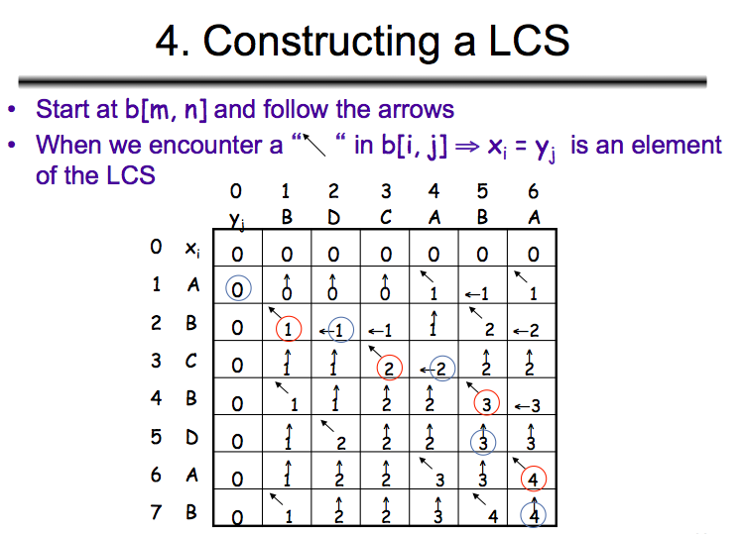

Slide 16
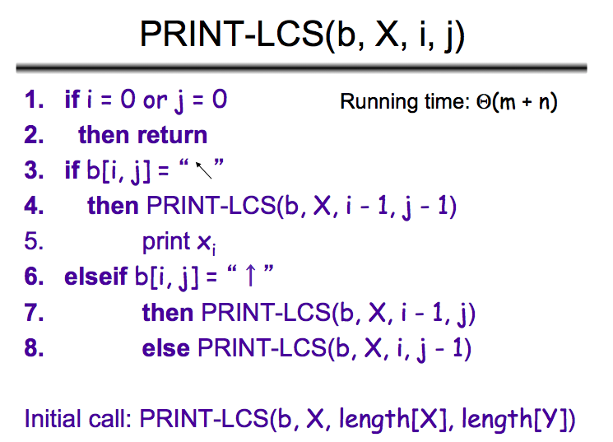

Slide 17
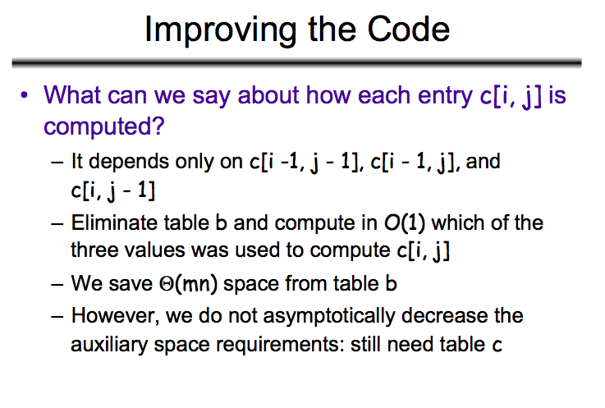

Slide 18
