Slide 1
Algorithm Analysis
and Design
ETCS-301
Dr. Deepak Gupta
Computer Science & Engineering
Maharaja Agrasen Institute of Technology, Delhi (GGSIPU)
Email: drdeepakgupta.cse@gmail.com, deepakgupta@mait.ac.in

Slide 2
OBST (Optimal Binary Search Tree)
OBST is one special kind of advanced tree.
It focus on how to reduce the cost of the search of the BST.
It may not have the lowest height !
It needs 3 tables to record probabilities, cost, and root.

Slide 3
Problem
It has n keys (representation k₁,k₂,…,k_{n}) in sorted order (so that k₁<k₂<…<k_{n}), and we wish to build a binary search tree from these keys. For each k_{i} ,we have a probability p_{i} that a search will be for k_{i}.
In contrast of, some searches may be for values not in k_{i}, and so we also have n+1 “dummy keys” d₀,d₁,…,d_{n} representating not in k_{i}.
In particular, d₀ represents all values less than k₁, and d_{n} represents all values greater than k_{n}, and for i=1,2,…,n-1, the dummy key d_{i} represents all values between k_{i} and k_{i+1}.
＊The dummy keys are leaves (external nodes), and the data keys mean internal nodes.

Slide 4
Formula & Prove
The case of search are two situations, one is success, and the other, without saying, is failure.
We can get the first statement :
(i=1~n) ∑ p_{i} + (i=0~n) ∑ q_{i} = 1
Success
Failure

Slide 5
Because we have probabilities of searches for each key and each dummy key, we can determine the expected cost of a search in a given binary search tree T. Let us assume that the actual cost of a search is the number of nodes examined, i.e., the depth of the node found by the search in T,plus1. Then the expected cost of a search in T is : (The second statement)
E[ search cost in T]
= (i=1~n) ∑ p_{i} ．(depth_{T}(k_{i})+1)
+ (i=0~n) ∑ q_{i} ．(depth_{T}(d_{i})+1)
=1 + (i=1~n) ∑ p_{i} ．depth_{T}(k_{i})
+ (i=0~n) ∑ q_{i} ．depth_{T}(d_{i})
Where depth_{T} denotes a node’s depth in the tree T.

Slide 6
k2
k2
k1
k4
k1
k5
d0
d1
d0
d1
k4
d5
k3
k5
d2
d3
d4
d5
d4
k3
Figure (a)
i | 0 | 1 | 2 | 3 | 4 | 5
pi |  | 0.15 | 0.10 | 0.05 | 0.10 | 0.20
qi | 0.05 | 0.10 | 0.05 | 0.05 | 0.05 | 0.10
d2
d3
Figure (b)

Slide 7
By Figure (a), we can calculate the expected search cost node by node:
Node# | Depth | probability | cost
k1 | 1 | 0.15 | 0.30
k2 | 0 | 0.10 | 0.10
k3 | 2 | 0.05 | 0.15
k4 | 1 | 0.10 | 0.20
K5 | 2 | 0.20 | 0.60
d0 | 2 | 0.05 | 0.15
d1 | 3 | 0.10 | 0.30
d2 | 3 | 0.05 | 0.20
d3 | 3 | 0.05 | 0.20
d4 | 3 | 0.05 | 0.20
d5 | 3 | 0.10 | 0.40
Cost=
Probability * (Depth+1)

Slide 8
And the total cost = (0.30 + 0.10 + 0.15 + 0.20 + 0.60 + 0.15 + 0.30 + 0.20 + 0.20 + 0.20 + 0.40 ) = 2.80
So Figure (a) costs 2.80 ,on another, the Figure (b) costs 2.75, and that tree is really optimal.
We can see the height of (b) is more than (a) , and the key k5 has the greatest search probability of any key, yet the root of the OBST shown is k2.(The lowest expected cost of any BST with k5 at the root is 2.85)

Slide 9
Example
Consider 5 keys with these search probabilities:
p₁ = 0.25, p₂ = 0.2, p₃ = 0.05, p₄ = 0.2, p₅ = 0.3.
k₂
i depth_{T}(k_{i}) depth_{T}(k_{i})·p_{i}
1 1 0.25
2 0 0
3 2 0.1
4 1 0.2
5 2 0.6
1.15
k₁
k₄
k₃
k₅
Therefore, E[search cost] = 2.15.

Slide 10
Example
p₁ = 0.25, p₂ = 0.2, p₃ = 0.05, p₄ = 0.2, p₅ = 0.3.
k₂
i depth_{T}(k_{i}) depth_{T}(k_{i})·p_{i}
1 1 0.25
2 0 0
3 3 0.15
4 2 0.4
5 1 0.3
1.10
k₁
k₅
k₄
Therefore, E[search cost] = 2.10.
k₃
This tree turns out to be optimal for this set of keys.

Slide 11
Observation
Observations:
  Optimal BST may not have smallest height.
  Optimal BST may not have highest-probability key at root.
Build by exhaustive checking?
  Construct each n-node BST.
  For each,
  assign keys and compute expected search cost.
  But there are Ω(4^{n}/n^{3/2}) different BSTs with n nodes.

Slide 12
Optimal Substructure
Any subtree of a BST contains keys in a contiguous range k_{i}, ..., k_{j} for some 1 ≤ i ≤ j ≤ n.
If T is an optimal BST and
T contains subtree T′ with keys k_{i}, ..., k_{j} ,
then T′ must be an optimal BST for keys k_{i}, ..., k_{j}.
Proof: … … .
T
T′

Slide 13
Optimal Substructure
One of the keys in k_{i}, …, k_{j}, say k_{r}, where i ≤ r ≤ j,
must be the root of an optimal subtree for these keys.
Left subtree of k_{r} contains k_{i},..., k_{r−1}.
Right subtree of k_{r} contains k_{r+1}, ..., k_{j}.
To find an optimal BST:
  Examine all candidate roots k_{r}, for i ≤ r ≤ j
  Determine all optimal BSTs containing k_{i}, ..., k_{r−1} and containing k_{r+1}, ..., k_{j}
k_{r}
k_{i}
k_{r-1}
k_{r+1}
k_{j}

Slide 14
Recursive Solution
Find optimal BST for k_{i}, ..., k_{j}, where i ≥ 1, j ≤ n, j ≥ i−1. When j = i − 1, the tree is empty.
Define e[i, j] = expected search cost of optimal BST for k_{i}, ..., k_{j}.
If j = i − 1, then e[i, j] = 0.
If j ≥ i,
  Select a root k_{r}, for some i ≤ r ≤ j .
  Recursively make an optimal BSTs
    for k_{i}, .., k_{r−1} as the left subtree, e[i, r - 1] and
    for k_{r+1}, ..., k_{j} as the right subtree, e[r + 1, j].

Slide 15
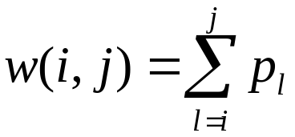
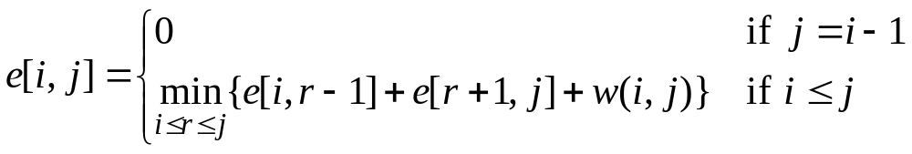
Recursive Solution
When the OPT subtree becomes a subtree of a node:
  Depth of every node in OPT subtree goes up by 1.
  Expected search cost increases by
If k_{r} is the root of an optimal BST for k_{i} ,..,k_{j}:
  e[i, j ] = p_{r} + (e[i, r−1] + w(i, r−1))+(e[r+1, j] + w(r+1, j))
  = e[i, r−1] + e[r+1, j] + w(i, j).
But, we don’t know k_{r}. Hence,
(because w(i, j)=w(i,r−1) + p_{r} + w(r + 1, j))

Slide 16
Computing an Optimal Solution
For each subproblem (i, j), store:
expected search cost in a table e[1..n + 1, 0..n]
  Will use only entries e[i, j ], where j ≥ i−1.
root[i, j] = root of subtree with keys k_{i}, ..., k_{j}, for 1 ≤ i ≤ j ≤ n.
w[1..n + 1, 0..n] = sum of probabilities
  w[i, i − 1] = 0 for 1 ≤ i ≤ n.
  w[i, j] = w[i, j - 1] + p_{j} for 1 ≤ i ≤ j ≤ n.

Slide 17
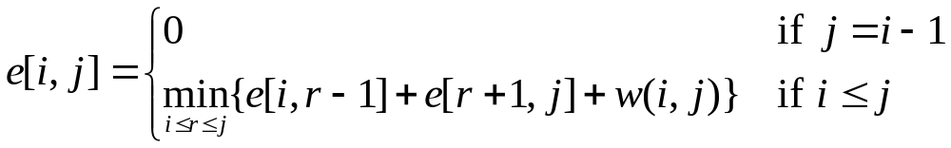
Pseudo-code
OPTIMAL-BST(p, n)
for i ← 1 to n + 1
do e[i, i− 1] ← 0
w[i, i − 1] ← 0
for l ← 1 to n
do for i ← 1 to n − l + 1
do j ← i + l − 1
      7. w[i, j] ← w[i, j − 1] + p_{j}
  8. e[i, j]← ∞
9. for r ←i to j
    do t ← e[i, r− 1] + e[r + 1, j] + w[i, j ]
11. if t < e[i, j]
12. then e[i, j] ← t
13. root[i, j] ←r
return e and root
Consider all trees with l
keys.
Fix the first key.
Fix the last key
Determine the root
of the optimal
(sub)tree
Time: O(n³)

Slide 18
Example
Construct an optimal binary search tree over five key values k1 < k2 < k3 < k4 < k5 with access probability 0.3, 0.2, 0.1, 0.15, and 0.25, respectively.
1. w[i,j]
 | j=0 | 1 | 2 | 3 | 4 | 5
i=1 | 0 | 0.3
2 |  | 0 | 0.2
3 |  |  | 0 | 0.1
4 |  |  |  | 0 | 0.15
5 |  |  |  |  | 0 | 0.25
6 |  |  |  |  |  | 0

Slide 19
1. e[i,j]
 | j=0 | 1 | 2 | 3 | 4 | 5
i=1 | 0 | 0.3
2 |  | 0 | 0.2
3 |  |  | 0 | 0.1
4 |  |  |  | 0 | 0.15
5 |  |  |  |  | 0 | 0.25
6 |  |  |  |  |  | 0
1. r[i,j]
 | j=0 | 1 | 2 | 3 | 4 | 5
i=1 |  | 1
2 |  |  | 2
3 |  |  |  | 3
4 |  |  |  |  | 4
5 |  |  |  |  |  | 5
6

Slide 20
2. w[i,j]
 | j=0 | 1 | 2 | 3 | 4 | 5
i=1 | 0 | 0.3 | 0.5
2 |  | 0 | 0.2 | 0.3
3 |  |  | 0 | 0.1 | 0.25
4 |  |  |  | 0 | 0.15 | 0.4
5 |  |  |  |  | 0 | 0.25
6 |  |  |  |  |  | 0
2. e[i,j]
 | j=0 | 1 | 2 | 3 | 4 | 5
i=1 | 0 | 0.3 | 0.7
2 |  | 0 | 0.2 | 0.4
3 |  |  | 0 | 0.1 | 0.35
4 |  |  |  | 0 | 0.15 | 0.55
5 |  |  |  |  | 0 | 0.25
6 |  |  |  |  |  | 0
2. r[i,j]
 | j=0 | 1 | 2 | 3 | 4 | 5
i=1 |  | 1 | 1
2 |  |  | 2 | 2
3 |  |  |  | 3 | 4
4 |  |  |  |  | 4 | 5
5 |  |  |  |  |  | 5
6

Slide 21
3. w[i,j]
 | j=0 | 1 | 2 | 3 | 4 | 5
i=1 | 0 | 0.3 | 0.5 | 0.6
2 |  | 0 | 0.2 | 0.3 | 0.45
3 |  |  | 0 | 0.1 | 0.25 | 0.5
4 |  |  |  | 0 | 0.15 | 0.4
5 |  |  |  |  | 0 | 0.25
6 |  |  |  |  |  | 0
3. e[i,j]
 | j=0 | 1 | 2 | 3 | 4 | 5
i=1 | 0 | 0.3 | 0.7 | 1
2 |  | 0 | 0.2 | 0.4 | 0.8
3 |  |  | 0 | 0.1 | 0.35 | 0.85
4 |  |  |  | 0 | 0.15 | 0.55
5 |  |  |  |  | 0 | 0.25
6 |  |  |  |  |  | 0
3. r[i,j]
 | j=0 | 1 | 2 | 3 | 4 | 5
i=1 |  | 1 | 1 | 2
2 |  |  | 2 | 2 | 3
3 |  |  |  | 3 | 4 | 5
4 |  |  |  |  | 4 | 5
5 |  |  |  |  |  | 5
6

Slide 22
4. w[i,j]
 | j=0 | 1 | 2 | 3 | 4 | 5
i=1 | 0 | 0.3 | 0.5 | 0.6 | 0.75
2 |  | 0 | 0.2 | 0.3 | 0.45 | 0.7
3 |  |  | 0 | 0.1 | 0.25 | 0.5
4 |  |  |  | 0 | 0.15 | 0.4
5 |  |  |  |  | 0 | 0.25
6 |  |  |  |  |  | 0
4. e[i,j]
 | j=0 | 1 | 2 | 3 | 4 | 5
i=1 | 0 | 0.3 | 0.7 | 1 | 1.4
2 |  | 0 | 0.2 | 0.4 | 0.8 | 1.35
3 |  |  | 0 | 0.1 | 0.35 | 0.85
4 |  |  |  | 0 | 0.15 | 0.55
5 |  |  |  |  | 0 | 0.25
6 |  |  |  |  |  | 0
4. r[i,j]
 | j=0 | 1 | 2 | 3 | 4 | 5
i=1 |  | 1 | 1 | 2 | 2
2 |  |  | 2 | 2 | 3 | 4
3 |  |  |  | 3 | 4 | 5
4 |  |  |  |  | 4 | 5
5 |  |  |  |  |  | 5
6

Slide 23
5. w[i,j]
 | j=0 | 1 | 2 | 3 | 4 | 5
i=1 | 0 | 0.3 | 0.5 | 0.6 | 0.75 | 1
2 |  | 0 | 0.2 | 0.3 | 0.45 | 0.7
3 |  |  | 0 | 0.1 | 0.25 | 0.5
4 |  |  |  | 0 | 0.15 | 0.4
5 |  |  |  |  | 0 | 0.25
6 |  |  |  |  |  | 0
5. e[i,j]
 | j=0 | 1 | 2 | 3 | 4 | 5
i=1 | 0 | 0.3 | 0.7 | 1 | 1.4 | 2.15
2 |  | 0 | 0.2 | 0.4 | 0.8 | 1.35
3 |  |  | 0 | 0.1 | 0.35 | 0.85
4 |  |  |  | 0 | 0.15 | 0.55
5 |  |  |  |  | 0 | 0.25
6 |  |  |  |  |  | 0
5. r[i,j]
 | j=0 | 1 | 2 | 3 | 4 | 5
i=1 |  | 1 | 1 | 1 | 2 | 2
2 |  |  | 2 | 2 | 2 | 4
3 |  |  |  | 3 | 4 | 4
4 |  |  |  |  | 4 | 5
5 |  |  |  |  |  | 5
6

Slide 24
r[1, 5] = 2 shows that the root of the tree over k1, k2, k3, k4, k5 is k2.
k2
k1
k3, k4, k5
r[3, 5] = 4 shows that the root of the subtree over k3, k4, k5 is k4.
k2
k4
k1
k4
k3
k5
k3
k5

Slide 25
Elements of Dynamic Programming
Optimal substructure
Overlapping subproblems

Slide 26
Binomial Coefficients
(x + y)² = x² + 2xy + y², coefficients are 1,2,1
(x + y)³ = x³ + 3x²y + 3xy² + y³, coefficients are 1,3,3,1
(x + y)⁴ = x⁴ + 4x³y + 6x²y² + 4xy³ + y⁴,
coefficients are 1,4,6,4,1
(x + y)⁵ = x⁵ + 5x⁴y + 10x³y² + 10x²y³ + 5xy⁴ + y⁵,
coefficients are 1,5,10,10,5,1
The n+1 coefficients can be computed for (x + y)^{n} according to the formula c(n, i) = n! / (i! * (n – i)!)
for each of i = 0..n
The repeated computation of all the factorials gets to be expensive
We can use dynamic programming to save the factorials as we go

Slide 27
Solution by dynamic programming
n c(n,0) c(n,1) c(n,2) c(n,3) c(n,4) c(n,5) c(n,6)
0 1
1 1 1
2 1 2 1
3 1 3 3 1
4 1 4 6 4 1
5 1 5 10 10 5 1
6 1 6 15 20 15 6 1
Each row depends only on the preceding row
Only linear space and quadratic time are needed
This algorithm is known as Pascal’s Triangle

Slide 28
Binomial Coefficients
The binomial coefficient C(n, k) is the number of ways of choosing a subset of k elements from a set of n elements.
By its definition, C(n,k)=n! / ((n-k)!*k!)
This definition formula is not used for computation because even for small values of n, the values of n factorial n! get really large.
Instead, C(n,k) can be computed by following formula:
C(n,k)=C(n-1, k-1)+C(n-1, k)
C(n,0)=1
C(n,n)=1

Slide 29
Binomial Coefficients –
Simple Recursive Solution
long C(int n, int k) {
if ((k==0) || (k==n))
return 1;
else
return C(n - 1, k) + C(n - 1, k - 1);
}

Slide 30
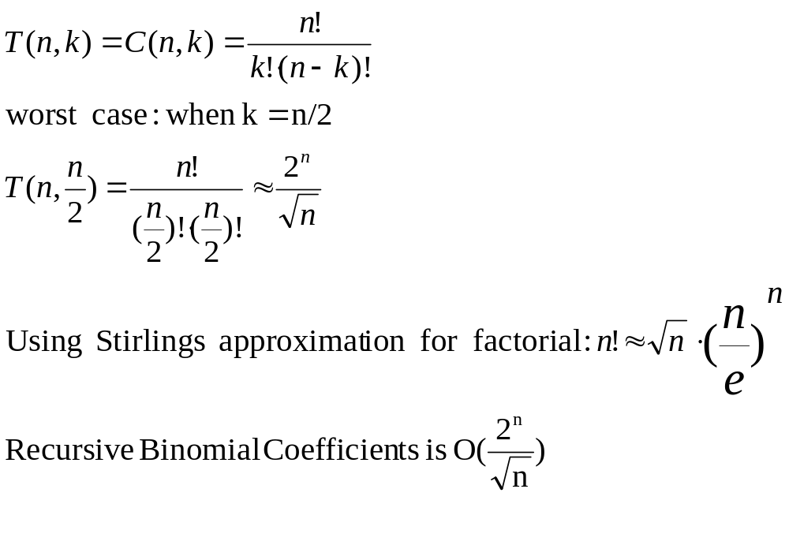
Recursive Binomial Coefficients –
Complexity Analysis

Slide 31
Binomial Coefficients –
RecursionTree for C(5,2)
C(5,2)
C(4,1)
C(4,2)
C(3,0)
C(3,1)
C(3,1)
C(3,2)
C(2,0)
C(2,1)
C(2,0)
C(2,1)
C(2,1)
C(2,2)
C(1,0)
C(1,1)
C(1,0)
C(1,1)
C(1,0)
C(1,1)

Slide 32
Optimization level 1: Memoization
We can speed up the recursive algorithm by writing down in a table the results of the recursive calls (the subproblems) and looking them up again if we need them later.
In this way we do not compute again a recursive call that was already computed before, just take the result from the table
This process was called memoization
  Memoization (not memorization!): the term comes from memo (memorandum), since the technique consists of recording a value so that we can look it up later.

Slide 33
Binomial Coefficients –
Using Memoization
ResultEntry {
boolean done;
long value;
}
ResultEntry[n+1][k+1] result;
We store results of subproblems in a table:
result[i][j] represents C(i,j)
In the beginning, all table entries must be initialized with result[i][j].done=false.

Slide 34
Binomial Coefficients –
Using Memoization (cont)
long C(int n, int k) {
if (result[n][k].done == true)
return result[n][k].value;
if ((k == 0) || (k == n)) {
result[n][k].done = true;
result[n][k].value = 1;
return result[n][k].value;
}
result[n][k].done = true;
result[n][k].value = C(n - 1, k) + C(n - 1, k - 1);
return result[n][k].value;
}

Slide 35
Binomial Coefficients –
RecursionTree with Memoization
C(5,2)
C(4,1)
C(4,2)
C(3,0)
C(3,1)
C(3,1)
C(3,2)
C(2,0)
C(2,1)
C(2,1)
C(2,2)
C(1,0)
C(1,1)
Lookup in table stops
further recursive expansion
of these nodes

Slide 36
Binomial Coefficients w. Memoization –
Complexity Analysis
T(n, k) – exactly n*k table entries are assigned exactly once

Slide 37
Optimization level 2:
Dynamic Programming
We want to eliminate recursivity
We look at the recursion tree to see in which order are done the elements of the result table
If we figure out the order, we can replace the recursion with an iterative loop that intentionally ﬁlls the table in the right order
This technique is called Dynamic Programming
  Dynamic programming: The term was introduced in the 1950s by Richard Bellman. Bellman developed methods for constructing training and logistics schedules for the air forces, or as they called them, ‘programs’. The word ‘dynamic’ is meant to suggest that the table is ﬁlled in over time, rather than all at once

Slide 38
Binomial Coefficients – Table Filling Order
result[i][j] stores the value of C(i,j)
Table has n+1 rows and k+1 columns, k<=n
Initialization: C(i,0)=1 and C(i,i)=1 for i=1 to n
0
1
k
n
0
1
1 | 1
1 |  | 1
1 |  |  | 1
1
1
1 |  |  |  |  |  |  |  | 1
1 |  |  |  |  |  |  |  |  | 1
1
Entries
that
must be
computed
i
n

Slide 39
Binomial Coefficients – Order (cont)
result[i][j] stores the value of C(i,j)
Rest of entries (i,j), for i=2 to n and j = 1 to i-1 are computed using entry (i-1, j-1) and (i-1, j)
0
1
j
k
n
0
1
i-1
i
n

Slide 40
Binomial Coefficients –
Dynamic Programming
long[][]result;
long C(int n, int k) {
result = new long [n + 1][n + 1];
int i, j;
for (i=0; i<=n; i++) {
result[i][0]=1;
result[i][i]=1;
}
for (i=2; i<=n; i++)
for(j=1; j<i; j++)
result[i][j]=result[i-1][j-1]+result[i-1][j];
return result[n][k];
}
Time: O(n*n) (or O(n*k))
Memory: O(n*n) (or O(n*k))

Slide 41
Optimization level 3:
Memory Efficient Dynamic Programming
In many dynamic programming algorithms, it may be not necessary to retain all intermediate results through the entire computation.
Every step (every subproblem) depends usually on a reduced set of subproblems, not all other subproblems
We replace the big table storing the results of all subproblems by some smaller buffers that are reused during the computation

Slide 42
Binomial Coefficients –
Reduce Memory Complexity
At every iteration for i, we compute the values of a row using the values of the row before it
Two buffers of the length of a row are enough
The buffers are reused after each iteration
0
1
j
k
n
0
1
i-1
Previous row
i
Current row
n

Slide 43
Binomial Coefficients –
Memory Efficient Dynamic Programming
long C(int n, int k) {
long[] result1 = new long[n + 1];
long[] result2 = new long[n + 1];
result1[0] = 1;
result1[1] = 1;
for (int i = 2; i <= n; i++) {
result2[0] = 1;
for (int j = 1; j < i; j++)
result2[j] = result1[j - 1] + result1[j];
result2[i] = 1;
long[] auxi = result1;
result1 = result2;
result2 = auxi;
}
return result1[k];
}
Time: O(n*n) (or O(n*k))
Memory: O(n) (or O(k))

