Slide 1
Computer Organization and Architecture
ETCS-204
Dr. Deepak Gupta
Computer Science & Engineering
Maharaja Agrasen Institute of Technology, Delhi (GSIPU)
Email: drdeepakgupta.cse@gmail.com, deepakgupta@mait.ac.in
Web: sites.google.com/view/drdeepakgupta

Slide 2
Syllabus
Unit-I
Basic Computer Organization and Register transfer language: Over view of basic digital building blocks, Basic structure of a digital computer: Von-Neuman architecture, Introduction to types of buses, Bus and memory transfer, Bus architecture using multiplexer and tri-state buffer, register transfer language, Micro operation: arithmetic, logical, shift micro operation with hardware implementation, Arithmetic Logic Shift Unit. Levels of programming languages: Machine language, Assembly language, High level language, programme development steps: compiling and assembling programmes.
Unit-II
Computer Design and Instruction set architecture Instruction codes, General computer registers with common bus system, addressing modes, computer instructions: Memory Reference, Register reference, Input-Output Instructions, Instruction cycle, Input-Output configuration and interrupt cycle. Internal architecture of 8085 microprocessor: Pin diagram, 8085 instruction set.
Unit-III
CPU Design: Hardwired Control Unit, Timing and control, Micro Programmed Control Unit: Control memory and address sequencing. Pipelining: Introduction to Flynn‘s classification, arithmetic pipeline, instruction pipeline, pipeline conflict and hazards. Computer arithmetic: Unsigned, Signed 1‘s, 2‘s compliment notations, addition, subtraction, multiplication and division (Hardware implementation), introduction to floating point notation: IEEE 754 standard.
Unit-IV
Memory & Input/output organization: Memory Hierarchy, Main Memory (RAM and ROM Chips), Virtual memory, Cache memory and mappings. Input/Output interface: I/O bus and interface modules, I/O bus Vs memory bus, Isolated Vs Memory mapped I/O, Bus arbitration, modes of transfer.

Slide 3
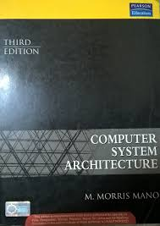
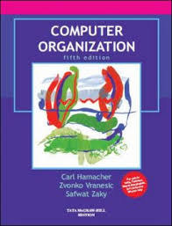
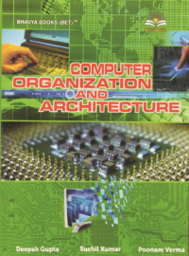
Books
[T1] M. Morris, Mano, “Computer System Architecture”, PHI 3rd Edition 2007.
[T2] Carl Hamacher, “Computer Organization”, McGraw Hill, 5th Edition 2002.
[Suggestion] Deepak Gupta et al. “Computer Organization and Architecture”, Bhavya Books Publications.

Slide 4
Computer Architecture?
Structure and behavior of the computer as seen by the user.
those properties, which directly affect the logical working of a program;
the attributes, which are apparent to a programmer
Examples: instruction set and formats, techniques for addressing memory, number of bits used to represent data

Slide 5
Computer Organization?
Organization: interconnection of operational units for realizing the architectural specifications
Determination of which hardware should be used and
how the parts should be connected together

Slide 6
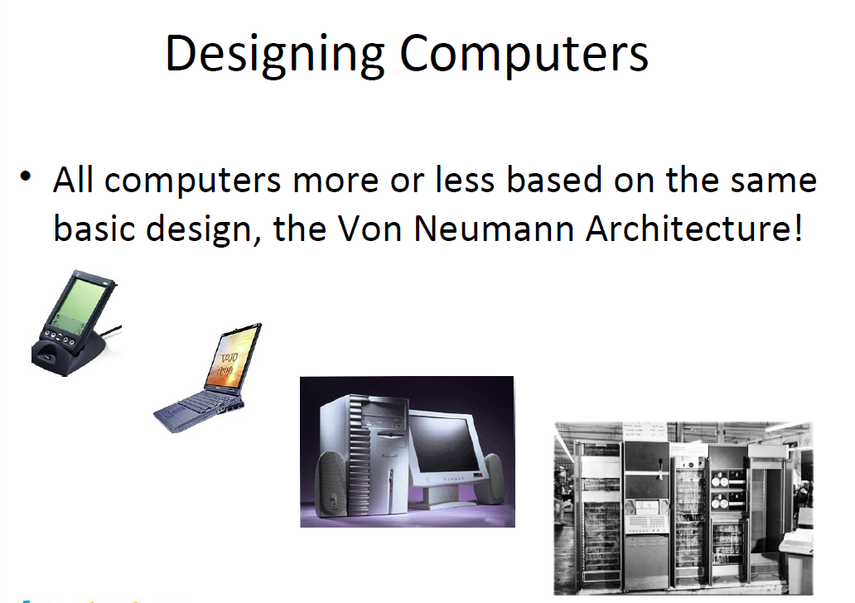

Slide 7
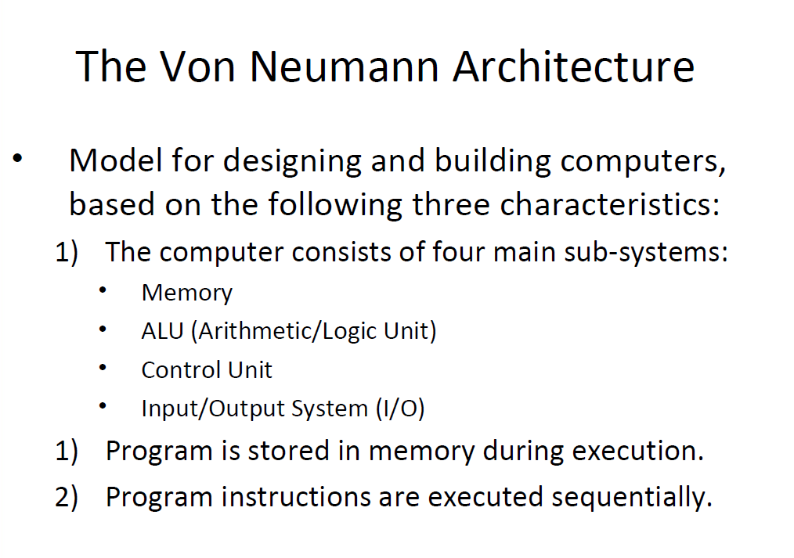

Slide 8
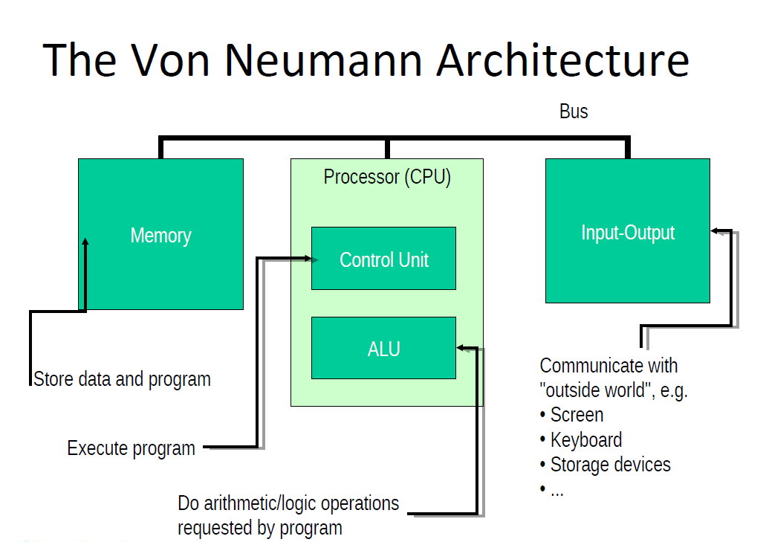

Slide 9
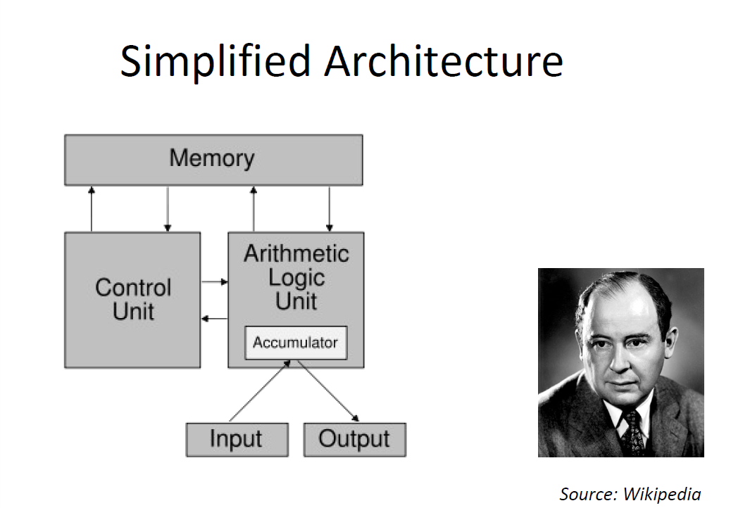

Slide 10
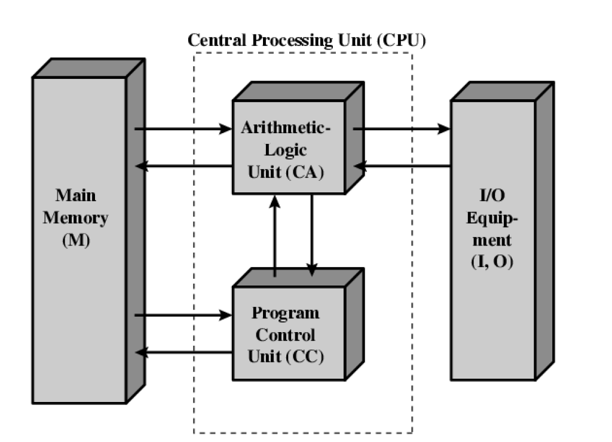

Slide 11
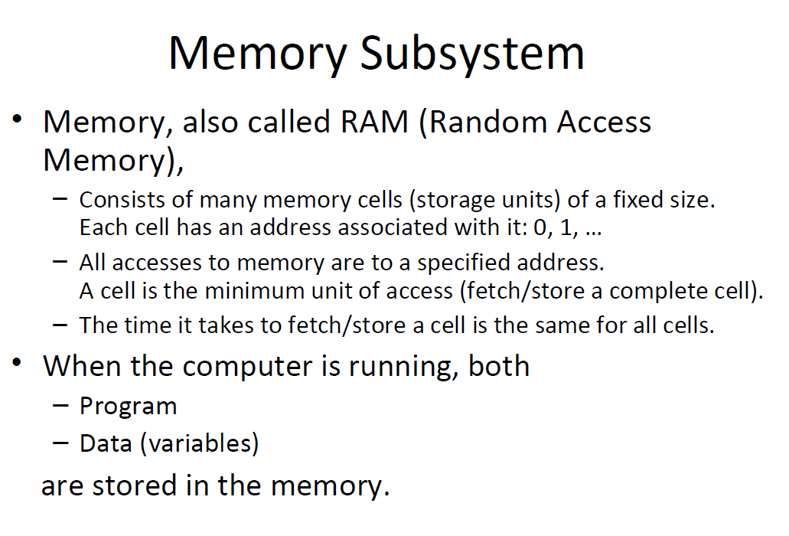

Slide 12
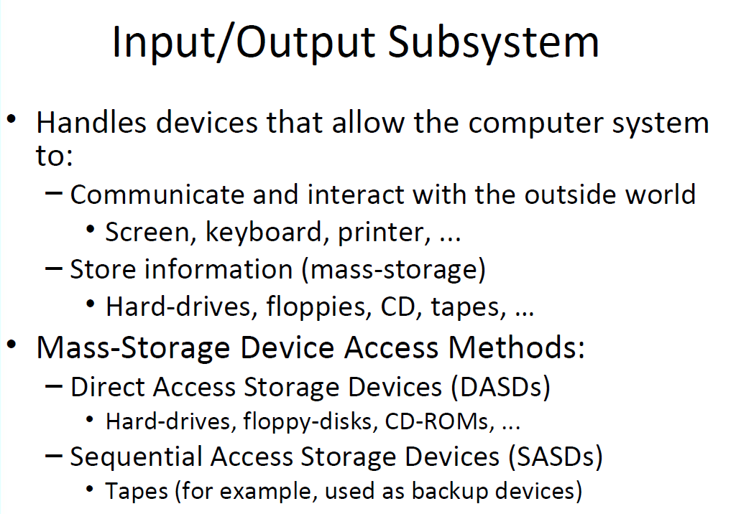

Slide 13
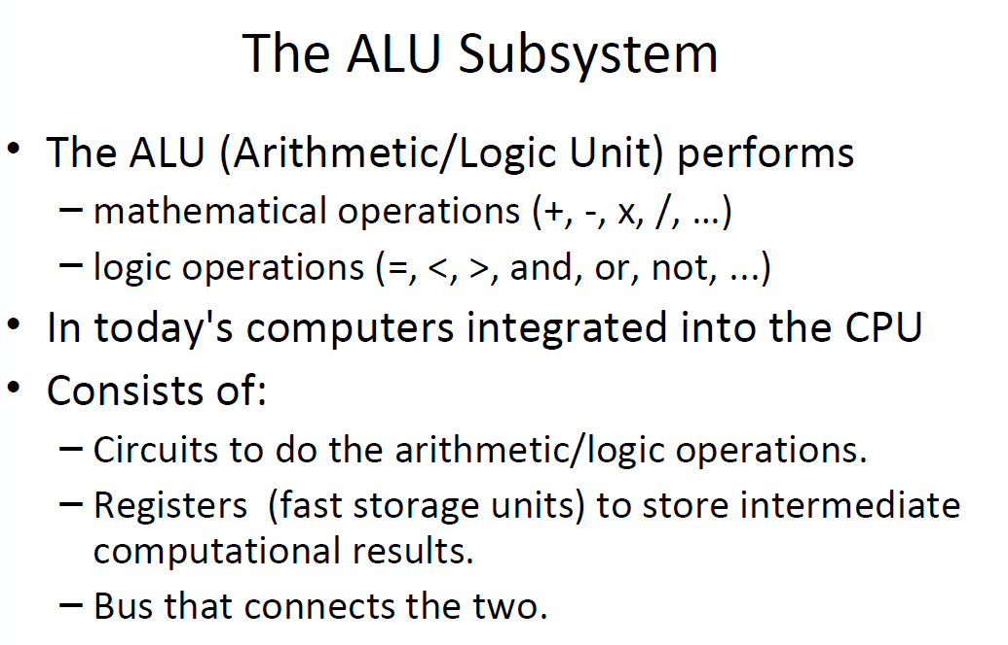

Slide 14
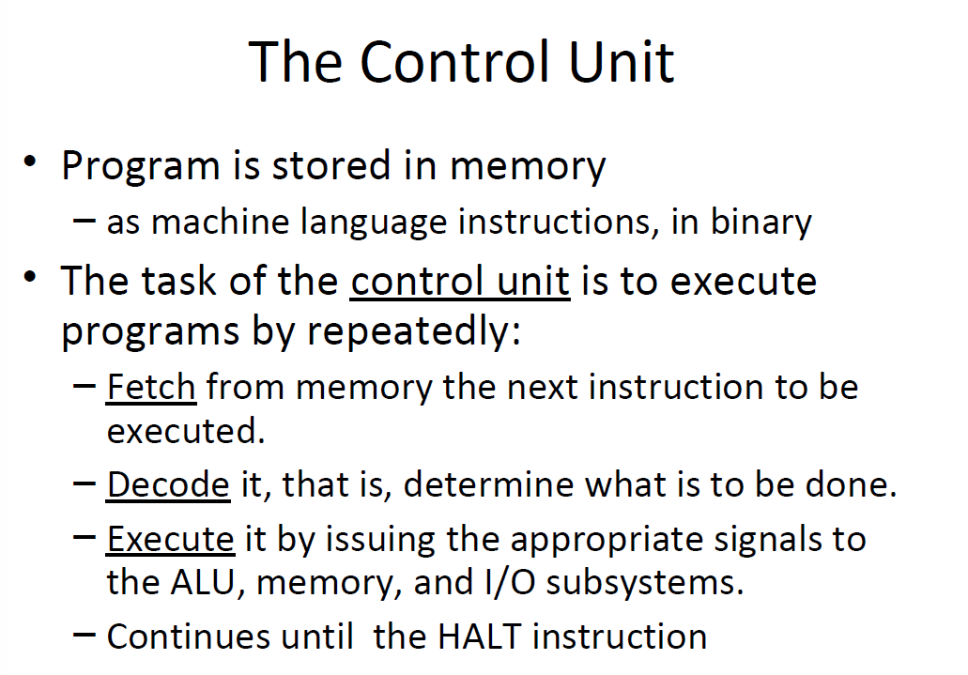

Slide 15
CPU Busses
A group of wires connecting two or more devices and providing a path to perform communication is called Bus. A bus that connects major computer components/modules (CPU, Memory, I/O) is called system bus. These system buses are separated into three functional groups:
Data bus.
The data bus consists of 8, 16, 32 or more parallel lines. The data bus lines are bidirectional. This means that CPU can read data on these lines from memory or from a port as well as data out on these lines to a memory location or to a port.
2. Address bus.
It is a unidirectional bus. The address bus consists of 16, 20, 24 or more parallel lines. The CPU send out the address of the memory location or I/O port that is to be written or read from by using this address bus.
3. Control bus.
Control lines regulate the activity on the bus. The CPU sends signals on the control bus to enable the outputs of addressed memory device or port device.

Slide 16
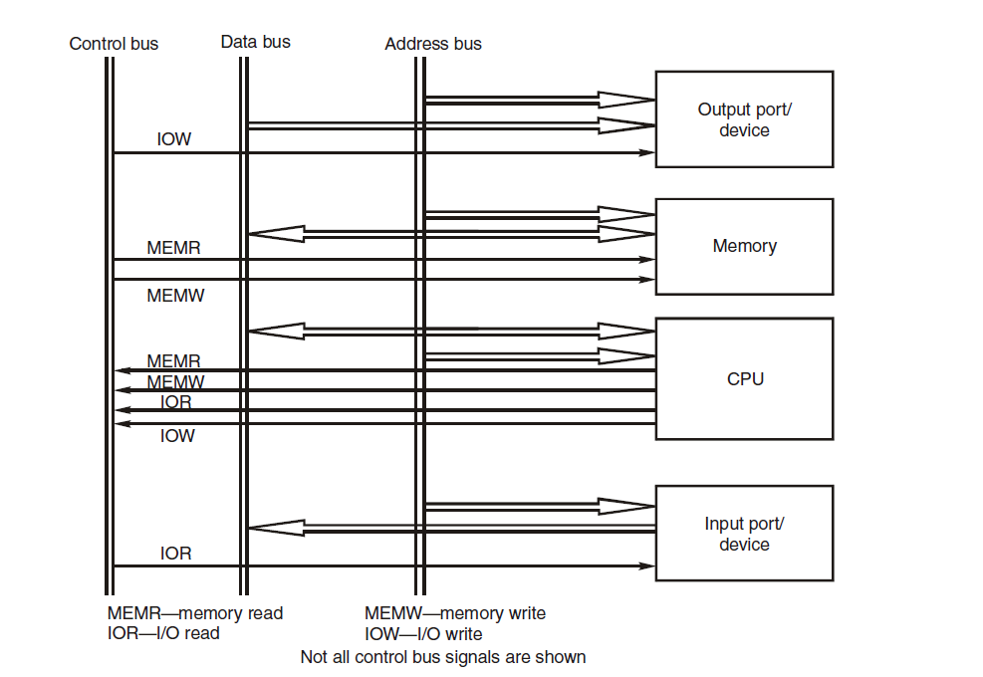

Slide 17
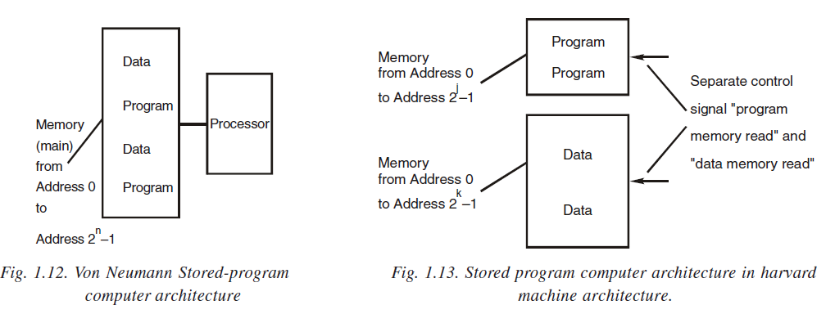
Von Neumann vs Harvard Architecture
Harvard architecture has separate data and instruction busses, allowing transfers to be performed simultaneously on both busses.
Von Neumann architecture has only one bus which is used for both data transfers and instruction fetches, and therefore data transfers and instruction fetches must be scheduled - they cannot be performed at the same time.

Slide 18
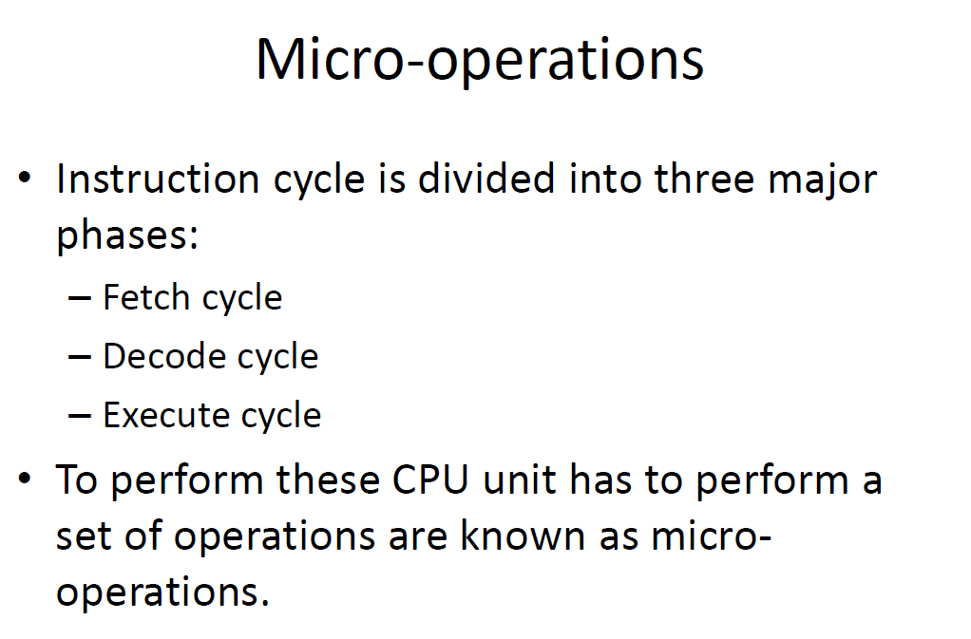

Slide 19
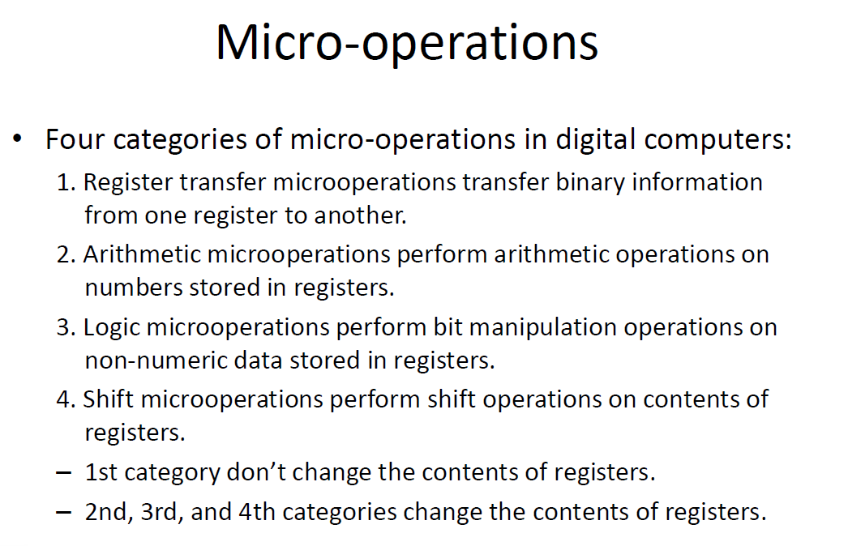

Slide 20
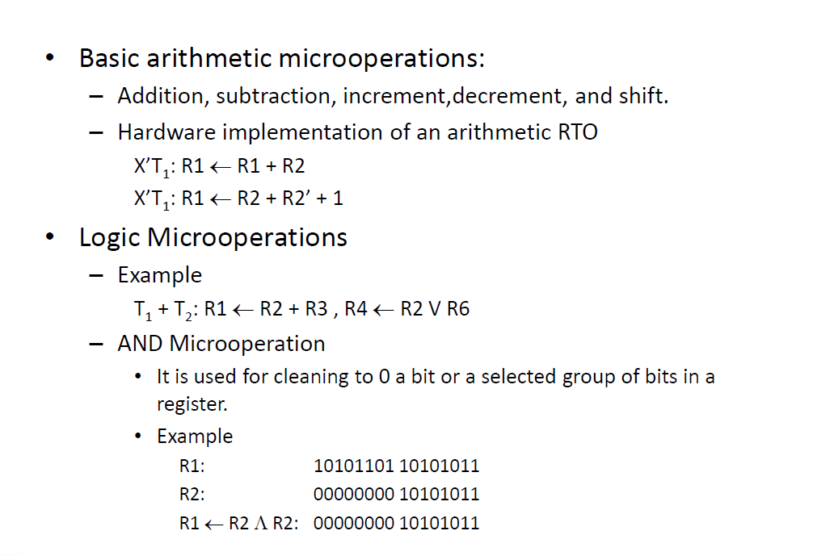

Slide 21
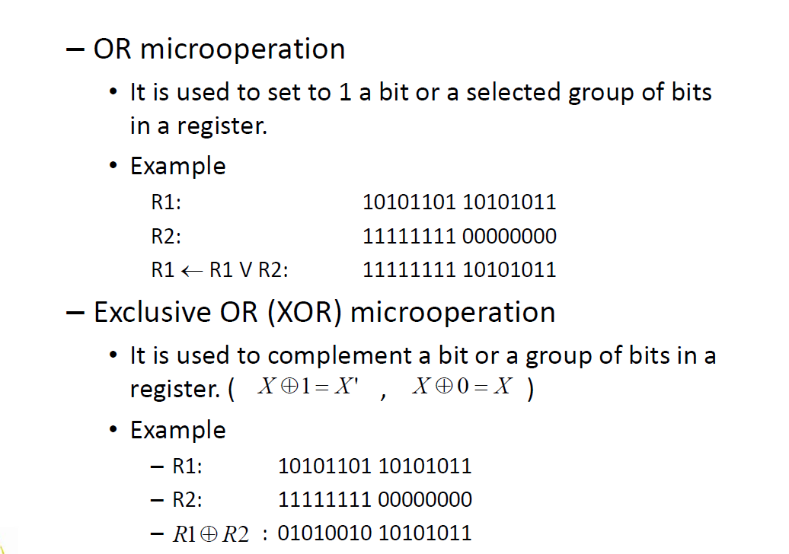

Slide 22
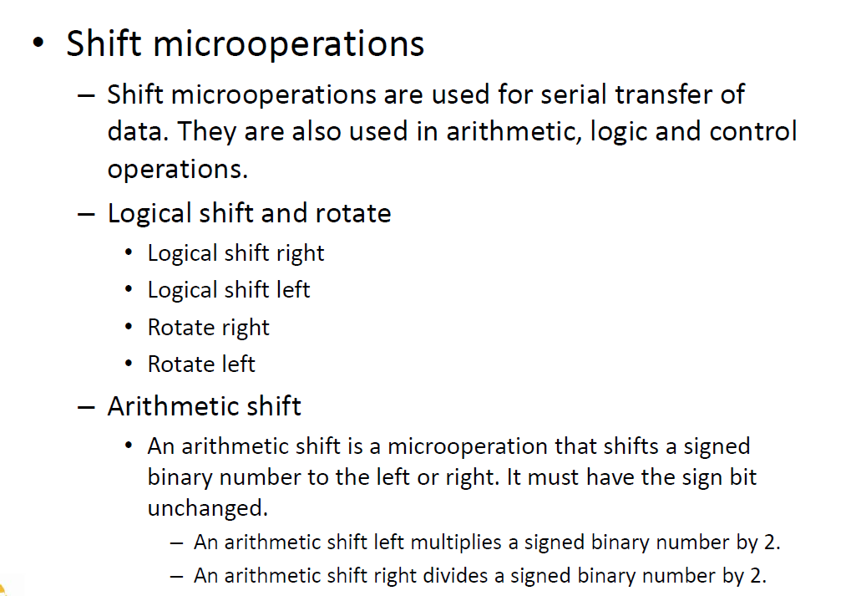

Slide 23
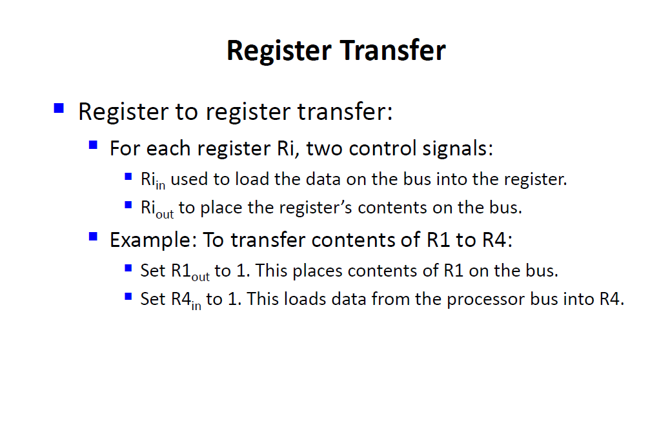

Slide 24
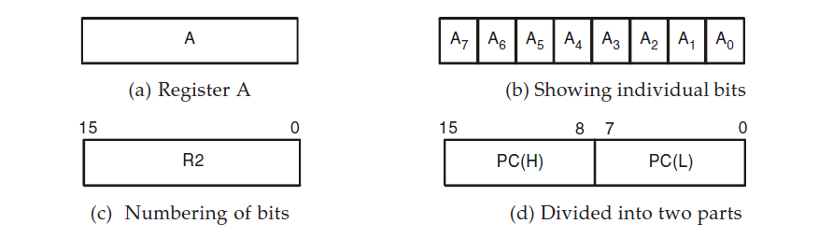
Register Transfer and Representation
The registers in a digital computer are designated by capital letters (and if required are also followed by numerals) to denote the function of the register.

Slide 25
The symbolic notation used to describe the microoperation transfer among registers is called a register transfer language. This is a way of expressing the different microoperations sequence in the symbolic form among registers of a computer.
For example, the statement.
R2 R1
simply denotes that the content of register R1 is to be transferred into register R2. After this transfer operation takes place the previous content of R2 will be replaced by the content of R1 but the content of register R1 does not change after the transfer. R1 is the source register and R2 is the destination register. If we want that the transfer can take place only when certain control condition satisfies, this can be shown by means of an if then statement as
if (P = 1) then (R2 R1)
where P is a control signal, generated in the control section. Also, some time we use control function to separate the control variables from the register transfer operation. A control function is a Boolean variable that is equal to 1 or 0. Thus, the above statement is equivalent as
P : R2 R1
where colon is used to terminate the control condition.

Slide 26
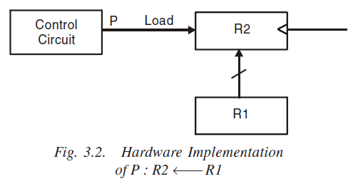
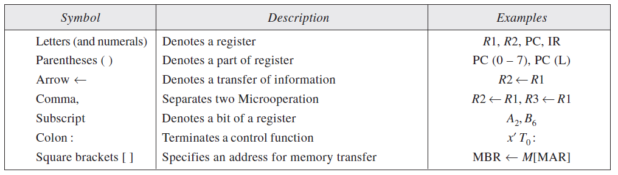

Slide 27
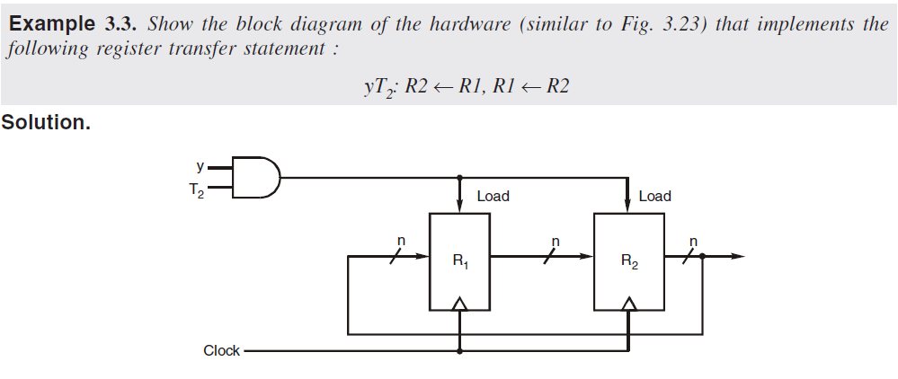
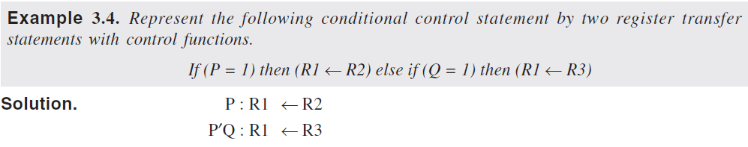
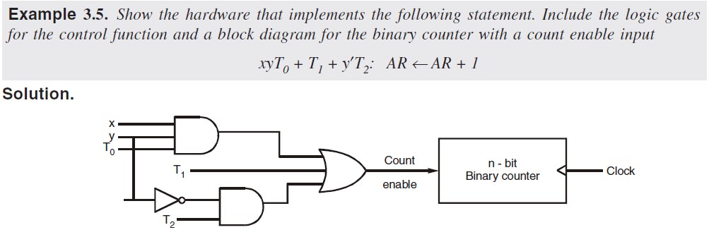
Examples

