Slide 1
Computer Organization and Architecture
ETCS-204
Dr. Deepak Gupta
Computer Science & Engineering
Maharaja Agrasen Institute of Technology, Delhi (GSIPU)
Email: drdeepakgupta.cse@gmail.com, deepakgupta@mait.ac.in
Web: sites.google.com/view/drdeepakgupta

Slide 2
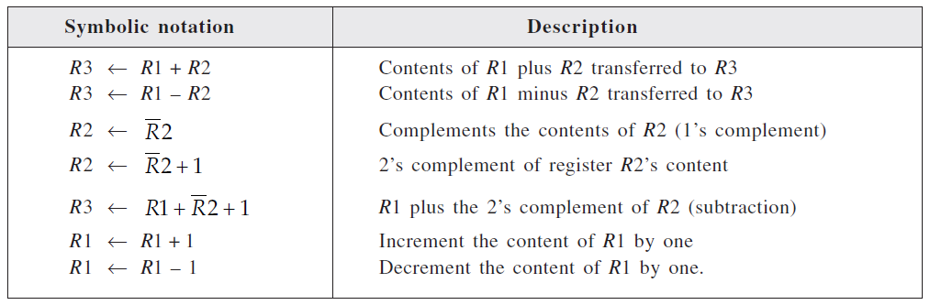
Arithmetic Microoperations

Slide 3
Arithmetic Microoperations
Adder
Adder/Subtractor
Incrementor
Decrementor

Slide 4
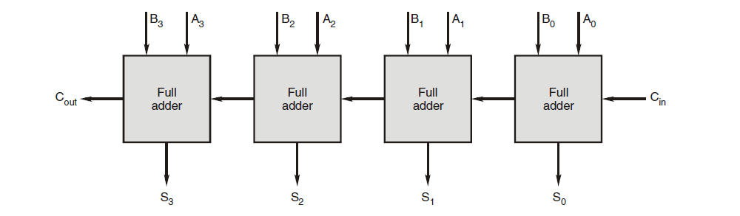
4-bit Parallel Adder

Slide 5
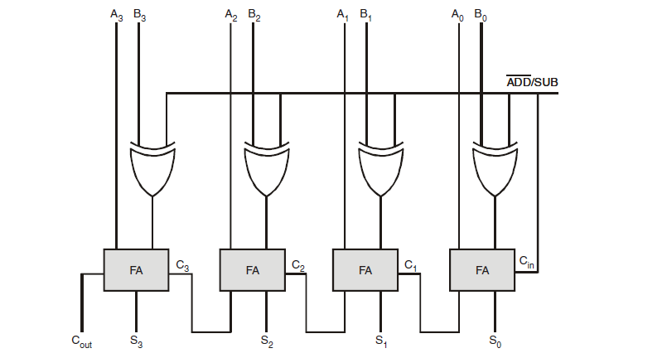
4-bit Adder/Subtractor
Y = A+B
Y = A-B = A+B’+1

Slide 6
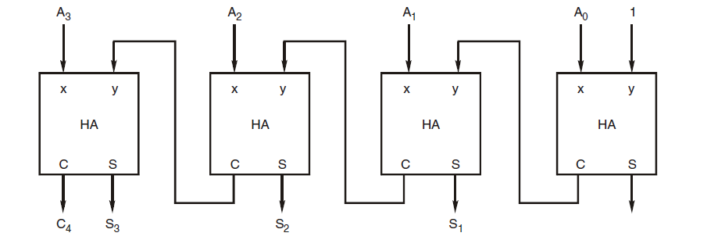
4-bit Incrementor
Y = A+1;

Slide 7
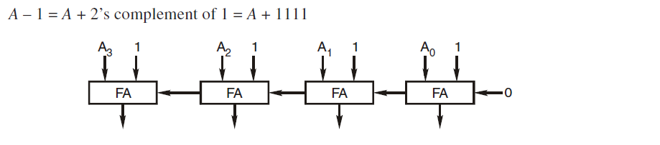
4-bit Decrementor
Y = A-1 = A+2’s complement of (0001)
i.e. Y = A+1111

Slide 8
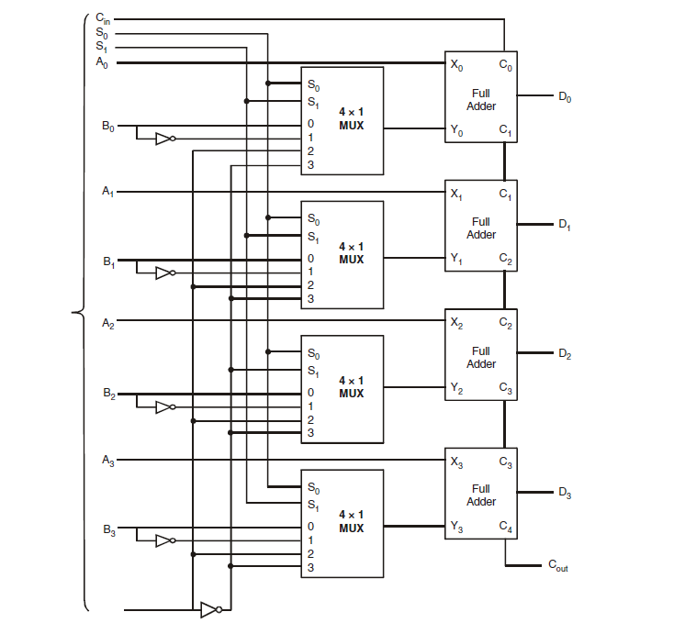
4-bit Arithmetic Circuit

Slide 9
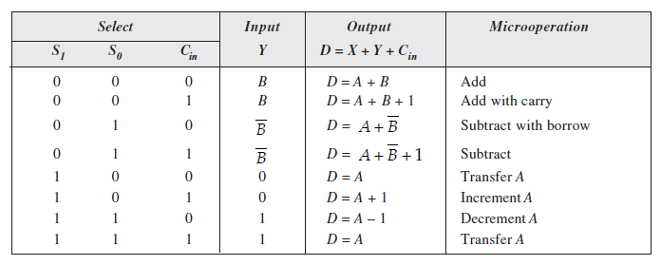
4-bit Arithmetic Circuit

