Slide 1
Computer Organization and Architecture
ETCS-204
Dr. Deepak Gupta
Computer Science & Engineering
Maharaja Agrasen Institute of Technology, Delhi (GSIPU)
Email: drdeepakgupta.cse@gmail.com, deepakgupta@mait.ac.in
Web: sites.google.com/view/drdeepakgupta

Slide 2
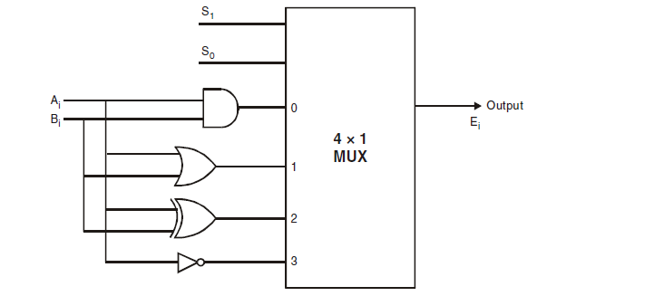
Logical Microoperations

Slide 3
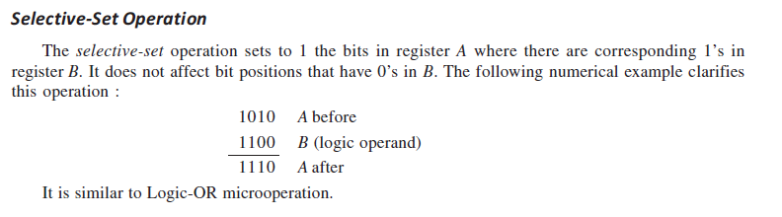
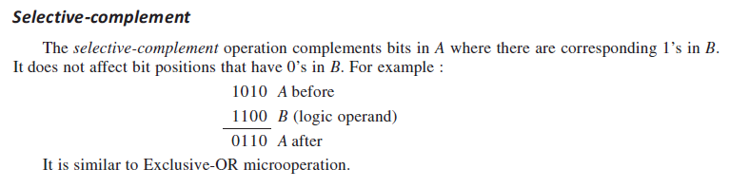
Selective Operations

Slide 4
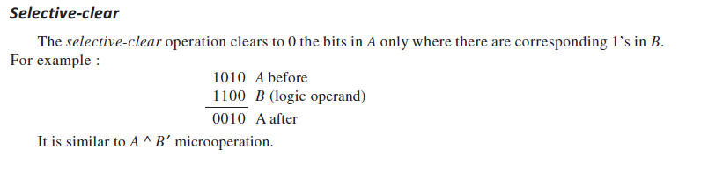
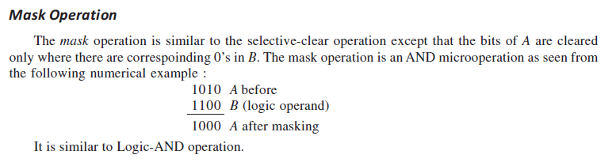
Selective Operations

Slide 5
Shift Microoperations
Shift microoperation can be classified as:
Logical,
Circular,
Arithmetic.

Slide 6
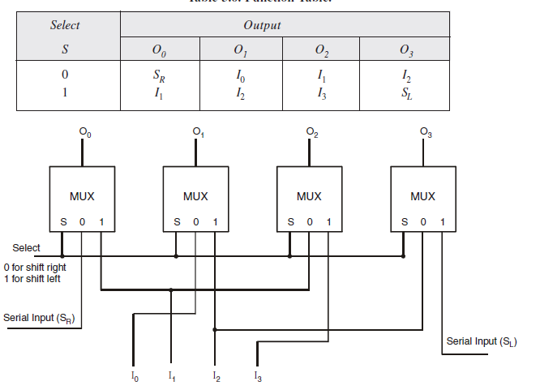
4-bit logical shifter

Slide 7
Q1. Design 4-bit Circular Shifter
Q2. Design 4-bit Arithmetic Shifter

Slide 8
Bus and Memory Transfer
Bus: A group of wires that connected several devices to carry the data (or) information is called as a bus.
Bus Transfer: The data transfer between various blocks connected to the common bus is called bus transfer.
Memory Transfer: The data is stored (write) into memory or read from memory is called memory transfer.

Slide 9
Designing of Common Bus System
Via Multiplexer
Via Tri-State Buffer

Slide 10
Common Bus Via Multiplexer
Example 4 Registers (A, B, C, D) where each register is of 4 bits
Number of Multiplexers: 4 multiplexers, one for each bit of register
Size of Multiplexers needed: 4 X 1, number of registers
Number of selection input in each Mux: 2 Select Lines to select one of the 4 registers

Slide 11
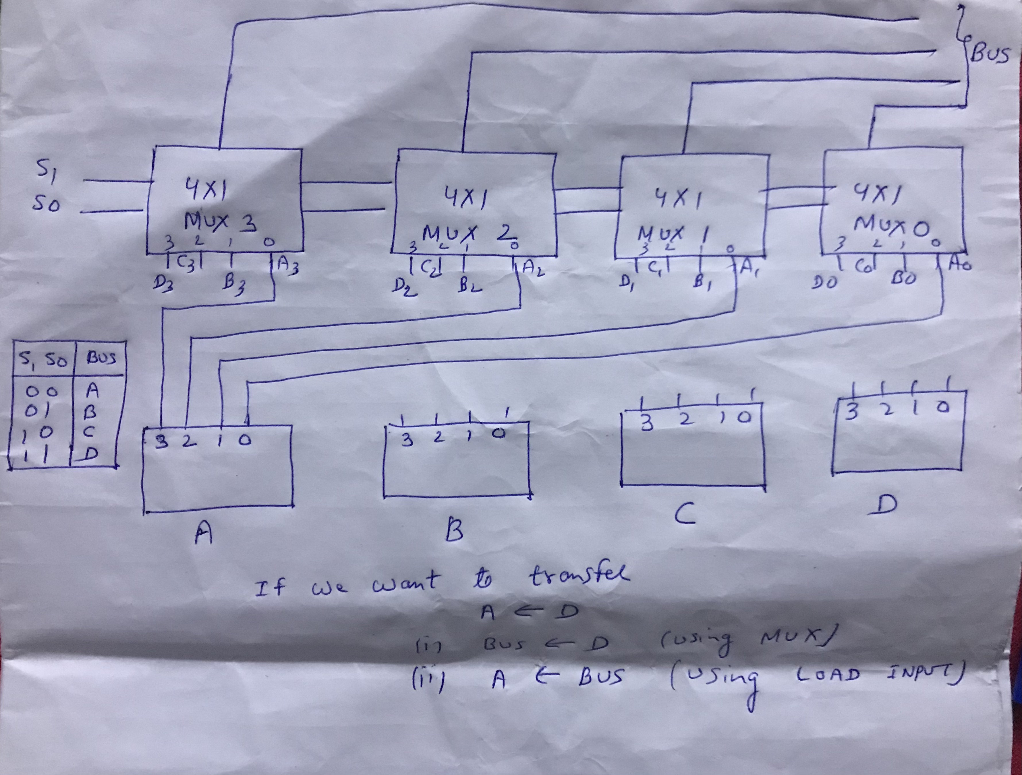

Slide 12

Common Bus Via Tristate Buffer
Example 4 Registers (A, B, C, D) where each register is of 4 bits
Number of Decoders: 4 decoders, one for each bit of register
Number of tristate buffers: 16, multiplication of no of registers and their size

Slide 13
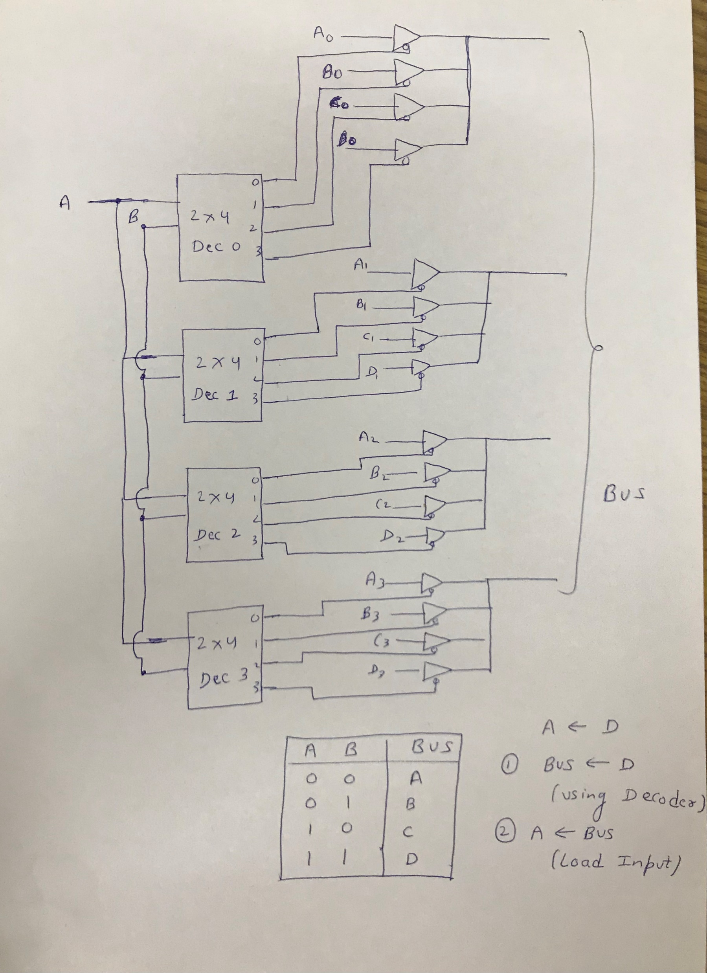

Slide 14
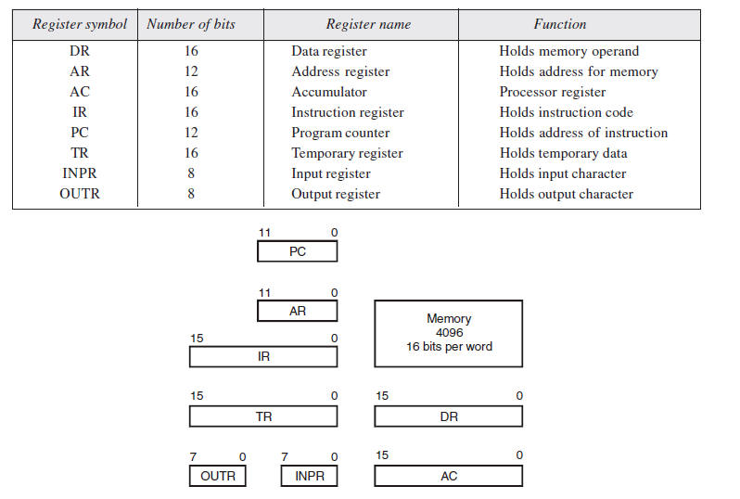
Computer Registers

Slide 15
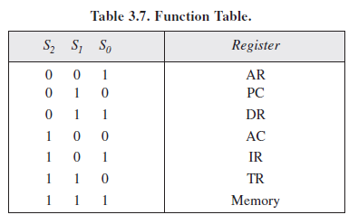
Bus Organization

Slide 16
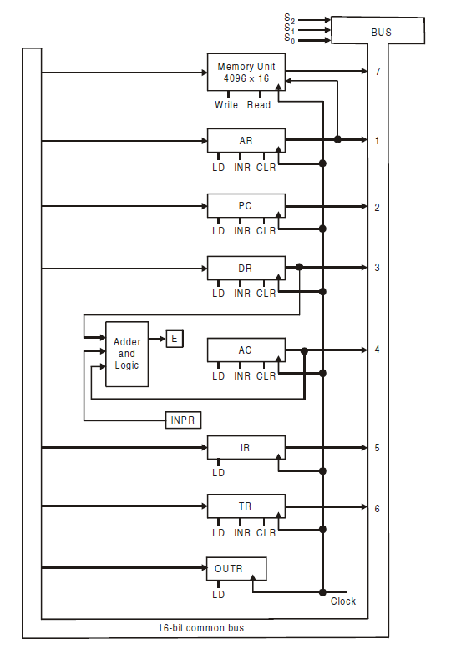

Slide 17
Bus Arbitration
Bus Arbitration: A mechanism which decides the selection of current master to access bus is known as bus arbitration
Amongst several masters and slave units are connected to a shared bus, it may happen that more than one master or slave units will request access to the bus at a same time. In such situations bus access is give to the master having highest priority. A mechanism which decides the selection of current master to access bus is known as bus arbitration. Three different mechanisms are commonly used for this.
1. Daisy chaining
2. Parallel arbitration
3. Independent requesting

Slide 18
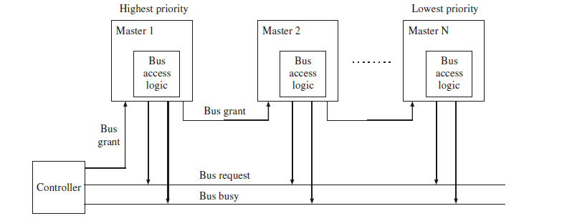
Daisy Chaining
Daisy chaining method is cheaper and simple method. All masters make use of the same line for bus request. The bus grant signal serially propagates through each master until it encounters the first one that is requesting access to the bus. This master blocks the propagation of the bus grant signal, activates the busy line and gains control of the bus. Therefore, any other requesting module will not receive the grant signal and hence cannot get the bus access.

Slide 19
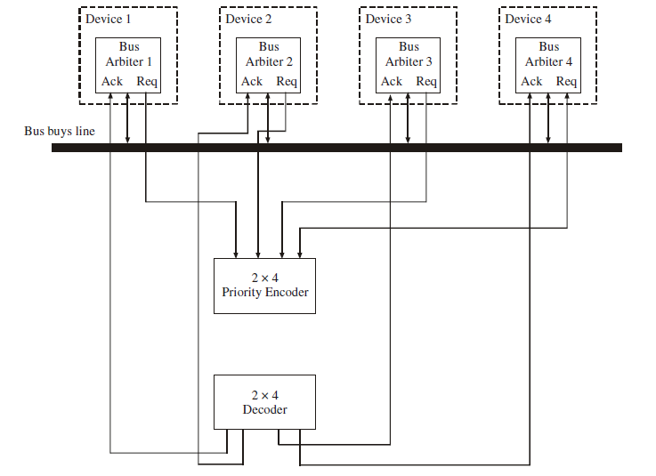
Parallel Arbitration
Figure shows the parallel arbitration logic, it consists of priority encoder and a decoder. In this mechanism, each bus arbiter has a bus request output line and a bus acknowledges input line. Each arbiter enables the request line when its device (processor) is requesting access to the system bus.

Slide 20
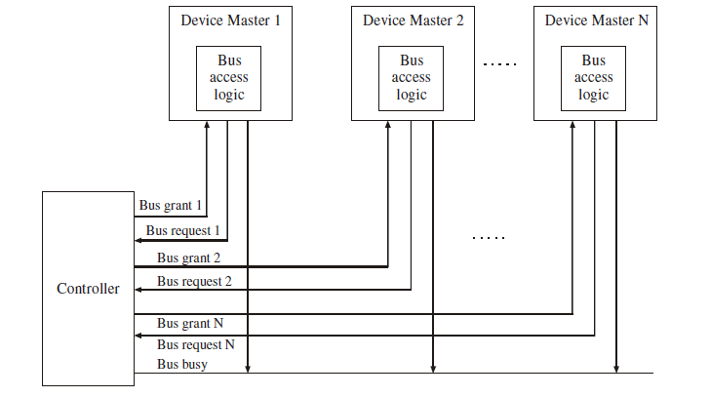
Independent Priority
Figure shows the system connections for the independent priority scheme. In this scheme each master has a separate pair of bus request and bus grant lines and each pair has a priority assigned to it. The built in priority encoder within the controller selects the highest priority and asserts the corresponding bus grant signal.

Slide 21
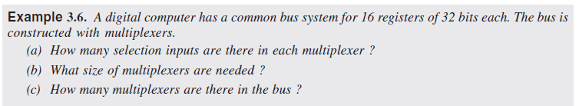
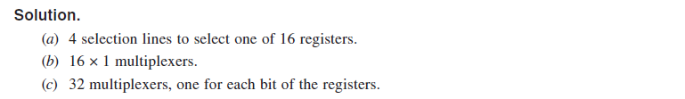

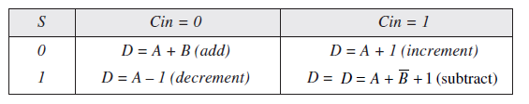

Slide 22
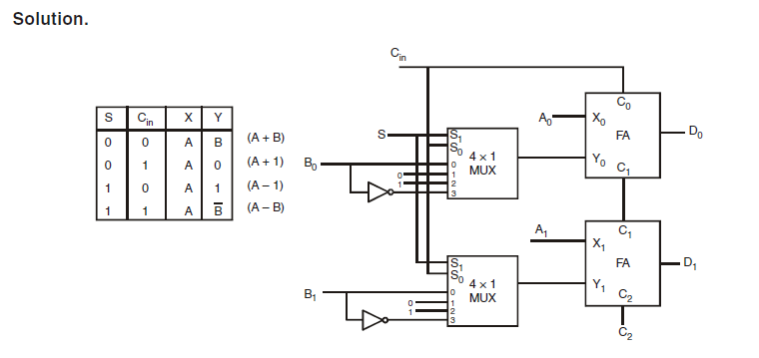

Slide 23
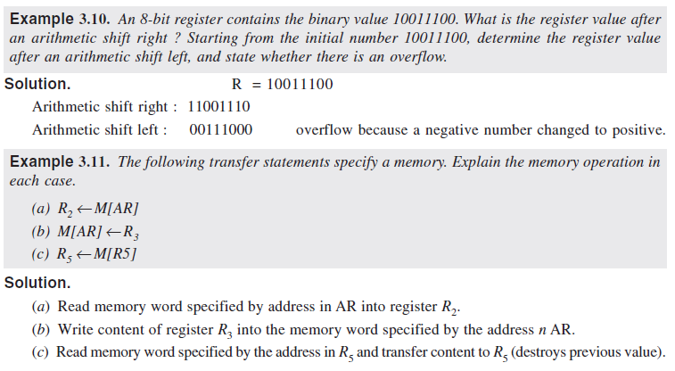

Slide 24
