Slide 1
Computer Organization and Architecture
ETCS-204
Dr. Deepak Gupta
Computer Science & Engineering
Maharaja Agrasen Institute of Technology, Delhi (GSIPU)
Email: drdeepakgupta.cse@gmail.com, deepakgupta@mait.ac.in
Web: sites.google.com/view/drdeepakgupta

Slide 2
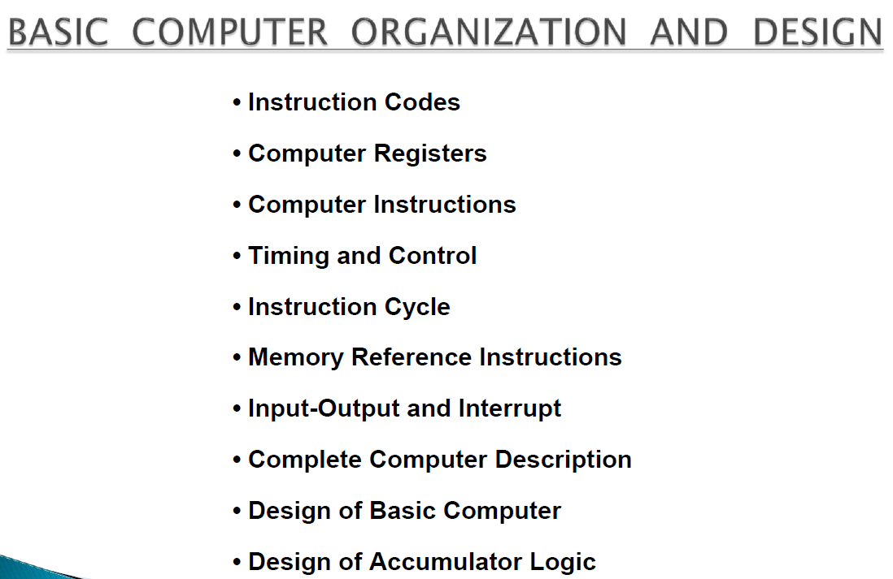

Slide 3
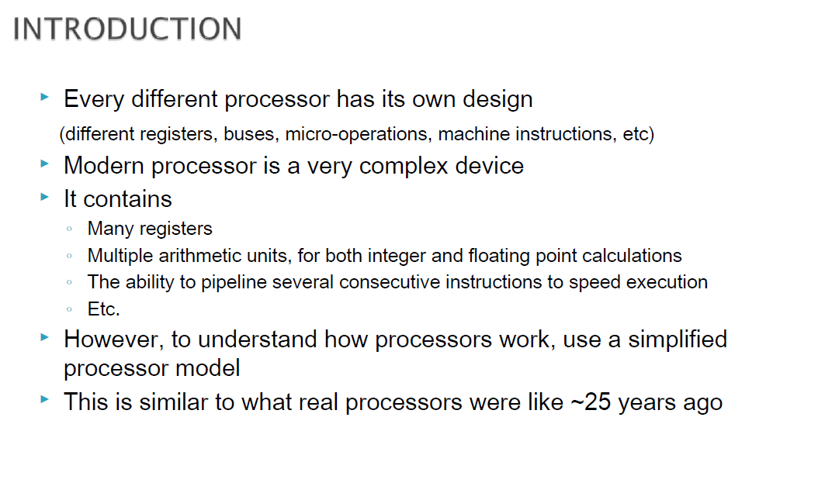

Slide 4
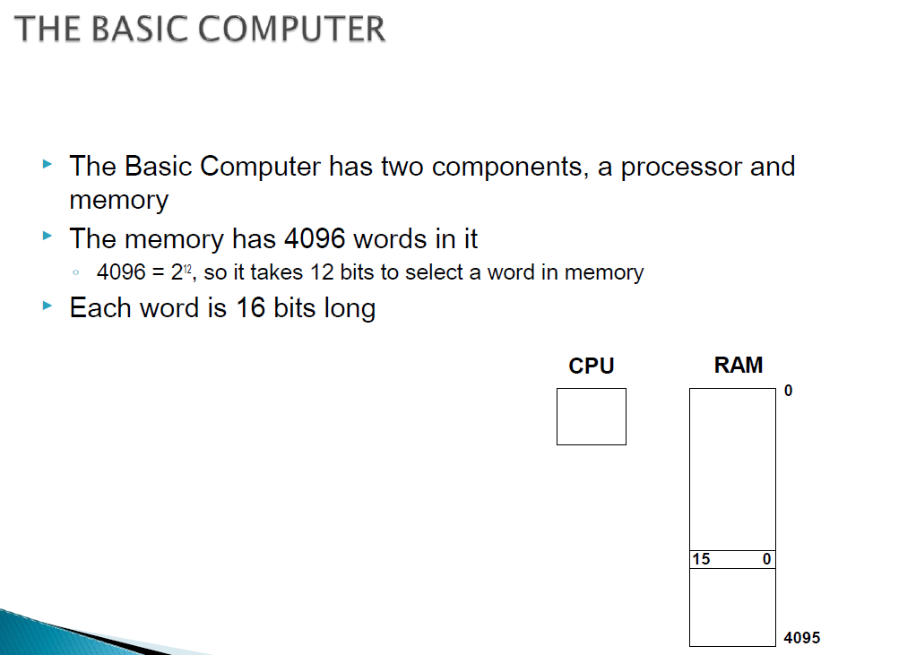

Slide 5
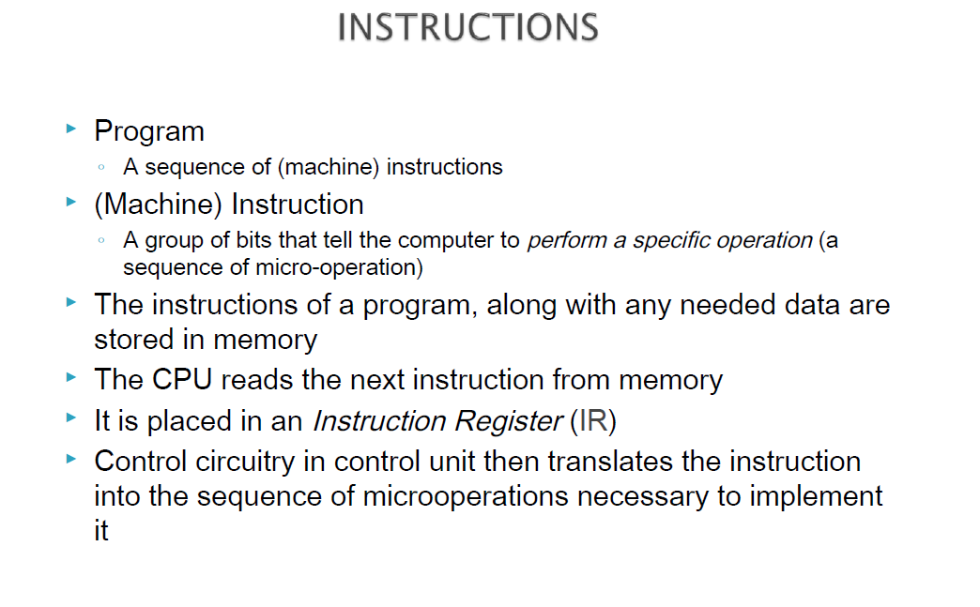

Slide 6
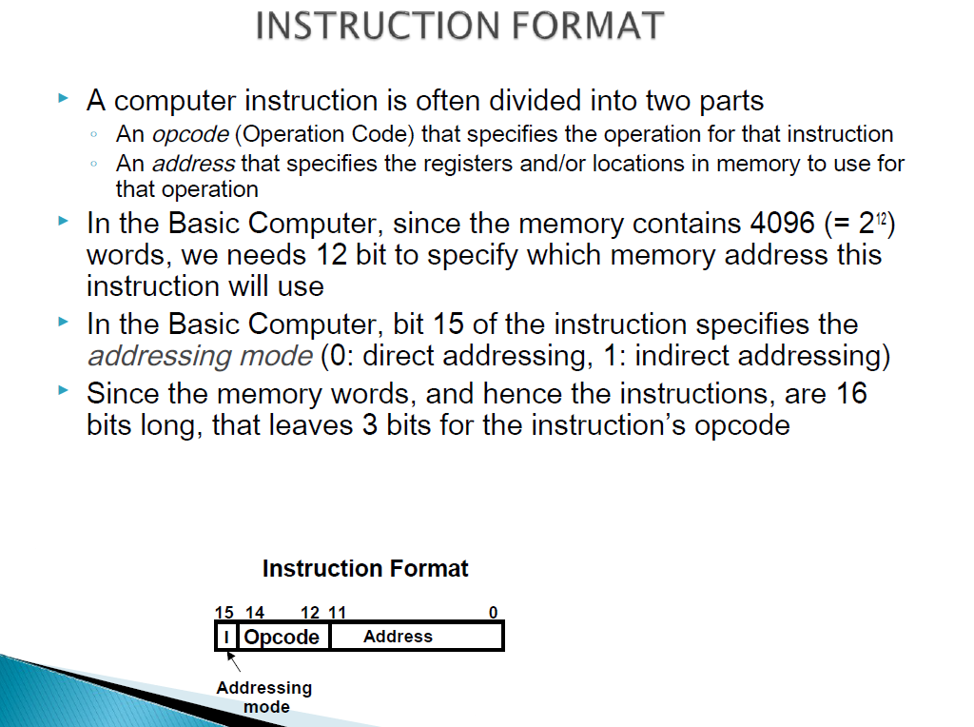

Slide 7
Instruction code format
Instruction code format with two parts : Op. Code + Address
Op. Code : specify 16 possible operations(4 bits)
Address : specify the address of an operand(12 bits)
If an operation in an instruction code does not need an operand from memory, the rest of the bits in the instruction(address field) can be used for other purpose
15 12 11 0
15 12 11 0
Op. Code Address
data
instruction
Not an instruction

Slide 8
Components of Instructions
Operations (opcodes)
Number of operands (Number of data locations)
opcode:add value in src1 to
value in src2 and place the
result in dst.
ADD R1, R2, R3 R1 ← R2 + R3
Instruction encodings
add r1,r2,r3
opcode
src1
src2
dst

Slide 9
Number of Operands per instruction
No Operands HALT NOP
1 operand NOT R4 R4 ← R4
2 operands ADD R1, R2 R1 ← R1 + R2
3 operands ADD R1, R2, R3 R1 ← R2 + R3
> 3 operands MADD R4,R1,R2,R3 R4 ← R1+(R2*R3)
Each specify one operation and 1,2, 3 or 4 data locations.
Notes:
9

Slide 10
Instructions are read from memory as words
Instructions can be formatted to fit in one or more memory words.
An instruction may contain
An opcode + data (immediate operand)
An opcode + the address of data (direct addressing)
An opcode + an address where the address of the data is found (indirect addressing)
Data only (location has no instructions)
An opcode only (register-reference or input/output instruction)
Notes:
10

Slide 11
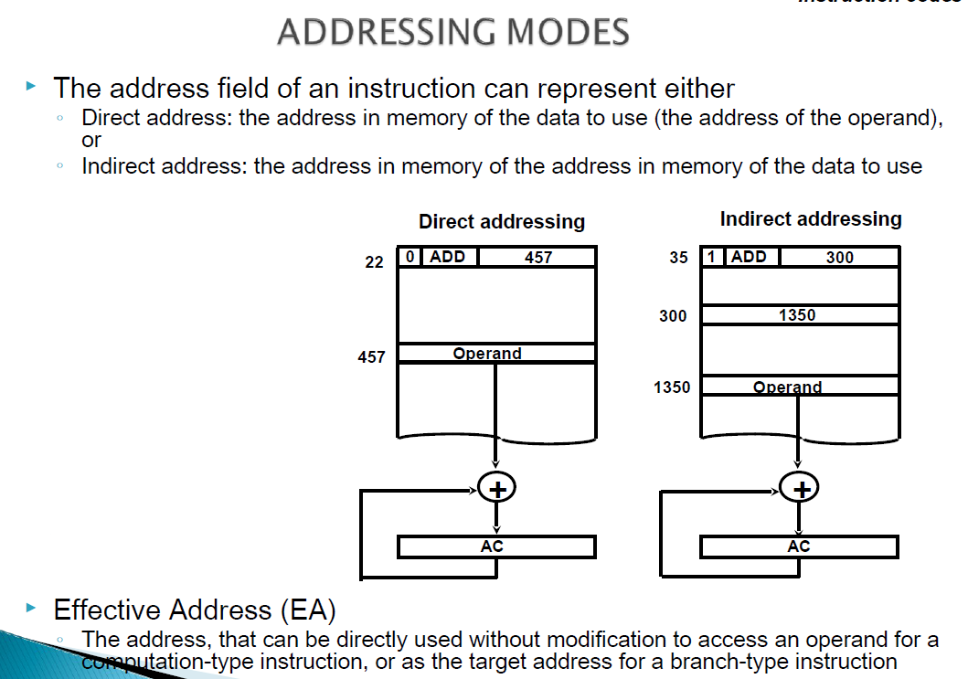

Slide 12
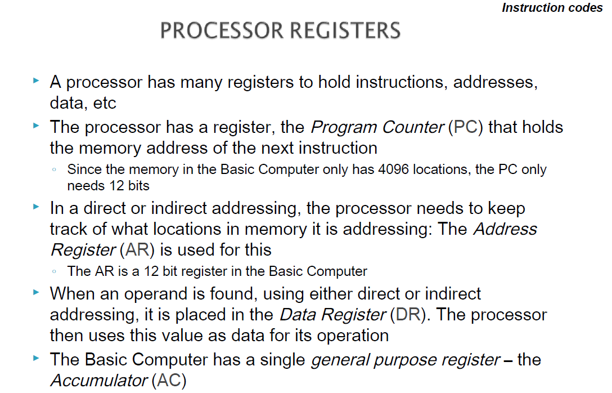

Slide 13
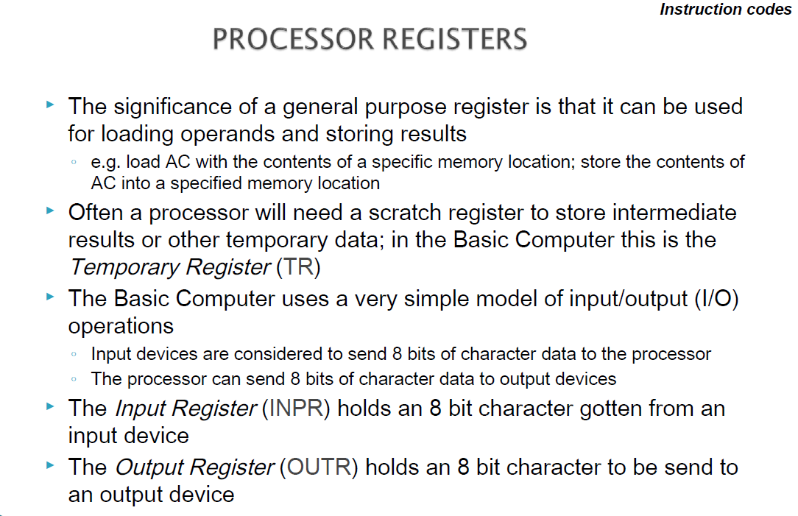

Slide 14
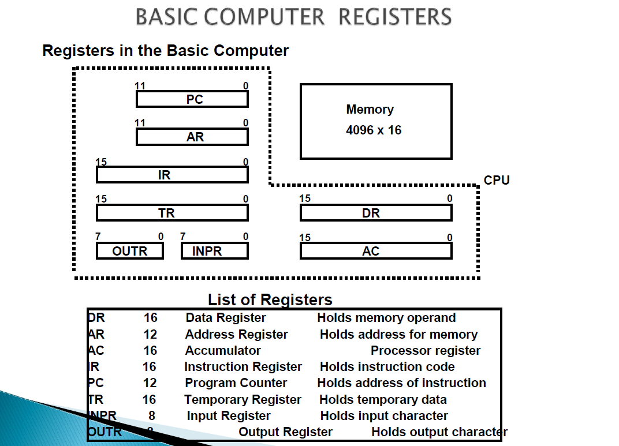

Slide 15
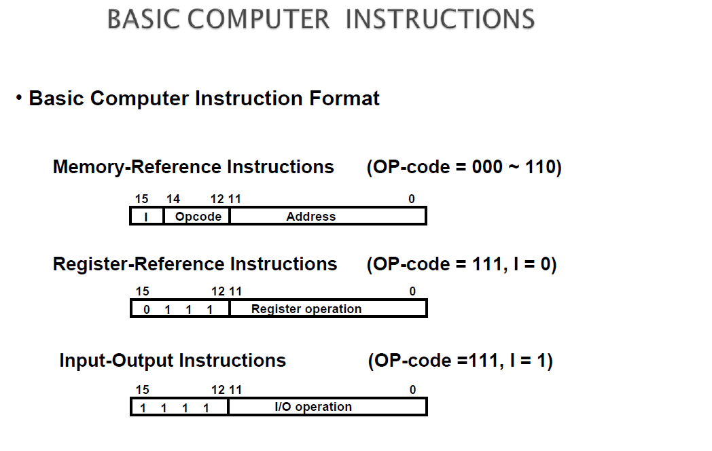

Slide 16
