Slide 1
Computer Organization and Architecture
ETCS-204
Dr. Deepak Gupta
Computer Science & Engineering
Maharaja Agrasen Institute of Technology, Delhi (GSIPU)
Email: drdeepakgupta.cse@gmail.com, deepakgupta@mait.ac.in
Web: sites.google.com/view/drdeepakgupta

Slide 2
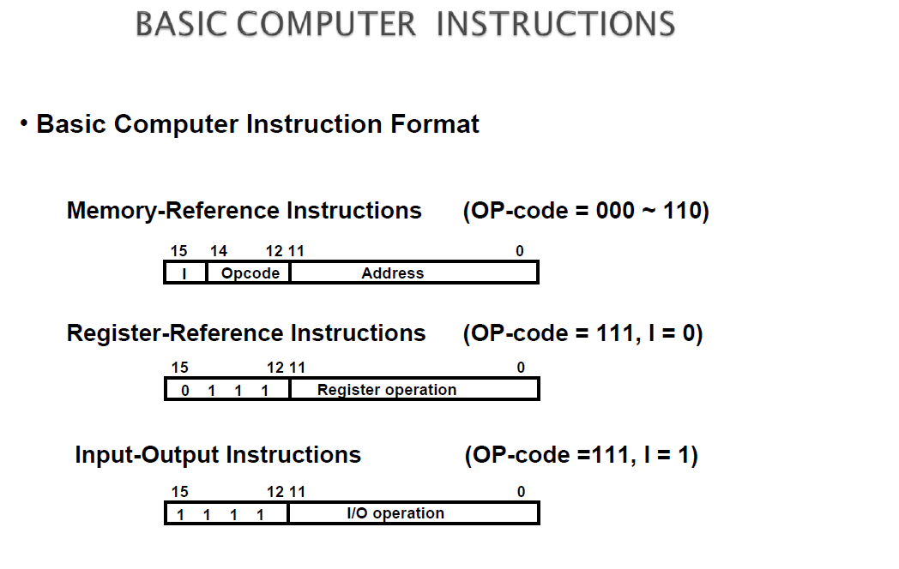

Slide 3
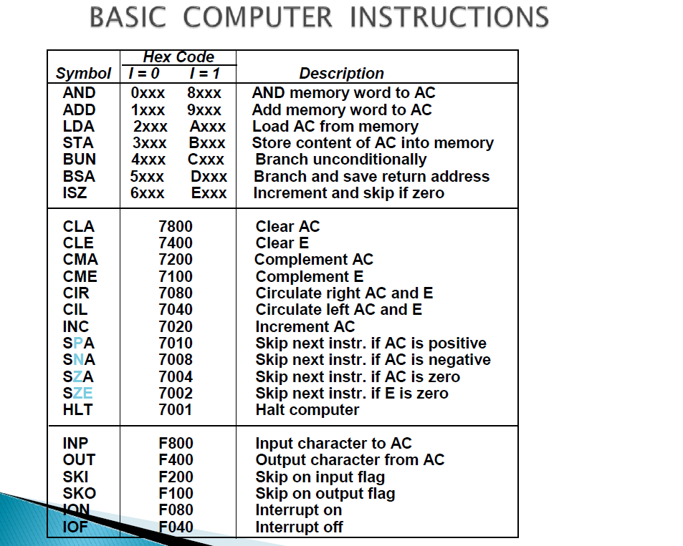

Slide 4
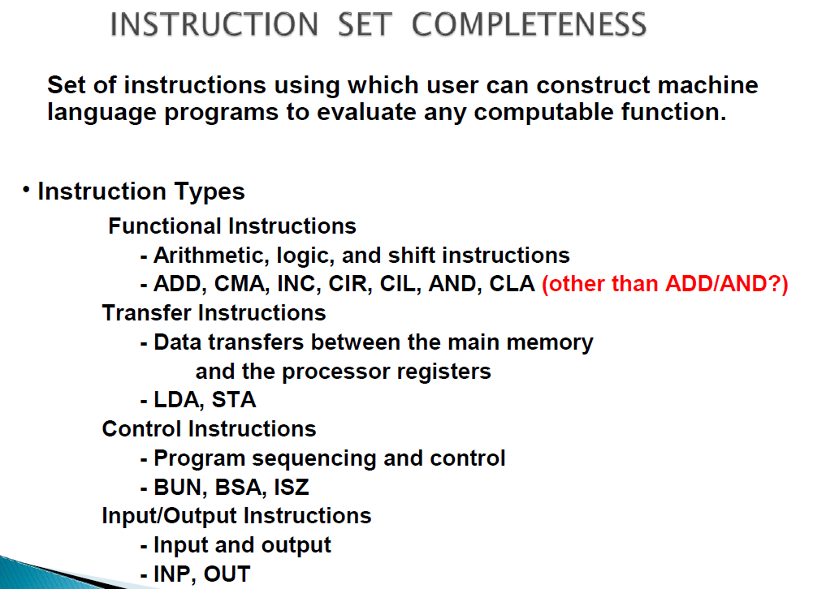

Slide 5
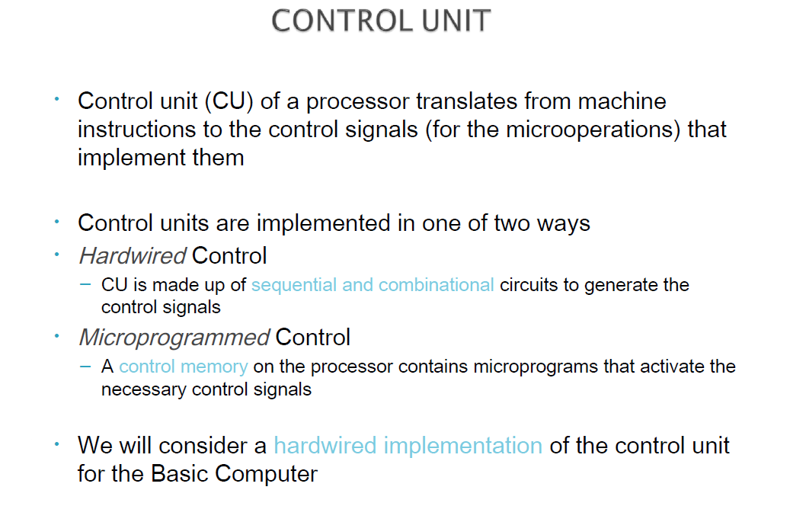

Slide 6
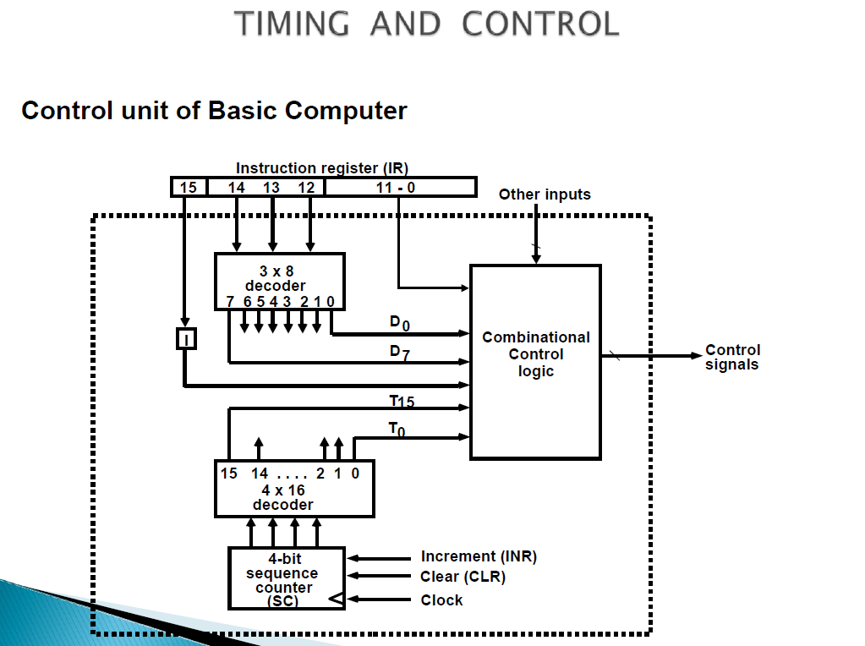

Slide 7
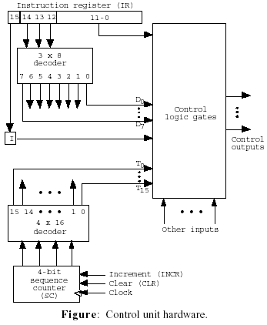
A 4-bit binary sequence counter (SC) to count from 0 to 15 to achieve time sequencing;
> A 4x16 decoder to decode the output of the counter into 16 timing signals, T0, ..., T15
A digital circuit with inputs
D0, ..., D7, T0, ..., T15, I,
and address bits in IR (11-0)
to generate control outputs
supplied to control inputs and select signals of registers , bus.
Notes:
7

Slide 8
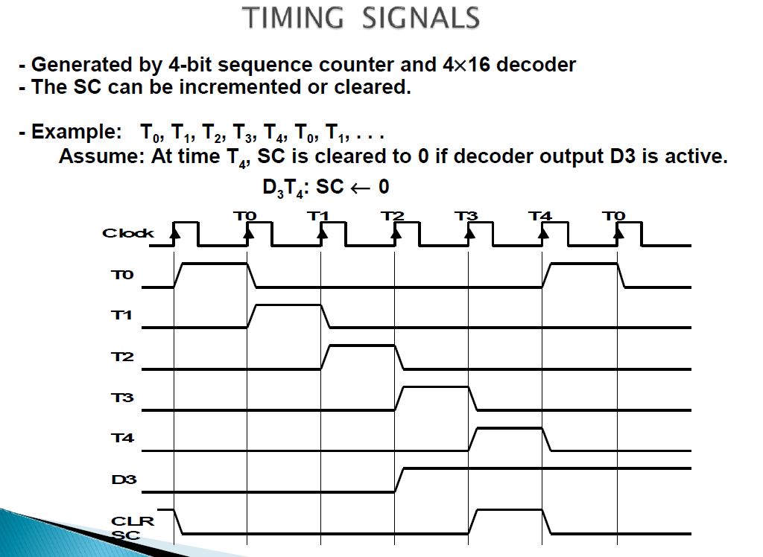

Slide 9
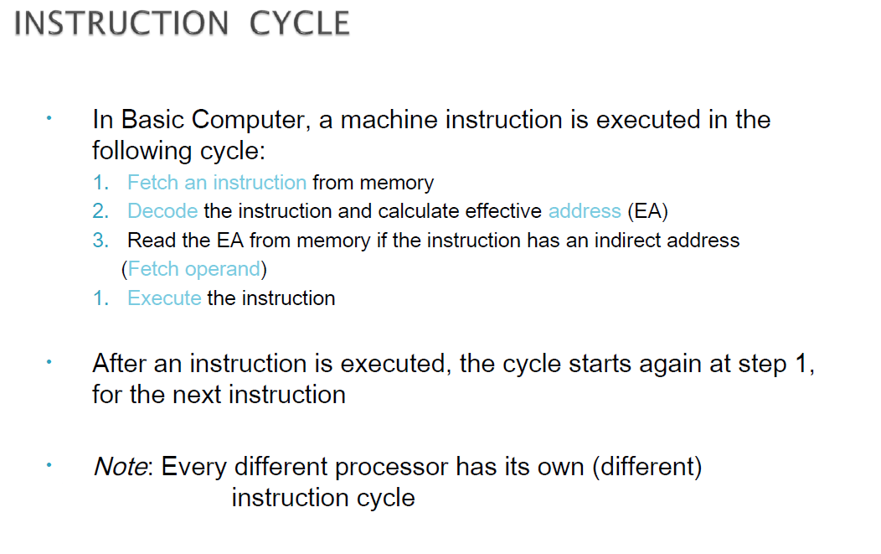

Slide 10
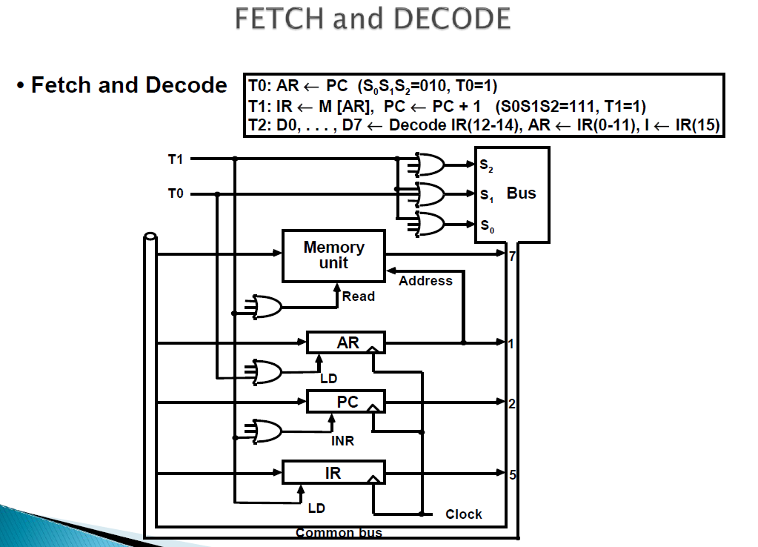

Slide 11
