Slide 1
Computer Organization and Architecture
ETCS-204
Dr. Deepak Gupta
Computer Science & Engineering
Maharaja Agrasen Institute of Technology, Delhi (GSIPU)
Email: drdeepakgupta.cse@gmail.com, deepakgupta@mait.ac.in
Web: sites.google.com/view/drdeepakgupta

Slide 2
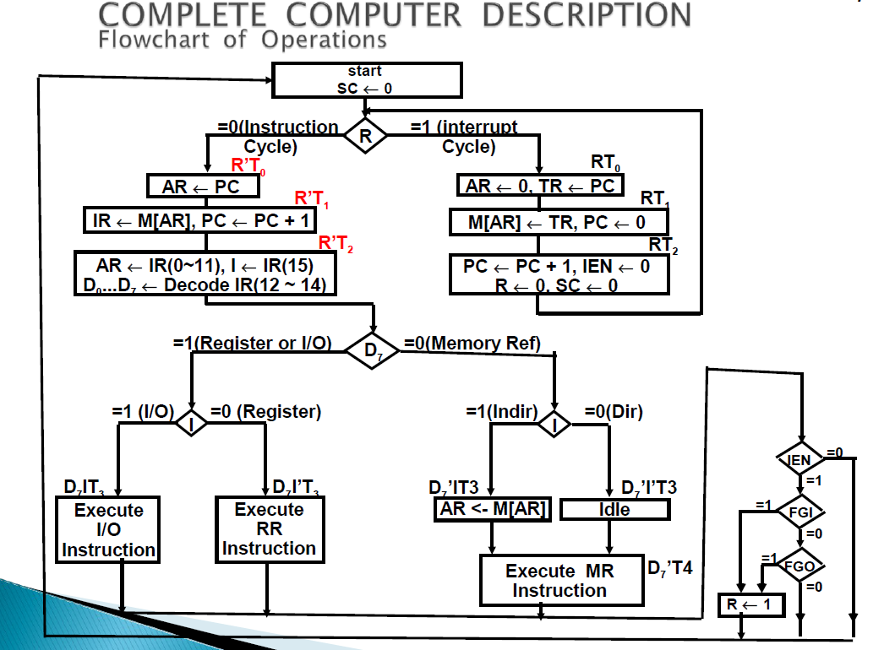

Slide 3
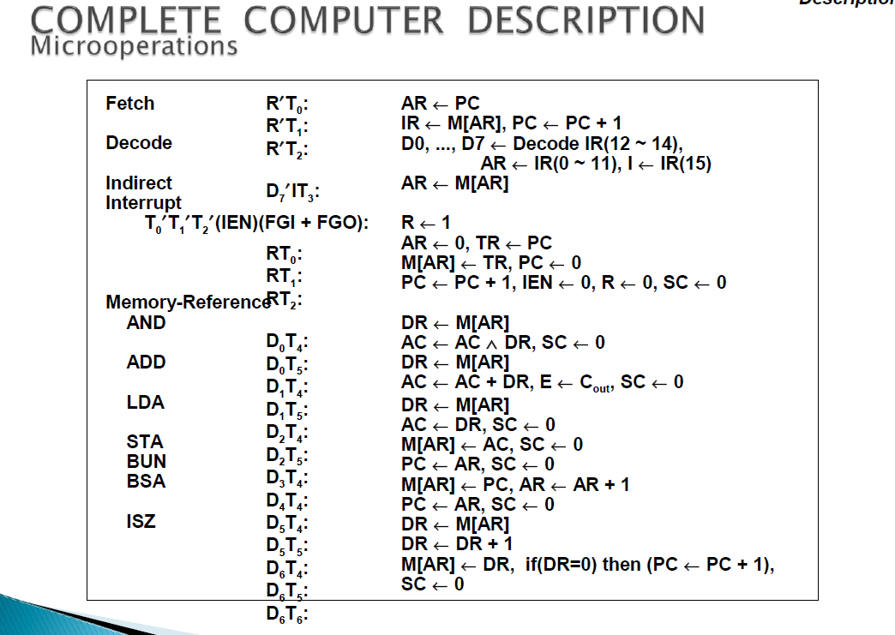

Slide 4
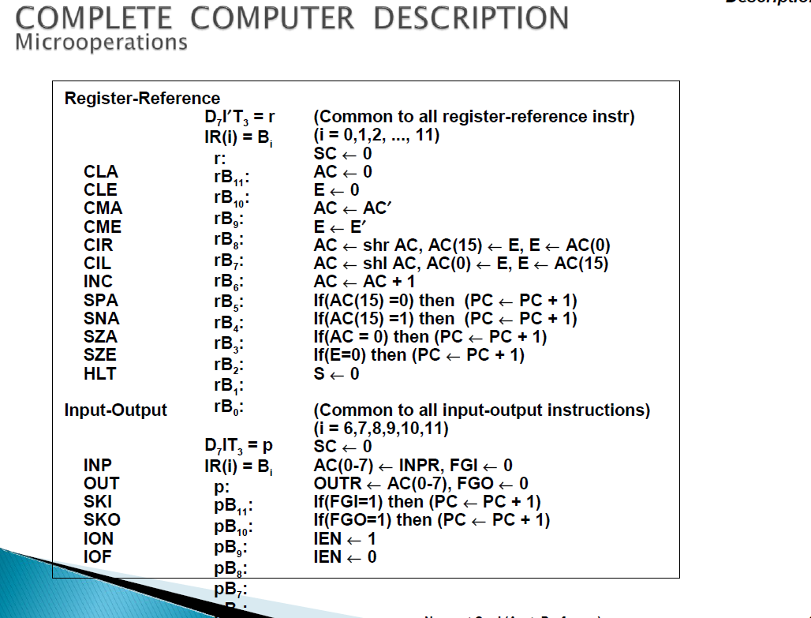

Slide 5
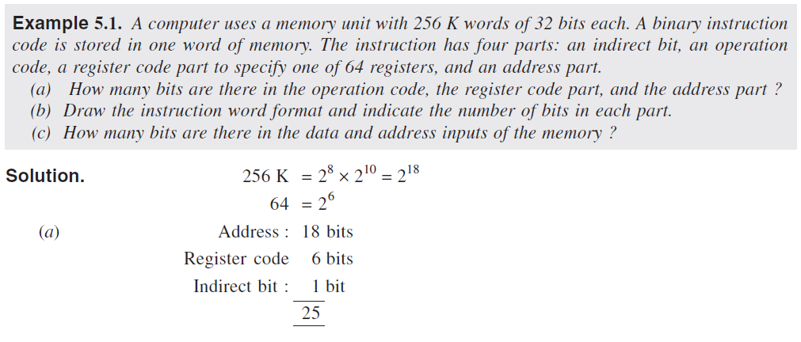

Some Solved Examples

Slide 6
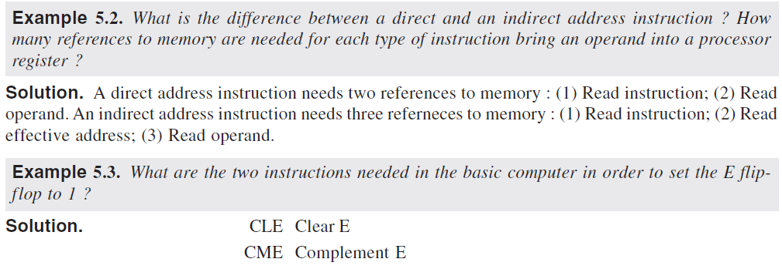

Slide 7
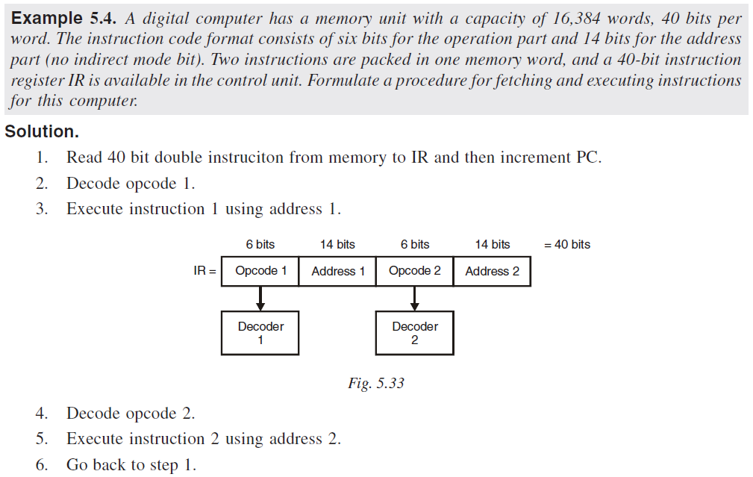

Slide 8




Slide 9



Slide 10
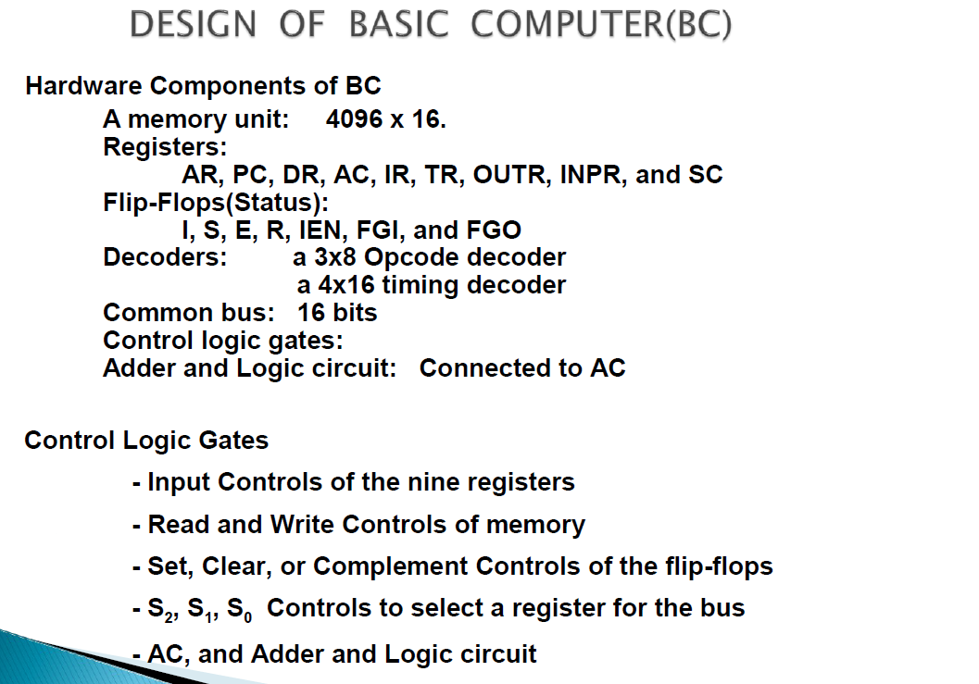

Slide 11
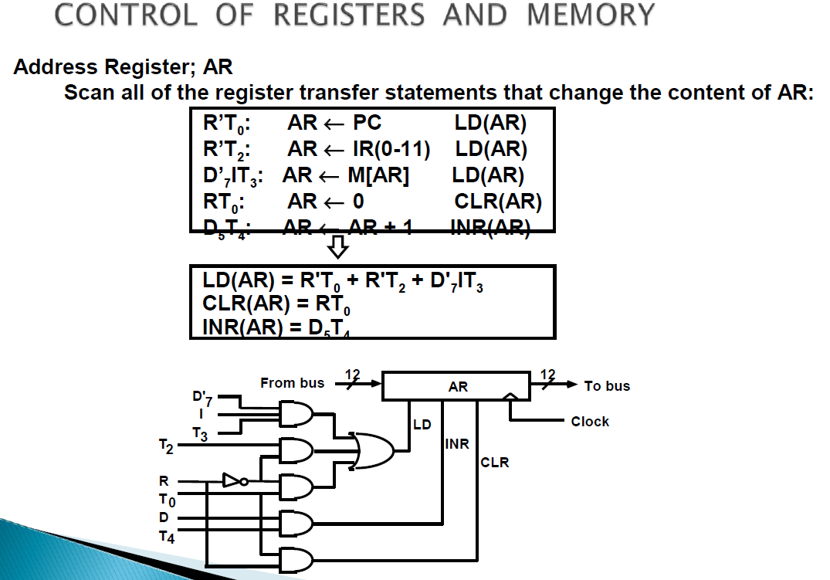

Slide 12
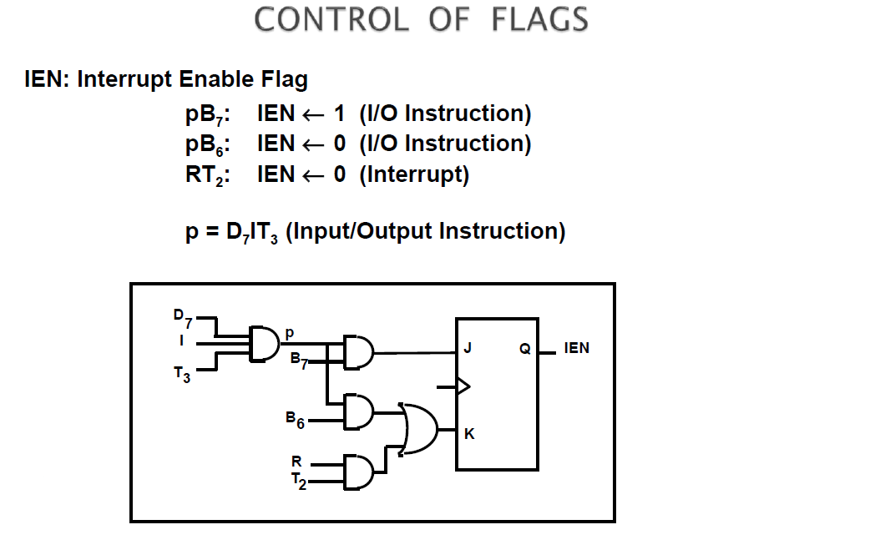

Slide 13
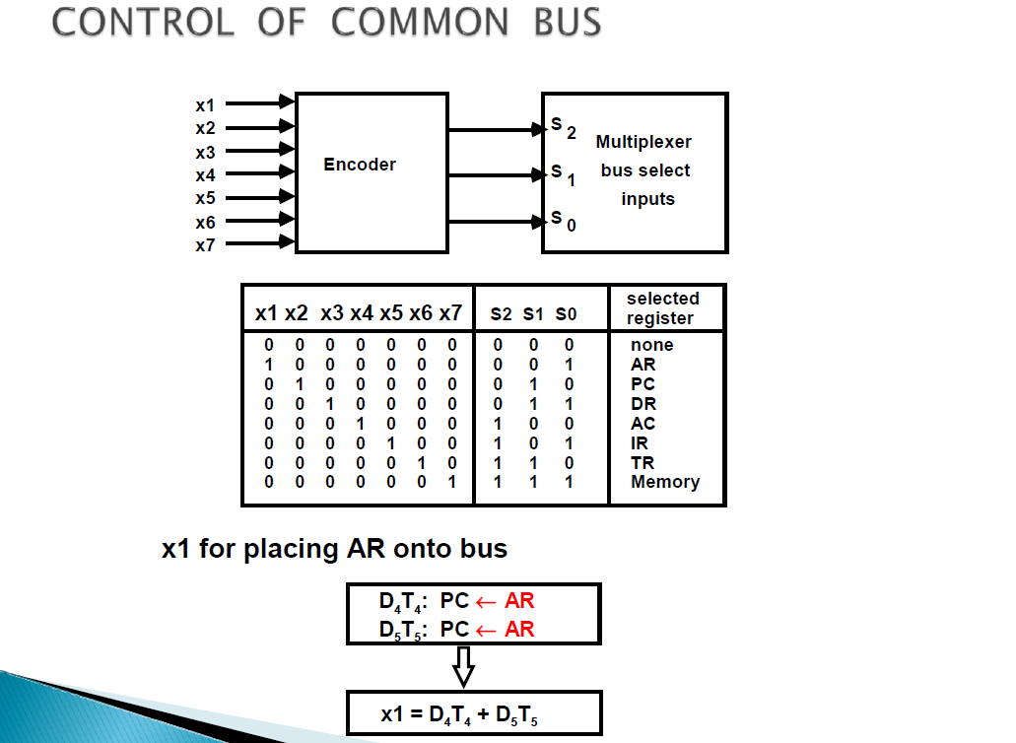

Slide 14
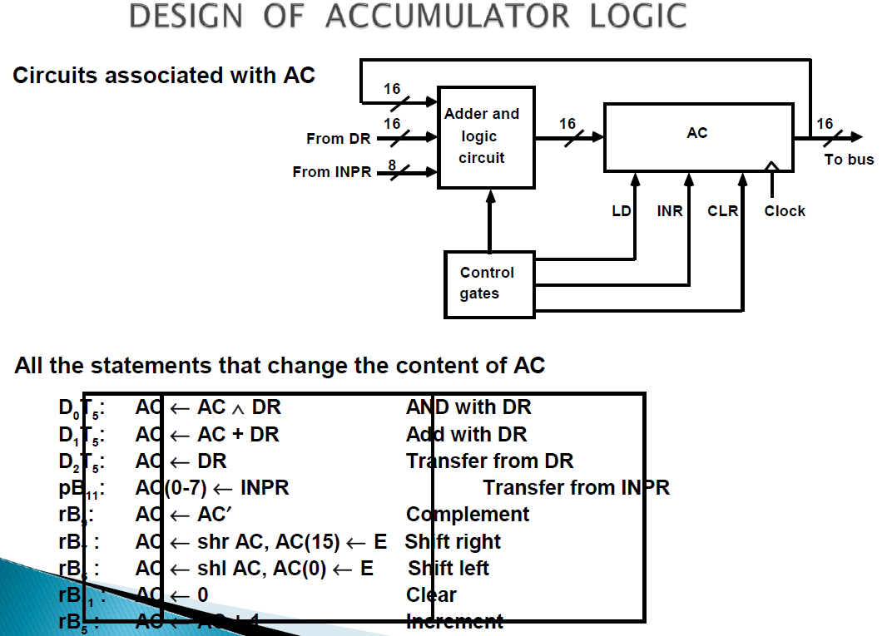

Slide 15
