Slide 1
Computer Organization and Architecture
ETCS-204
Dr. Deepak Gupta
Computer Science & Engineering
Maharaja Agrasen Institute of Technology, Delhi (GSIPU)
Email: drdeepakgupta.cse@gmail.com, deepakgupta@mait.ac.in
Web: sites.google.com/view/drdeepakgupta

Slide 2
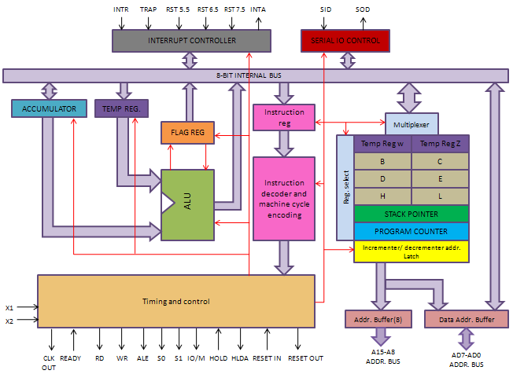
Internal Architecture of 8085 Microprocessor

Slide 3
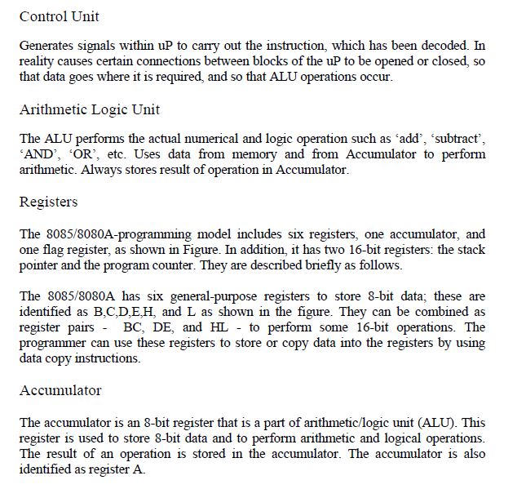

Slide 4
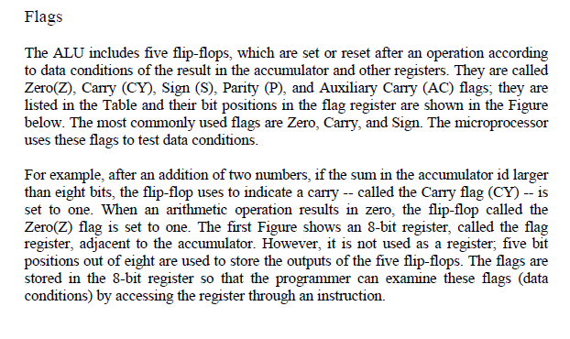
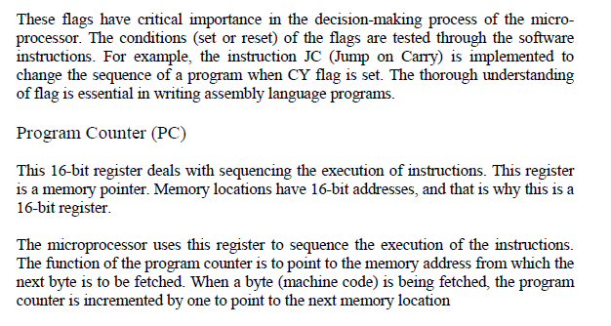

Slide 5
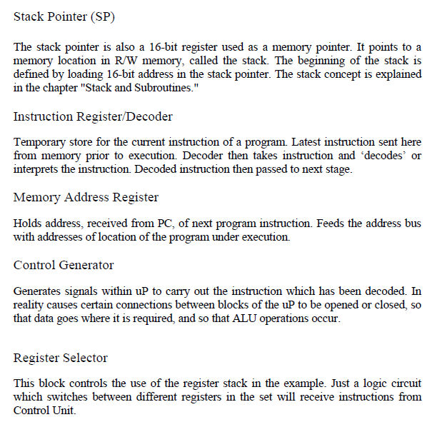

Slide 6
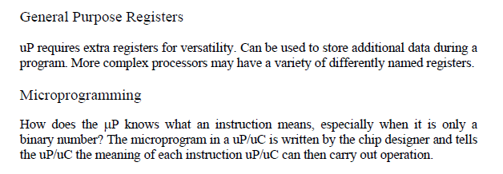

Slide 7
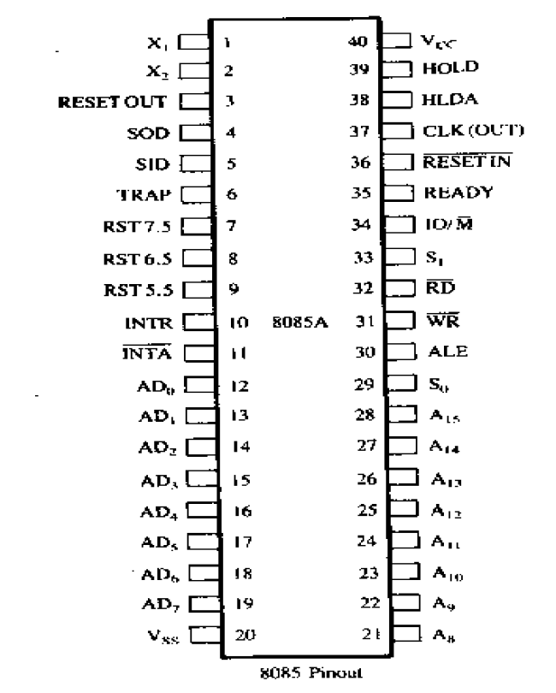
Pin Diagram of 8085 Microprocessor

Slide 8
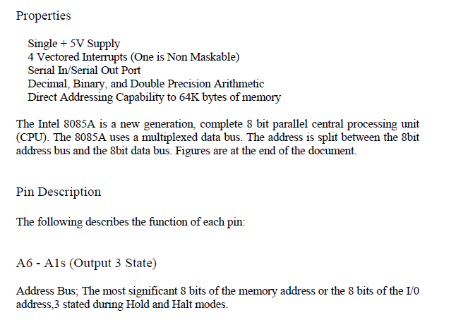

Slide 9
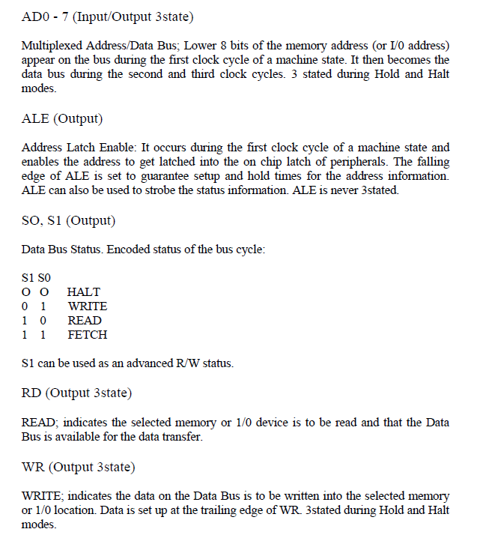

Slide 10
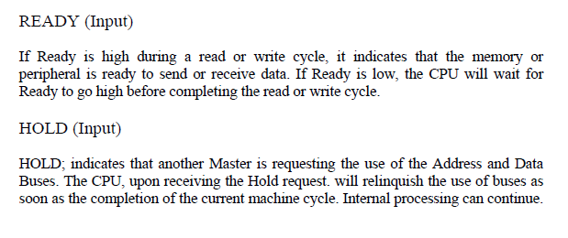
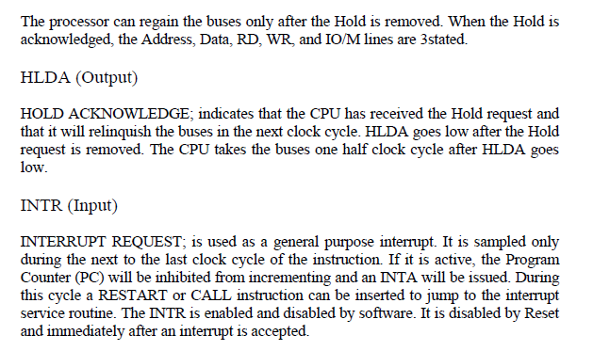

Slide 11
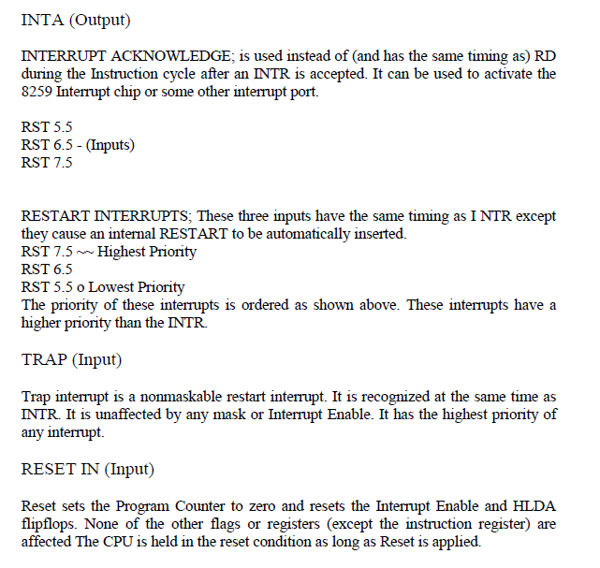

Slide 12
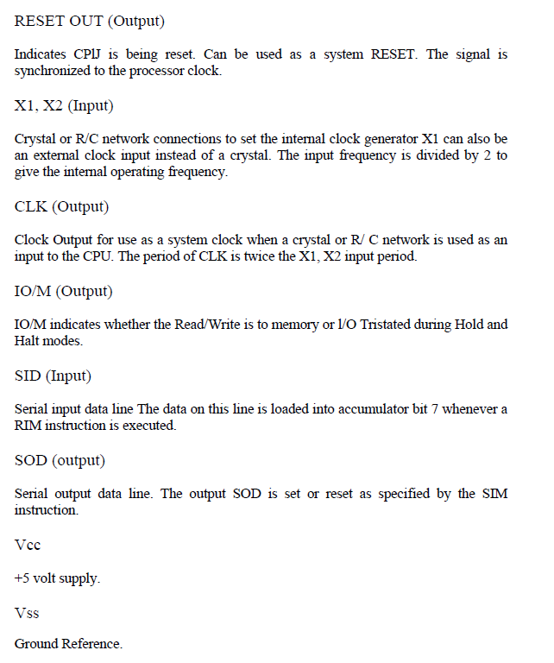

Slide 13
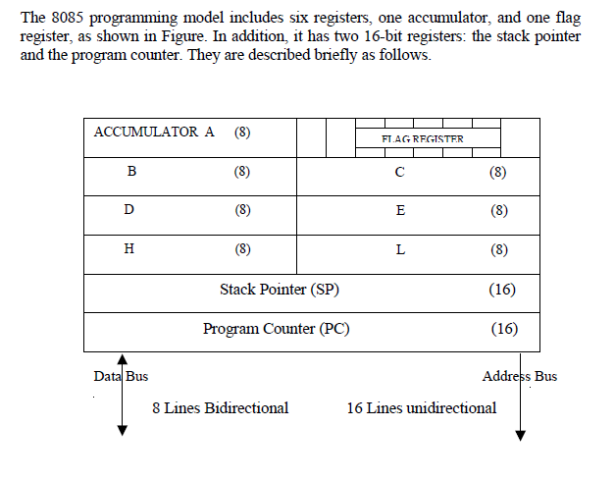
8085 Programming Model

Slide 14
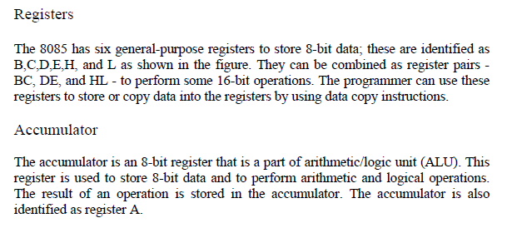
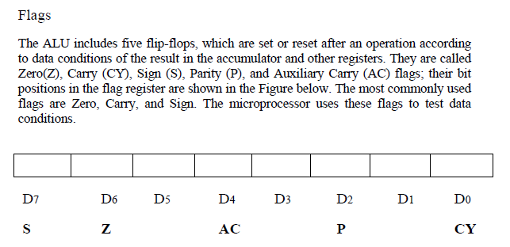

Slide 15
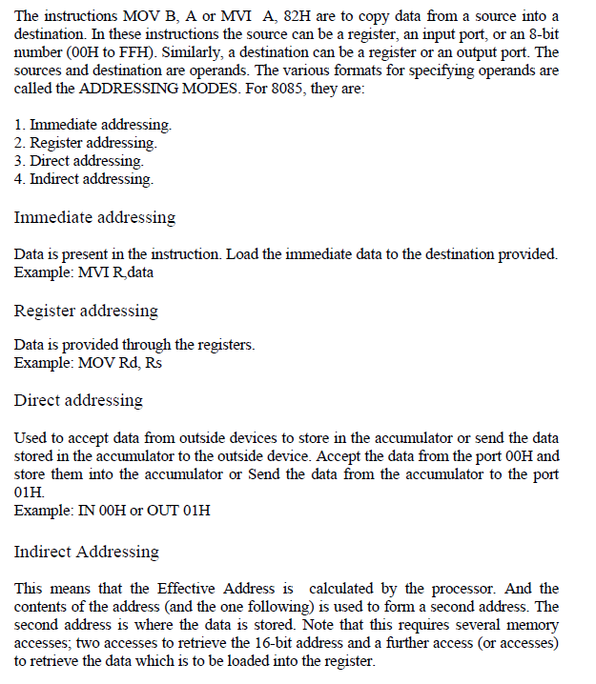
8085 Addressing Modes

Slide 16
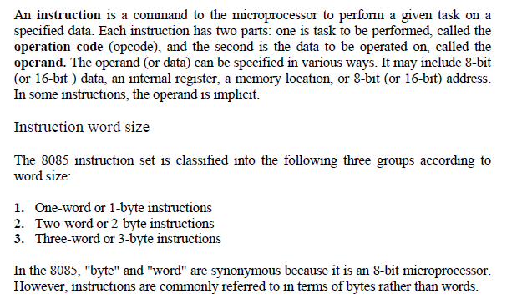
Type of Instructions

Slide 17
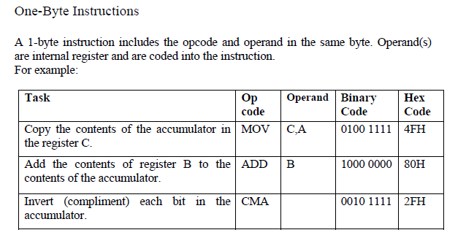

Slide 18
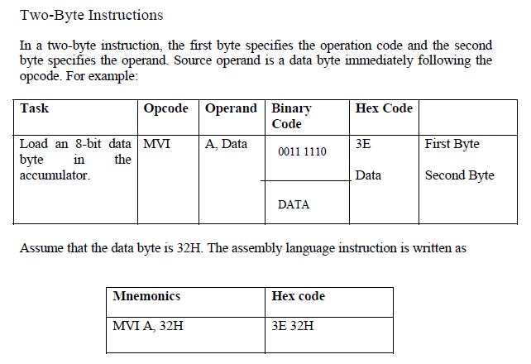

Slide 19
