Slide 1
Disability
Presentation By-
Bharat Kumar 12814802719
Anuj Dhingra 13014802719
Varun Negi 13314802719
Ria Monga 13514802719
Syeda Reeha Quasar 14114802719

Slide 2
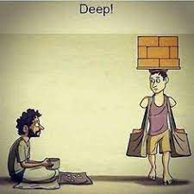
What Do you see?
“Never stand begging when you have the power to earn”
Notes:
Reeha

Slide 3
What is DisAbility?
Limits or challenges a person faces
Not all disabilities is visible!
Disability is not Inability
Notes:
This is a word made with a combination of 2 words dis and ability. Ability is the resource to perform well at something and when we prefix with dis it becomes disability and it means limits or challenges a person faces. It is not a word we associate with people with special needs but it's something that anyone can face. If I have to associate this word with people, I will associate it with someone whose circumstances limit them from dreaming, someone who has stopped trying, someone who is not trying to find solutions or ways, and this someone can be anyone of us.
REEHA

Slide 4
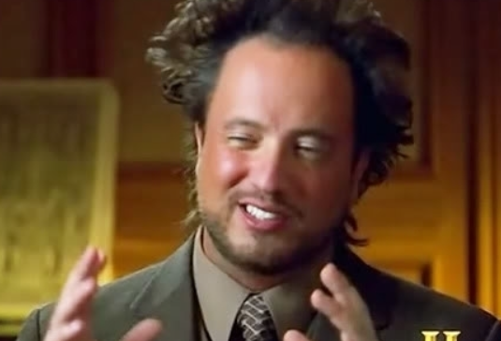
Excuses don’t WORK in life
“I don’t believe I can do it.”
This attitude is one of the major reasons why people don’t start.
If success was free, everyone would have it.
But there are few successful individuals and each of them had put in enough productive work irrespective of in what condition they were before they received anything in return.
In life, you can blame a lot of people and you can wallow in self-pity, or you can pick yourself up and say, listen, I have to be responsible for myself.
Notes:
ANUJ The right mindset will take you to places that one can not even imagine. If you have the right mindset in life and are willing to achieve something and do something for the society then excuses won’t really matter to you irrespective of whatever disability you have. On the other hand if your mindset in not right no matter what resources you have in hand nothing can take you to success . One must always follow the path of hard work and sooner or later success would follow you instead of excuses. Adaptability is must in life.
Adaptability expands your capacity to handle change, no matter how serious it might be. Instead of throwing away your energy trying to change your circumstance, you will change yourself right from within, thus making you thrive in whatever situation you find yourself.

Slide 5
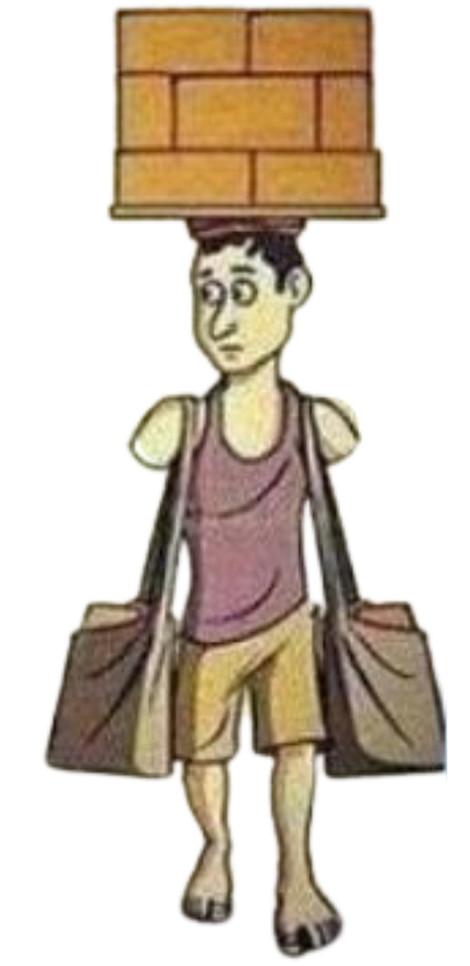
Current STATE or resources Does not limit ANYONE
There is no greater disability in society than the inability to see oneself as more, limiting us to the comfort zone we created.
If I can do it, why can’t you?
A Disable person have chance to rise and a chance to try again and again but a person with “ I don’t believe I can do it “ - attitude, is failing even before trying
Notes:
ANUJ

Slide 6
InspiRATION
Christopher Reeve
Albert Einstein
Ravindra Jain
Frida Kahlo
Ludwig Van Beethoven
Stephen Hawking
Nicholas James Vujicic
George Washington
Tom Cruise
Helen Keller
Rowan Atkinson
Franklin D. Roosevelt
Arunima Sinha
Sudha Chandran
Walt Disney
Notes:
VARUN There are many great and successful person who have some kind of disability but still doesn’t let it stop them.
Helen Keller lose her sight and hearing after a bout of illness at the age of nineteen months.
Keller was a prolific author, writing 14 books and hundreds of speeches and essay on topics ranging from animals to Mahatma gandhi.
The Father of Theory of Relativity was one of the most famous people with disabilities. He faced difficulty in learning and was not unable to speak until he was 3 years old. He faced major issues in doing the basic maths in school. Expressing himself by writing was also a mammoth task for him. One of his famous quotes was “Insanity: doing the same thing over and over again and expecting different results.”
https://www.narayanseva.org/blog/15-inspirational-people-with-disabilities

Slide 7

—Mary Kay Ash
“Aerodynamically the bumblebee shouldn't be able to fly. But the bumblebee doesn't know that so it goes on flying anyway.”
Notes:
VARUN The bumblebee doesn’t know or care that to us it looks more like a small insect than a creature that can fly at around 10 miles an hour with remarkable maneuverability. It is unconcerned with what we think of it and with human theories of flight. How birds and planes fly doesn’t matter to the bumblebee. What matters to the bumblebee is that it has a job to do and the tools to do it. You and I have jobs to do, purposes to fulfill, things we feel drawn to do – and we have many, maybe all the tools we need to do it.
Don’t let anyone tell you that you can’t, be your own person and do it anyway. There are no limits to what we can achieve, we only limit ourselves with our own thinking.

Slide 8
SolutionS
SMALL STEPS
Try
Deciding to take small steps towards your tasks makes the task look easier.
It’s important to have motivation and keep on making efforts and trying.
Attainable Goals
DESIRE
Choose goals to help you motivate yourself, but not so big that you freeze when facing them.
Hard work and perseverance are the open secrets to success. But how many are willing to do that?
Notes:
RIA MONGA
SMALL STEPS - Eg: The 5-min rule.
DESIRE - If you have a strong desire to transform your life and willing to die for it, you are more likely to succeed.
ATTAINABLE GOALS: We often end selecting very high goals for us, which are doomed to fail. This leads to disappointment and lack of motivation.
DON’T GIVE UP ON TRYING
KEEP THAT DESIRE BURNING
Extras
BE KIND TO YOURSELF
GRATITUDE: You can express for the things you have, and work to express gratitude

Slide 9

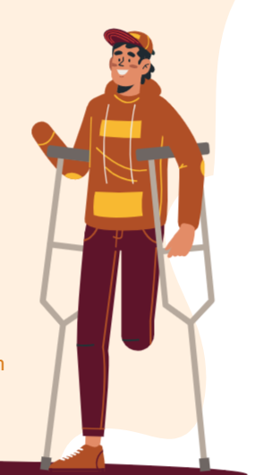

Conclusion
Disability is not an obstacle to success; wrong mindset is.
Be deaf when people tell you that you can not fulfill your dreams and goal.
We all have our comfort zones, whether we have a disability or not, and stepping out of those comfort zones can be more difficult for some people than others.
Always believe that universe has something in store for everyone.
No matter what you can do it.
Notes:
BHARAT

Slide 10
THANKS
Do you have any questions?

