Slide 1
Switching Theory and Logic Design (STLD)
Theory - ETEC-205
B. Tech – 3rd Sem
August 2020 – January 2021
Faculty: Ms. Anubha Goel

Slide 2
STLD Lesson Plan

Slide 3
Outline of the lecture
Combinational circuits
Magnitude comparator
Parity generator
Decoder
Encoder
Priority encoder
Multiplexer
Demultiplexer

Slide 4
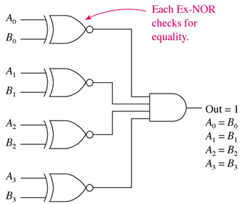
magnitude comparator
Combinational circuit that compares the magnitude of two binary numbers, A and B, to determine whether (A > B), (A < B) or (A = B)
For two 4-bit numbers, A (A₃A₂A₁A₀) and B (B₃B₂B₁B₀), there are three possible cases
CASE 1: [A = B]
If and only if all pairs of corresponding bits are equal, i.e. A₃ =B₃ and A₂ =B₂ and A₁ =B₁ and A₀ =B₀
This equality can be represented by a logic function
x_{i} = A_{i}B_{i} +A_{i}’B_{i}’ for i = 0,1,2,3
‘x_{i}’ = 1, if bits at i^{th} position are equal, i.e. if both are 1 or both are 0
For A=B, all ‘x_{i}’ should be 1, indicating AND of all x_{i}
Therefore, [A = B] = x₃ x₂ x₁ x₀

Slide 5
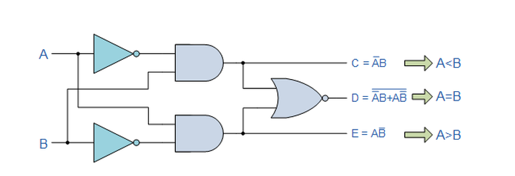
magnitude comparator
Determining whether (A > B) or (A < B), requires comparison of magnitudes of pairs of corresponding bits
Comparison of numbers, A (A₃A₂A₁A₀) and B (B₃B₂B₁B₀) start from the most significant bit (MSB) position. If both are equal, them next lower significant pair bits are compared
Comparison is done till a pair of unequal bits is obtained
Among the unequal pair, if
Corresponding digit of A is ‘1’ and B is ‘0’, then A > B
Corresponding digit of A is ‘0’ and B is ‘1’, then A < B

Slide 6
magnitude comparator
CASE 2 : [A > B]
If (A₃ = 1 & B₃ = 0)
If A₃ = B₃ and (A₂ = 1 & B₂ = 0)
If A₃ = B₃ , A₂ = B₂ and (A₁ = 1 & B₁ = 0)
If A₃ = B₃ , A₂ = B₂ , A₁ = B₁ and (A₀ = 1 & B₀ = 0)
This inequality can be represented by a logic function
[A > B] = A₃B₃’ + x₃ A₂B₂’ + x₃ x₂ A₁B₁’ + x₃ x₂ x₁ A₀B₀’
CASE 3 : [A < B]
If (A₃ = 0 & B₃ = 1)
If A₃ = B₃ and (A₂ = 0 & B₂ = 1)
If A₃ = B₃ , A₂ = B₂ and (A₁ = 0 & B₁ = 1)
If A₃ = B₃ , A₂ = B₂ , A₁ = B₁ and (A₀ = 0 & B₀ = 1)
This inequality can be represented by a logic function
[A < B] = A₃’B₃ + x₃ A₂’B₂ + x₃ x₂ A₁’B₁ + x₃ x₂ x₁ A₀’B₀
[A=B], [A>B] and [A<B] are considered the output variables of the magnitude comparator, which equals to logic ‘1’ or HIGH, according to the magnitudes of A and B

Slide 7
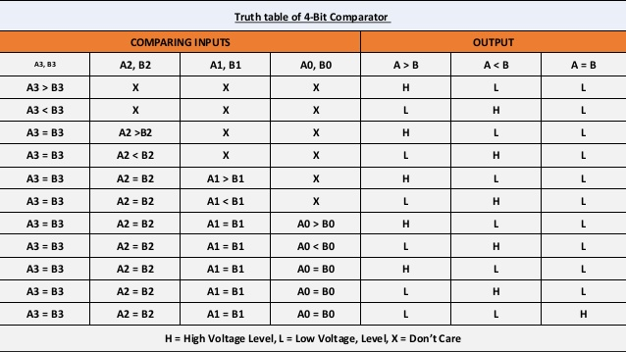
magnitude comparator

Slide 8
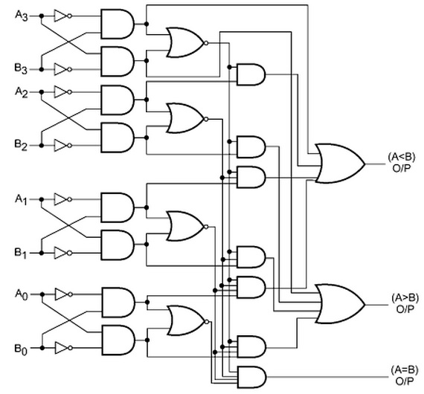
magnitude comparator
The logic circuit of magnitude comparator
NOR gates to check the equality and hence, calculate ‘x_{i}’
AND, OR and NOT gates to check Inequality

Slide 9
PARITY GENERATOR and checker
PARITY bit is an extra bit which is used for the purpose of error detection
While transmitting the binary message, parity bit is attached with the message bits such that the count of number of 1’s is either odd or even
The receiver counts the number of 1’s in the received data and detects an error by checking the parity
Parity check can detect only single bit errors
At the transmitter end, the circuit that generates parity bit is called Parity Generator
At the receiver end, the circuit that checks the parity is called Parity Checker
According to the number of 1’s, there are classified as
EVEN parity - the total number of 1’s in the transmitted data (binary message including parity bit) is even
ODD parity - the total number of 1’s in the transmitted data (binary message including parity bit) is odd

Slide 10
PARITY GENERATOR and checker
EVEN-PARITY GENERATOR
Parity bit is added at the beginning or at the end of the message
The EVEN parity bit (P) for 4-bit message signal D₃D₂D₁D₀, is generated by counting number of 1’s in D₃D₂D₁D₀
P=1, if the count of 1’s in the 4-bit input is odd (such that the count of 1’s in the 4-bit input and parity bit together is even)
P=0, if the count of 1’s in the 4-bit input is even
4-BIT MESSAGE |  |  |  | PARITY BIT
D₃ | D₂ | D₁ | D₀ | P
0 | 0 | 0 | 0 | 0
0 | 0 | 0 | 1 | 1
0 | 0 | 1 | 0 | 1
0 | 0 | 1 | 1 | 0
0 | 1 | 0 | 0 | 1
0 | 1 | 0 | 1 | 0
0 | 1 | 1 | 0 | 0
0 | 1 | 1 | 1 | 1
1 | 0 | 0 | 0 | 1
1 | 0 | 0 | 1 | 0
1 | 0 | 1 | 0 | 0
1 | 0 | 1 | 1 | 1
1 | 1 | 0 | 0 | 0
1 | 1 | 0 | 1 | 1
1 | 1 | 1 | 0 | 1
1 | 1 | 1 | 1 | 0

Slide 11
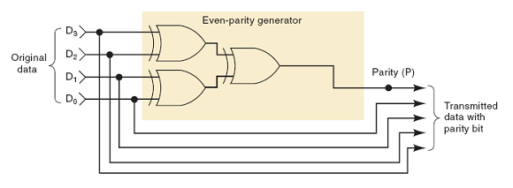
PARITY GENERATOR and checker
EVEN-PARITY GENERATOR
By truth table the equation for output parity bit (P) is obtained as
P = D₃ (XOR) D₂ (XOR) D₁ (XOR) D₀
The logic circuit for even parity generator requires 3 XOR gates

Slide 12
PARITY GENERATOR and checker
PARITY CHECKER
At the receiver occurrence of an error is reported, if
the number of 1’s are even in an odd parity system or
the number of 1’s are odd in even parity system
To check the error, all the bits in the received data are XORed to give an output ERROR (E).
If E=1, then there is an error
If E=0, then there is no error during the transmission
4-BIT MESSAGE PARITY BIT |  |  |  |  | ERROR BIT
D₃ | D₂ | D₁ | D₀ | P | E
0 | 0 | 0 | 0 | 0 | 0
0 | 0 | 0 | 1 | 1 | 0
0 | 0 | 1 | 0 | 0 | 1
0 | 0 | 1 | 1 | 1 | 1
0 | 1 | 0 | 0 | 0 | 1
0 | 1 | 0 | 1 | 0 | 0
0 | 1 | 1 | 0 | 0 | 0
0 | 1 | 1 | 1 | 1 | 0
1 | 0 | 0 | 0 | 0 | 1
1 | 0 | 0 | 1 | 1 | 1
1 | 0 | 1 | 0 | 0 | 0
1 | 0 | 1 | 1 | 0 | 1
1 | 1 | 0 | 0 | 0 | 0
1 | 1 | 0 | 1 | 1 | 0
1 | 1 | 1 | 0 | 0 | 1
1 | 1 | 1 | 1 | 0 | 0

Slide 13
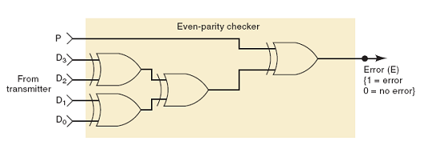
PARITY GENERATOR and checker
EVEN-PARITY CHECKER
The equation for output error bit (E) is obtained as
E = D₃ (XOR) D₂ (XOR) D₁ (XOR) D₀ (XOR) P
The logic circuit for even parity generator requires 4 XOR gates

Slide 14
Decoder
Combinational circuit that converts ‘n’ binary input line code into ‘m’ output lines is called a DECODER
For ‘n’ input lines, there are 2^{n} possible input combination. For each possible input combination only one output line is active, hence m is equal to 2^{n}
Referred as n:m or n-to-m line decoder, where m = 2^{n}
Few are 1:2, 2:4, 3:8, 4:16 and so on
There may/may not be an additional control input called ENABLE
If HIGH or ‘1’ will provide the output according to input code
If LOW or ‘0’ will force all the outputs to be LOW irrespective of the input combination
n:m
DECODER
‘m= 2^{n}’
output lines
‘n’
input lines

Slide 15
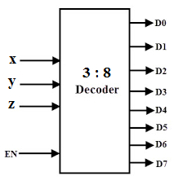
Decoder
3:8 or 3-to-8 line decoder
Three input lines are decoded into 8 output lines
Each output line represents one of the eight possible minterms
Inputs |  |  | Outputs
x | y | z | D₀ | D₁ | D₂ | D₃ | D₄ | D₅ | D₆ | D₇
0 | 0 | 0 | 1 | 0 | 0 | 0 | 0 | 0 | 0 | 0
0 | 0 | 1 | 0 | 1 | 0 | 0 | 0 | 0 | 0 | 0
0 | 1 | 0 | 0 | 0 | 1 | 0 | 0 | 0 | 0 | 0
0 | 1 | 1 | 0 | 0 | 0 | 1 | 0 | 0 | 0 | 0
1 | 0 | 0 | 0 | 0 | 0 | 0 | 1 | 0 | 0 | 0
1 | 0 | 1 | 0 | 0 | 0 | 0 | 0 | 1 | 0 | 0
1 | 1 | 0 | 0 | 0 | 0 | 0 | 0 | 0 | 1 | 0
1 | 1 | 1 | 0 | 0 | 0 | 0 | 0 | 0 | 0 | 1

Slide 16
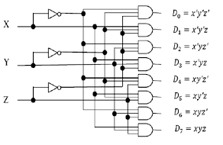
Decoder
3:8 or 3-to-8 line decoder
According to the minterm represented by each output line, they can be also realized by logically ANDing the input variables x, y and z,

Slide 17
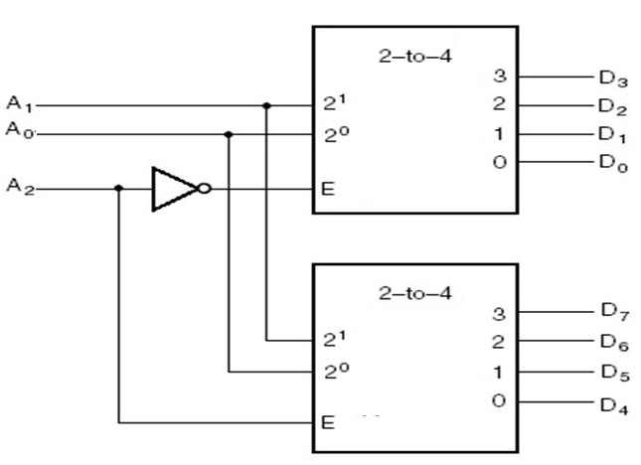
Decoder
A larger order decoders can be realized using multiple smaller order decoders
The ENABLE input is used to select among the multiple smaller decoders
ENABLE input is enabled (= HIGH or ‘1’) or disabled (= LOW or ‘0’), according to the input combinations/minterms that are to be generated
3:8 decoder using 2 × 2:4 decoders
Inputs |  |  | Outputs
A₂ | A₁ | A₀ | D₀ | D₁ | D₂ | D₃ | D₄ | D₅ | D₆ | D₇
0 | 0 | 0 | 1 | 0 | 0 | 0 | 0 | 0 | 0 | 0
0 | 0 | 1 | 0 | 1 | 0 | 0 | 0 | 0 | 0 | 0
0 | 1 | 0 | 0 | 0 | 1 | 0 | 0 | 0 | 0 | 0
0 | 1 | 1 | 0 | 0 | 0 | 1 | 0 | 0 | 0 | 0
1 | 0 | 0 | 0 | 0 | 0 | 0 | 1 | 0 | 0 | 0
1 | 0 | 1 | 0 | 0 | 0 | 0 | 0 | 1 | 0 | 0
1 | 1 | 0 | 0 | 0 | 0 | 0 | 0 | 0 | 1 | 0
1 | 1 | 1 | 0 | 0 | 0 | 0 | 0 | 0 | 0 | 1

Slide 18
Decoder
4:16 decoder:
There will be 4 Input lines and 16 output lines.
Depending upon the input combination, only one of the 16 lines will be HIGH.
Inputs |  |  |  | Outputs
A₃ | A₂ | A₁ | A₀ | D₀ | D₁ | D₂ | D₃ | D₄ | D₅ | D₆ | D₇ | D₈ | D₉ | D₁₀ | D₁₁ | D₁₂ | D₁₃ | D₁₄ | D₁₅
0 | 0 | 0 | 0 | 1 | 0 | 0 | 0 | 0 | 0 | 0 | 0 | 0 | 0 | 0 | 0 | 0 | 0 | 0 | 0
0 | 0 | 0 | 1 | 0 | 1 | 0 | 0 | 0 | 0 | 0 | 0 | 0 | 0 | 0 | 0 | 0 | 0 | 0 | 0
0 | 0 | 1 | 0 | 0 | 0 | 1 | 0 | 0 | 0 | 0 | 0 | 0 | 0 | 0 | 0 | 0 | 0 | 0 | 0
0 | 0 | 1 | 1 | 0 | 0 | 0 | 1 | 0 | 0 | 0 | 0 | 0 | 0 | 0 | 0 | 0 | 0 | 0 | 0
0 | 1 | 0 | 0 | 0 | 0 | 0 | 0 | 1 | 0 | 0 | 0 | 0 | 0 | 0 | 0 | 0 | 0 | 0 | 0
0 | 1 | 0 | 1 | 0 | 0 | 0 | 0 | 0 | 1 | 0 | 0 | 0 | 0 | 0 | 0 | 0 | 0 | 0 | 0
0 | 1 | 1 | 0 | 0 | 0 | 0 | 0 | 0 | 0 | 1 | 0 | 0 | 0 | 0 | 0 | 0 | 0 | 0 | 0
0 | 1 | 1 | 1 | 0 | 0 | 0 | 0 | 0 | 0 | 0 | 1 | 0 | 0 | 0 | 0 | 0 | 0 | 0 | 0
1 | 0 | 0 | 0 | 0 | 0 | 0 | 0 | 0 | 0 | 0 | 0 | 1 | 0 | 0 | 0 | 0 | 0 | 0 | 0
1 | 0 | 0 | 1 | 0 | 0 | 0 | 0 | 0 | 0 | 0 | 0 | 0 | 1 | 0 | 0 | 0 | 0 | 0 | 0
1 | 0 | 1 | 0 | 0 | 0 | 0 | 0 | 0 | 0 | 0 | 0 | 0 | 0 | 1 | 0 | 0 | 0 | 0 | 0
1 | 0 | 1 | 1 | 0 | 0 | 0 | 0 | 0 | 0 | 0 | 0 | 0 | 0 | 0 | 1 | 0 | 0 | 0 | 0
1 | 1 | 0 | 0 | 0 | 0 | 0 | 0 | 0 | 0 | 0 | 0 | 0 | 0 | 0 | 0 | 1 | 0 | 0 | 0
1 | 1 | 0 | 1 | 0 | 0 | 0 | 0 | 0 | 0 | 0 | 0 | 0 | 0 | 0 | 0 | 0 | 1 | 0 | 0
1 | 1 | 1 | 0 | 0 | 0 | 0 | 0 | 0 | 0 | 0 | 0 | 0 | 0 | 0 | 0 | 0 | 0 | 1 | 0
1 | 1 | 1 | 1 | 0 | 0 | 0 | 0 | 0 | 0 | 0 | 0 | 0 | 0 | 0 | 0 | 0 | 0 | 0 | 1

Slide 19
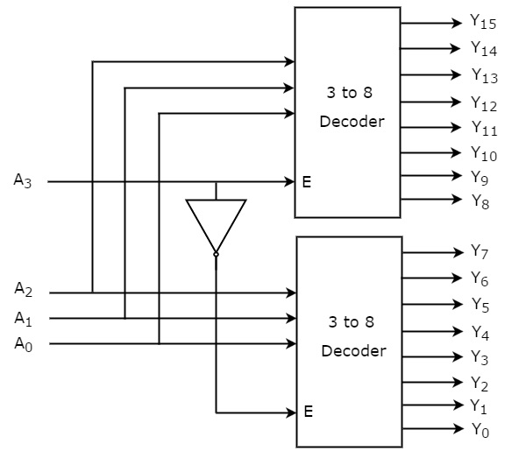
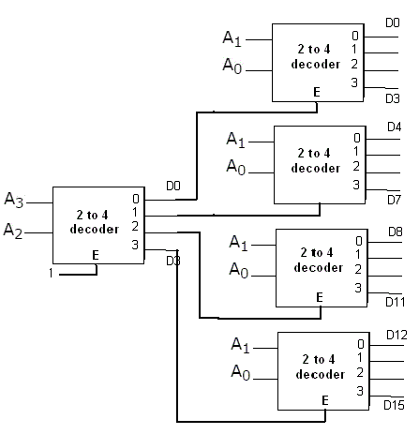
Decoder
4:16 decoder using 2 × 3:8 decoders
4:16 decoder using 5 × 2:4 decoders

Slide 20
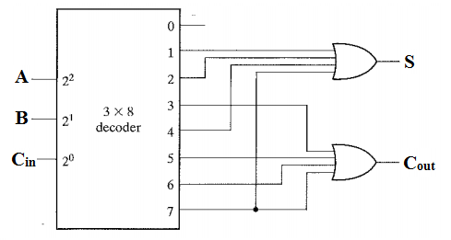
Decoder
(EXAMPLE 1)
Realize full adder circuit using one 3:8 decoder
The output equations of Full Adder are:
SUM (S) = f(A, B, C_{in}) = ∑ (1,2,4,7)
CARRY-OUT (C_{out}) = f(A, B, C_{in}) = ∑ (3,5,6,7)

Slide 21
encoder
Combinational circuit that perform inverse operation of a Decoder
It converts ‘m’ binary input line code into ‘n’ output lines, where m = 2^{n}
For each of the 2^{n} input lines, the output corresponding to its binary value is generated
Only one input line can be HIGH or ‘1’ at a particular time
Referred as m:n or m-to-n encoder, where m = 2^{n}
Few are 2:1, 4:2, 8:3, 16:4 and so on
m:n
ENCODER
‘n’
output lines
‘m= 2^{n}’
input lines

Slide 22
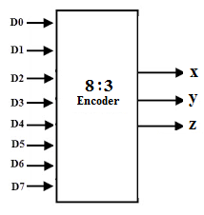
encoder
8:3 encoder
Also referred as octal-to-binary encoder
Eight input lines are encoded into its equivalent 3-bit binary value, represented by 3 output lines
Inputs |  |  |  |  |  |  |  | Outputs
D₀ | D₁ | D₂ | D₃ | D₄ | D₅ | D₆ | D₇ | x | y | z
1 | 0 | 0 | 0 | 0 | 0 | 0 | 0 | 0 | 0 | 0
0 | 1 | 0 | 0 | 0 | 0 | 0 | 0 | 0 | 0 | 1
0 | 0 | 1 | 0 | 0 | 0 | 0 | 0 | 0 | 1 | 0
0 | 0 | 0 | 1 | 0 | 0 | 0 | 0 | 0 | 1 | 1
0 | 0 | 0 | 0 | 1 | 0 | 0 | 0 | 1 | 0 | 0
0 | 0 | 0 | 0 | 0 | 1 | 0 | 0 | 1 | 0 | 1
0 | 0 | 0 | 0 | 0 | 0 | 1 | 0 | 1 | 1 | 0
0 | 0 | 0 | 0 | 0 | 0 | 0 | 1 | 1 | 1 | 1
The output equations are:
x = D₄ + D₅ + D₆+ D₇
y = D₂ + D₃ + D₆+ D₇
z = D₁ + D₃ + D₅+ D₇

Slide 23
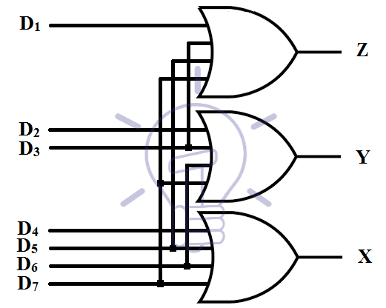
encoder
8:3 encoder
According to the input line being represented by each output line, 8:3 encoder can also be realized using OR gates for the input lines D₀ – D₇

Slide 24
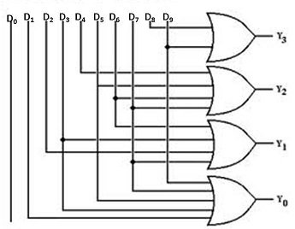
encoder
10:4 encoder or Decimal-to-BCD encoder
Ten input lines are there (one for each decimal digit), each is encoded into its corresponding 4-bit BCD code, represented by 4 output lines
Decimal Inputs | Outputs
 | Y₃ | Y₂ | Y₁ | Y₀
D₀ | 0 | 0 | 0 | 0
D₁ | 0 | 0 | 0 | 1
D₂ | 0 | 0 | 1 | 0
D₃ | 0 | 0 | 1 | 1
D₄ | 0 | 1 | 0 | 0
D₅ | 0 | 1 | 0 | 1
D₆ | 0 | 1 | 1 | 0
D₇ | 0 | 1 | 1 | 1
D₈ | 1 | 0 | 0 | 0
D₉ | 1 | 0 | 0 | 1
The output equations are:
Y₃ = D₈ + D₉
Y₂ = D₄ + D₅ + D₆+ D₇
Y₁ = D₂ + D₃ + D₆+ D₇
Y₀ = D₁ + D₃ + D₅ + D₇ + D₉

Slide 25
PRIORITY encoder
PRIORITY ENCODER: Encoder that includes priority function
It calculates the output when two or more inputs are equal to ‘1’ at the same time
The output is obtained according to the input which is having the highest priority
In a 4:2 priority encoder, among the 4 inputs, the order of priority is: Y₃ > Y₂ > Y₁ > Y₀
In a ‘m : n’ priority encoder, the output equivalent to an input line can be obtained only and only if,
all the other high priority inputs are ‘0’
irrespective of the values of other lower priority input lines

Slide 26
PRIORITY encoder
The working of priority encoder is
Y₃ has highest priority: If ‘Y₃ = 1’ the output will be A₁A₀= 11, regardless of values of Y₂, Y₁ and Y₀,
Y₂ is next in precedence order: If ‘Y₂ = 1’ then the output A₁A₀= 10, if and only if ‘Y₃ = 0’ regardless of values of Y₁, and Y₀
Similarly, for ‘Y₁ = 1’ the output is A₁A₀= 01; and for ‘Y₀ = 1’ the output is A₁A₀= 00, only if all the higher priority inputs are ‘0’
An additional output, ‘Valid’ or ‘V’ is used to indicate that multiple input lines that are ‘1’
V=1, if one or more inputs are ‘1’
V=0, if all inputs are ‘0’
The ‘X’ in truth table signifies the don’t care combination
Inputs |  |  |  | Outputs
Y₀ | Y₁ | Y₂ | Y₃ | A₁ | A₀ | V
0 | 0 | 0 | 0 | X | X | 0
1 | 0 | 0 | 0 | 0 | 0 | 1
X | 1 | 0 | 0 | 0 | 1 | 1
X | X | 1 | 0 | 1 | 0 | 1
X | X | X | 1 | 1 | 1 | 1

Slide 27
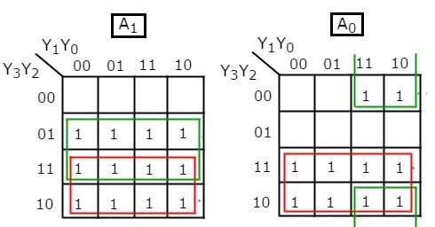
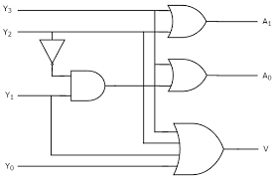
PRIORITY encoder
From the truth table, the equation for A₁, A₀ and V can be derived in terms of input variables Y₃, Y₂, Y₁ and Y₀
The input combinations with ‘X’ can take both values ‘1’ or ‘0’, so all the possible minterms are considered for minimizing using K-maps
The equations for output lines are:
A₁ = Y₂ + Y₃
A₀ = Y₃ + Y₂’ Y₁
V = Y₃ + Y₂ + Y₁+ Y₀

Slide 28
multiplexer
MULTIPLEXER: Combinational circuit that selects binary information from many input lines and directs it to the single output line, called MANY-to-ONE device
There will one and only one output line
Selection of input line is directed by additional control input lines called Select lines
For selecting among ‘n’ input lines, the number of select line required are ‘m’, where n = 2^{m}
The binary combination decides which input is to be connected with output
Referred as n:1 multiplexer or n:1 MUX, with m select lines. Few are 2:1(m=1), 4:1(m=2), 8:1(m=3), 16:1(m=4) and so on
‘m’
select lines
‘n’
input lines
n:1 MUX
‘one’
output lines

Slide 29
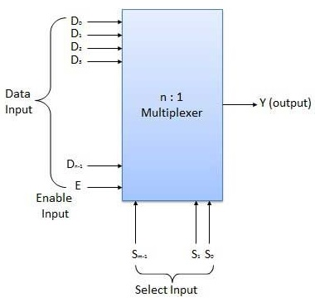
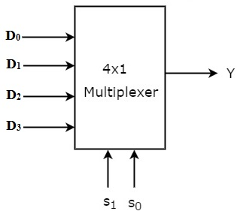
multiplexer
4:1 MUX:
4 inputs, 1 output, 2 select lines
According to select lines, S₁-S₀, input line will be connected to output line
S₁S₀=00, output Y= D₀
S₁S₀=01, output Y= D₁
S₁S₀=10, output Y= D₂
S₁S₀=11, output Y= D₃
The value of input (0 or 1), will be provided as the output, Y
Select Inputs |  | Outputs
S₁ | S₀ | Y
0 | 0 | D₀
0 | 1 | D₁
1 | 0 | D₂
1 | 1 | D₃

Slide 30
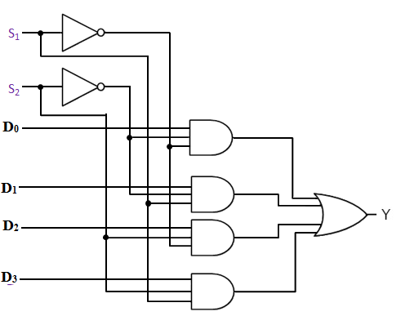
multiplexer
4:1 MUX:
The logic diagram of MUX is realized using basic gates
The output equation is:
Y = S₁’S ₀’ D₀ + S₁’S₀D₁ + S₁S₀’D₂ + S₁S₀D₃

Slide 31
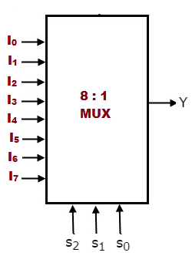
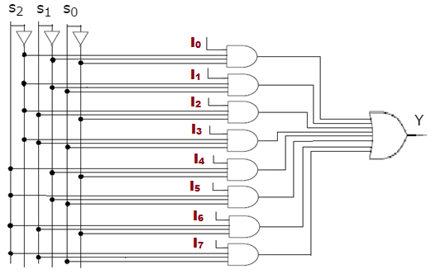
multiplexer
8:1 MUX:
8 inputs, 1 output, 3 select lines
Binary combination of S₂S₁S₀ directs the input being connected to Y
Select Inputs |  |  | Output
S₂ | S₁ | S₀ | Y
0 | 0 | 0 | I₀
0 | 0 | 1 | I₁
0 | 1 | 0 | I₂
0 | 1 | 1 | I₃
1 | 0 | 0 | I₄
1 | 0 | 1 | I₅
1 | 1 | 0 | I₆
1 | 1 | 1 | I₇

Slide 32
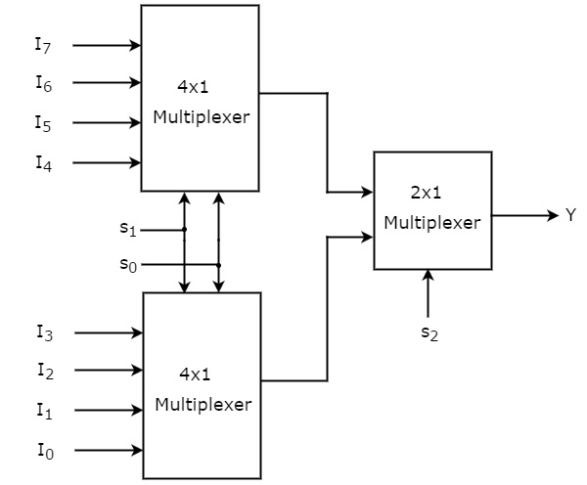
multiplexer
A larger order multiplexer can be realized using multiple smaller order multiplexers
8:1 MUX using 2 × 4:1 MUX
Select Inputs |  |  | Output
S₂ | S₁ | S₀ | Y
0 | 0 | 0 | I₀
0 | 0 | 1 | I₁
0 | 1 | 0 | I₂
0 | 1 | 1 | I₃
1 | 0 | 0 | I₄
1 | 0 | 1 | I₅
1 | 1 | 0 | I₆
1 | 1 | 1 | I₇

Slide 33
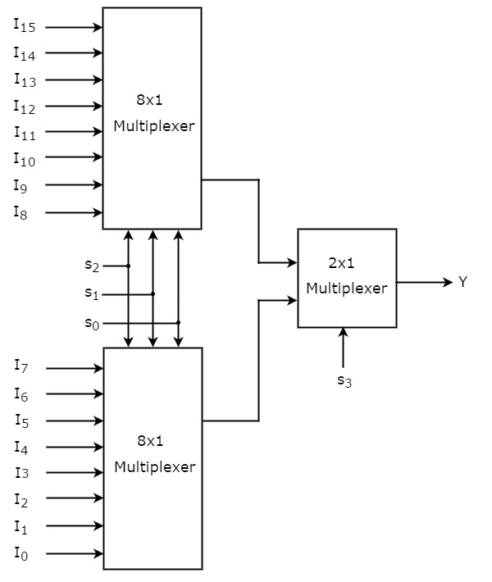
MULTIPLEXER
16:1 MUX using 8:1 MUX
Inputs |  |  |  | Outputs
S₃ | S₂ | S₁ | S₀ | Y
0 | 0 | 0 | 0 | I₀
0 | 0 | 0 | 1 | I₁
0 | 0 | 1 | 0 | I₂
0 | 0 | 1 | 1 | I₃
0 | 1 | 0 | 0 | I₄
0 | 1 | 0 | 1 | I₅
0 | 1 | 1 | 0 | I₆
0 | 1 | 1 | 1 | I₇
1 | 0 | 0 | 0 | I₈
1 | 0 | 0 | 1 | I₉
1 | 0 | 1 | 0 | I₁₀
1 | 0 | 1 | 1 | I₁₁
1 | 1 | 0 | 0 | I₁₂
1 | 1 | 0 | 1 | I₁₃
1 | 1 | 1 | 0 | I₁₄
1 | 1 | 1 | 1 | I₁₅

Slide 34
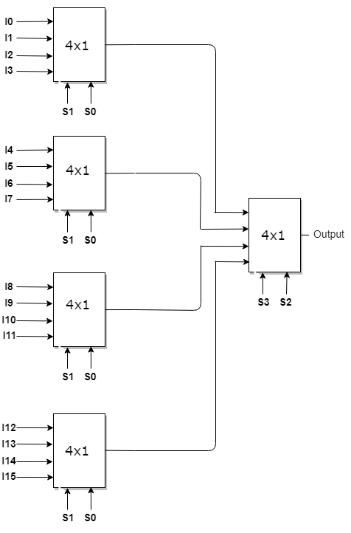
MULTIPLEXER
16:1 MUX using 5 × 4:1 MUX
Inputs |  |  |  | Outputs
S₃ | S₂ | S₁ | S₀ | Y
0 | 0 | 0 | 0 | I₀
0 | 0 | 0 | 1 | I₁
0 | 0 | 1 | 0 | I₂
0 | 0 | 1 | 1 | I₃
0 | 1 | 0 | 0 | I₄
0 | 1 | 0 | 1 | I₅
0 | 1 | 1 | 0 | I₆
0 | 1 | 1 | 1 | I₇
1 | 0 | 0 | 0 | I₈
1 | 0 | 0 | 1 | I₉
1 | 0 | 1 | 0 | I₁₀
1 | 0 | 1 | 1 | I₁₁
1 | 1 | 0 | 0 | I₁₂
1 | 1 | 0 | 1 | I₁₃
1 | 1 | 1 | 0 | I₁₄
1 | 1 | 1 | 1 | I₁₅

Slide 35
multiplexer
Higher-order MUX using single next lower-order MUX
Instead of multiple lower-order MUX, single lower-order MUX is used
For realization of ‘n’ variables function, ‘n-1’ variables are directly connected as select lines and the last variable is connected to the 2^{(n-1)} input lines
The output function is evaluated such that it can be connected to the input lines of the MUX as either 0,1, the last variable or the complement of the last variable
E.g. Realization of F(x,y,z) using one 4:1 MUX, will have ‘x’ and ‘y’ connected to select lines and ‘z’ as four input lines of 4:1

Slide 36
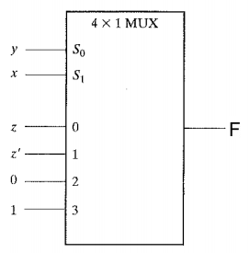
multiplexer
Higher-order MUX using single next lower-order MUX
(EXAMPLE 1)
8:1 MUX using one 4:1 MUX
e.g Realize F(x,y,z) =∑ (1,2,6,7) using only one 4:1 MUX
Select Inputs |  |  | Output
x | y | z | F
0 | 0 | 0 | 0 | F = z
0 | 0 | 1 | 1
0 | 1 | 0 | 1 | F = z’
0 | 1 | 1 | 0
1 | 0 | 0 | 0 | F = 0
1 | 0 | 1 | 0
1 | 1 | 0 | 1 | F = 1
1 | 1 | 1 | 1

Slide 37
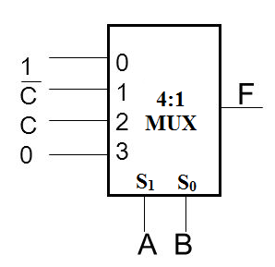
multiplexer
Higher-order MUX using single next lower-order MUX
(EXAMPLE 2)
8:1 MUX using one 4:1 MUX
e.g Realize F(A,B,C) =∑ (0,1,2,5) using only one 4:1 MUX
Select Inputs |  |  | Output
A | B | C | F
0 | 0 | 0 | 1 | F = 1
0 | 0 | 1 | 1
0 | 1 | 0 | 1 | F = C’
0 | 1 | 1 | 0
1 | 0 | 0 | 0 | F = C
1 | 0 | 1 | 1
1 | 1 | 0 | 0 | F = 0
1 | 1 | 1 | 0

Slide 38
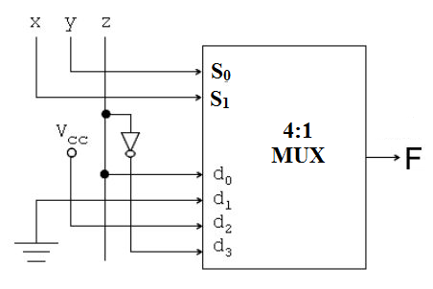
multiplexer
Higher-order MUX using single next lower-order MUX
(EXAMPLE 3)
8:1 MUX using one 4:1 MUX
e.g Realize F(x,y,z) =∑ (1,4,5,6) using only one 4:1 MUX
Select Inputs |  |  | Output
x | y | z | F
0 | 0 | 0 | 0 | F = z
0 | 0 | 1 | 1
0 | 1 | 0 | 0 | F = 0
0 | 1 | 1 | 0
1 | 0 | 0 | 1 | F = 1
1 | 0 | 1 | 1
1 | 1 | 0 | 1 | F = z’
1 | 1 | 1 | 0

Slide 39
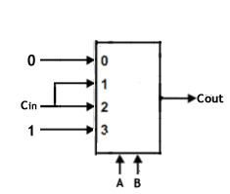
multiplexer
Higher-order MUX using single next lower-order MUX
(EXAMPLE 4)
8:1 MUX using one 4:1 MUX
e.g Realize Carry-out of Full Adder using only one 4:1 MUX
Select Inputs |  |  | Output
A | B | C_{in} | C_{out}
0 | 0 | 0 | 0 | F = 0
0 | 0 | 1 | 0
0 | 1 | 0 | 0 | F = C_{in}
0 | 1 | 1 | 1
1 | 0 | 0 | 0 | F = C_{in}
1 | 0 | 1 | 1
1 | 1 | 0 | 1 | F = 1
1 | 1 | 1 | 1

Slide 40
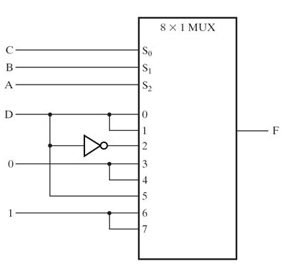
multiplexer
Higher-order MUX using single next lower-order MUX (EXAMPLE 5)
16:1 MUX using one 8:1 MUX
Realize F(A,B,C,D) = ∑(1,3,4,11,12,13,14,15) using only one 8:1 MUX
The Least Significant Bit (LSB) variable, ‘D’, is provided at the inputs of 8:1 MUX
Inputs |  |  |  | Outputs
A | B | C | D | F
0 | 0 | 0 | 0 | 0 | F = D
0 | 0 | 0 | 1 | 1
0 | 0 | 1 | 0 | 0 | F = D
0 | 0 | 1 | 1 | 1
0 | 1 | 0 | 0 | 1 | F = D’
0 | 1 | 0 | 1 | 0
0 | 1 | 1 | 0 | 0 | F = 0
0 | 1 | 1 | 1 | 0
1 | 0 | 0 | 0 | 0 | F = 0
1 | 0 | 0 | 1 | 0
1 | 0 | 1 | 0 | 0 | F = D
1 | 0 | 1 | 1 | 1
1 | 1 | 0 | 0 | 1 | F = 1
1 | 1 | 0 | 1 | 1
1 | 1 | 1 | 0 | 1 | F = 1
1 | 1 | 1 | 1 | 1

Slide 41
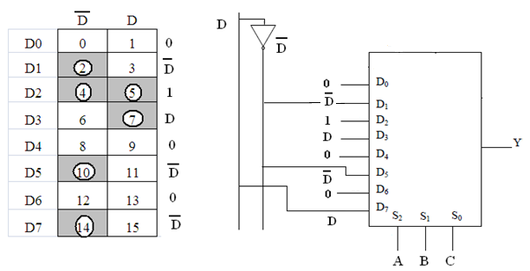
multiplexer
Higher-order MUX using single next lower-order MUX (EXAMPLE 6)
16:1 MUX using one 8:1 MUX
Realize F(A,B,C,D) = ∑(2,4,5,7,10,14) using only one 8:1 MUX
The LSB variable, ‘D’, is provided at the inputs of 8:1 MUX
Inputs |  |  |  | Outputs
A | B | C | D | F
0 | 0 | 0 | 0 | 0 | F = 0
0 | 0 | 0 | 1 | 0
0 | 0 | 1 | 0 | 1 | F = D’
0 | 0 | 1 | 1 | 0
0 | 1 | 0 | 0 | 1 | F = 1
0 | 1 | 0 | 1 | 1
0 | 1 | 1 | 0 | 0 | F = D
0 | 1 | 1 | 1 | 1
1 | 0 | 0 | 0 | 0 | F = 0
1 | 0 | 0 | 1 | 0
1 | 0 | 1 | 0 | 1 | F = D’
1 | 0 | 1 | 1 | 0
1 | 1 | 0 | 0 | 0 | F = 0
1 | 1 | 0 | 1 | 0
1 | 1 | 1 | 0 | 1 | F = D’
1 | 1 | 1 | 1 | 0

Slide 42
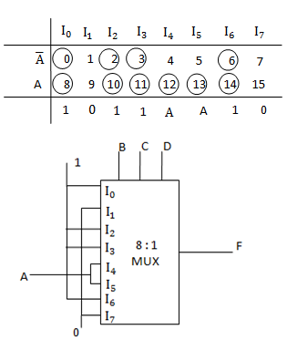
multiplexer
Higher-order MUX using single next lower-order MUX (EXAMPLE 7)
16:1 MUX using one 8:1 MUX
Realize F(A,B,C,D) = ∑(0,2,3,6,8,10,11,12,13,14) using only one 8:1 MUX
The MSB variable, ‘A’, is provided at the inputs of 8:1 MUX
Inputs |  |  |  | Outputs
A | B | C | D | F
0 | 0 | 0 | 0 | 1
0 | 0 | 0 | 1 | 0
0 | 0 | 1 | 0 | 1
0 | 0 | 1 | 1 | 1
0 | 1 | 0 | 0 | 0
0 | 1 | 0 | 1 | 0
0 | 1 | 1 | 0 | 1
0 | 1 | 1 | 1 | 0
1 | 0 | 0 | 0 | 1
1 | 0 | 0 | 1 | 0
1 | 0 | 1 | 0 | 1
1 | 0 | 1 | 1 | 1
1 | 1 | 0 | 0 | 1
1 | 1 | 0 | 1 | 1
1 | 1 | 1 | 0 | 1
1 | 1 | 1 | 1 | 0

Slide 43
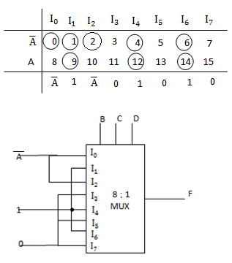
multiplexer
Higher-order MUX using single next lower-order MUX (EXAMPLE 8)
16:1 MUX using one 8:1 MUX
Realize F(A,B,C,D) = ∑(0,1,2,4,6,9,12,14) using only one 8:1 MUX
The MSB variable, ‘A’, is provided at the inputs of 8:1 MUX
Inputs |  |  |  | Outputs
A | B | C | D | F
0 | 0 | 0 | 0 | 1
0 | 0 | 0 | 1 | 0
0 | 0 | 1 | 0 | 1
0 | 0 | 1 | 1 | 1
0 | 1 | 0 | 0 | 0
0 | 1 | 0 | 1 | 0
0 | 1 | 1 | 0 | 1
0 | 1 | 1 | 1 | 0
1 | 0 | 0 | 0 | 1
1 | 0 | 0 | 1 | 0
1 | 0 | 1 | 0 | 1
1 | 0 | 1 | 1 | 1
1 | 1 | 0 | 0 | 1
1 | 1 | 0 | 1 | 1
1 | 1 | 1 | 0 | 1
1 | 1 | 1 | 1 | 0

Slide 44
De-multiplexer
DE-MULTIPLEXER: performs reverse operation of a MULTIPLEXER
Combinational circuit that takes binary information from a single input and directs it to one of the many output lines, called ONE-TO-MANY device
There will one and only one input line
Selection of output line is controlled by Select lines
For selecting among ‘n’ output lines, the number of select line required are ‘m’, where n = 2^{m}
The binary combination decides the output line which will be connected with the input
Referred as 1:n de-multiplexer or 1:n DEMUX, with m select lines. Few are 1:2(m=1), 1:4(m=2), 1:8(m=3), 1:16(m=4), so on
‘m’
select lines
‘one’
input line
1:n DEMUX
‘many’
output lines

Slide 45
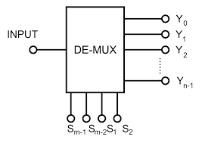
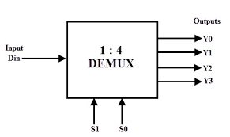
DE-multiplexer
1:4 DEMUX:
1 input, 4 output, 2 select lines
According to select lines, S₁-S₀, input line will be connected to one of the output lines
S₁S₀=00, output Y₀ = D_{in}
S₁S₀=01, output Y₁ = D_{in}
S₁S₀=10, output Y₂ = D_{in}
S₁S₀=11, output Y₃ = D_{in}
The value of input (0 or 1), will be provided as the respective output, Y₀-Y₃
Select Inputs |  | Outputs
S₁ | S₀ | Y₀ | Y₁ | Y₂ | Y₃
0 | 0 | D_{in} | 0 | 0 | 0
0 | 1 | 0 | D_{in} | 0 | 0
1 | 0 | 0 | 0 | D_{in} | 0
1 | 1 | 0 | 0 | 0 | D_{in}

Slide 46
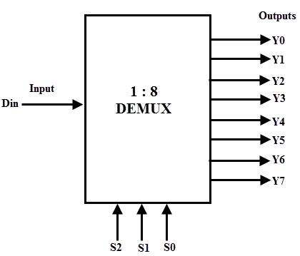
DE-multiplexer
1:8 DEMUX:
1 input, 8 outputs, 3 select lines
Binary combination of S₂S₁S₀ directs the input to either of the output lines, Y₀-Y₇
Select Inputs |  |  | Outputs
S₂ | S₁ | S₀ | Y₀ | Y₁ | Y₂ | Y₃ | Y₄ | Y₅ | Y₆ | Y₇
0 | 0 | 0 | D_{in} | 0 | 0 | 0 | 0 | 0 | 0 | 0
0 | 0 | 1 | 0 | D_{in} | 0 | 0 | 0 | 0 | 0 | 0
0 | 1 | 0 | 0 | 0 | D_{in} | 0 | 0 | 0 | 0 | 0
0 | 1 | 1 | 0 | 0 | 0 | D_{in} | 0 | 0 | 0 | 0
1 | 0 | 0 | 0 | 0 | 0 | 0 | D_{in} | 0 | 0 | 0
1 | 0 | 1 | 0 | 0 | 0 | 0 | 0 | D_{in} | 0 | 0
1 | 1 | 0 | 0 | 0 | 0 | 0 | 0 | 0 | D_{in} | 0
1 | 1 | 1 | 0 | 0 | 0 | 0 | 0 | 0 | 0 | D_{in}

Slide 47
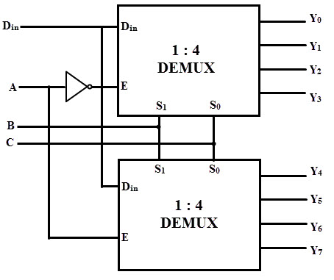
DE-multiplexer
A larger order de-multiplexer can be realized using multiple smaller order de-multiplexers
1:8 DEMUX using 2 × 1:4 DEMUX
Select Inputs |  |  | Outputs
A | B | C | Y₀ | Y₁ | Y₂ | Y₃ | Y₄ | Y₅ | Y₆ | Y₇
0 | 0 | 0 | D_{in} | 0 | 0 | 0 | 0 | 0 | 0 | 0
0 | 0 | 1 | 0 | D_{in} | 0 | 0 | 0 | 0 | 0 | 0
0 | 1 | 0 | 0 | 0 | D_{in} | 0 | 0 | 0 | 0 | 0
0 | 1 | 1 | 0 | 0 | 0 | D_{in} | 0 | 0 | 0 | 0
1 | 0 | 0 | 0 | 0 | 0 | 0 | D_{in} | 0 | 0 | 0
1 | 0 | 1 | 0 | 0 | 0 | 0 | 0 | D_{in} | 0 | 0
1 | 1 | 0 | 0 | 0 | 0 | 0 | 0 | 0 | D_{in} | 0
1 | 1 | 1 | 0 | 0 | 0 | 0 | 0 | 0 | 0 | D_{in}

Slide 48
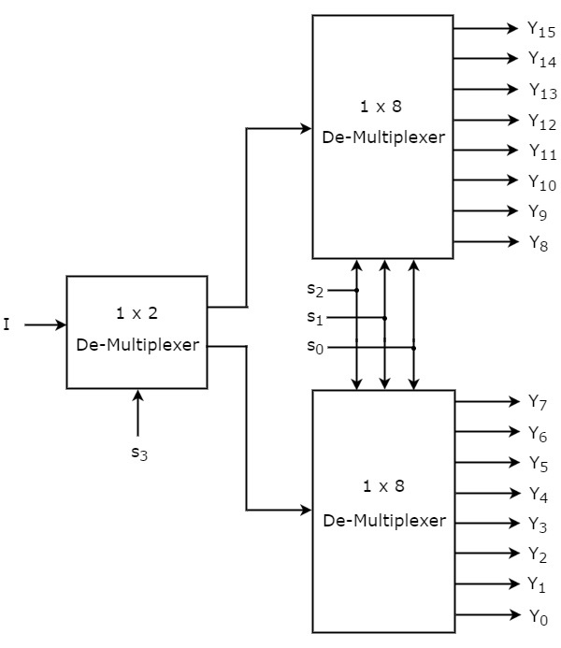
De-MULTIPLEXER
1:16 DEMUX using 1:8 DEMUX
Inputs |  |  |  | Input (D_{in}) available at Output
S₃ | S₂ | S₁ | S₀
0 | 0 | 0 | 0 | Y₀
0 | 0 | 0 | 1 | Y₁
0 | 0 | 1 | 0 | Y₂
0 | 0 | 1 | 1 | Y₃
0 | 1 | 0 | 0 | Y₄
0 | 1 | 0 | 1 | Y₅
0 | 1 | 1 | 0 | Y₆
0 | 1 | 1 | 1 | Y₇
1 | 0 | 0 | 0 | Y₈
1 | 0 | 0 | 1 | Y₉
1 | 0 | 1 | 0 | Y₁₀
1 | 0 | 1 | 1 | Y₁₁
1 | 1 | 0 | 0 | Y₁₂
1 | 1 | 0 | 1 | Y₁₃
1 | 1 | 1 | 0 | Y₁₄
1 | 1 | 1 | 1 | Y₁₅

Slide 49
Problems (TBD)

