Slide 1
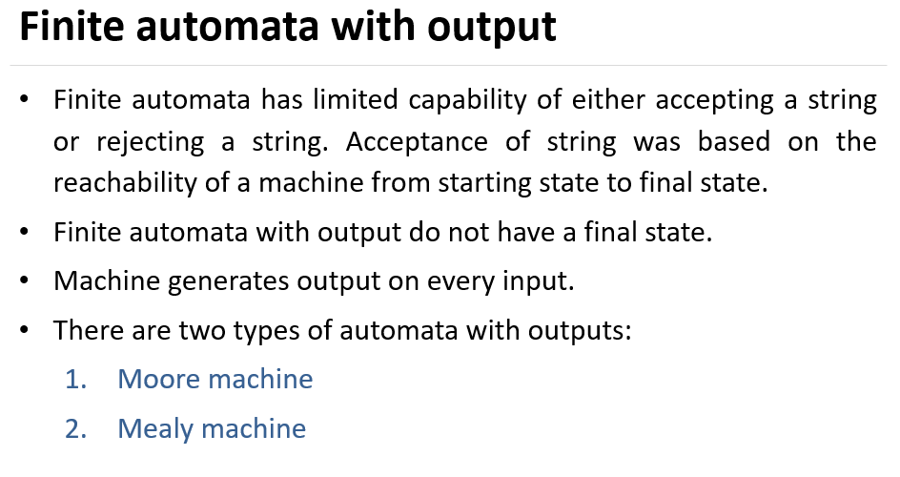

Slide 2
Moore machines are finite state machines with output value and its
output depends only on present state.
Mealy machines are also finite state machines with output value and its output depends on present state and current input symbol.

Slide 3
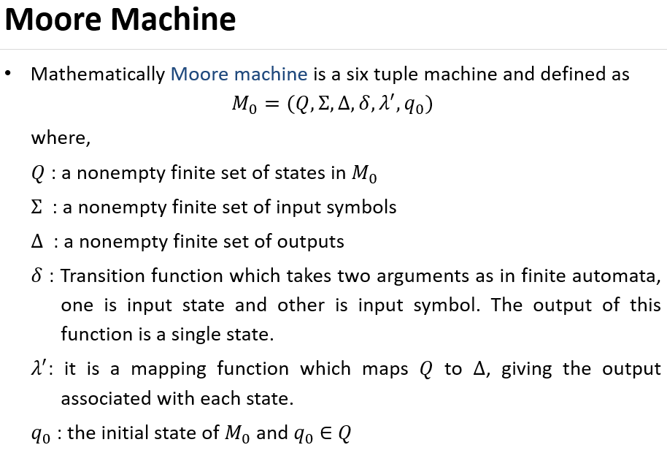

Slide 4
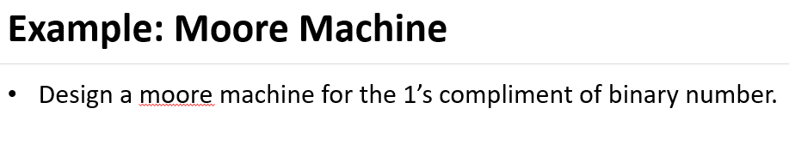

Slide 5
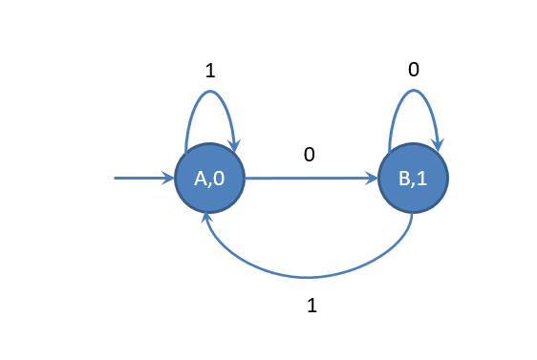

Slide 6
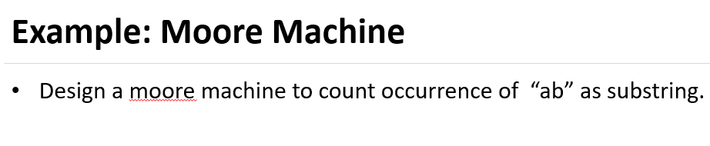

Slide 7
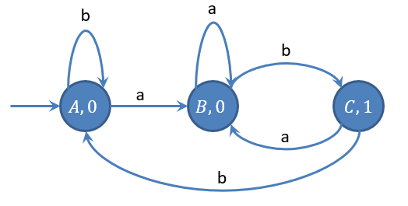

Slide 8
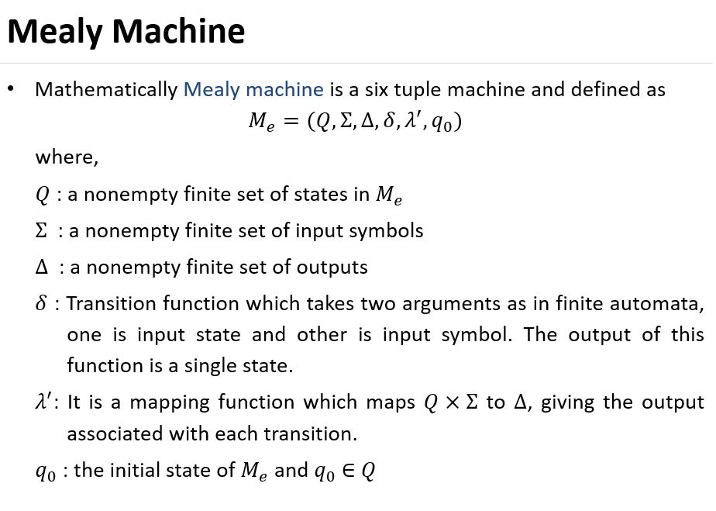

Slide 9
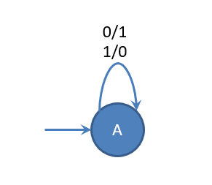
Example: Mealy Machine
Design Mealy machine for 1’s compliment of a binary number

Slide 10
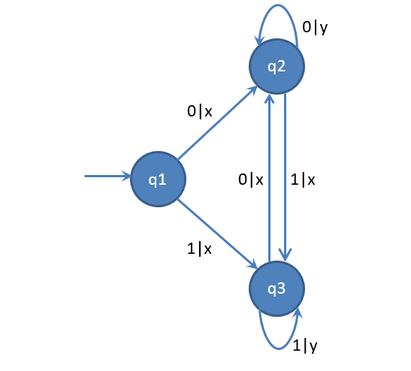
Example: Mealy Machine
Design Mealy machine for regular expression (0+1)*(00+11)

Slide 12
Conversions

Slide 13
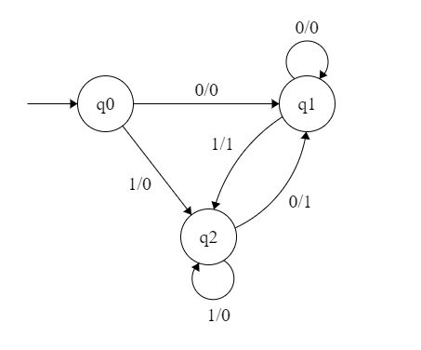
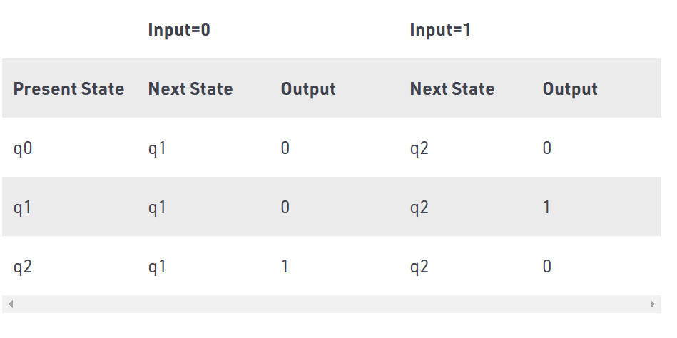
Mealy to Moore

Slide 14
Steps:
Step 1. First find out those states which have more than 1 outputs
associated with them. q1 and q2 are the states which have both output 0 and 1 associated with them.
Step 2. Create two states for these states. For q1, two states will be
q10 (state with output 0) and q11 (state with output 1). Similarly for q2, two states will be q20 and q21.
Step 3. Create an empty moore machine with new generated state.
For moore machine, Output will be associated to each state
irrespective of inputs.

Slide 15
Step 4: Fill the entries of next state using mealy machine transition table.
For q0 on input 0, next state is q10 (q1 with output 0). Similarly, for q0 on input 1, next state is q20 (q2 with output 0).
For q1 (both q10 and q11) on input 0, next state is q10. Similarly, for q1(both q10 and q11), next state is q21.
For q10, output will be 0 and for q11, output will be 1. Similarly, other entries can be filled.

Slide 16
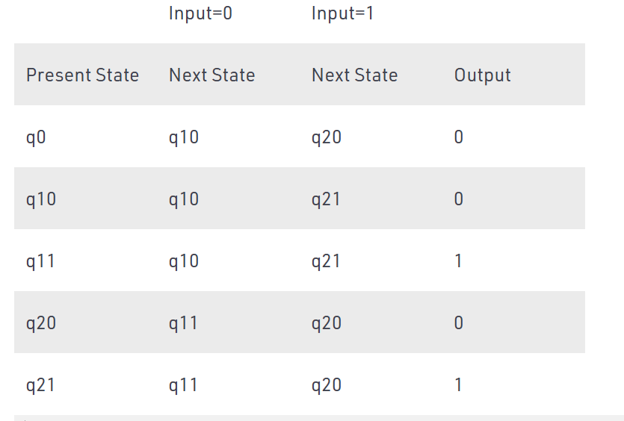

Slide 17
Moore to Mealy
Step1: Construct an empty mealy machine using all states of moore machine
Step2: Next state for each state can also be directly found from moore machine transition
Step 3:
As we have output corresponding to each input in moore machine transition table , use this to fill the Output entries .
Eg:Output corresponding to q10, q11, q20 and q21 are 0, 1, 0 and 1
respectively.

Slide 18
 | Input=0 |  | Input=1
Present State | Next State | Output | Next State | Output
q0 | q10 |  | q20
q10 | q10 |  | q21
q11 | q10 |  | q21
q20 | q11 |  | q20
q21 | q11 |  | q20

Slide 19
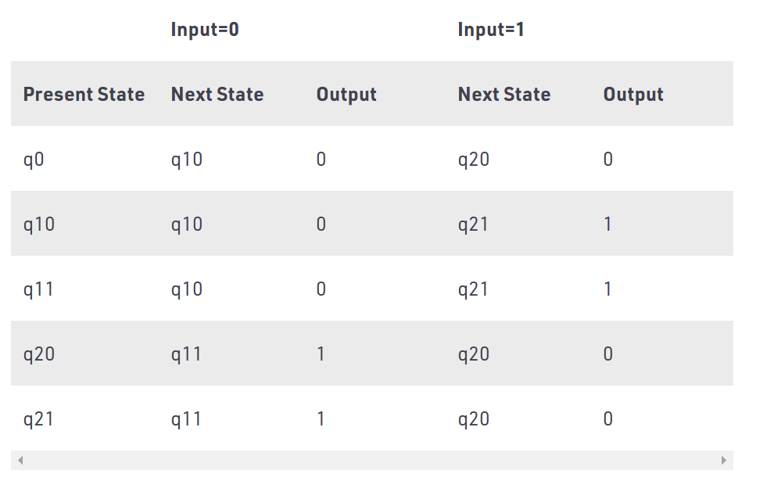

Slide 20
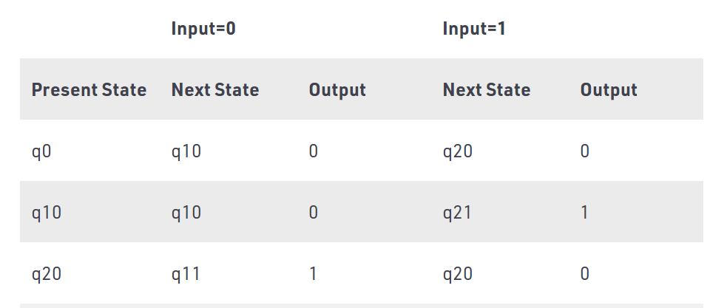
Step4: As we can see from table, q10 and q11 are similar to each other
(same value of next state and Output for different Input). Similarly, q20 and q21 are also similar. So, q11 and q21 can be eliminated.

Slide 21
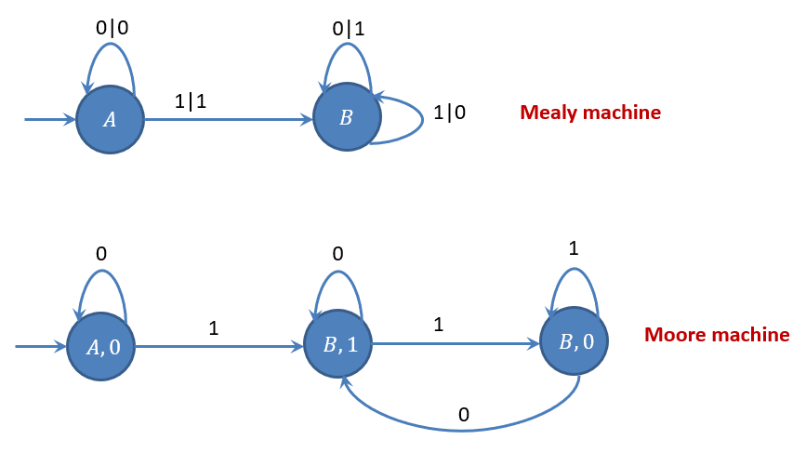
Mealy to Moore Conversion- Example

Slide 22
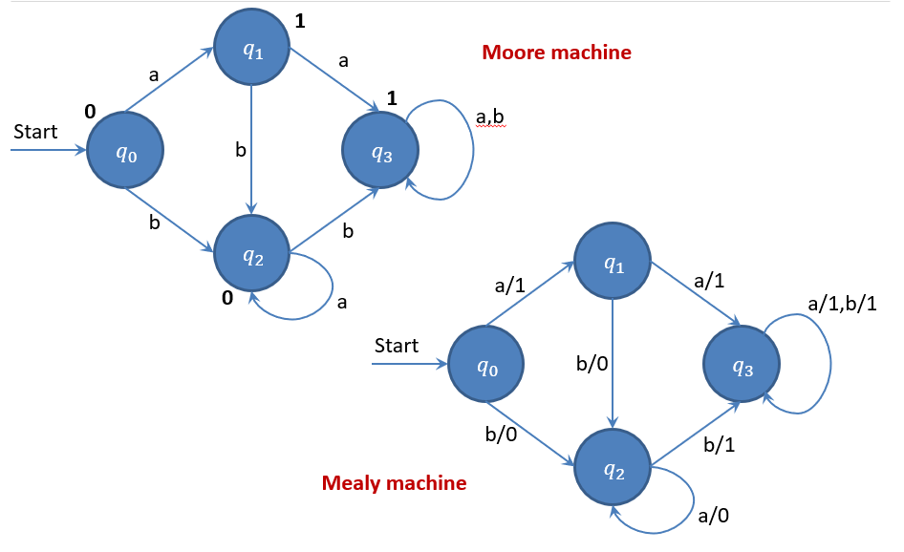
Moore to Mealy Conversion

