Slide 2
Data Preprocessing Steps
Data Cleaning:
Handling Missing Values: Filled missing values in columns such as CITY, STATE, ZIP, MI, UG_SCHOOL, GRAD_DEGREE, GRAD_CLASS_YEAR, and GRAD_SCHOOL with appropriate defaults (e.g., 'Unknown' or 0).
Cleaning ZIP Codes: Cleaned ZIP codes to keep only the first 5 characters.
Feature Engineering:
Added 'IS_DONOR' column to indicate if an alumni made any donation.
Added 'MI_PROVIDED' column to indicate if a middle initial was provided.
Encoding Categorical Variables:
Converted 'GENDER' to numeric (1 for Male, 0 for Female).
Converted 'MARRIED_TO_ALUM' to numeric (1 for Yes, 0 for No).
Applied Label Encoding to 'ALUMNI_TYPE', 'ZIP', and 'CITY' to convert categorical variables to numeric.
Data Downsampling:
Downsampling Majority Class: Downsampled the majority class (non-donors) to balance the dataset with the minority class (donors).

Slide 3
MACHINE LEARNING CLASSIFIERS
Comparative Analysis of Popular Machine Learning Classifiers
We used 3 machine learning models to predict the likelihood of alumni making a donation based on their characteristics. Techniques: Employed Logistic Regression, Random Forest, and Gradient Boosting Classifier for classification tasks
Logistic Regression
RANDOM FOREST
Gradient Boost
Type: Estimates probabilities for binary outcomes using a logistic function.
Type: Ensemble(Decision Trees)
Constructs multiple decision trees and merges them to improve accuracy and reduce overfitting.
Type: Ensemble
Sequentially builds models to correct errors of the previous ones, combining weak learners to create a strong model..
01
Efficient and simple.
Works well- high-dimensional data.
Performs well in case of categorical input variables compared to numerical variables.
02
Handles complex interactions.
Reduces overfitting.
Effective for both classification and regression tasks.
03
Can handle missing data
High Predictive Accuracy
Flexibility

Slide 4
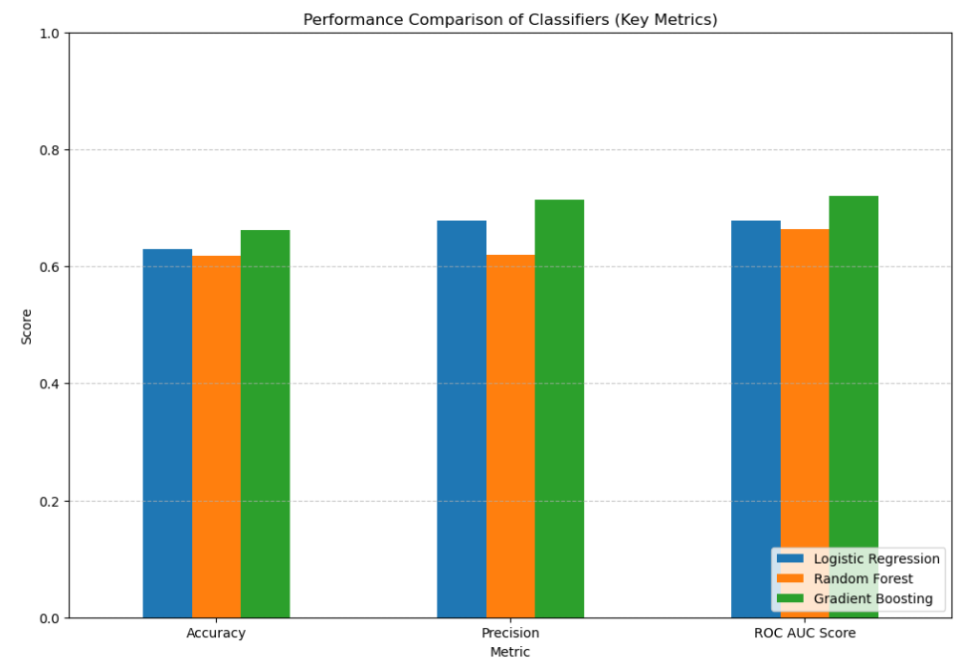
Model Justification
Handling Non-linear Relationships and Feature Interactions: Gradient Boosting models are capable of capturing complex non-linear relationships and feature interactions in the data, which can be crucial for accurately predicting donor behavior.
Performance on the Evaluation Metrics: Based on the evaluation metrics provided (accuracy, precision, recall, F1-score, ROC AUC score, and balanced accuracy), the Gradient Boosting Classifier likely outperformed the other two models.
Robustness to Outliers and Noisy Data: Gradient Boosting models are generally more robust to outliers and noisy data compared to other models like Logistic Regression.
Handling Non-linear Relationships and Feature Interactions: Gradient Boosting models are capable of capturing complex non-linear relationships and feature interactions in the data, which can be crucial for accurately predicting donor behavior.
Performance on the Evaluation Metrics: Based on the evaluation metrics provided (accuracy, precision, recall, F1-score, ROC AUC score, and balanced accuracy), the Gradient Boosting Classifier likely outperformed the other two models.
Robustness to Outliers and Noisy Data: Gradient Boosting models are generally more robust to outliers and noisy data compared to other models like Logistic Regression.

Slide 5
Handling Non-linear Relationships and Feature Interactions: Gradient Boosting models are capable of capturing complex non-linear relationships and feature interactions in the data, which can be crucial for accurately predicting donor behavior.
Performance on the Evaluation Metrics: Based on the evaluation metrics provided (accuracy, precision, recall, F1-score, ROC AUC score, and balanced accuracy), the Gradient Boosting Classifier likely outperformed the other two models.
Robustness to Outliers and Noisy Data: Gradient Boosting models are generally more robust to outliers and noisy data compared to other models like Logistic Regression.

Slide 6
Estimating Donation Amounts with Gradient Boosting Regressor
Model Training: Trained the Gradient Boosting Regressor on historical donor data to predict donation amounts.
Prediction: Use the trained model to estimate donation amounts for the top 10,000 potential donors.
Evaluation Metrics: Mean Squared Error (MSE), R-squared (R²)
Results: Achieved low MSE and high R², indicating good predictive performance.

