Slide 1
Invecto
COMPLIANCE GUARD
Invecto Compliance Guard
AI-Powered Cloud Compliance Platform
THE PROBLEM
"Cloud misconfigurations cause 65% of security incidents — enterprises lack a unified, AI-driven compliance engine that audits across multiple frameworks, cloud providers, and container platforms in real time."
TEAM
AWS
Azure
GCP
▸ Syed Ashfaq Mohiddin — Project Lead
▸ Swastik Shetty — Mentor
1 / 8
Terraform
Docker
K8s
CIS
NIST
CCM

Slide 2
Invecto
COMPLIANCE GUARD
The "Cyber-AI" Problem Statement
THE GAP
Traditional compliance tools operate in silos — separate tools for AWS vs Azure vs GCP, separate scanners for Terraform vs Docker vs Kubernetes, and manual mapping to CIS/NIST/CCM frameworks. Security teams spend 70%+ of their time on manual audit configuration rather than actual remediation.
$4.45M
82%
60%
₹250 Cr
Avg. breach cost (IBM 2023)
Breaches involve cloud data
Orgs fail first compliance audit
DPDP Act max penalty
TARGET AUDIENCE
▸ Enterprise Cloud Teams & DevSecOps — managing multi-cloud infrastructure
▸ Financial Services — RBI-regulated banks requiring continuous compliance
▸ Healthcare & Critical Infrastructure — HIPAA, DPDP Act requirements
2 / 8

Slide 3
Invecto
COMPLIANCE GUARD
Proposed AI Solution
SOLUTION OVERVIEW
THE "AI SECRET SAUCE"
Bespoke AI-Enhanced Platform — built from scratch with a custom compliance engine + Cisco Sec-8B LLM inference for context-aware auditing. Not an out-of-the-box wrapper.
▸ Cisco Sec-8B LLM — context-aware IaC analysis
▸ Predictive compliance scoring + trend analysis
▸ Auto-generated HCL/YAML fix snippets
▸ Single scan → CIS + NIST + CCM simultaneously
CORE ARCHITECTURE
DATA INPUT
AI PROCESSING
SECURITY ACTION
Step 1
Step 2
Step 3
Cloud APIs (AWS/Azure/GCP) Terraform files Docker/K8s manifests GitHub repos
Cisco Sec-8B LLM Inference CIS/NIST/CCM Rule Engine Severity Classification Topology Mapping
Compliance Dashboard PDF/CSV/JSON Reports Auto-Remediation Drift Alerts
→
→
3 / 8

Slide 4
Invecto
COMPLIANCE GUARD
Technical Innovation & "Persistence"
HOW WE DIFFER FROM ZSCALER / PRISMA CLOUD
SELF-HEALING / RESILIENCE
▸ Unified multi-framework (CIS + NIST + CCM) in single scan
▸ AI-powered via Cisco Sec-8B — not pattern-matching
▸ Full container compliance (Docker + K8s) alongside cloud
▸ Real-time topology visualization with compliance heatmap
▸ Privacy-first: all inference on private infrastructure
▸ Scan cache persistence — survives server restarts
▸ Encrypted credential vault (.data directory)
▸ Graceful degradation to deterministic rule engine
▸ WebSocket real-time drift detection alerts
TECH STACK
Backend
Frontend
Cloud
Reports
Python, FastAPI, Uvicorn, Cisco Sec-8B
Next.js 14, React, Glassmorphic UI
Boto3, Azure SDK, Google Cloud SDK
ReportLab PDF, CSV, JSON
4 / 8

Slide 5
Invecto
COMPLIANCE GUARD
Business Impact & Compliance
EFFICIENCY GAINS
REGULATORY ALIGNMENT
▸ MTTD reduced by 85% (4hrs → 35 seconds)
▸ 500+ controls in single scan — replaces 3 separate tools
▸ MTTR reduced 60% — auto-generated fix snippets
▸ 10+ hours saved per audit cycle — auto-reports
▸ DPDP Act (India) — data classification & access auditing
▸ RBI Guidelines — IAM, encryption, key rotation checks
▸ CIS Benchmarks v4.1 — cloud hardening gold standard
▸ NIST 800-53 & CSA CCM v4.1 — federal & cloud governance
SCALABILITY
☁ Multi-Cloud Native
🔍 Auto-Discovery
⚡ CI/CD Integration
📦 Container Scale
AWS, Azure, GCP from a single dashboard
All regions & resources per cloud account
GitHub Actions scan on every push
Unlimited Docker/K8s file scanning
5 / 8

Slide 6
Invecto
COMPLIANCE GUARD
Roadmap & PoC
● CURRENT STAGE: Working PoC — Fully Functional Prototype
THE "TWO-WEEK PLAN"
▸ Week 1: Azure + GCP live scan parity, drift detection
▸ Week 2: GitHub Actions CI/CD, scheduled scans, RBAC
MILESTONES
DONE
DONE
IN PROGRESS
PLANNED
Week 1-2
Week 3-4
Month 2
Month 3
Core engine, CIS/NIST/CCM rule mapping, Terraform + container scanning, PDF reports
Live AWS scanning, topology visualization, dashboard with trend analysis
Azure + GCP live parity, GitHub CI/CD, scheduled scans
Enterprise pilot, RBAC, API gateway, SaaS deployment
6 / 8

Slide 7
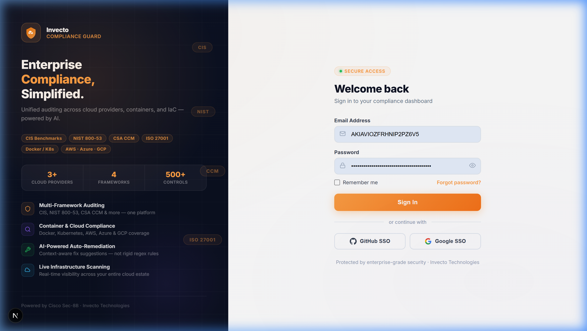
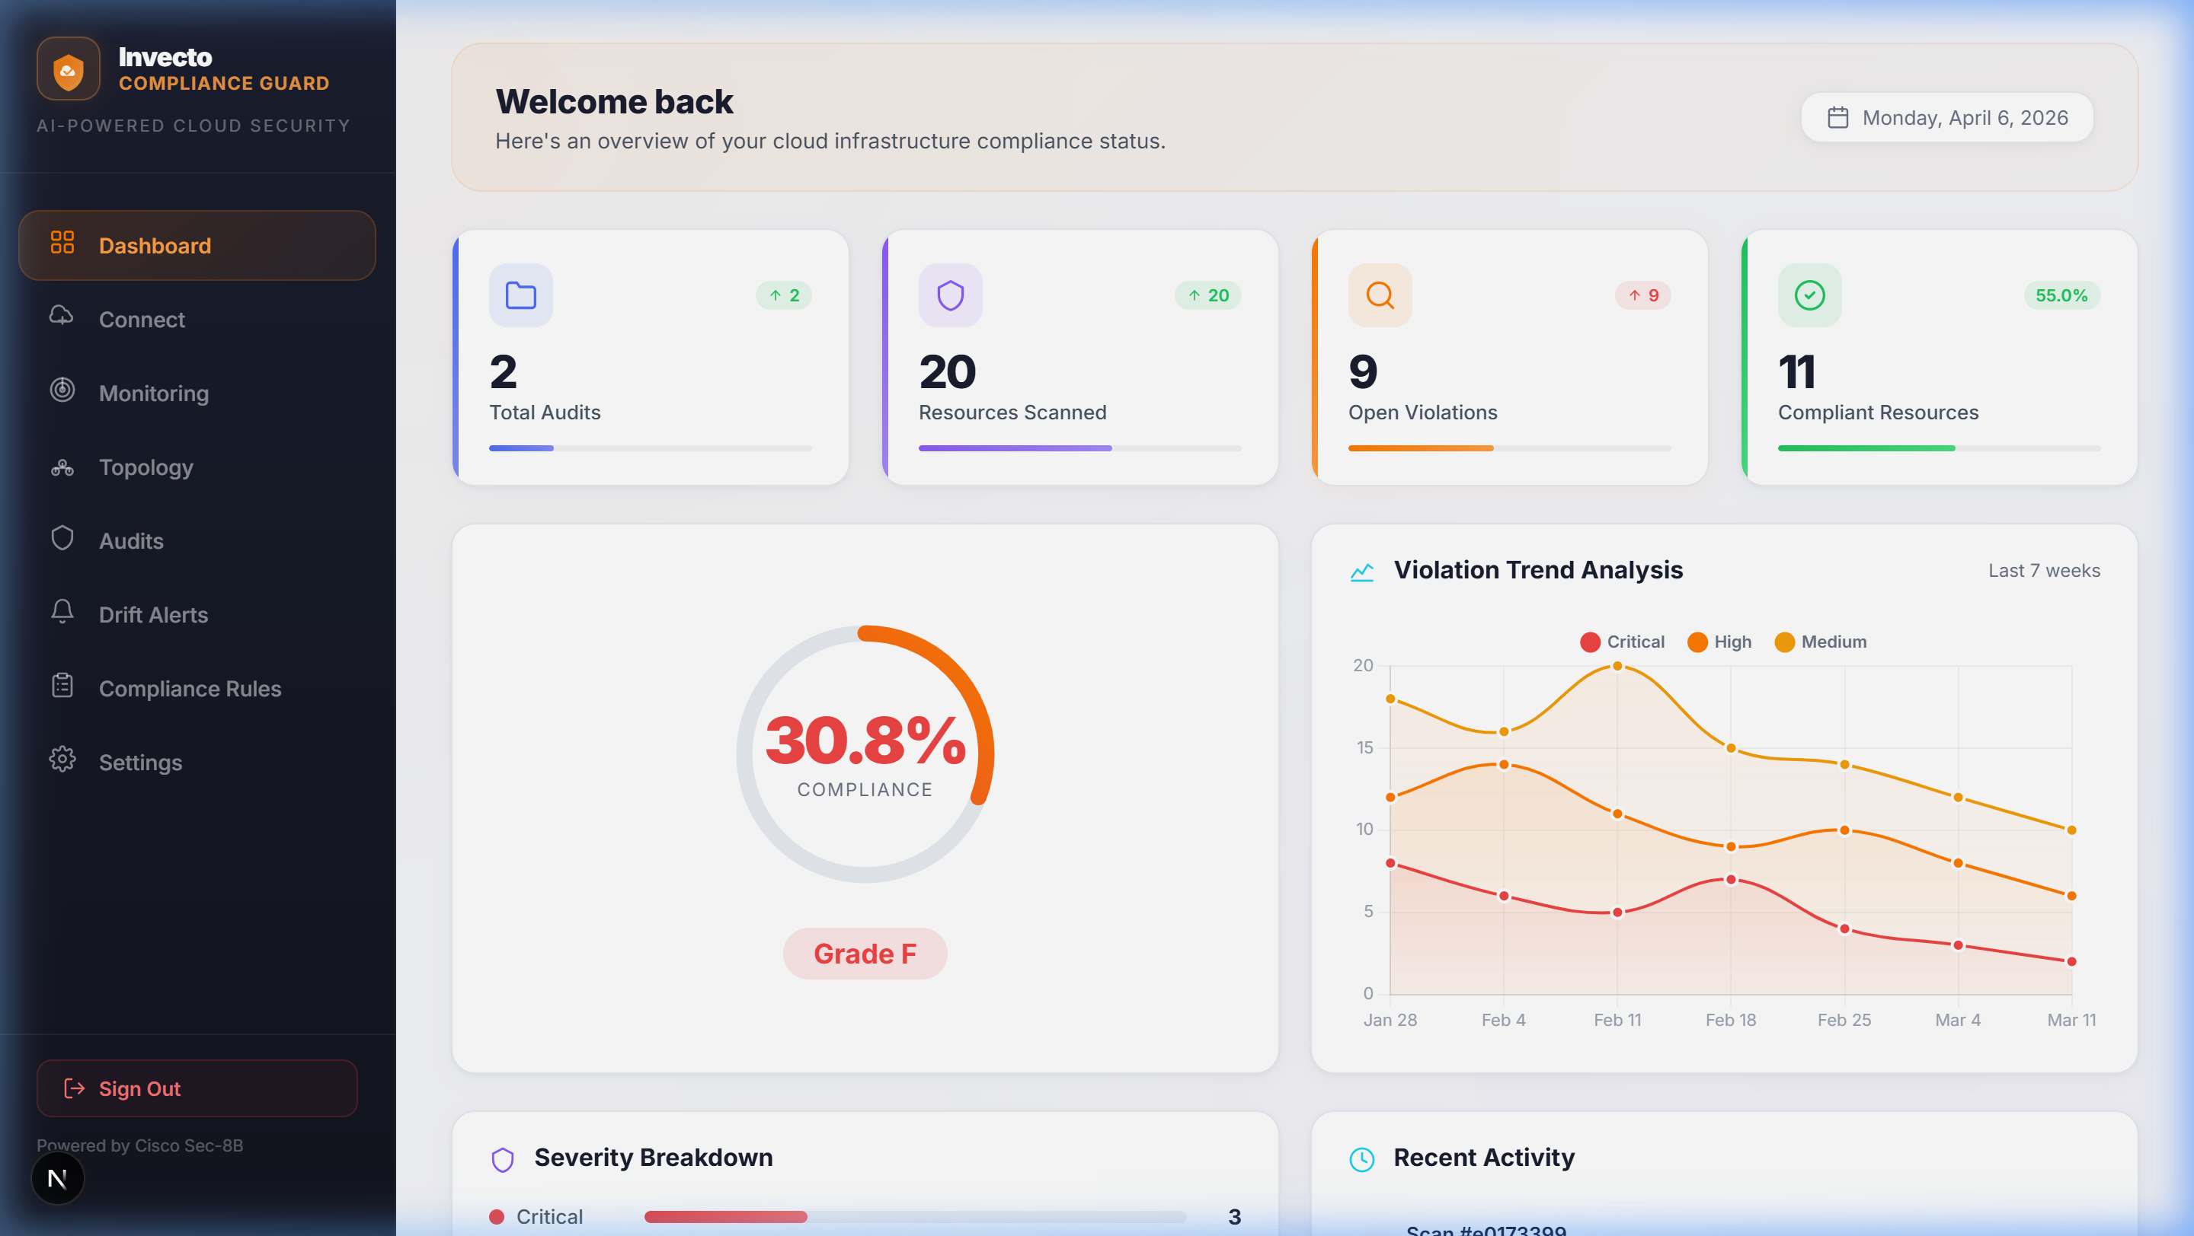
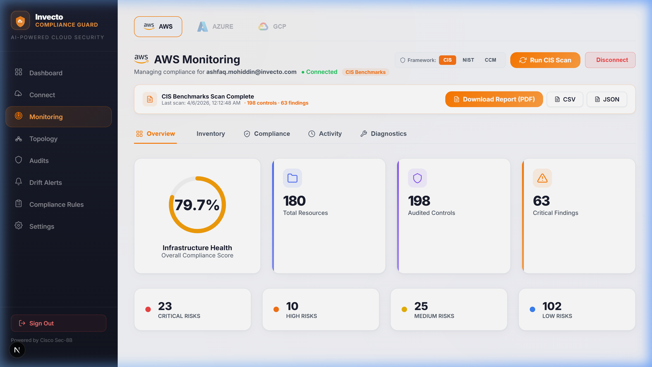
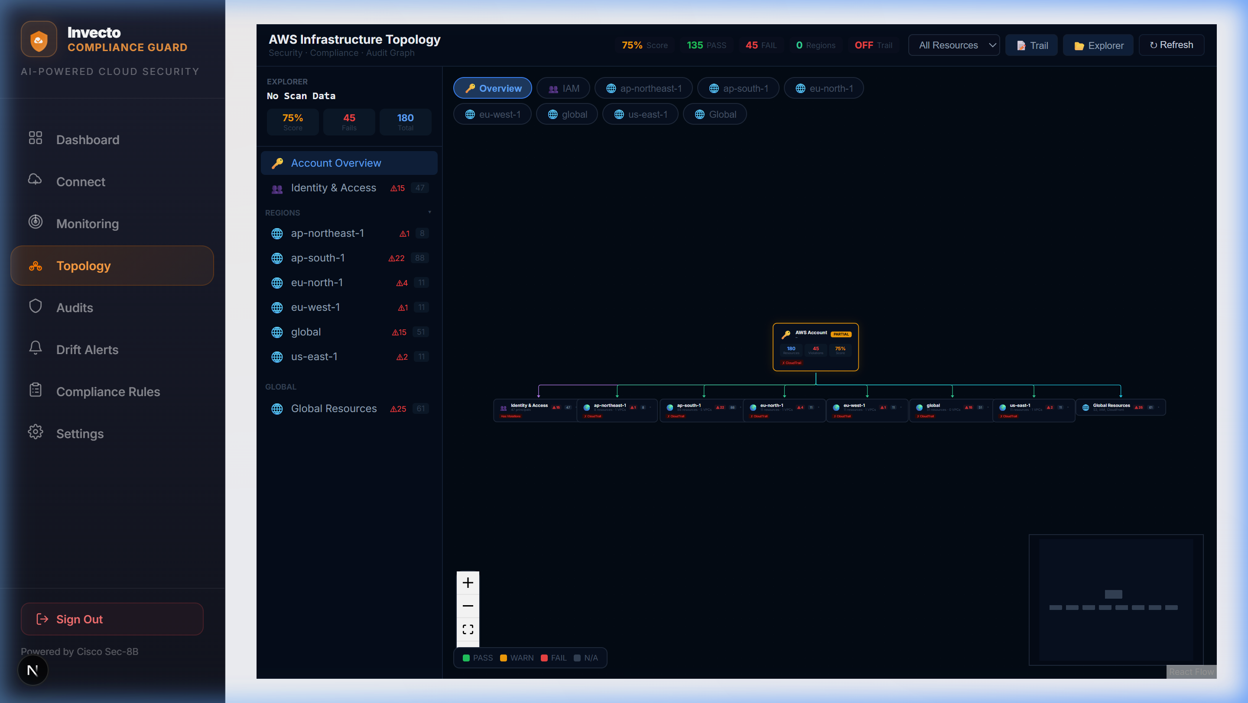
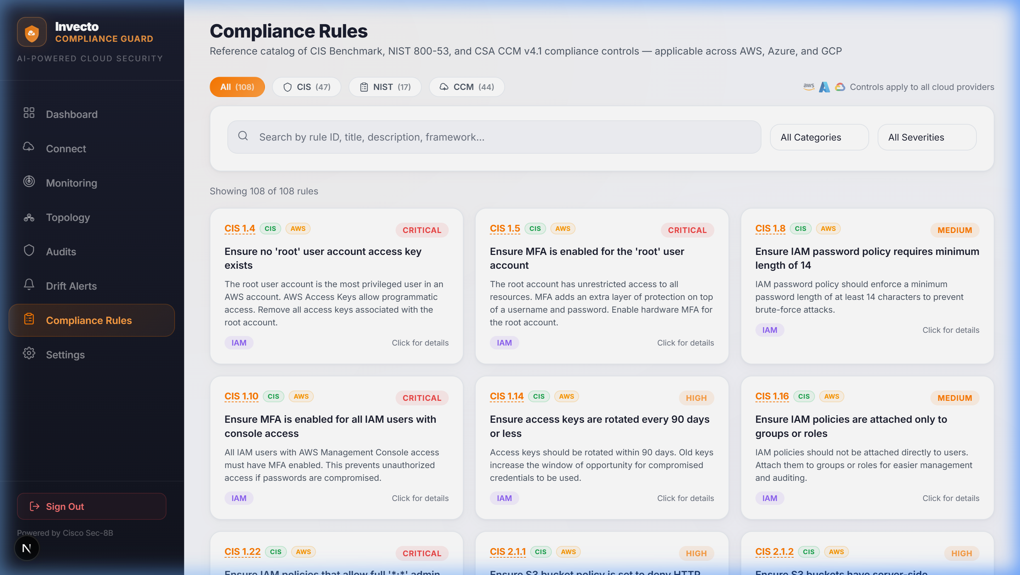
Invecto
COMPLIANCE GUARD
Working Proof of Concept — Live Application
● LIVE DEMO SCREENSHOTS
Login — Enterprise Auth
Dashboard — Compliance Overview
AWS Monitoring — 180 Resources
Infrastructure Topology — Multi-Region Heatmap
Compliance Rules — 108 Controls (CIS/NIST/CCM)
7 / 8

Slide 8
Invecto
COMPLIANCE GUARD
The Ask & Conclusion
RESOURCES NEEDED
WHY THIS PROJECT SHOULD WIN
▸ GPU compute for Cisco Sec-8B model hosting & inference
▸ Azure & GCP sandbox accounts for live validation
▸ Security mentorship for adversarial AI testing
▸ Enterprise pilot partner for real-world validation
1
First unified multi-framework compliance engine — CIS + NIST + CCM in a single AI-powered scan across AWS, Azure, GCP, Terraform, Docker, and Kubernetes
2
Privacy-first AI — Cisco Sec-8B runs entirely on private infrastructure; zero data leaves the org
3
Working PoC with real results — 180+ live AWS resources scanned, 63 critical findings identified, downloadable compliance reports generated
Invecto Compliance Guard
AI-Powered Cloud Compliance — Simplified.
Powered by Cisco Sec-8B · Invecto Technologies
8 / 8

