Slide 1
Hospital Management System ------------------------------------------------- Group members: Name : Pantho,Samith Binda ID : 16-31654-1 Name : Rahman,Sayma ID : 16-31580-1 Name : Razzaque,Syeda Tasnuva ID : 16-31660-1

Slide 2
Contents
Hospital management rule
2. Requirements
3. ER-Diagram for hospital management system
4. Normalization of Database
5. Tables create with screen-shot
6. Enable & disable constraints of table
7. Inserting data and screen-shot of data

Slide 3
1.Hospital Management Rules
1. Patient has an identification id. System also store patient’s name, gender, address, phone number.
2. Rooms will be assigned for a patient when he/she admit in the hospital. Every patient may not admit in the hospital. If any patient admit into the hospital then his/her date of admit and date of discharge will be stored.
3. Every room has a different number and there are many types of rooms.
4. In each room at least one nurse works and each nurse can work for more than one room.
5. Every nurse has an individual id and system also stores every nurse’s name, address, gender, phone number, life history, experience year, salary and also the doctor’s name under whom she works for.
6. Nurses gives medicines to a patient as the prescription that a doctor provided.
7. There is also a medicine shop where different kinds of medicines are stored. Medicines has individual id for each of them. And also an individually name and a fixed price for each medicine. The medicine shop may contains multiple number of a medicine.

Slide 4
Continue:-
8. When nurses give medicine to a patient than the quantity and the total price of medicines will also store in the system for every individual patient.
9. Receptionist maintains records. Every receptionist has a primary id. In the record his/her name, address, gender, phone number, experience, salary are also stored. They will admit a patient in the hospital if needed and also provide the total bill of a patient when discharge. They also give the appointments to a doctor. There are more than one receptionist in a hospital.
10. One patient can get admit into the hospital by one receptionist but one receptionist may admit more than one patient.
11. Doctors have different id and also name, salary, room number, time which are also stored in the system.
12. Doctors provide prescription for patients. One patient may receive a prescription from one doctor but one doctor may provide more than one prescription for several patients.
13. Doctors also maintains nurses’ who works for him. Each doctor has a specific room for his/her. And also a specific time for seeing patients.

Slide 5
Continue:-
14. In a hospital there are also some trainees who helps the doctors. A doctor may have more than one trainees but each trainee will work under a specific doctor. System also store their identification id, name, address, gender, phone number and the doctor’s name under whom he/she works for.
15. There are also a lab in the hospital where more than one pharmacists work and examine the medicines and give permission to use them. Doctors are also noticed about the medicines through the pharmacists. Each pharmacist has a different id, name address, gender, phone number, salary, experience which all are stored in the system.
16. There is also a blood bank where different types of blood and the quantity are stored. If any patient needs blood than the quantity and the bill will store in the system along with patient’s id. When a donor donates blood than the blood will first check in the lab and then will reserve into the bank. If the blood reserve in the blood bank than the blood’s id, type, donor’s name, donor’s address, donor’s phone number are also stored in the system.

Slide 6
Continue:-
17. When a patient will discharge every patient will receive a report from the receptionist. There are four kinds of report like operation report, normal report, birth report and also death report.
18. A hospital has many ambulances. Every ambulance has an individual number. There are also two types of ambulance like ac and non ac. Receptionist provide an ambulance to a patient if needed. If an ambulance may hired by a patient than it’s hired charge will also add along with patient’s total bill.
19. Doctor, nurse, receptionist, pharmacists and trainees all are the employee. There are specific working schedule for each employee along with their id.
20. Ambulance, Medicine, Room, Blood bank are in Service.

Slide 7
2.Hospital Management Requirements
From the concept we get the entity sets:
1. Patients
2. Service
3. Report
4. Employees
Concerning the Patients:-
1. Attributes: ID, name, address, phone,gender.
2. Patient_id is used for taking Service.
3. Patient_id also used to allocate Doctor_id and Nurse_id.
4. Patient_id is used for taking Report from Receptionist.

Slide 8
Continue:-
Concerning the Service:-
1. Attributes: type,bill
2. Type consists of ambulance, medicine, blood bank.
3. Service is a weak entity set with Patients.
4. Blood bank has a weak relationship with Downer.
5. Madicine_id is used for the quantity which consists of Patient_id.
6. Room_no is allocates Patient.
Concerning the Report:-
1. Attributes: Operation_Report(O.R), Normal_Report(N.R), Birth_Report(B.R), Death_Report(D.R).
2. Patient_id and Receptionist_id is used for Report.

Slide 9
Continue:-
Concerning the Employees:-
1. Attributes: ID, name, salary, address, history, phone, working hour.
2. Trainee, Doctor, Nurse, Receptionist, Pharmacists is an Employee.
3. Pharmacist_id is used for examine Medicine.
4. Doctor_id allocates Nurse.
5. Receptionist_id allocates Report.

Slide 10
3.ER-Diagram for Hospital Management System

Slide 11
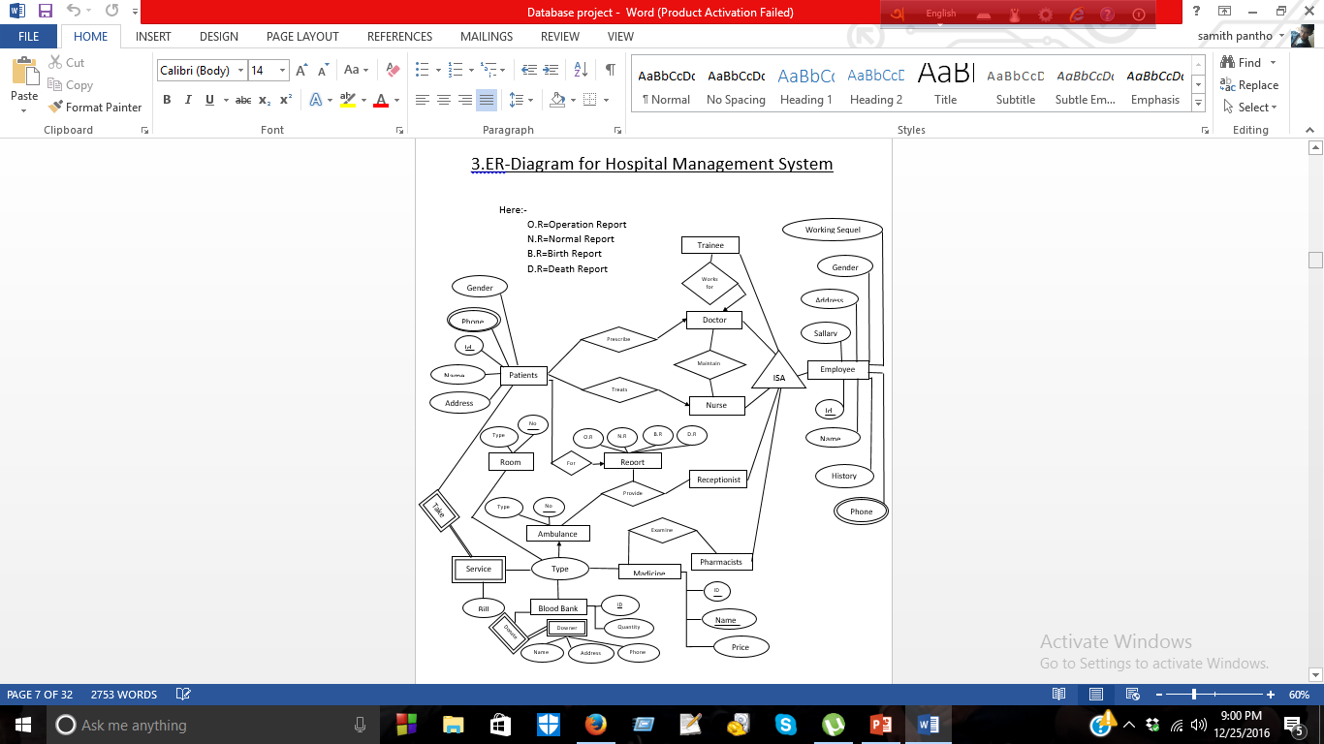

Slide 12
4.Normalization:

Slide 13
From the ER-Diagram we can create these tables:-
1. Patient(patient_id, patient_name, patient_address, patient_gender, patient_phone).
2. Employee(patient_id ,trainee_id, trainee_name, trainee_address, trainee_gender, trainee_phone, trainee_salary, trainee_workinghour, trainee_history, doctor_id, doctor_name, doctor_address, doctor_gender, doctor_phone, doctor_salary, doctor_workinghour, doctor_history, nurse_id, nurse_name, nurse_address, nurse_gender, nurse_phone, nurse_salary, nurse _workinghour, nurse_history ,receptionist_id, receptionist_name, receptionist_address, receptionist_gender, receptionist_phone, receptionist_salary, receptionist_workinghour, receptionist_history ,pharmacist_id, pharmacist_name, pharmacist_address, pharmacist_gender, pharmacist_phone, pharmacist_salary, pharmacist_workinghour, pharmacist_history).
3. Report(patient_id, receptionist_id, report_type).
4. Service(patient_id, ambulance_no, ambulance_type, blood_type, quantity, downer_name, downer_address, downer_phone, room_no, room_type, medicine_no, medicine_name, medicine_price,bill).

Slide 14
1st Normal Form:-
Patient:-
Patient_id | patient_name | patient_address | patient_gender | patient_phone
Employee table has many attributes. As 1st Normal form we divided this table into 6 different tables:-
Employee:-
ID | Type
Patient_id

Slide 15
Continue:-
Patient_id
Table Name -> | Trainee (Tra) | Doctor (Doc) | Nurse (Nur) | Pharmacist (Pha) | Receptionist (Rec)
 | Tra_id | Doc_id | Nur_id | Pha_id | Rec_id
 | Tra_name | Doc_name | Nur_name | Pha_name | Rec_name
 | Tra_address | Doc_address | Nur_address | Pha_address | Rec_address
 | Tra_gender | Doc_gender | Nur_gender | Pha_gender | Rec_gender
 | Tra_phone | Doc_phone | Nur_phone | Pha_phone | Rec_phone
 | Tra_salary | Doc_salary | Nur_salary | Pha_salary | Rec_salary
 | Tra_workhour | Doc_workhour | Nur_workhour | Pha_workhour | Rec_workhour
 | Tra_history | Doc_history | Nur_history | Pha_history | Rec_history
 | Doc_id |  | Doc_id | Medicine_no

Slide 16
Report:- Service:-
Patient_id | Receptionist_id | Report_type
Patient_id | Ambu_no | Amb_type | Room_no | Room_type | Blood_id | quantity | bill | Downer_name | Downer_address | Downer_phone | Madiine_name | Madicine_price | Medicine_no

Slide 17
2nd Normal Form:- In 2nd Normal form Patient, Employee table are the same. In Trainee table :-
Doc _id | Tra_id | Tra_ name | Tra_ address | Tra_ salary | Tra_ history | Tra_ workhour | Tra_ phone | Tra_ gender

Slide 18
Doc-tra table:- Trainee table:-
Doctor_id | Tra_id
Tra_id | Tra_ name | Tra_ address | Tra_ salary | Tra_ history | Tra_ workhour | Tra_ phone | Tra_ gender

Slide 19
In Nurse table:-
Doc _id | Nur_id | Nur _ name | Nur _ address | Nur _ salary | Nur _ history | Nur _ workhour | Nur _ phone | Nur _ gender | Patient_ id

Slide 20
Patient -Doc-Nar table :- Nurse table :-
Patient_id | Doc_id | Nur_id

Slide 21
In Pharmacist table :-
Pha_ id | Medicine_ no | Pha_ name | Pha_ address | Pha_ salary | Pha_ history | Pha_ workhour | Pha_ phone | Pha_ gender

Slide 22
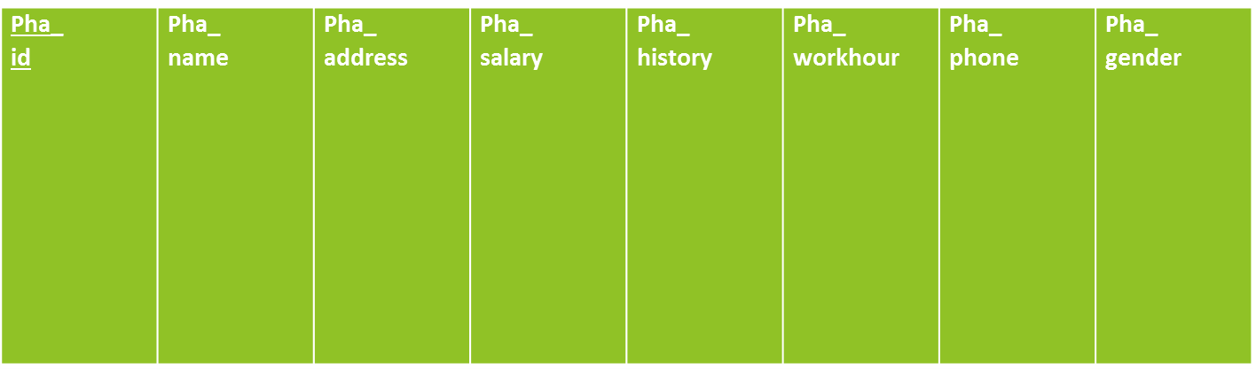
Medicine-pha table :- Pharmacist table :-
Pha_ id | Medicine_ no

Slide 23
Receptionist, Report table are same as 1st Normal form. In Service table:-
Patient_id | Ambu_no | Amb_type | Room_no | Room_type | Blood_id | quantity | bill | Downer_name | Downer_address | Downer_phone | Madiine_name | Madicine_price | Medicine_no

Slide 24


Ambulance table :- Room table:- Blood-downer table:-
Service_no | Ambu_no | Ambu_type

Slide 25


Medicine table:- Service table:- Patient-service table:-
Service_no | Medicine_no | Medicine_name | Medicine_price

Slide 26
3rd Normal Form:- In Patient-service table:- Bill table:-
Patient_ id | Service_no | Quantity | Bill
Patient_id | Bill

Slide 27
Patient-service table:-
Patient_id | Service_no | Quantity

Slide 28
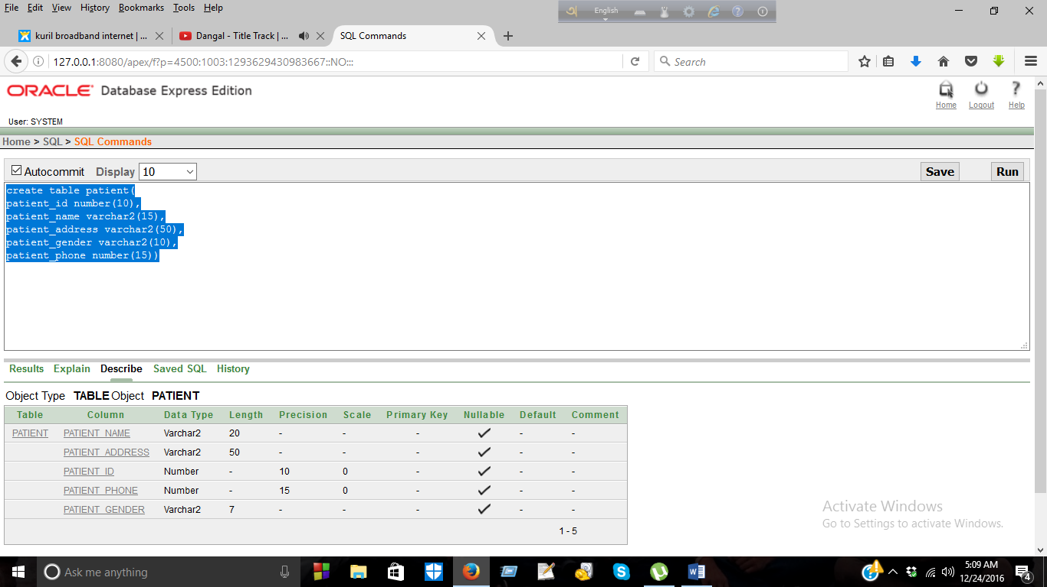
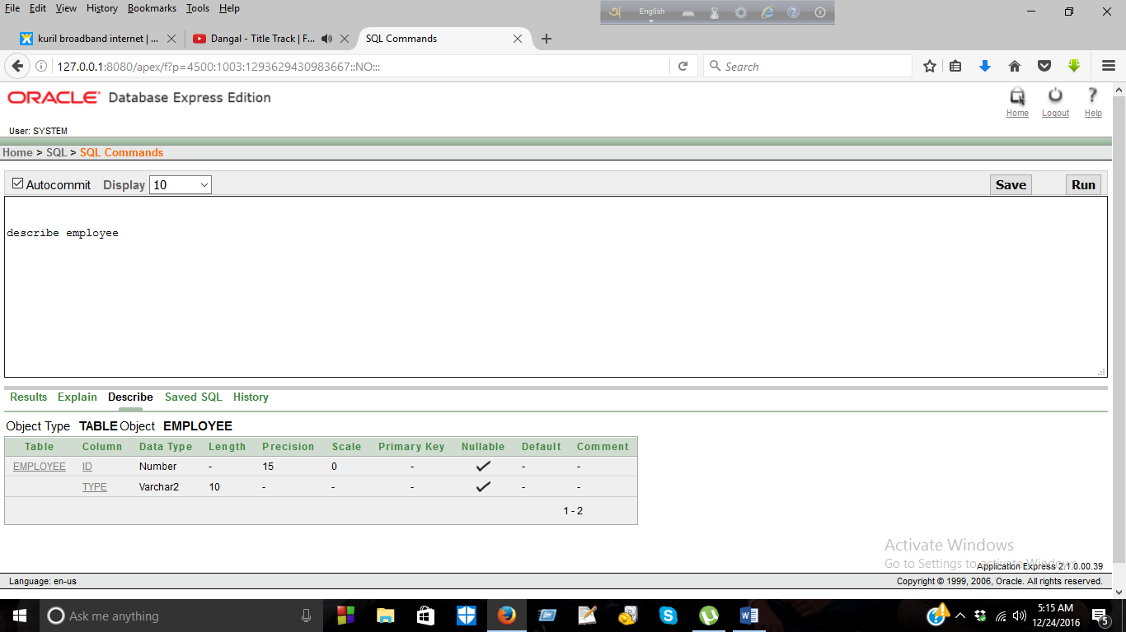
5.Create table
Creating Patient table:-
create table patient(
patient_id number(10),
patient_name varchar2(15),
patient_address varchar2(50),
patient_gender varchar2(10),
patient_phone number(15));
Create Employee table:-
create table employee(
id number(15),
type varchar2(10));

Slide 29
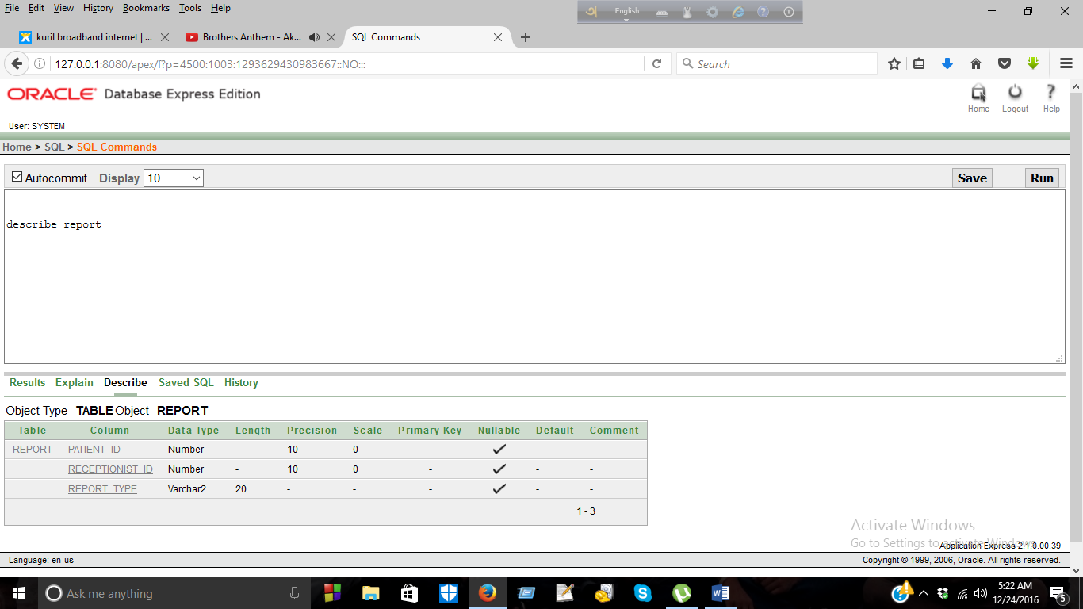
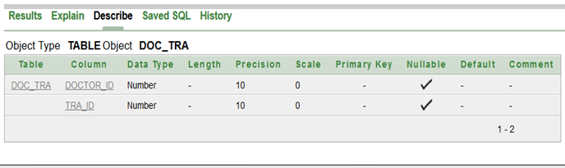
Creating Report table:-
create table report(
patient_id number(10),
receptionist_id number(10),
report_type varchar2(20));
Creating Doc_tra table:-
create table doc_tra(
doctor_id number(10),
tra_id number(10));

Slide 30
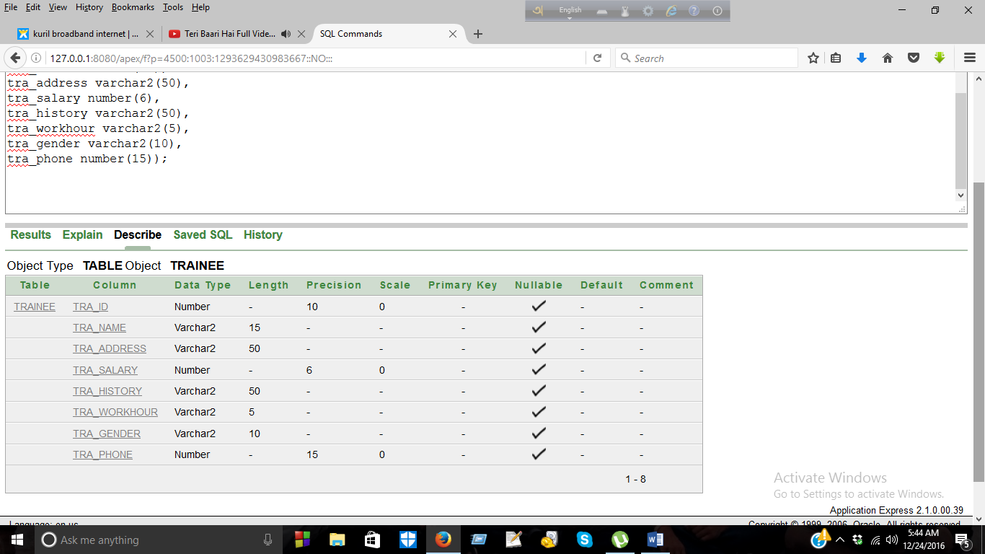
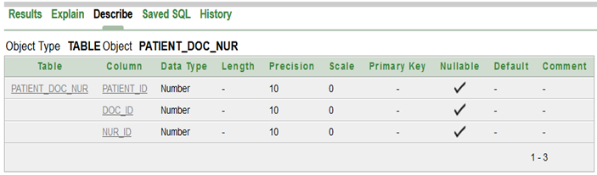
Creating Trainee table:-
create table trainee(
tra_id number(10),
tra_name varchar2(15),
tra_address varchar2(50),
tra_salary number(6),
tra_history varchar2(50),
tra_workhour varchar2(5),
tra_gender varchar2(10),
tra_phone number(15));
Creating Patient_Doc_nur table:-
create table patient_doc_nur(
patient_id number(10),
doc_id number(10),
nur_id number(10));

Slide 31
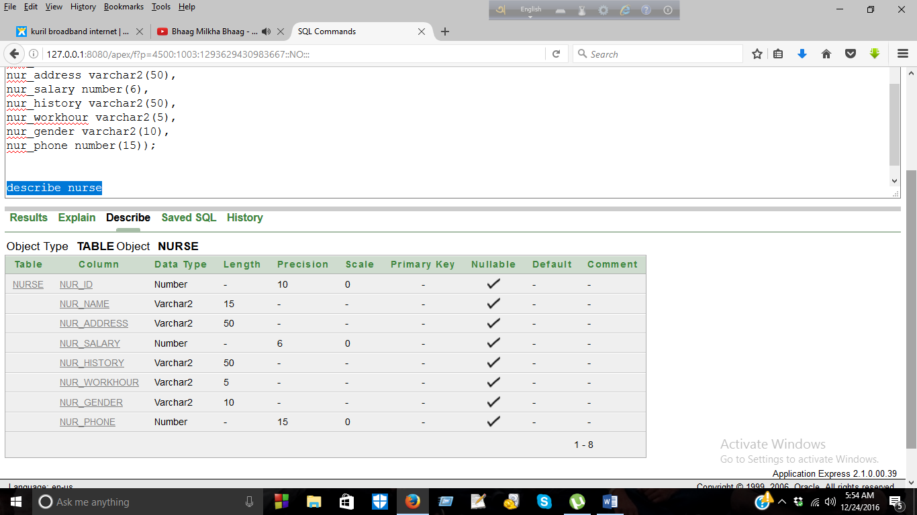
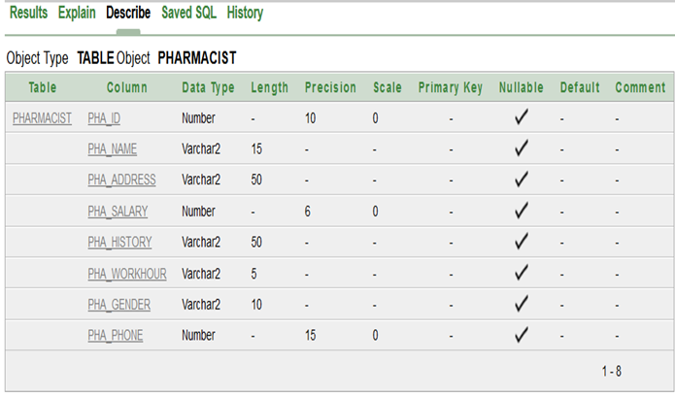
Creating Nurse table:-
create table nurse(
nur_id number(10),
nur_name varchar2(15),
nur_address varchar2(50),
nur_salary number(6),
nur_history varchar2(50),
nur_workhour varchar2(5),
nur_gender varchar2(10),
nur_phone number(15));
Creating Pharmacist table:-
create table pharmacist(
pha_id number(10),
pha_name varchar2(15),
pha_address varchar2(50),
pha_salary number(6),
pha_history varchar2(50),
pha_workhour varchar2(5),
pha_gender varchar2(10),
pha_phone number(15));

Slide 32
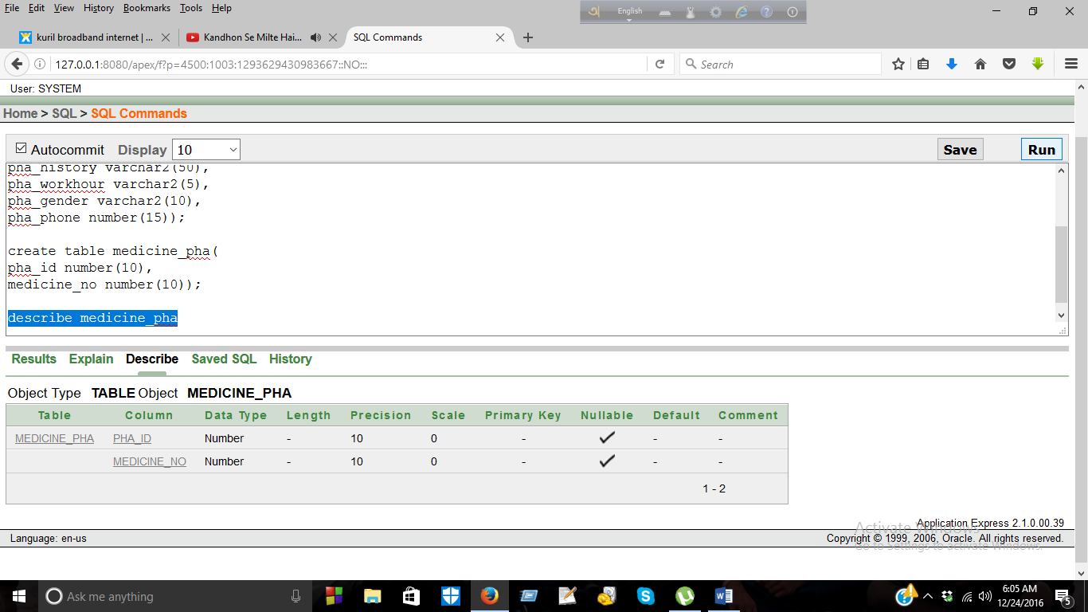
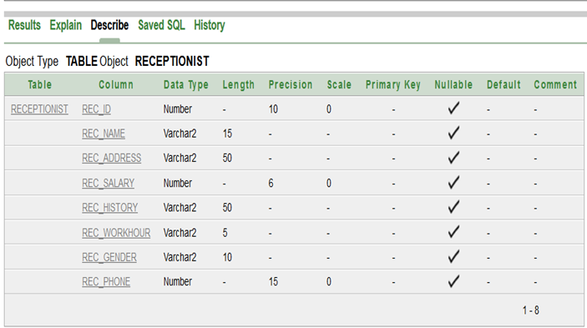
Creating Medicine_pha table:-
create table medicine_pha(
pha_id number(10),
medicine_no number(10));
Creating Receptionist table:-
create table receptionist(
rec_id number(10),
rec_name varchar2(15),
rec_address varchar2(50),
rec_salary number(6),
rec_history varchar2(50),
rec_workhour varchar2(5),
rec_gender varchar2(10),
rec_phone number(15));

Slide 33
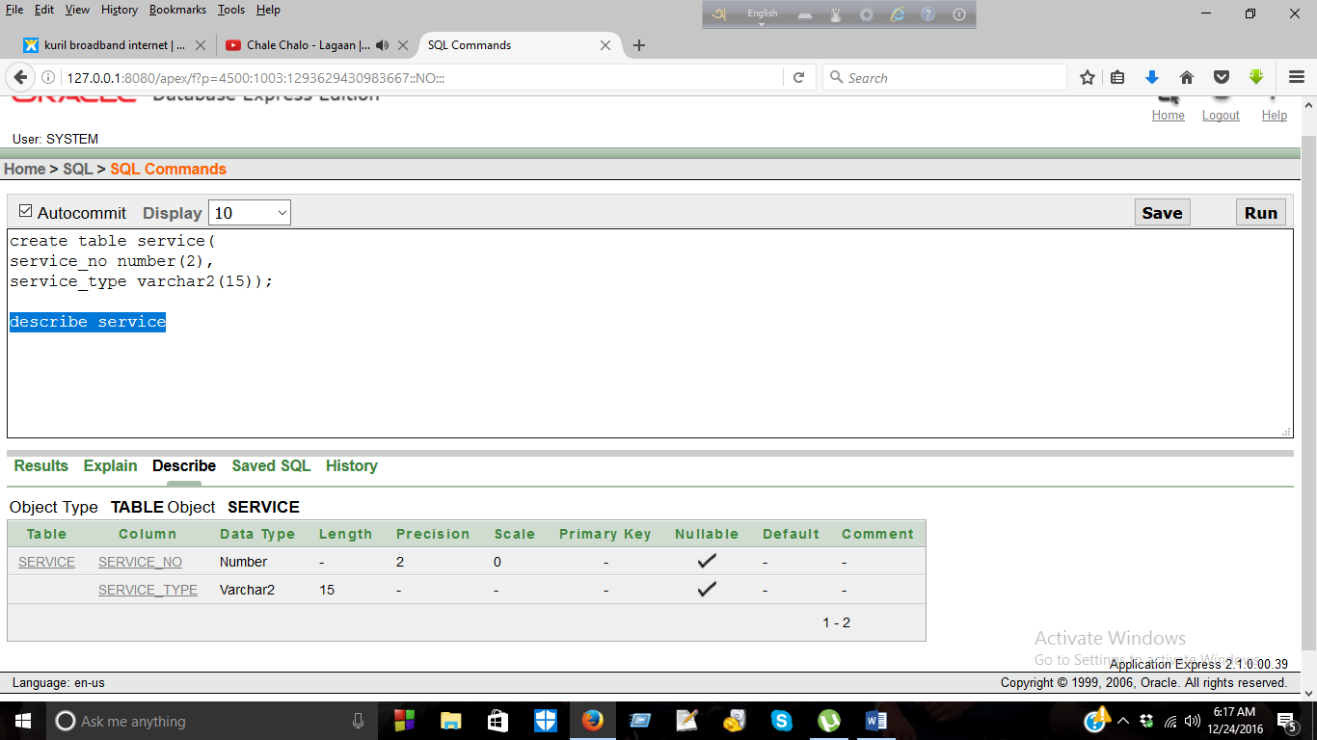
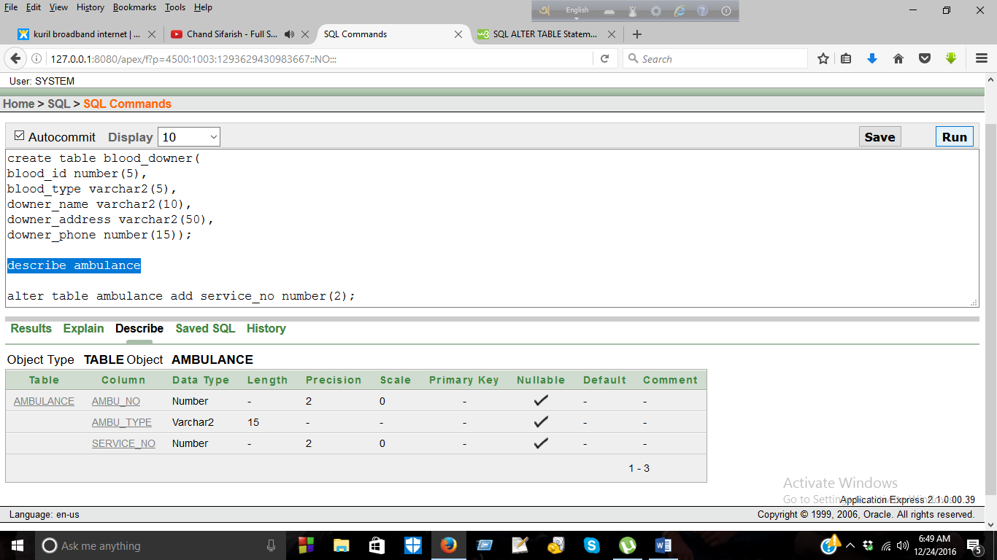
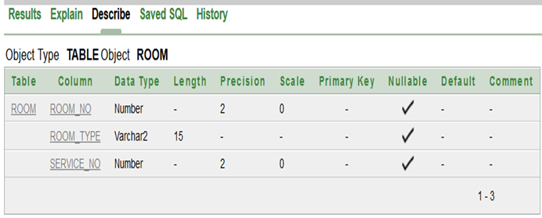
Creating Service table:-
create table service(
service_no number(2),
service_type varchar2(15));
Creating Ambulance table:-
create table ambulance(
ambu_no number(2),
ambu_type varchar2(15),
service_no number(2));
Creating Room table:-
create table room(
room_no number(2),
room_type varchar2(15),
service_no number(2));

Slide 34
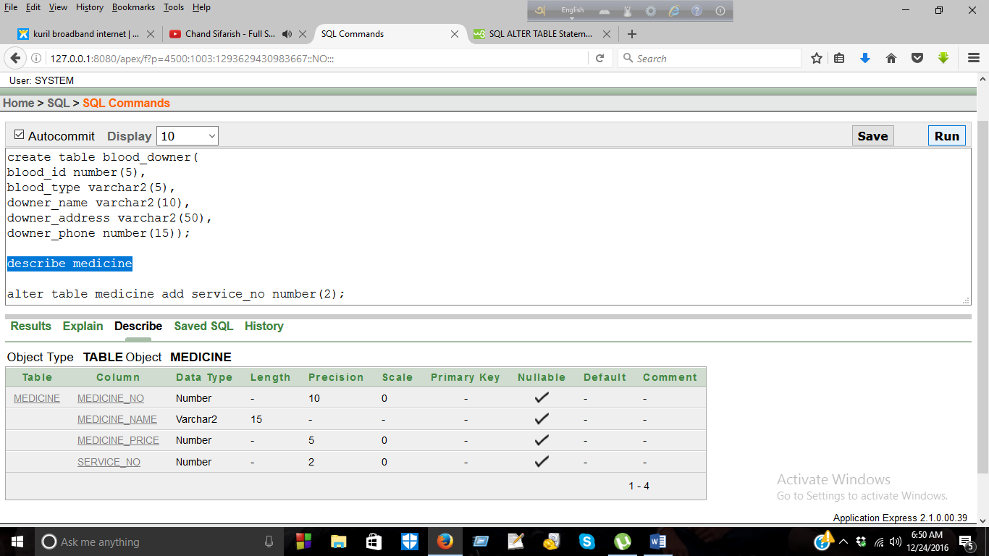
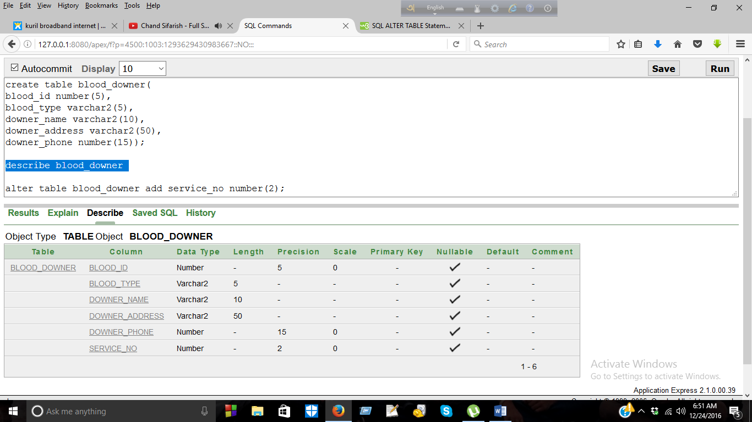
Creating Medicine table:-
create table medicine(
medicine_no number(10),
medicine_name varchar2(15),
medicine_price number(5),
service_no number(2));
Creating Blood_downer table:-
create table blood_downer(
blood_id number(5),
blood_type varchar2(5),
downer_name varchar2(10),
downer_address varchar2(50),
downer_phone number(15),
service_no number(2));

Slide 35
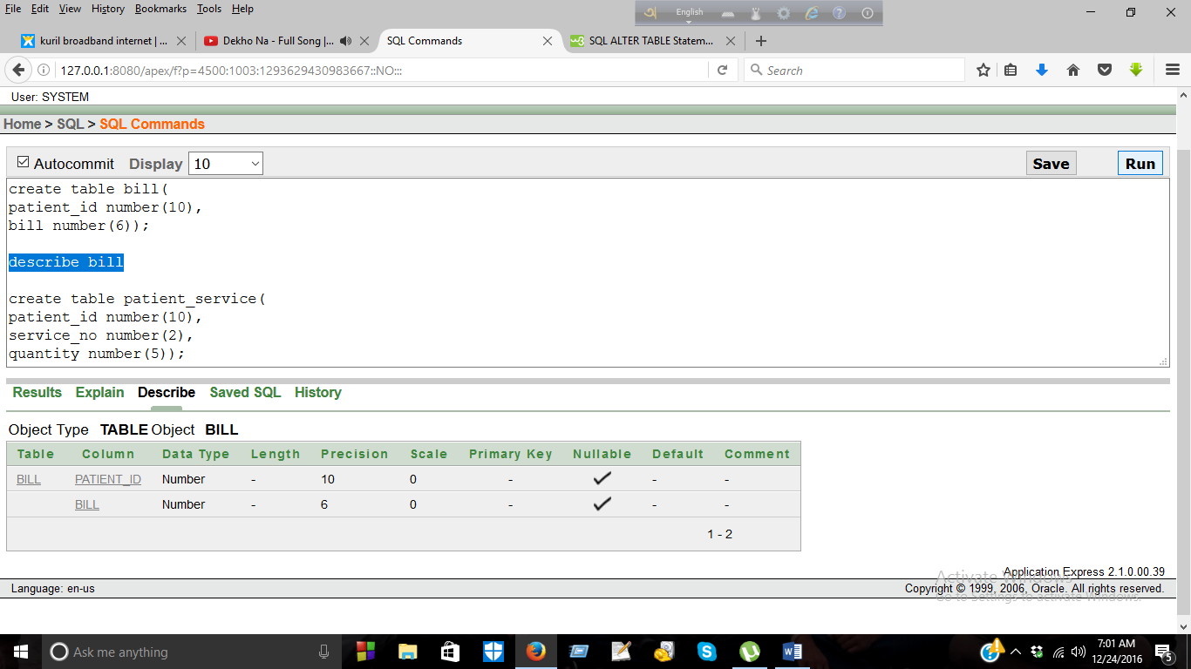
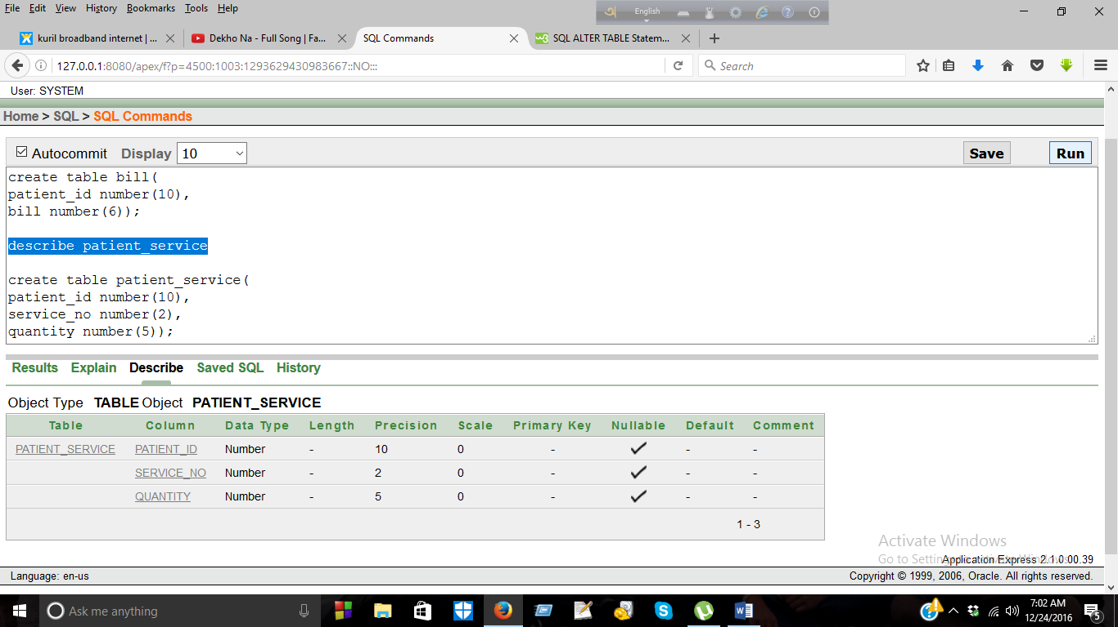
Creating Bill table:-
create table bill(
patient_id number(10),
bill number(6));
Creating Patient_service table:-
create table patient_service(
patient_id number(10),
service_no number(2),
quantity number(5));

Slide 36
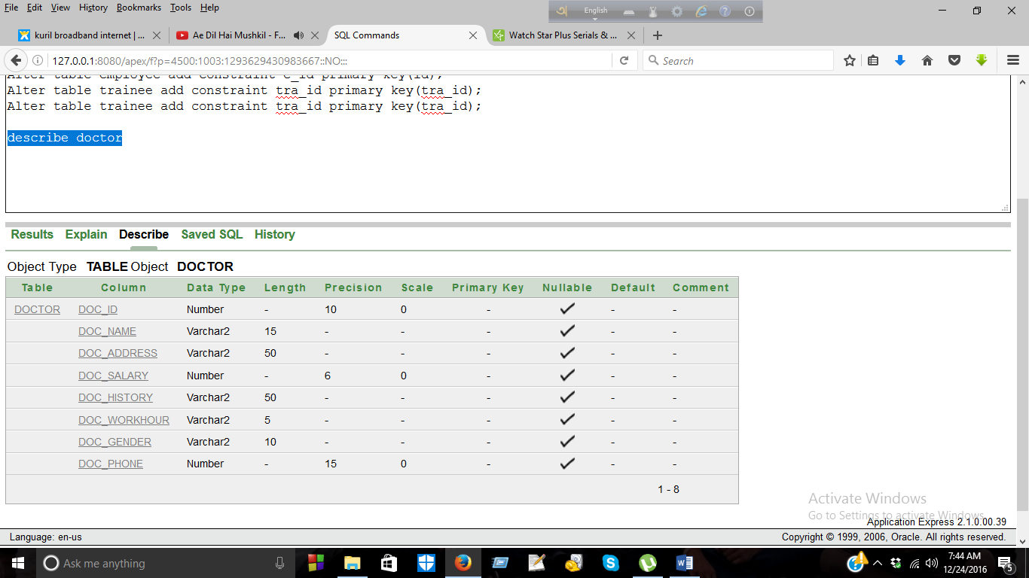
Creating Doctor table:-
create table doctor(
doc_id number(10),
doc_name varchar2(15),
doc_address varchar2(50),
doc_salary number(6),
doc_history varchar2(50),
doc_workhour varchar2(5),
doc_gender varchar2(10),
doc_phone number(15));

Slide 37
6. Add , enable & disable constraints
Add Primary keys:-
Alter table patient add constraint p_id primary key(patient_id);
Alter table employee add constraint e_id primary key(id);
Alter table trainee add constraint tra_id primary key(tra_id);
Alter table doctor add constraint doc_id primary key(doc_id);
Alter table nurse add constraint nur_id primary key(nur_id);
Alter table pharmacist add constraint pha_id primary key(pha_id);
Alter table receptionist add constraint rec_id primary key(rec_id);
Alter table service add constraint ser_no primary key(service_no);
Alter table ambulance add constraint ambu_no primary key(ambu_no);
Alter table room add constraint room_no primary key(room_no);
Alter table medicine add constraint med_no primary key(medicine_no);
Alter table blood_downer add constraint bd_id primary key(blood_id);

Slide 38
Add Foreign Keys:-
alter table report add constraint r1 foreign key (patient_id) references patient(patient_id);
alter table report add constraint r2 foreign key (receptionist_id) references receptionist(rec_id);
alter table doc_tra add constraint doc foreign key (doctor_id) references doctor(doc_id);
alter table doc_tra add constraint tra foreign key (tra_id) references trainee(tra_id);
alter table patient_doc_nur add constraint pat foreign key (patient_id) references patient(patient_id);
alter table patient_doc_nur add constraint p_doc foreign key (doc_id) references doctor(doc_id);

Slide 39
Add Foreign Keys(Continue):-
alter table patient_doc_nur add constraint p_nur foreign key (nur_id) references nurse(nur_id);
alter table medicine_pha add constraint m_no foreign key (medicine_no) references medicine(medicine_no);
alter table medicine_pha add constraint pha_no foreign key (pha_id) references pharmacist(pha_id);
alter table ambulance add constraint ser1 foreign key (service_no) references service(service_no);
alter table room add constraint ser2 foreign key (service_no) references service(service_no);
alter table medicine add constraint ser3 foreign key (service_no) references service(service_no);

Slide 40
Add Foreign Keys(Continue):-
alter table blood_downer add constraint ser4 foreign key (service_no) references service(service_no);
alter table bill add constraint bill_id foreign key (patient_id) references patient(patient_id);
alter table patient_service add constraint pat_ser foreign key (patient_id) references patient(patient_id);
alter table patient_service add constraint ser_pat foreign key (service_no) references service(service_no);

Slide 41
Add Default key:-
alter table bill modify bill default '0';
Add Check key:-
Alter table ambulance add constraint c1 check(service_no=1);
Alter table room add constraint c2 check(service_no=2);
Alter table medicine add constraint c3 check(service_no=3);
Alter table blood_downer add constraint c4 check(service_no=4);
Alter table patient_service add constraint c5 check(service_no=1 or service_no=2 or service_no=3 or service_no=4);

Slide 42
Disable Constraint:-
alter table patient_service disable constraint c1;
alter table patient_service disable constraint c2;
alter table patient_service disable constraint c3;
alter table patient_service disable constraint c4;
alter table patient_service disable constraint c5;
alter table patient disable constraint p_id;
alter table employee disable constraint e_id;
alter table nurse disable constraint nur_id;
alter table receptionist disable constraint rec_id;
alter table report disable constraint r1;
alter table ambulance disable constraint ambu_no;
alter table service disable constraint service_no;
alter table patient_doc_nur disable constraint p_doc;

Slide 43
Enable Constraints:-
alter table patient_service enable constraint c1;
alter table patient_service enable constraint c2;
alter table patient_service enable constraint c3;
alter table patient_service enable constraint c4;
alter table patient_service enable constraint c5;
alter table patient enable constraint p_id;
alter table employee enable constraint e_id;
alter table nurse enable constraint nur_id;
alter table receptionist enable constraint rec_id;
alter table report enable constraint r1;
alter table ambulance enable constraint ambu_no;
alter table service enable constraint service_no;
alter table patient_doc_nur enable constraint p_doc;

Slide 44
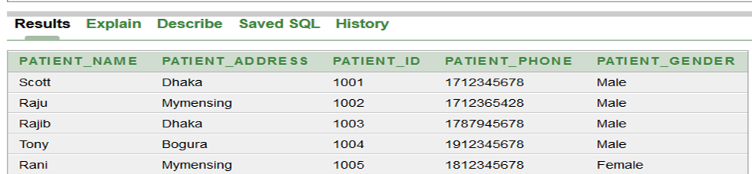
7. Inserting Data
Insert into Patient:-
insert into patient(patient_id, patient_name, patient_address, patient_gender, patient_phone) values (1001,'Scott','Dhaka','Male',01712345678);
insert into patient(patient_id, patient_name, patient_address, patient_gender, patient_phone) values (1002,'Raju','Mymensing','Male',01712365428);
insert into patient(patient_id, patient_name, patient_address, patient_gender, patient_phone) values (1003,'Rajib','Dhaka','Male',01787945678);
insert into patient(patient_id, patient_name, patient_address, patient_gender, patient_phone) values (1004,'Tony','Bogura','Male',01912345678);
insert into patient(patient_id, patient_name, patient_address, patient_gender, patient_phone) values (1005,'Rani','Mymensing','Female',01812345678);
select * from patient;

Slide 45
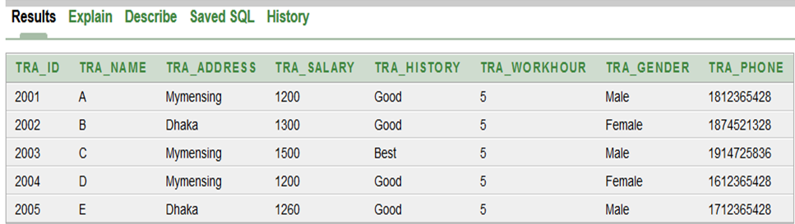
Insert into Trainee:-
insert into trainee(tra_id, tra_name, tra_address,tra_gender,tra_phone,tra_history,tra_salary,tra_workhour) values (2001,'A','Mymensing','Male',01812365428,'Good','1200',5);
insert into trainee(tra_id, tra_name, tra_address,tra_gender,tra_phone,tra_history,tra_salary,tra_workhour) values (2002,'B','Dhaka','Female',01874521328,'Good','1300',5);
insert into trainee(tra_id, tra_name, tra_address,tra_gender,tra_phone,tra_history,tra_salary,tra_workhour) values (2003,'C','Mymensing','Male',01914725836,'Best','1500',5);
insert into trainee(tra_id, tra_name, tra_address,tra_gender,tra_phone,tra_history,tra_salary,tra_workhour) values (2004,'D','Mymensing','Female',01612365428,'Good','1200',5);
insert into trainee(tra_id, tra_name, tra_address,tra_gender,tra_phone,tra_history,tra_salary,tra_workhour) values (2005,'E','Dhaka','Male',01712365428,'Good','1260',5);
select * from trainee;

Slide 46
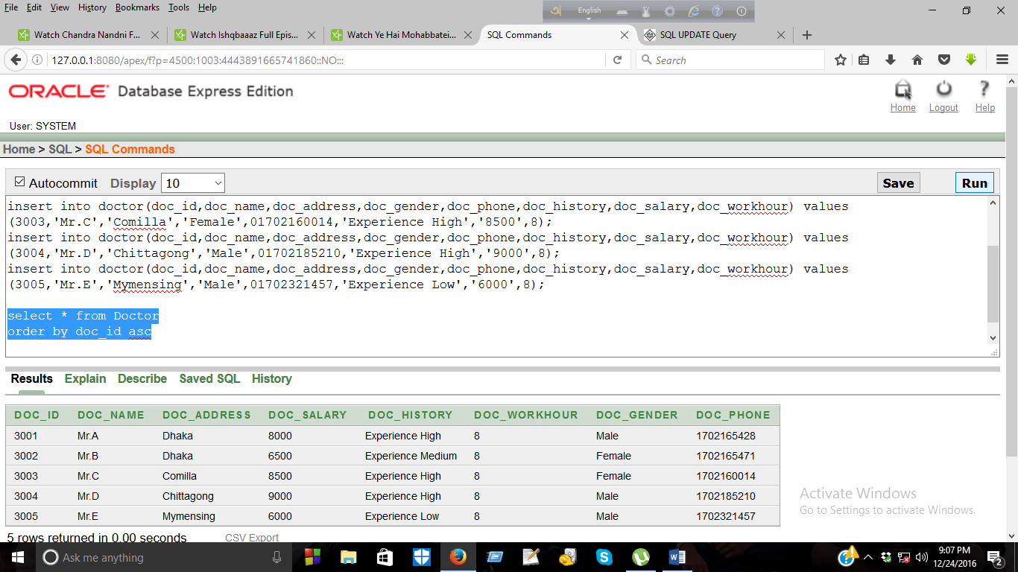
Insert into Doctor:-
insert into doctor(doc_id,doc_name,doc_address,doc_gender,doc_phone,doc_history,doc_salary,doc_workhour) values (3001,'Mr.A','Dhaka','Male',01702165428,'Experience High','8000',8);
insert into doctor(doc_id,doc_name,doc_address,doc_gender,doc_phone,doc_history,doc_salary,doc_workhour) values (3002,'Mr.B','Dhaka','Female',01702165471,'Experience Medium','6500',8);
insert into doctor(doc_id,doc_name,doc_address,doc_gender,doc_phone,doc_history,doc_salary,doc_workhour) values (3003,'Mr.C','Comilla','Female',01702160014,'Experience High','8500',8);
insert into doctor(doc_id,doc_name,doc_address,doc_gender,doc_phone,doc_history,doc_salary,doc_workhour) values (3004,'Mr.D','Chittagong','Male',01702185210,'Experience High','9000',8);
insert into doctor(doc_id,doc_name,doc_address,doc_gender,doc_phone,doc_history,doc_salary,doc_workhour) values (3005,'Mr.E','Mymensing','Male',01702321457,'Experience Low','6000',8);
select * from Doctor;

Slide 47
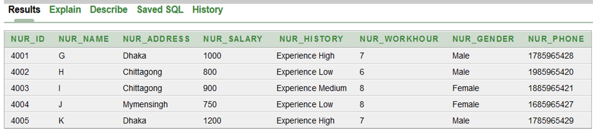
Insert into Nurse:-
insert into nurse(nur_id,nur_name,nur_address,nur_gender,nur_phone,nur_history,nur_salary,nur_workhour) values (4001,'G','Dhaka','Male',01785965428,'Experience High','1000',7);
insert into nurse(nur_id,nur_name,nur_address,nur_gender,nur_phone,nur_history,nur_salary,nur_workhour) values (4002,'H','Chittagong','Male',01985965420,'Experience Low','800',6);
insert into nurse(nur_id,nur_name,nur_address,nur_gender,nur_phone,nur_history,nur_salary,nur_workhour) values (4003,'I','Chittagong','Female',01885965421,'Experience Medium','900',8);
insert into nurse(nur_id,nur_name,nur_address,nur_gender,nur_phone,nur_history,nur_salary,nur_workhour) values (4004,'J','Mymensingh','Female',01685965427,'Experience Low','750',8);
insert into nurse(nur_id,nur_name,nur_address,nur_gender,nur_phone,nur_history,nur_salary,nur_workhour) values (4005,'K','Dhaka','Male',01785965429,'Experience High','1200',7);
select * from nurse;

Slide 48
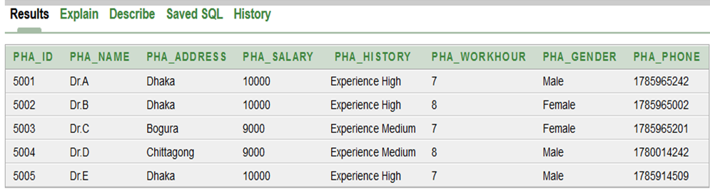
Insert into Pharmacist:-
insert into Pharmacist(pha_id,pha_name,pha_address,pha_gender,pha_phone,pha_history,pha_salary,pha_workhour) values (5001,'Dr.A','Dhaka','Male',01785965242,'Experience High','10000',7);
insert into Pharmacist(pha_id,pha_name,pha_address,pha_gender,pha_phone,pha_history,pha_salary,pha_workhour) values (5002,'Dr.B','Dhaka','Female',01785965002,'Experience High','10000',8);
insert into Pharmacist(pha_id,pha_name,pha_address,pha_gender,pha_phone,pha_history,pha_salary,pha_workhour) values (5003,'Dr.C','Bogura','Female',01785965201,'Experience Medium','9000',7);
insert into Pharmacist(pha_id,pha_name,pha_address,pha_gender,pha_phone,pha_history,pha_salary,pha_workhour) values (5004,'Dr.D','Chittagong','Male',01780014242,'Experience Medium','9000',8);
insert into Pharmacist(pha_id,pha_name,pha_address,pha_gender,pha_phone,pha_history,pha_salary,pha_workhour) values (5005,'Dr.E','Dhaka','Male',01785914509,'Experience High','10000',7);
select * from Pharmacist;

Slide 49
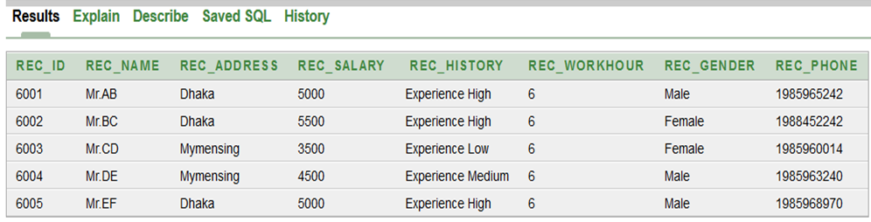
Insert into Receptionist:-
insert into receptionist(rec_id,rec_name,rec_address,rec_gender,rec_phone,rec_history,rec_salary,rec_workhour) values (6001,'Mr.AB','Dhaka','Male',01985965242,'Experience High','5000',6);
insert into receptionist(rec_id,rec_name,rec_address,rec_gender,rec_phone,rec_history,rec_salary,rec_workhour) values (6002,'Mr.BC','Dhaka','Female',01988452242,'Experience High','5500',6);
insert into receptionist(rec_id,rec_name,rec_address,rec_gender,rec_phone,rec_history,rec_salary,rec_workhour) values (6003,'Mr.CD','Mymensing','Female',01985960014,'Experience Low','3500',6);
insert into receptionist(rec_id,rec_name,rec_address,rec_gender,rec_phone,rec_history,rec_salary,rec_workhour) values (6004,'Mr.DE','Mymensing','Male',01985963240,'Experience Medium','4500',6);
insert into receptionist(rec_id,rec_name,rec_address,rec_gender,rec_phone,rec_history,rec_salary,rec_workhour) values (6005,'Mr.EF','Dhaka','Male',01985968970,'Experience High','5000',6);
select * from receptionist;

Slide 50
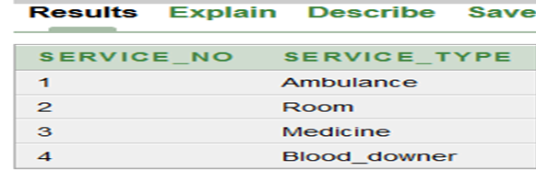
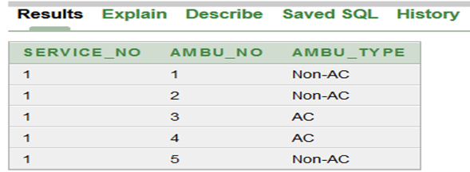
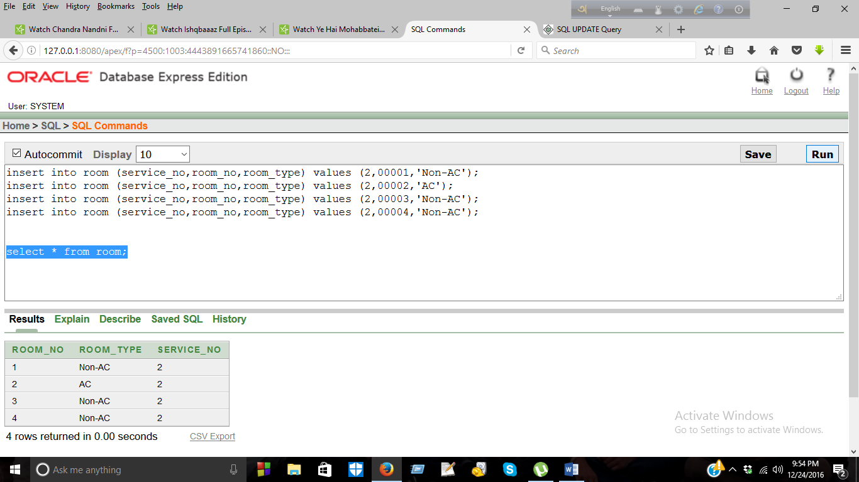
Insert into Service:-
insert into service (service_no,service_type) values (1,'Ambulance');
insert into service (service_no,service_type) values (2,'Room');
insert into service (service_no,service_type) values (3,'Medicine');
insert into service (service_no,service_type) values (4,'Blood_downer');
select * from service;
Insert into Ambulance:-
insert into ambulance (service_no,ambu_no,ambu_type) values (1,001,'Non-AC');
insert into ambulance (service_no,ambu_no,ambu_type) values (1,002,'Non-AC');
insert into ambulance (service_no,ambu_no,ambu_type) values (1,003,'AC');
insert into ambulance (service_no,ambu_no,ambu_type) values (1,004,'AC');
insert into ambulance (service_no,ambu_no,ambu_type) values (1,005,'Non-AC');
select * from ambulance;
Insert into Room:-
insert into room (service_no,room_no,room_type) values (2,00001,'Non-AC');
insert into room (service_no,room_no,room_type) values (2,00002,'AC');
insert into room (service_no,room_no,room_type) values (2,00003,'Non-AC');
insert into room (service_no,room_no,room_type) values (2,00004,'Non-AC');
select * from room;

Slide 51
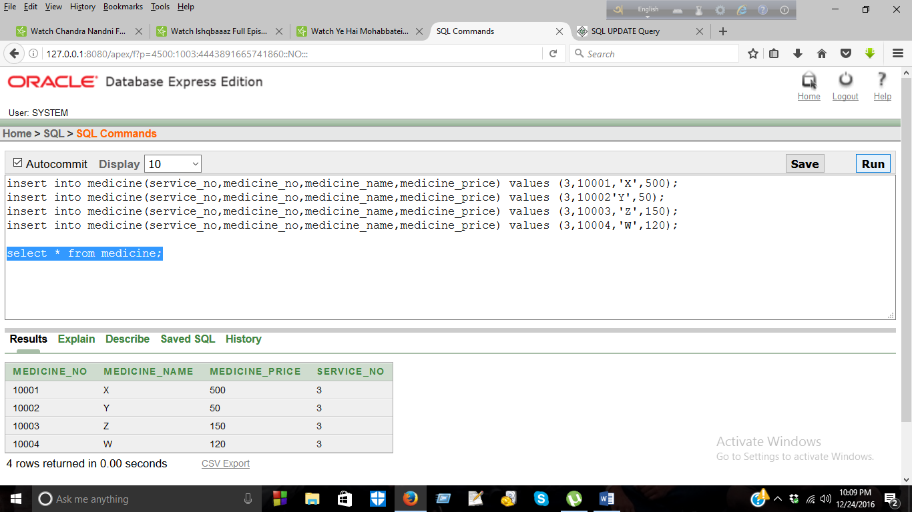
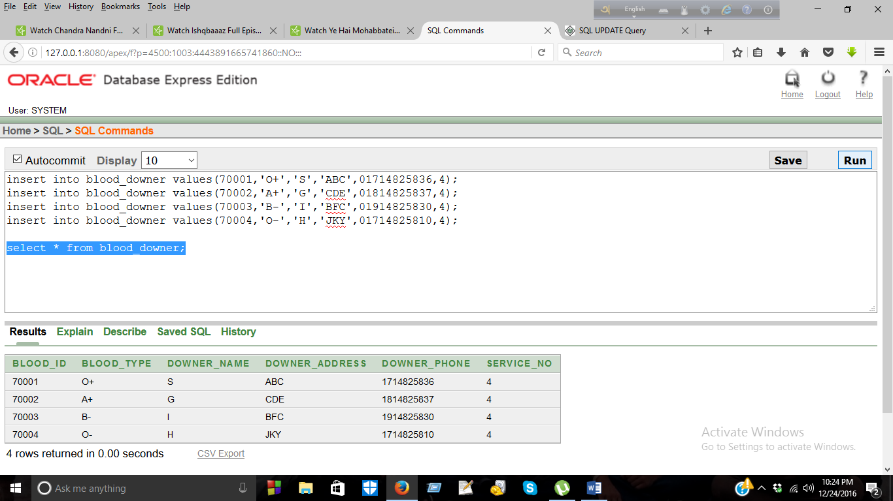
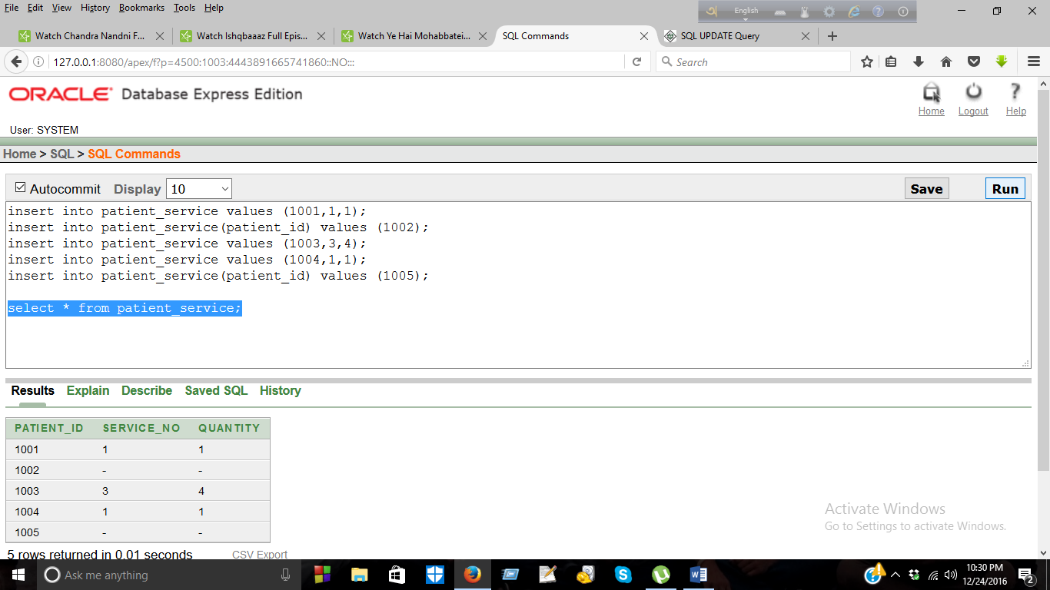
Insert into Medicine:-
insert into medicine(service_no,medicine_no,medicine_name,medicine_price) values (3,10001,'X',500);
insert into medicine(service_no,medicine_no,medicine_name,medicine_price) values (3,10002'Y',50);
insert into medicine(service_no,medicine_no,medicine_name,medicine_price) values (3,10003,'Z',150);
insert into medicine(service_no,medicine_no,medicine_name,medicine_price) values (3,10004,'W',120);
select * from medicine;
Insert into Blood_downer:-
insert into blood_downer values(70001,'O+','S','ABC',01714825836,4);
insert into blood_downer values(70002,'A+','G','CDE',01814825837,4);
insert into blood_downer values(70003,'B-','I','BFC',01914825830,4);
insert into blood_downer values(70004,'O-','H','JKY',01714825810,4);
select * from blood_downer;
Insert into Patient_service:-
insert into patient_service values (1001,1,1);
insert into patient_service(patient_id) values (1002);
insert into patient_service values (1003,3,4);
insert into patient_service values (1004,1,1);
insert into patient_service(patient_id) values (1005);
select * from patient_service;

Slide 52
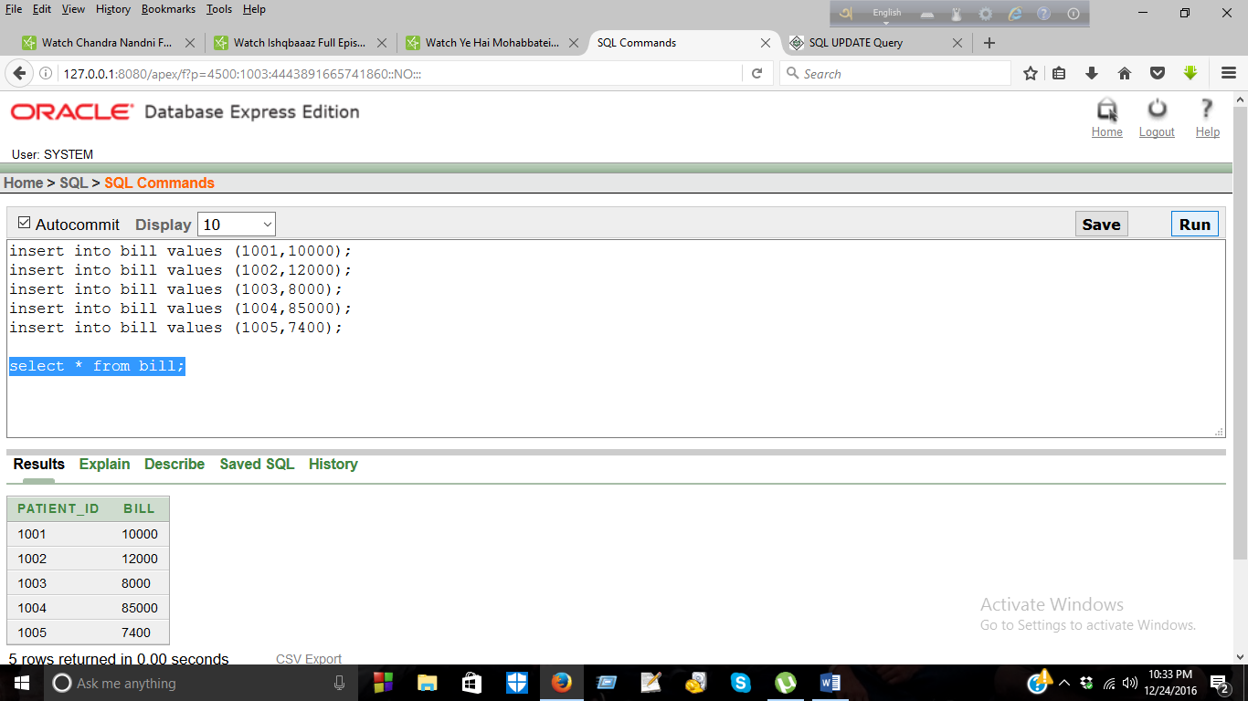
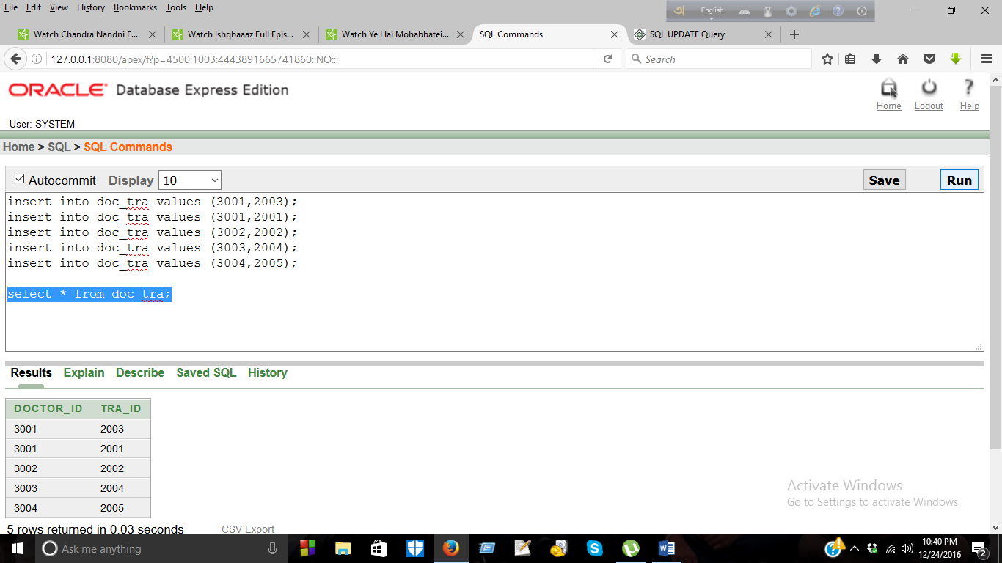
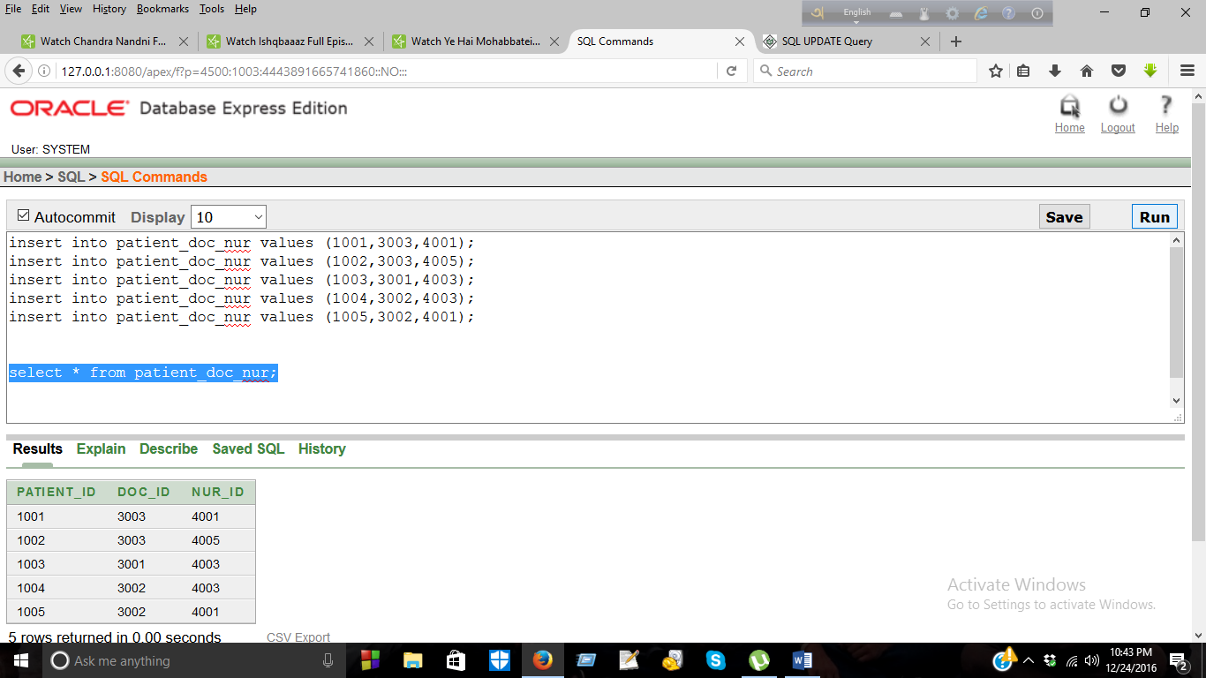
Insert into Bill:-
insert into bill values (1001,10000);
insert into bill values (1002,12000);
insert into bill values (1003,8000);
insert into bill values (1004,85000);
insert into bill values (1005,7400);
select * from bill;
Inset into Doc_tra :-
insert into doc_tra values (3001,2003);
insert into doc_tra values (3001,2001);
insert into doc_tra values (3002,2002);
insert into doc_tra values (3003,2004);
insert into doc_tra values (3004,2005);
select * from doc_tra;
Insert into Patient_doc_nur:-
insert into patient_doc_nur values (1001,3003,4001);
insert into patient_doc_nur values (1002,3003,4005);
insert into patient_doc_nur values (1003,3001,4003);
insert into patient_doc_nur values (1004,3002,4003);
insert into patient_doc_nur values (1005,3002,4001);
select * from patient_doc_nur;

Slide 53
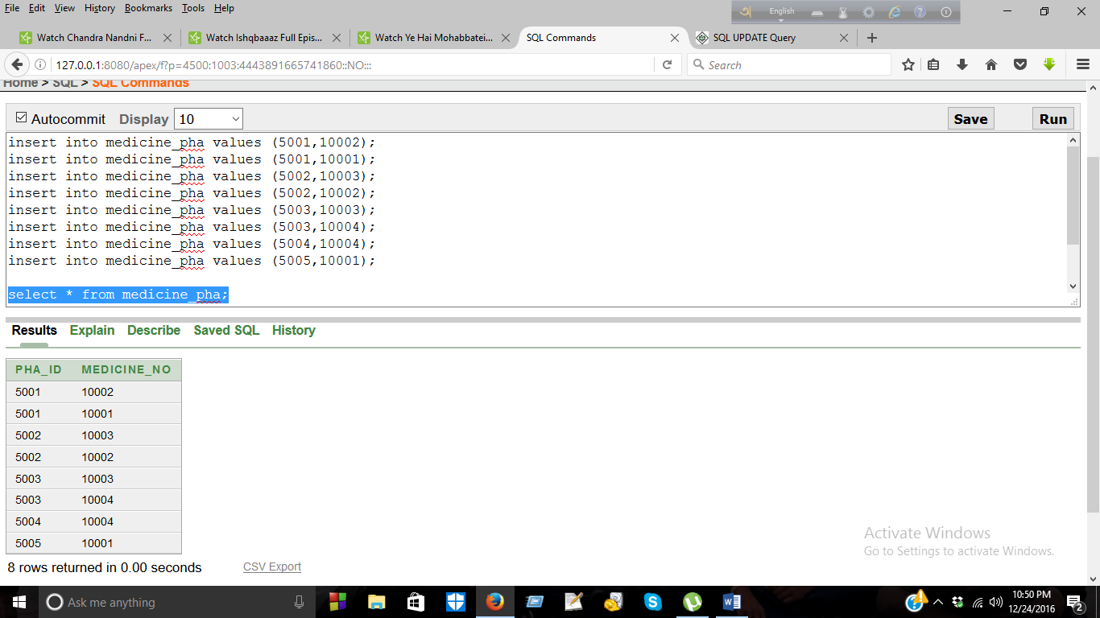
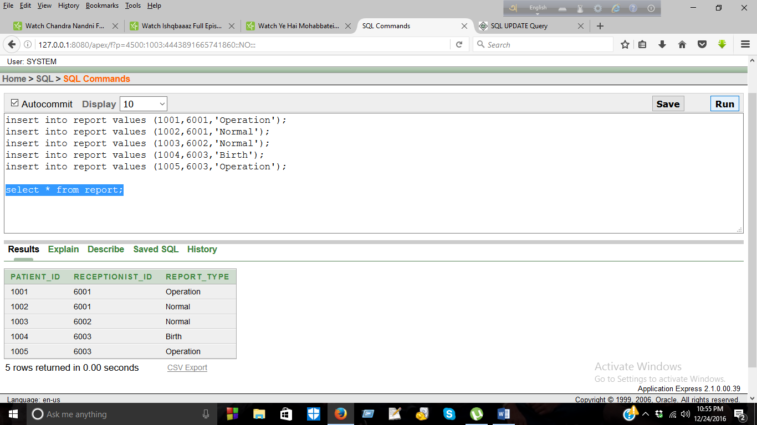
Insert into Medicine_pha :-
insert into medicine_pha values (5001,10002);
insert into medicine_pha values (5001,10001);
insert into medicine_pha values (5002,10003);
insert into medicine_pha values (5002,10002);
insert into medicine_pha values (5003,10003);
insert into medicine_pha values (5003,10004);
insert into medicine_pha values (5004,10004);
insert into medicine_pha values (5005,10001);
select * from medicine_pha;
Insert into Report:-
insert into report values (1001,6001,'Operation');
insert into report values (1002,6001,'Normal');
insert into report values (1003,6002,'Normal');
insert into report values (1004,6003,'Birth');
insert into report values (1005,6003,'Operation');
select * from report;

Slide 54


