Slide 1
Create OR, AN and XOR gate using animation

Slide 2
TRUTH TABLE OF OR GATE
A | B | Y
0 | 0 | 0
0 | 1 | 1
1 | 0 | 1
1 | 1 | 1

Slide 3
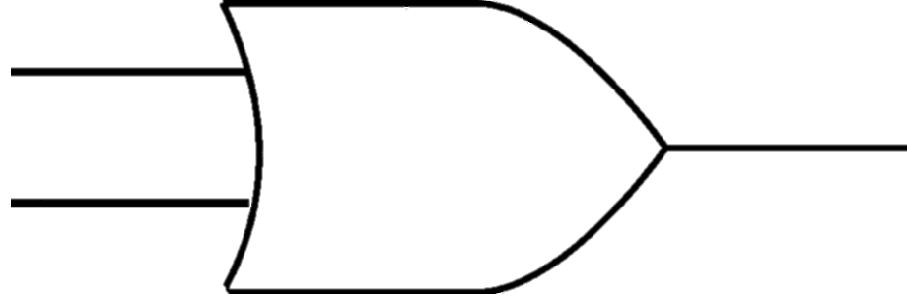
WORKING OF OR GATE
A
1
1
0
0
1
1
1
0
Y
0
1
1
B
0

Slide 4
TRUTH TABLE OF AND GATE
A | B | Y
0 | 0 | 0
0 | 1 | 0
1 | 0 | 0
1 | 1 | 1

Slide 5
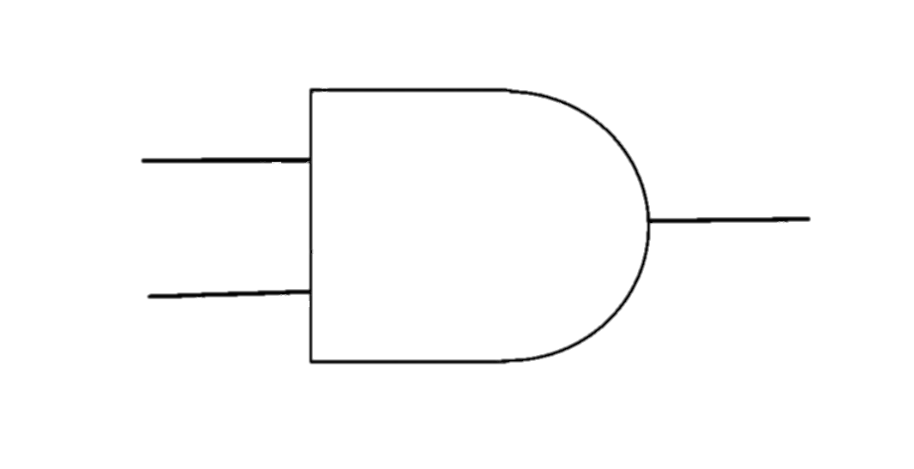
WORKING OF AND GATE
A
1
0
1
0
1
Y
0
0
0
1
0
B
1
0

Slide 6
TRUTH TABLE OF XOR GATE
A | B | Y
0 | 0 | 0
0 | 1 | 1
1 | 0 | 1
1 | 1 | 0

Slide 7
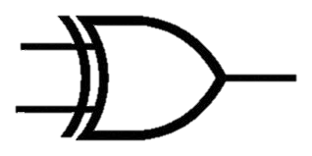
WORKING OF XOR GATE
1
0
1
A
0
1
0
1
0
Y
1
1
0
B
0

