Slide 1

EXPLORATORY DATA ANALYSIS OF BRITISH AIRWAYS CUSTOMER REVIEWS
Presented by : Syeda Umme Kulsum
CSRDS01
CL20240256571

Slide 2
Dataset EXplaination
01
Problem statement
02
Table of contents
Data Collection And Cleaning
03
RESULTS AND OBSERVATION
04

Slide 3
01
Dataset EXplaination

Slide 4
INTRODUCTION
The project is assigned by the FORAGE as an internship objective, The datset is a website which requires web scrapping and analyse the customer reviews over time for British Airways

Slide 5
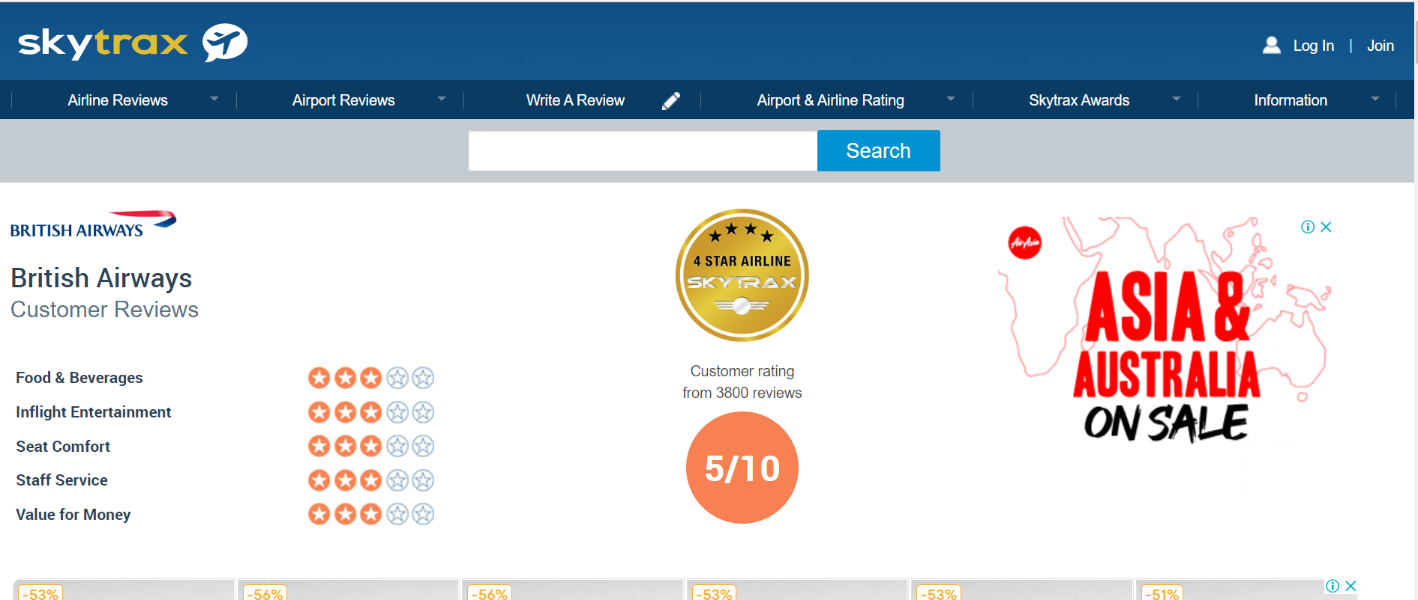
WEB SCARPPING

Slide 6
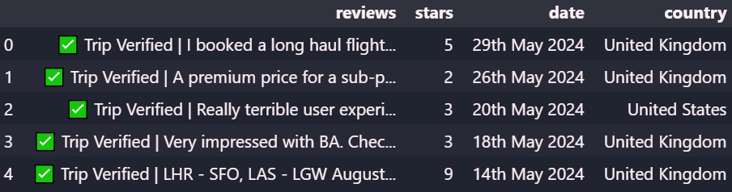
SCRAPPED Dataset

Slide 7
EXPLAINATION
The dataset has 3000 records and there are 4 columns extracted
reviews: this column consist of all the reviews by the customers
stars: this column consist of the rating given by cutomer
Date: The dates reviews were written on
Country: The country were the customer reside in

Slide 8
02
problem statement

Slide 9
PROBLEM STATEMENT
The Problem Statement was to observe the trends in customer reviews of British Airways with Time. And note its changes and perform Elxploratory Data Analysis through Numpy, Pandas and Matplotlib.

Slide 10
03
DATA COLLECTION AND CLEANING

Slide 11
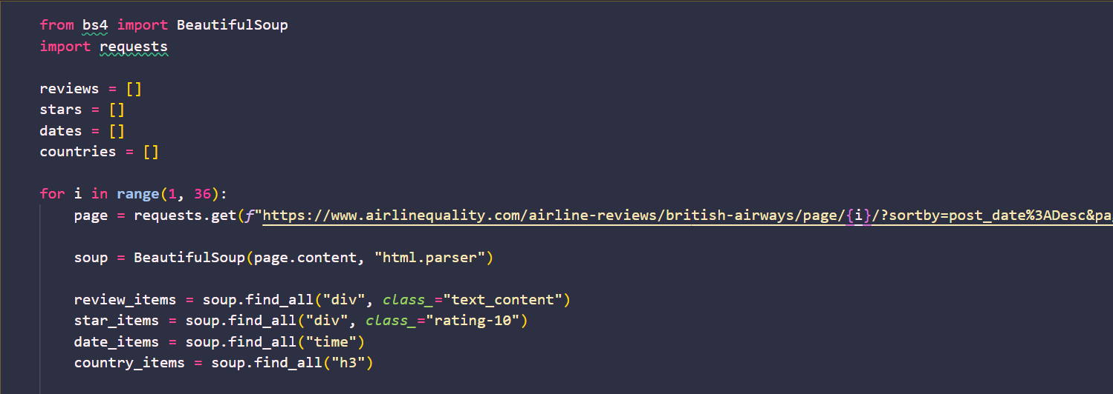
Data collecting
The data is collected through beautiful soup library in python

Slide 12
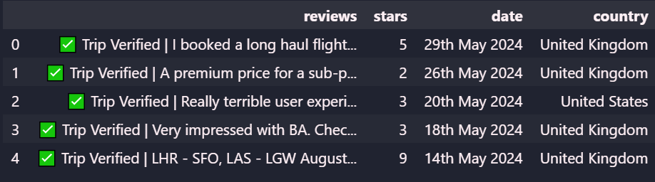
Data collecting
The collected data is then imported in a csv file

Slide 13

DATA PREPROCESSING
1. Removing Null values
2. Remove Outliers
3. Create Separate column for verified trips
4. Drop unnamed column
5. Drop rows with unsufficient data

Slide 14
04
RESULTS AND OBSERVATIONS

Slide 15
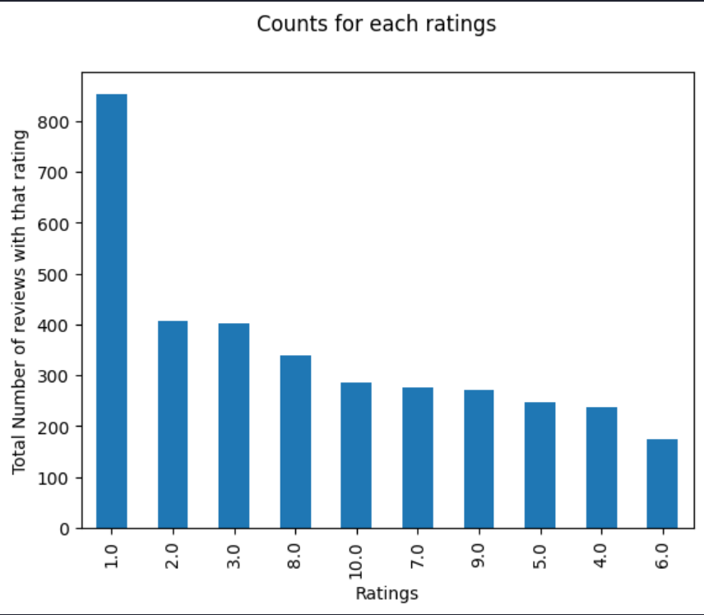
1. COUNT OF EACH RATING
The Bar graph represents the count of ratings 1,2,3,8,10,7,9,5,4,6 in the entire datset, hence there are a lot of negative reviews in the dataset

Slide 16
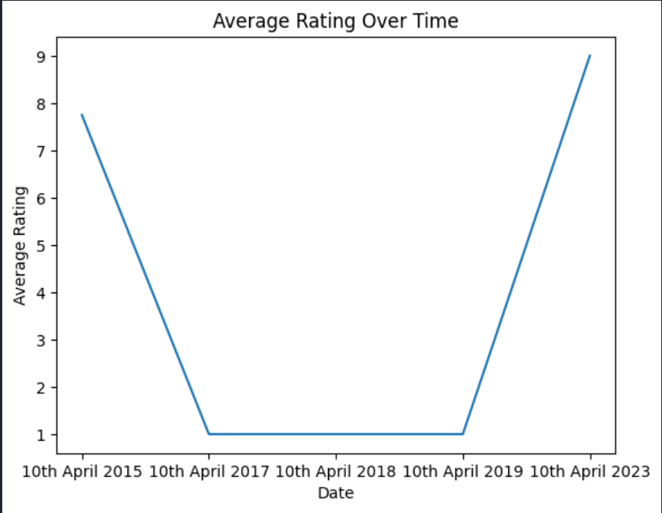
2. avg rating with time
The mean rating with time has significantly improved since april 2019

Slide 17
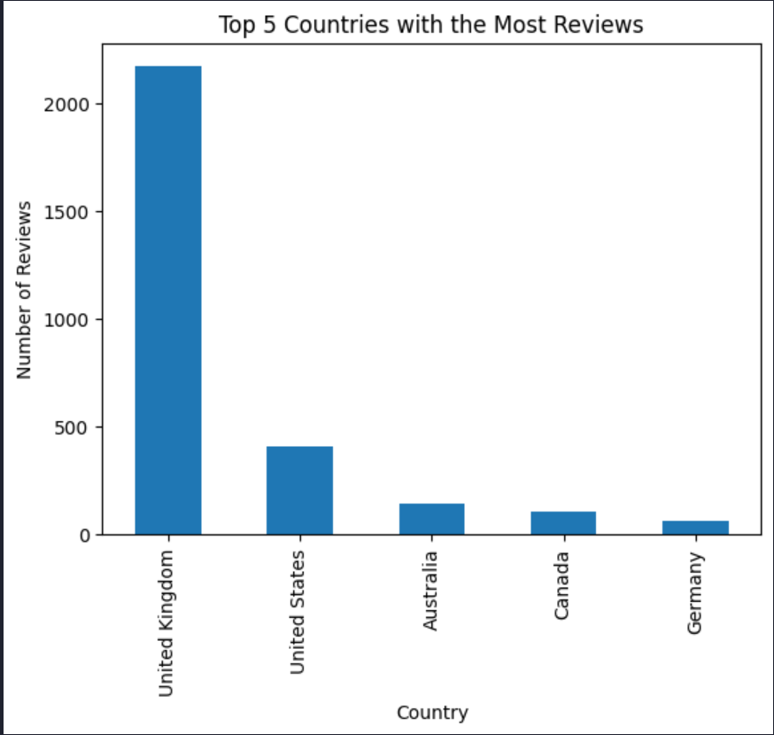
3. Countries with most reviews
The United Kingdoms has the most reviews

Slide 18
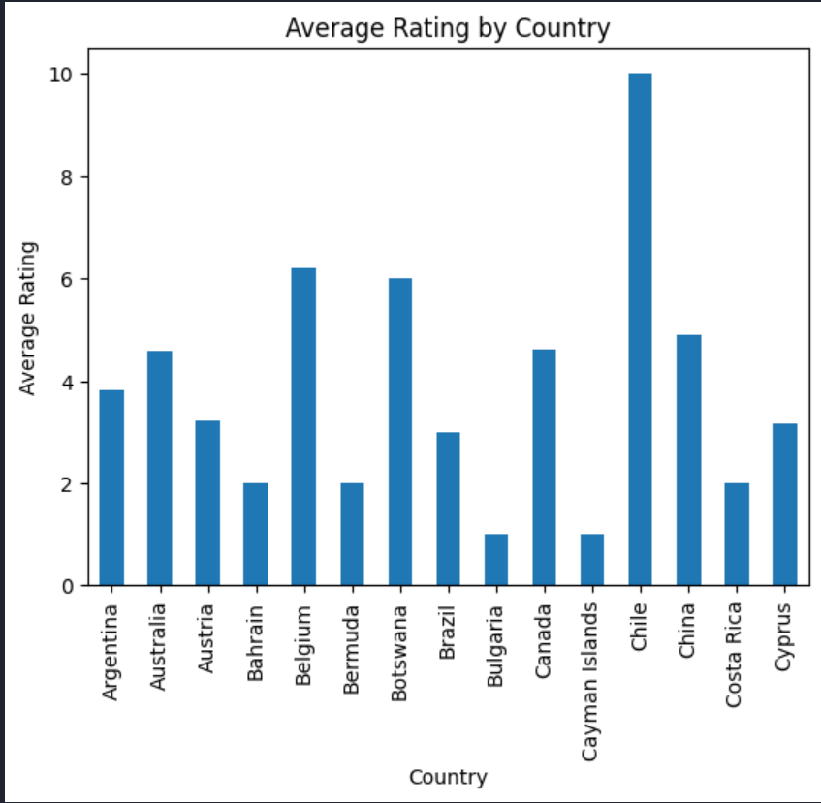
4. Average rating by countries
The Country Chile has the most positive review and rating

Slide 19
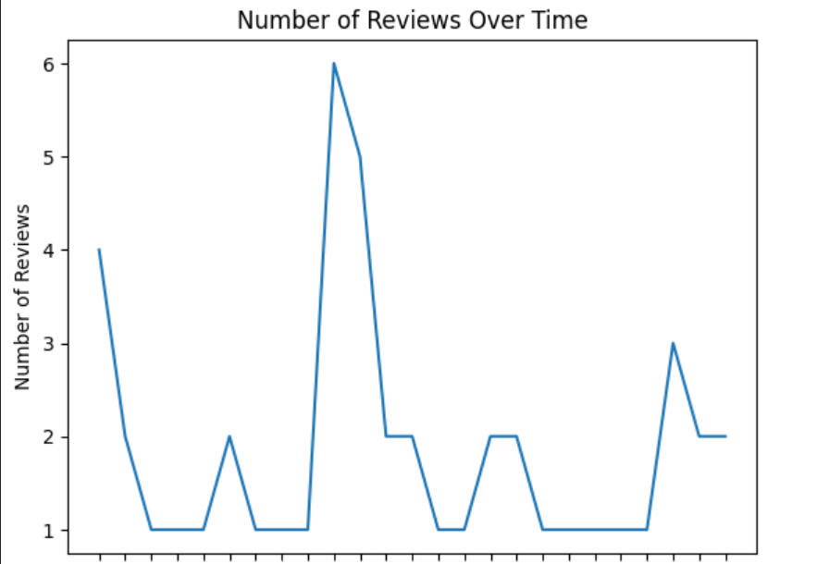
5. Number of reviews over time
The number of reviews over time has decreased

Slide 20
Conclusion
United Kingdom has the highest number of customers in British Airways
Over time the negative reviews has been decreasing
Over time there is a significant raise in ratings as well.

Slide 21
THANK YOU

