Slide 1

Progress report on smart mirror
Supervised by: Prof. Tejaswi Khanna
Presented by:
Azhar ali(1409610016)
Vivek gupta(1409610066)
Anupam kumari(1409610013)

Slide 2
Goal Of Smart Mirror
An Interactive Touch Free Mirror that maximises time efficiency and Productivity.
The Smart Mirror must be simple and as intuitive as possible.
The user could interact and obtain the information they want during their normal morning and night routines.
It will keep the user updated and monitor the temperature,humidity levels,news,date and time.

Slide 3
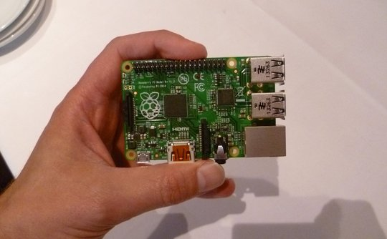

Slide 4
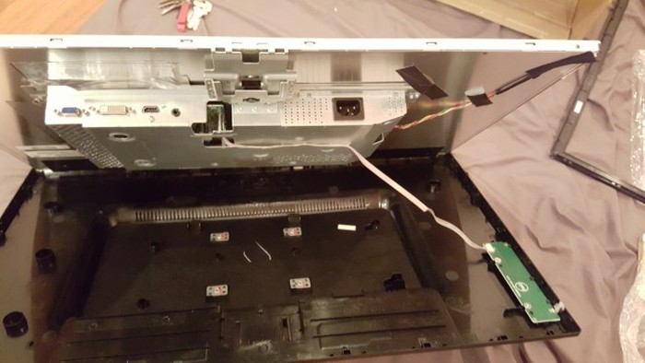

Slide 5
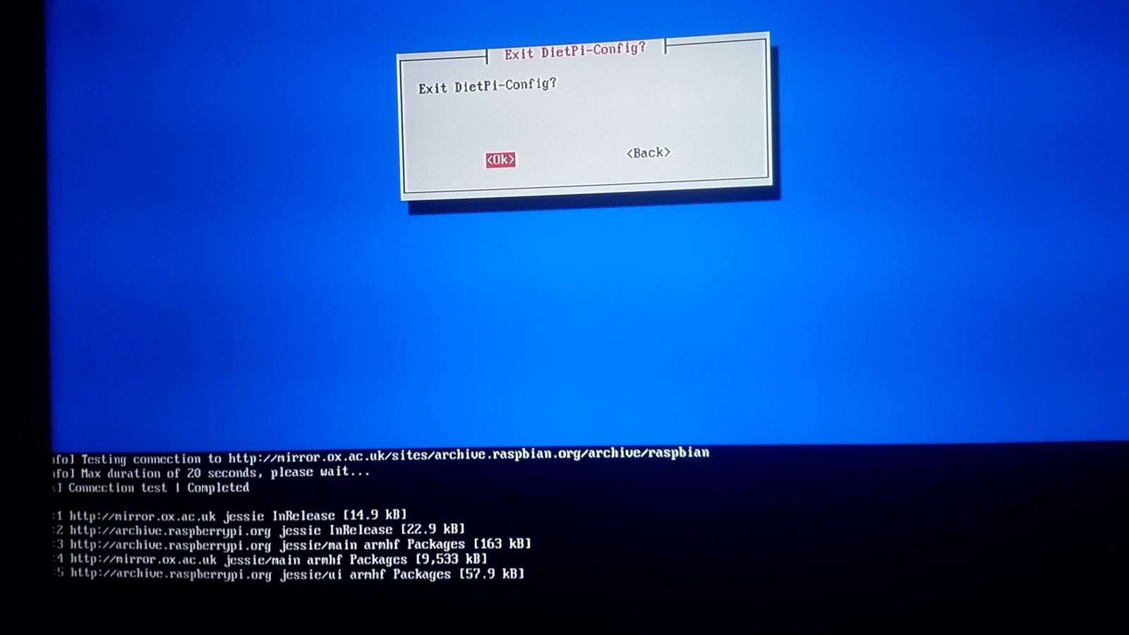

Slide 6
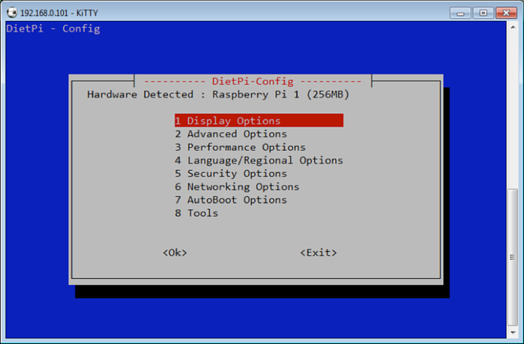

Slide 7
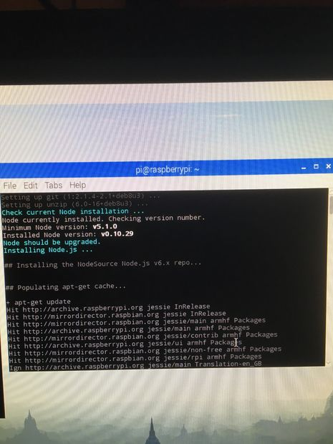

Slide 8
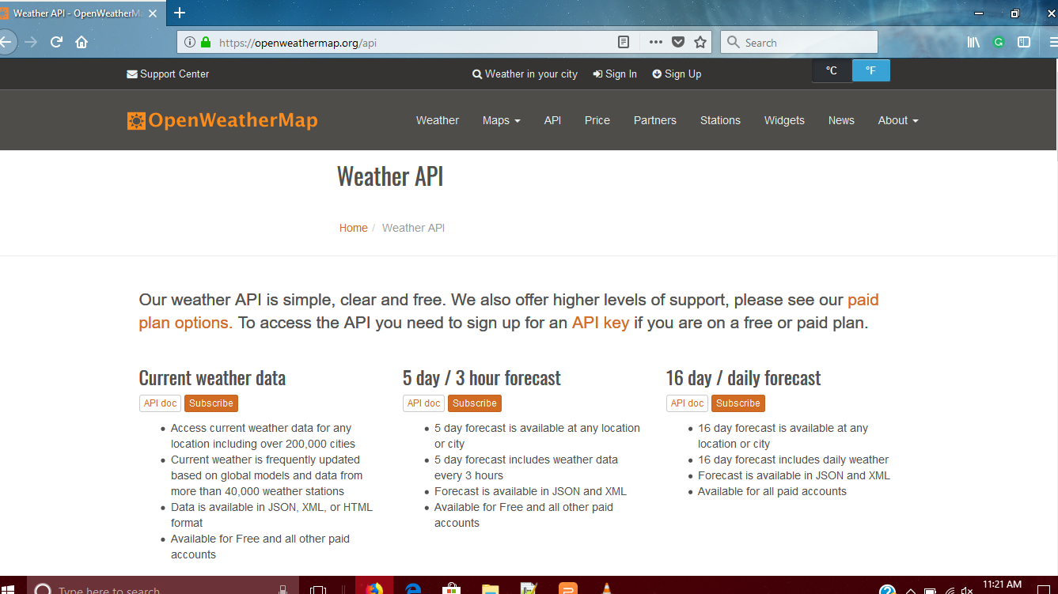

Slide 9
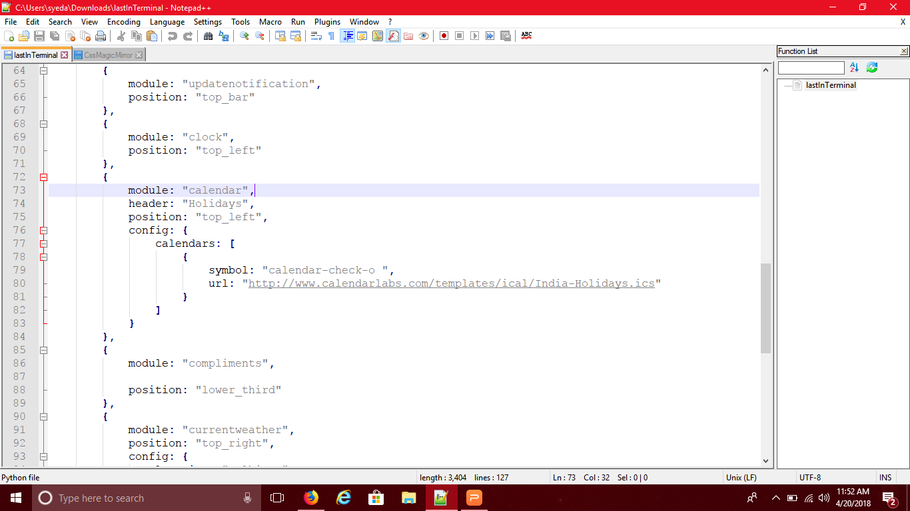

Slide 10
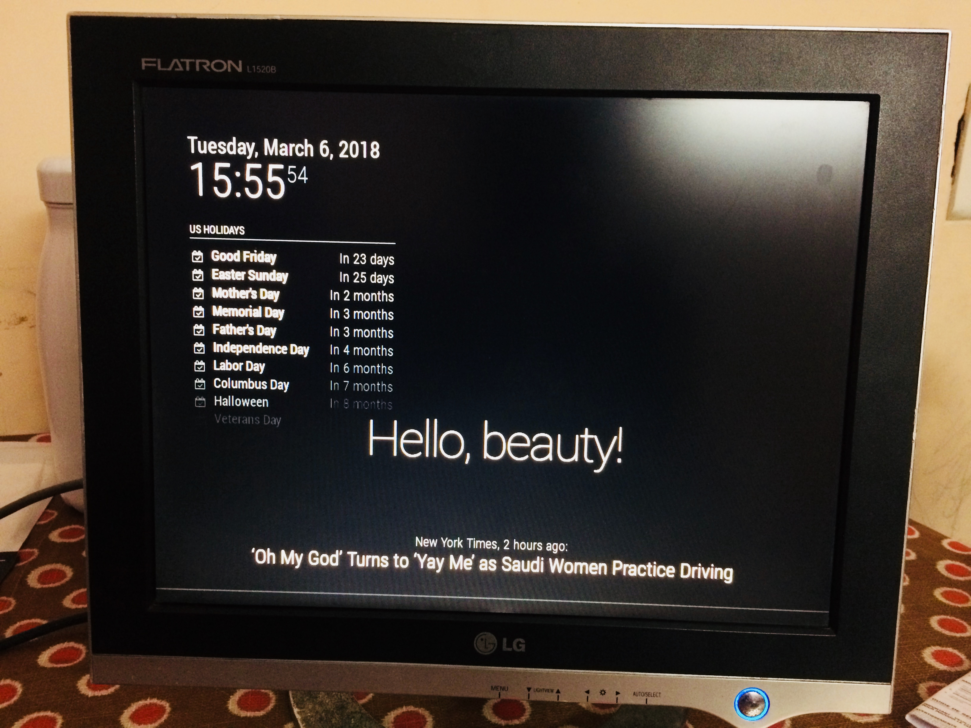

Slide 12
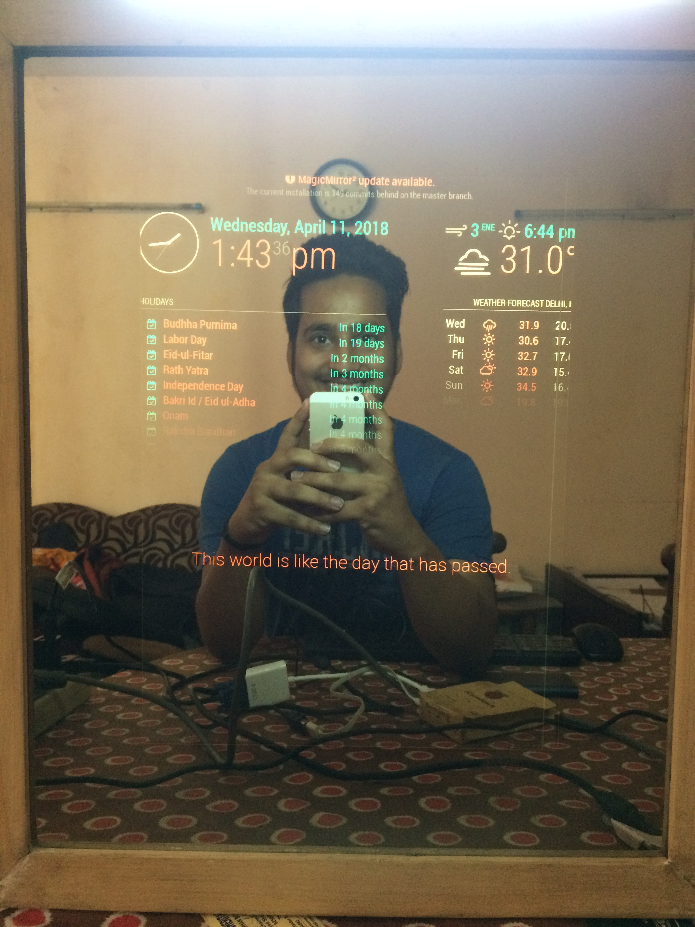
Output

Slide 13
Motivation
Home automation has been around for a long time and it is all about turning the house into an intelligent unit with the goal of increasing comfort and efficiency at home. Some of the typical applications are automatic lights, intelligent washing mechine, smart fan etc.
In my project I will not be focusing on home automation since I don't have access to any smart home devices. However it would be very easy to write an application to turn on and off the lights using voice commands or gestures on the mirror or even an application to change the temperature of the room etc.

Slide 14
THANK YOU!!!!

