Slide 1
VERDANT CAPITAL / PILLAR 2
Our mission
Green Capital Allocation & Portfolio Intelligence
Direct capital toward
evidence, not assertions.
Evidence
Source-aware ESG assessments
Intelligence
Combine market intelligence and climate evidence to balance risk and return under explicit investment rules.
Dated market signals and risk
Accountability
Constrained allocation + audit trail
How can AI make sustainable investment decisions more verifiable?
Implemented as a decision-support simulator.
TEAM CYPHER • RESEARCH PROTOTYPE • SYNTHETIC EVALUATION IS LABELED
01 / 07
Notes:
20 seconds. Pillar 2 asks how AI processes market dynamics and climate indicators to direct capital toward verifiable sustainable investments. Our prototype demonstrates evidence-aware research, risk-aware allocation and traceable decisions. It does not independently certify ESG claims, trade securities or validate future returns.

Slide 2
VERDANT CAPITAL / PILLAR 2
The problem
Financial upside and sustainability credibility can point in different directions.
Evidence is fragmented
Rare events hide failure
Mistakes have unequal costs
Issuer claims, price histories and policy rules sit in different places.
A 99% accurate model can miss every positive case in a 99:1 split.
False alarms consume audit time. Missed events can create financial loss.
Missing evidence must stay unverified.
Accuracy alone is the wrong proof.
The operating threshold needs economics.
The need: a decision that a reviewer can inspect, challenge and reproduce.
TEAM CYPHER • RESEARCH PROTOTYPE • SYNTHETIC EVALUATION IS LABELED
02 / 07
Notes:
25 seconds. A rising share price does not verify sustainability. Real decisions must separate unavailable evidence from a negative finding. Our three challenge demonstrations address class imbalance, explanation and the economic consequences of errors. The benchmark prevalence is exactly 1%; we do not claim measured prevalence for real companies.

Slide 3
VERDANT CAPITAL / PILLAR 2
Our solution: three roles, one auditable decision
LangGraph coordinates the work; deterministic constraints govern the allocation.
ESG Verifier
Market Analyst
Portfolio Optimizer
Issuer-scoped evidence
Citations and validated output
No evidence → unverified
Cached adjusted prices
Historical return and volatility
KRBN ETF proxy context
SciPy SLSQP weights
Long-only + ESG exposure caps
Unused capital stays in cash
Minimize λ/2 · wᵀΣw − μ̃ᵀw
w ≥ 0 Σw = 1 wᵢ ≤ capᵢ
Bounded conflict review → deterministic memo → SQLite record + JSON export
TEAM CYPHER • RESEARCH PROTOTYPE • SYNTHETIC EVALUATION IS LABELED
03 / 07
Notes:
40 seconds. The objective balances adjusted historical return against variance. Unverified holdings are capped at 10% in strict mode; high ESG-risk holdings are excluded under that mode. Other caps depend on risk profile. An LLM does not set weights. Historical labels are heuristic, and the KRBN projection supplies context rather than directly entering optimization. Free-text principles are recorded, while structured controls enforce policy.

Slide 4
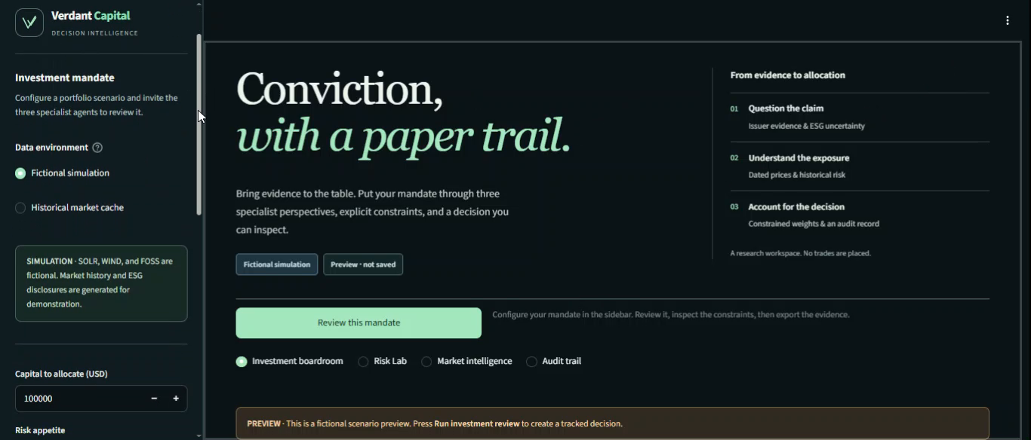
VERDANT CAPITAL / PILLAR 2
Product walkthrough
Click the video to play in desktop PowerPoint · 62-second silent screen recording
Supplied recording uses the earlier mint theme; the deck and current interface use charcoal/gold.
TEAM CYPHER • RESEARCH PROTOTYPE • SYNTHETIC EVALUATION IS LABELED
04 / 07
Notes:
Play the embedded video here, then continue to the challenge evidence. The clip is a supplied recording of the application, not a live market feed. It is embedded as H.264 MP4 and does not need Internet. Use desktop PowerPoint slideshow mode; click the movie. If a viewer does not support embedded playback, use docs/presentation_assets/product_demo.mp4. The supplied video shows an earlier mint palette, not the current gold skin. No audio track was supplied.

Slide 5
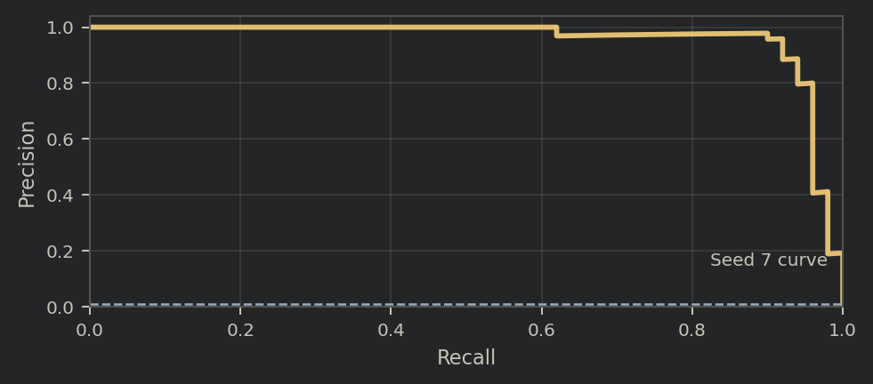
VERDANT CAPITAL / PILLAR 2
C02 + C06: detect rare cases, explain the mistakes
Controlled synthetic evidence; not validated real-company fraud or default detection.
C02 / 99:1 rare-event stress
C06 / three held-out SHAP cases
0.9583
TRUE POSITIVE +0.0014
No third-party verification
Mean PR-AUC across five seeds
FALSE POSITIVE +0.0017
4,950 negatives + 50 positives per test split
Missing baseline
FALSE NEGATIVE −0.0120
Missing baseline
Base score + Σ SHAP = model score
Bars show the dominant feature; full plots are in the report.
TEAM CYPHER • RESEARCH PROTOTYPE • SYNTHETIC EVALUATION IS LABELED
05 / 07
Notes:
50 seconds. C02: Isolation Forest with 200 trees, contamination 0.01, 20,000 training samples and 5,000 held-out cases per seed. Mean PR-AUC 0.9583; all seeds flag positives. A majority-only classifier would have 99% accuracy but zero recall. The curve shown is seed 7, whose PR-AUC is 0.957579. C06 explains three genuine held-out synthetic observations. TP dominant SHAP +0.08814664 from absent third-party verification; FP +0.10052287 and FN +0.11141636 from missing baseline. The FN total score remains below zero despite positive contributions. Full six-feature plots and reconstruction checks are provided in the 23-page report. SHAP does not explain portfolio weights or establish legal compliance.

Slide 6
VERDANT CAPITAL / PILLAR 2
C13: optimize the cost of a decision
Select on validation data. Freeze the threshold. Evaluate on untouched test cases.
Cost matrix / USD
Held-out confusion
DEFAULT TEST LOSS
No audit
Audit
Not flagged
Flagged
$35,200
Actual
negative
TN
FP
TN
FP
$0
$100
4,920
30
VALIDATION-SELECTED POLICY
Actual
positive
FN
TP
FN
TP
$17,900
$10,000
$100
1
49
(TP + FP) × $100
+ FN × $10,000
Threshold −0.0315983
$17,300 less loss
79 audits · 98% recall
Illustrative economics, not realized savings.
TEAM CYPHER • RESEARCH PROTOTYPE • SYNTHETIC EVALUATION IS LABELED
06 / 07
Notes:
45 seconds. Costs are illustrative: every audit, including a true positive, costs $100; a missed positive costs $10,000. A successful audit is assumed to prevent the loss fully. The model uses separate train/validation/test splits of 20,000/5,000/5,000 with 1% positives in validation and test. Every distinct validation score boundary is searched, including audit-all and audit-none; ties prefer fewer audits. Validation loss at the selected threshold is $18,400. Test result is TP49 FP30 FN1 TN4920 and $17,900 total loss. Default is TP47 FP5 FN3 TN4945 and $35,200. The additional 27 audits cost $2,700 but avoid two assumed $10,000 misses. Savings $17,300 (49.15%) are synthetic and assumption-dependent. Lower precision can be economically preferable; test savings are not guaranteed for other costs or populations.

Slide 7
VERDANT CAPITAL / PILLAR 2
Thank you.
Evidence-led capital. Auditable decisions.
Capital should follow evidence.
A working research prototype today.
Independent issuer evidence and real-world validation next.
Questions?
github.com/syedazoh/verdant_capital-
TEAM CYPHER • RESEARCH PROTOTYPE • SYNTHETIC EVALUATION IS LABELED
07 / 07
Notes:
10 seconds. We justify the mission as an evidence-aware allocation research prototype. C02/C06/C13 demonstrate controlled synthetic assurance, not certified issuer assessment, spot carbon-credit forecasting or proven investment returns. The full illustrated report explains all formulas, assumptions and limitations. Thank the judges and invite questions.

