Slide 1


IOT based Weather Station System

Slide 2


Team Members
Syed Babar Tameez
Fatima Khalid
Ghazala Bibi
Anber Arif
Safi ur Rehman

Slide 3
Introduction
A weather station is a device that collects data related to the weather & environment using different sensors.
To measure humidity
To measure temperature
To measure barometric pressure
To visualize the data using a mobile app (Blynk).

Slide 4
Platforms Used
Blynk app is used to display the infographics
Arduino-IDE was used for burning the code on chip.

Slide 5
Components Used
Node MCU ESP 8266 WiFi Module
DHT-11 (Temperature and Humidity Sensor)
BMP-280 (Barometric Pressure Sensor)
Jumper Wires
Breadboard

Slide 6
Node MCU ESP 8266
Programable Wi-Fi module.
Arduino-like hardware IO.
Wi-Fi networking – can be used as access point, host a web server, connect to internet to fetch, or upload data.
Can be programmed with simple and powerful Lua programming language or Arduino IDE.
Small sized module to fit smartly inside our IoT project.

Slide 7
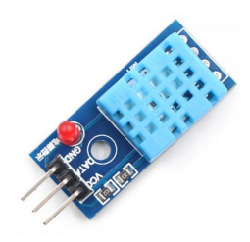
DHT-11 Sensor
DHT-11 is a Temperature and Humidity Sensor, which generates calibrated digital output. It can be interface with any microcontroller and get instantaneous results.
Temperature Range: 0-50 °C
Humidity Range: 20% to 90%RH

Slide 8
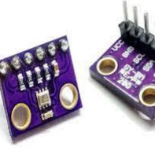
BMP-280 Sensor
It is an absolute barometric pressure sensor. It is optimized in terms of power consumption, resolution, and filter performance.
Operation range: Pressure -> 300-1100 hPa
Relative accuracy: ± 0.12 hPa
Interface: I²C and SPI

Slide 9
Power Consumption
DHT-11 Temperature and Humidity Sensor
Power Consumption
It consumes power of 3-5V and draws max current of 2.5mA.
Approach for optimal Consumption of Power
The sensor operates in sleep/standby mode consuming 60uA, compared to avg 0.3mA when making measurements.
BMP-280 (Barometric Pressure Sensor)
Power Consumption
It has low power consumption of 2.7 µA @1Hz.
Approach for optimal Consumption of Power
The sensor operates in sleep/standby mode consuming 0.1uA, compared to 2.7uA – 3.4uA when making measurements.

Slide 10
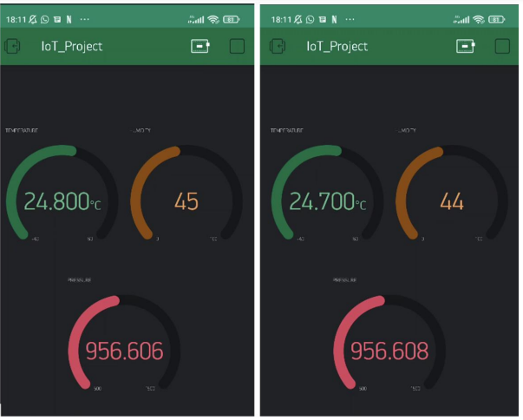
Communication Technology
WiFi is used to operate the Blynk App.
As we are using WiFi in our system and it has a star topology, so it means our system is based on star topology..

Slide 11
THANK YOU!!

