Slide 1

BloodTypeLab
How blood types change
over generations
What I built, what it teaches us,
and what you can do next
JUST FOR DISCUSSION • NOV 2026
Notes:
We are studying how the proportions of blood types can change in a population. I have built a working Python simulation and a local app. I want everyone to understand the idea and see how you guys can use it. We are studying a simplified synthetic population, not making a forecast for Austria.

Slide 2
The question behind the project
Austria gives us a starting point
Why might these
percentages change?
People inherit blood types.
Chance, migration and differences
in survival or reproduction can
change what comes next.
02
Notes:
The model starts with a published Austrian distribution: A 41%, B 15%, AB 7%, O 37%. The same source gives Rh-positive 81% and Rh-negative 19%. These are rounded reference values, not a new survey. The question is which mechanisms can change these proportions over time. The source assignment PDFs are referenced by the README but were not present in the reviewed repository. Verify the final requirements with supervisor. Check README.md sections 2 and 4.2; https://www.gesundheit.gv.at/labor/laborwerte/blutgruppenserologie-transfusion/blutgruppenuntersuchung.html

Slide 3
A blood type hides two inherited alleles
An allele is a version of a gene.
Each parent passes on one.
Example: AO × BO
 | Father A | Father O
Mother B | AB | BO
Mother O | AO | OO
A person with blood type A
can carry AA or AO.
The hidden O can reach a child.
Each outcome has a 25% chance.
A and B are codominant. O is recessive.
Our starting genotypes use a declared Hardy–Weinberg assumption.
03
Notes:
Project sources: README.md, bloodtypelab/engine.py, bloodtypelab/genetics.py, bloodtypelab/experiments.py. Repository reviewed 11 November 2026. Say: AO means that this person carries one A allele and one O allele. Their visible blood type is A. In this example one parent is AO and the other is BO. The four equally likely children are AB, AO, BO and OO. Every birth is a fresh random draw; four births need not produce one of each. We know the visible population percentages, so Hardy–Weinberg equilibrium is our assumption for estimating hidden genotypes. It is not extra measured data. RhD uses a simplified D/d model with D dominant.

Slide 4
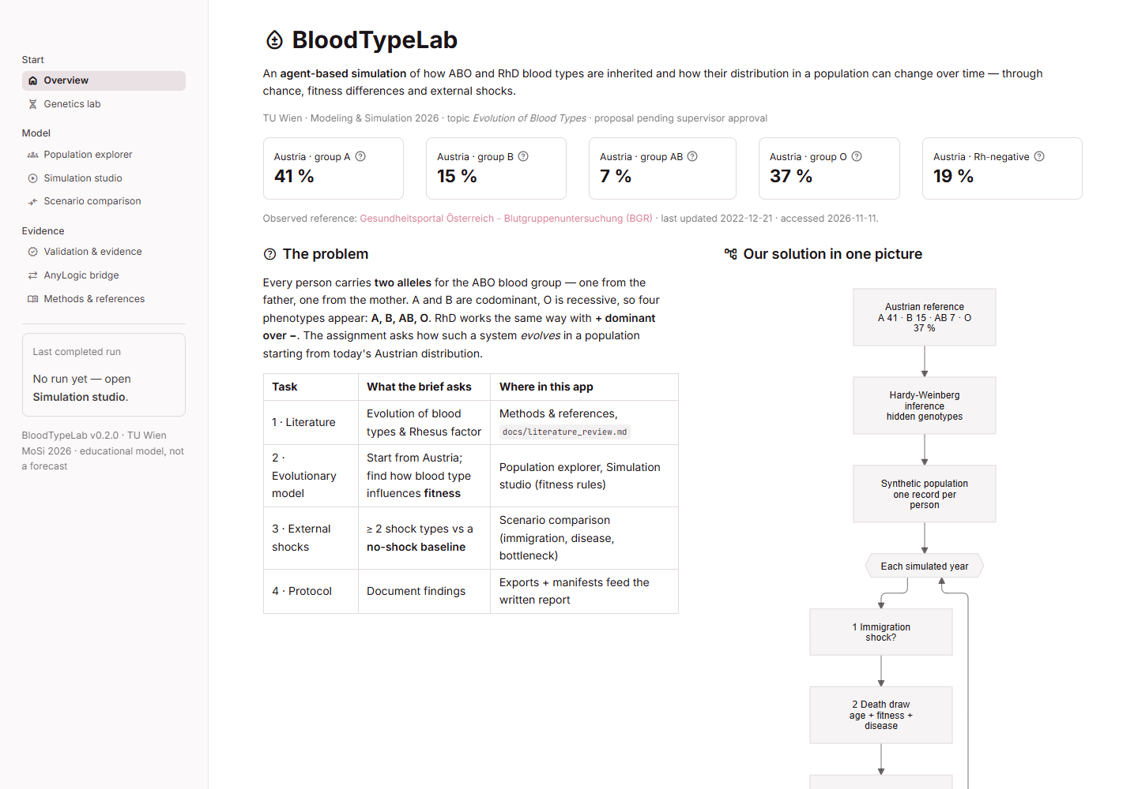
I built a working simulation and local app
The Python model
Follows synthetic people,
their ages and inherited alleles.
The Streamlit app
Lets us run scenarios,
compare repeated experiments,
check the rules and export results.
Eight pages connect the genetics explanation to reproducible experiments.
04
Notes:
Project sources: README.md, bloodtypelab/engine.py, bloodtypelab/genetics.py, bloodtypelab/experiments.py. Repository reviewed 11 November 2026. Say: This is an actual screenshot of the app. The scientific logic lives separately in the Python package. The interface helps us explore it. The eight pages are Overview, Genetics lab, Population explorer, Simulation studio, Scenario comparison, Validation & evidence, AnyLogic bridge, and Methods & references. The app is already runnable. The report and literature review still need completion. Screenshot: local project, 11 November 2026.

Slide 5
What happens in one simulated year?
1 | New people arrive | Only when we schedule immigration.
2 | Some people die | Age and selected risks determine the probability.
3 | Survivors get older | Everyone who survives gains one year.
4 | Eligible adults have children | A child receives one allele from each parent.
5 | We count the population | Record blood types and check the totals.
Newborns join at age 0. Only surviving adults can become parents.
05
Notes:
Project sources: README.md, bloodtypelab/engine.py, bloodtypelab/genetics.py, bloodtypelab/experiments.py. Repository reviewed 11 November 2026. Walk through the rows in order. The timing is part of the model: immigration, one combined death draw per person, ageing, reproduction, then metrics. A year here is one model step. Mortality uses age before ageing. Reproduction uses surviving adults after ageing. Newborns cannot reproduce in their birth year. Population balance: ending population equals starting population plus immigrants plus births minus deaths. The implementation also checks allele and phenotype totals.

Slide 6
We compare a baseline with specific changes
Scenario | What changes in the example?
Baseline | No external shock. The population still changes by chance.
Immigration | 600 people arrive from a hypothetical high-B population.
Disease | Group A has an extra 5% annual death risk for five years.
Bottleneck | A random event removes 50% of people, regardless of type.
Same starting population for each paired run. Shocks begin in year 30.
All shock magnitudes are hypothetical experiment settings.
06
Notes:
Project sources: README.md, bloodtypelab/engine.py, bloodtypelab/genetics.py, bloodtypelab/experiments.py. Repository reviewed 11 November 2026. Say: Baseline means the model with no shock. It is our reference for judging a change. The migration example adds 600 people once, or 20% of an initial 3,000. The source blood-type distribution is invented for the experiment and does not represent a real nationality. Disease adds a five-percent death probability to group A for years 30–34. The bottleneck removes people without selecting a blood type and helps us examine random drift. We also have fitness experiments, meaning differences in survival or reproductive success.

Slide 7
Example results from the current model
+3.7 percentage points
Compared with baseline
after 120 simulated years
Group B after the immigration scenario
−4.0 percentage points
3,000 starting people
20 paired runs
Different random seeds
Group A after the disease scenario
Run-to-run ranges: B +0.1 to +8.0 points; A −6.7 to −0.4 points.
These results show what our assumptions imply. They are not forecasts.
07
Notes:
README.md, bloodtypelab/engine.py, bloodtypelab/genetics.py, bloodtypelab/experiments.py. Repository reviewed 11 November 2026. These values were reproduced during the review with the existing engine and README command settings. Immigration B paired mean +3.659 pp, empirical 2.5th–97.5th percentile range +0.078 to +7.983 pp. Disease A paired mean -4.039 pp, range -6.702 to -0.350 pp. These are differences in phenotype population shares, not allele frequencies. Explain a percentage point with 15% becoming 19%: that is four points. Do not claim that these hypothetical scenarios predict Austria. The reproduced numerical summary is saved in the presentation evidence files.

Slide 8
One run cannot tell the whole story
Group B difference
from baseline
Chance changes which
alleles reach the next
generation.
Repeat the experiment
to see the spread.
The outer lines show variation across runs, not a confidence interval for the mean.
08
Notes:
Project sources are in README.md, bloodtypelab/engine.py, bloodtypelab/genetics.py, bloodtypelab/experiments.py. Repository reviewed 11 November 2026. Say: This graph shows the migration effect on group B, measured in percentage points relative to the matched baseline. The scenario and baseline start identically for each seed. The mean is one summary, and the outer lines show empirical 2.5th and 97.5th percentiles across the 20 paired differences. These percentiles are a descriptive range across stochastic runs, not a confidence interval for the expected effect. With only 20 replicates, tails are rough. The previous README wording about whether an effect is statistically distinguishable should be softened. For an expected-effect uncertainty statement, use a paired confidence interval or bootstrap over replicate differences. X-axis is simulated year; five-year sampling used for legibility.

Slide 9
What we have checked so far
81
Correct inheritance
Repeatable results from a seed
Population totals stay consistent
Exports and app pages work
existing tests passed
Still to establish
Are the scientific assumptions suitable?
Does an independent AnyLogic model agree?
The current AnyLogic demo compares Python-generated data with Python.
09
Notes:
You can check README.md, bloodtypelab/engine.py, bloodtypelab/genetics.py, bloodtypelab/experiments.py for this project attempt. Repository reviewed 11 November 2026. Verification means that the program follows the rules we wrote down. Validation means deciding whether those rules are appropriate for the question. Passing tests does not turn the scenario settings into measured biology. All 81 tests passed during this review in about 20 seconds. The current demo docking file is generated by Python and therefore only demonstrates the interface. It is not independent AnyLogic evidence. Review also found missing defensive checks in the docking importer; those are follow-up engineering tasks.

Slide 10
Where AnyLogic can help
Option 1: an independent model
Build the same rules in AnyLogic. Give both models the same starting people.
Compare many runs to check whether their results agree.
Option 2: reuse the Python model
AnyLogic can call Python through Pypeline.
This connects the tools, but does not independently check the model.
10
Notes:
AnyLogic is another simulation environment you guys have been told to use. We do not have to ditch the Python work. Independent replication is called docking. Calling the Python model from AnyLogic is integration, and serves a different purpose. The repository already exports initial agents and parameters and imports result counts. It still needs a native model. Pypeline can call a local Python interpreter in batches; per-birth calls would add avoidable overhead. Alpyne runs an exported AnyLogic RL model from Python and does not automatically translate Python into AnyLogic. Sources: README.md section 9; docs/anylogic_integration.md; https://www.anylogic.help/advanced/code/pypeline.html; https://github.com/the-anylogic-company/Alpyne

Slide 11
A manageable AnyLogic first version
Stage | What we need
1. Neutral model | Load the same people and run the yearly inheritance rules.
2. One shock | Add immigration and compare the same experiment.
3. Repeated runs | Save every run separately and collect complete yearly counts.
4. Agreement check | Check inputs, population size and blood-type results.
The current Java files are just a starting point. They do not yet implement every rule.
Check your installed AnyLogic edition or version maybe before committing to the full experiment.
11
Notes:
The smallest useful independent version has neutral ABO/RhD inheritance, no mutation, no pregnancy-loss extension, and then one immigration shock. This is a proposed scope, not an approved assignment requirement. Current starter files omit shocks and mutation, use uniform fathers instead of weighted mating when selection is active, omit Rh fertility weights, and overwrite the same output file. The importer accepts year-zero-only output and invalid counts. Fix those before trusting a pass. Official PLE documentation lists 50,000 dynamically created agents and model-time restrictions; the exact installed version and chosen libraries need a smoke test. Prefer a university licence if these limits affect our experiments. Do not claim PLE supports arbitrary 100–300-year models without a test. Source: anylogic/java_snippets/; bloodtypelab/anylogic_bridge.py; https://www.anylogic.help/anylogic/ui/editions.html.

Slide 12
Open scientific choices have practical defaults
Topic | Proposed starting choice
RhD | Keep the simple D/d inheritance model.
Mutation | Leave it off in the main experiments.
Population and time | Use a synthetic population starting from Austria; annual steps.
Fitness and shocks | Label magnitudes as hypotheses and test several values.
Demography | Keep an illustrative baseline; compare with official age-based data.
The group can propose these choices but supervisor must confirm the scope.
12
Notes:
Most open questions do not require rebuilding the project. They require a clear written choice, a reason and a check. RhD is already implemented as a simplified switchable module. Mutation already exists but defaults to zero. A 100–300-year study is a scenario exercise rather than a history of blood-type origins. Keep migration and disease as the two main shocks, with the bottleneck as a drift control. Fitness means reproductive contribution; malaria evidence cannot directly calibrate present-day Austria. Age-specific mortality and fertility tables are available from Statistik Austria. If we use actual fertility, review the density-regulation assumption and age distribution together instead of changing one number. ABO and Rh on separate chromosomes does not establish population-level independence; joint data or sensitivity analysis are needed. Sources: docs/decisions_from_supervisor.md; docs/assumptions_register.md; https://www.statistik.at/statistiken/bevoelkerung-und-soziales/bevoelkerung/demographische-indikatoren-und-tafeln/sterbetafeln; https://data.statistik.gv.at/web/meta.jsp?dataset=OGD_ind002fertilrat_HVD_FERTILRATE_1

Slide 13
The next group tasks
Workstream | A concrete finished result
Literature and data | Checked references, source dates and limits of the Austrian data.
Experiments | Baseline, two shocks and sensitivity runs with saved settings.
AnyLogic and verification | A runnable model and a documented comparison with Python.
Report and coordination | A written explanation, assigned owners and supervisor decisions.
Supervisor discussion
Confirm Python/AnyLogic and DES expectations, scientific scope,
required validation and the final submission format.
13
Notes:
End the main presentation here and discuss who will own each workstream. No owner is assigned by this deck. The eight supervisor questions are: executable RhD or literature only; mutation operator and rate; boundary and timescale; required evidence for fitness rules; immigration and disease as the two shocks; whether a separate discrete-event model is required; whether Python/Streamlit is accepted and AnyLogic optional; validation and hand-in requirements. Record the actual answer and date. Until then the decisions remain open. The local model uses annual steps, so a separate DES should only be added if it answers a requested question or the supervisor requires it. Source: docs/decisions_from_supervisor.md, docs/experiment_plan.md, docs/final_report_outline.md.

Slide 14
Backup: what the review found
Finding | What should change
Incomplete AnyLogic starter | Complete missing rules and produce a runnable project.
Docking accepts partial or invalid data | Require valid counts and every year for every replicate.
Limited agreement statistics | Include population size and handle zero variance explicitly.
Uncertainty wording | Separate variation across runs from uncertainty in the mean.
Uncalibrated assumptions | Keep labels visible and run sensitivity checks.
Review snapshot before the planned follow-up implementation.
14
Notes:
Technical backup. Verified during this review: year-zero-only data from five Python demo replicates receives a consistent verdict; negative ABO counts that still sum to N and Rh-positive counts greater than N are accepted. Source: bloodtypelab/anylogic_bridge.py lines 137–230. The code drops nonfinite z scores and fills unavailable z/KS values as passing. Correction covers z tests over years but not the combined metric-by-year family. A nonsignificant difference is not proof of equivalence. Suggested acceptance: strict input/schema/config matching, population comparison, explicit deterministic checks, a predeclared practical equivalence tolerance with intervals, and clear insufficient-evidence states. The Java snippets omit shock implementation, weighted fathers, Rh fertility, mutation and unique newborn IDs; output uses a single overwriting filename. These are actionable findings, not proof that the Python scientific engine is incorrect.

Slide 15
Backup: sources and important limits
Project evidence
README and scientific model
Assumptions register and experiment plan
Supervisor decisions and AnyLogic bridge
External checks
Austrian Health Portal: starting blood-type shares
Statistik Austria: mortality and fertility data
AnyLogic documentation: Pypeline, Alpyne and edition limits
Full links and explanations are in the speaker notes.
15
Notes:
Sources checked 11 November 2026. https://www.gesundheit.gv.at/labor/laborwerte/blutgruppenserologie-transfusion/blutgruppenuntersuchung.html
https://www.statistik.at/statistiken/bevoelkerung-und-soziales/bevoelkerung/demographische-indikatoren-und-tafeln/sterbetafeln
https://data.statistik.gv.at/web/meta.jsp?dataset=OGD_ind002fertilrat_HVD_FERTILRATE_1
https://www.anylogic.help/anylogic/ui/editions.html
https://www.anylogic.help/advanced/code/pypeline.html
https://github.com/the-anylogic-company/Alpyne
Primary evolution reference for the literature review: Ségurel et al. (2012), https://pmc.ncbi.nlm.nih.gov/articles/PMC3494955/
The starting shares match the published portal, but that is not a primary representative population dataset. Generic European Rh proportions should not silently replace Austria-specific values. The model starts from modern frequencies and does not reconstruct the evolutionary origin of the ABO system. Images: AI-generated conceptual cover, actual local application screenshot. No real patient data.

