Slide 1
Implementation and Inference of BLISSNet
An independent implementation of BLISSNet, adapted from synthetic fluid-flow benchmarks to real ERA5 2-metre temperature reanalysis over South Asia, Punjab, and Karnataka.
Based on: Veremchuk, Scott & Pan — BLISSNet, arXiv:2602.24228 (2026)
Daniyal Hussain Shah

Slide 2
BACKGROUND
Reconstructing fields from sparse sensors
The problem
Recover a full spatial field from a small set of sparse, irregularly placed observations which is common in climate, remote sensing, and flow reconstruction.
DeepONet-style operator
BLISSNet factorizes reconstruction into a trunk network (basis functions over coordinates) and a branch network (coefficients from observations); output is a weighted sum of bases.
Original scope
Proposed and validated on synthetic 2D Navier-Stokes and Quasi-Geostrophic flow on a fixed (0,1)² domain, with zero-shot generalization across grid resolutions and faster inference than cross-attention baselines (OFormer, Senseiver).
Re-implements BLISSNet independently and applies it to real ERA5 2m-temperature (t2m) data over South Asia and two sub-regions, then tests a question the original paper does not: generalization across different spatial domains.
This work
2

Slide 3
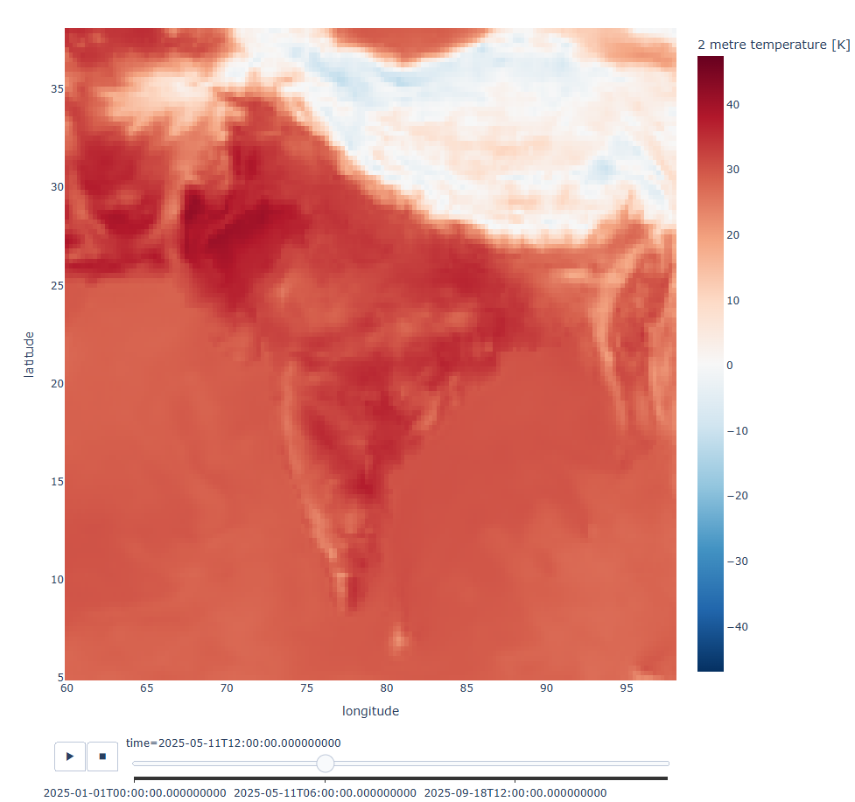
DATASET
ERA5 t2m: preparation and regional slicing
Source: ERA5 2m-temperature (t2m) reanalysis, hourly, full year 2025 - Copernicus Climate Data Store (via cfgrib).
t2m heatmap / region visualization
(paste screenshot)
1
Loaded raw South Asia GRIB t2m grid (5–38°N, 60–98°E)
2
Dropped unused coordinate variables (surface, step, valid_time, number)
3
Resample hourly → 6-hour means (8760 → 1460 timesteps)
4
Slice Punjab and Karnataka sub-regions by lat/lon bounds
5
Export all three regions to NetCDF for training / inference
Region | Bounds (lat, lon) | Grid (H × W) | Points (T×H×W)
South Asia | 5–38°N, 60–98°E | 133 × 153 | ≈29.7M
Punjab | 27.5–34°N, 69–75.5°E | 27 × 27 | ≈1.06M
Karnataka | 11.5–18.5°N, 74–78.5°E | 29 × 19 | ≈0.80M
All timesteps share 1460 6-hourly frames; only spatial extent differs across regions.
3

Slide 4
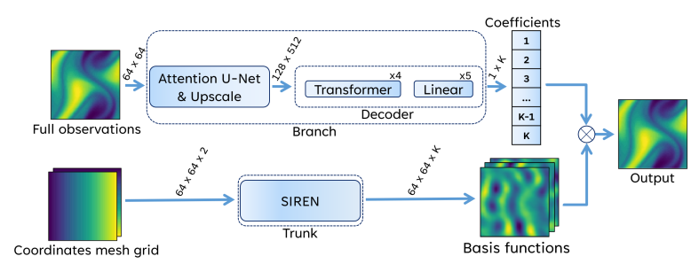
MODEL
BLISSNet architecture
Architecture diagram
(paste Fig. 1 / block diagram)
STAGE 1 – Full Field Reconstruction
Branch:
Attention U-Net encoder + Transformer/MLP Decoder → K coefficients from a fully observed grid Trunk:
SIREN network (sine activations) → K basis functions over a coordinate grid Output:
Field = Σ Coefficients × Basis functions.
Loss Function: MSE on reconstructed field
4

Slide 5
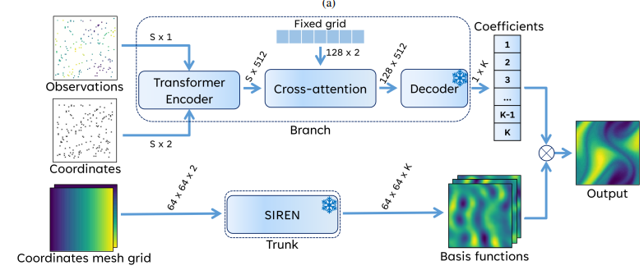
MODEL
BLISSNet architecture
Architecture diagram
(paste Fig. 1 / block diagram)
STAGE 2 – Sparse Field Interpolation
Trunk + decoder frozen from Stage 1 New encoder:
OFormer-style transformer encodes sparse, variable-count sensor coordinates + values Fixed cross-attention:
Queries a fixed 128×2 grid → constant-size coefficient vector (avoids O(D²) cross-attention cost)
4

Slide 6
Training pipeline
Three models trained independently. One per region and each with its own trunk, where each trunk is trained on coordinates from that region although the normalization of coordinates for every model was global [-1, 1] to test cross-generalization.
Embedding dim | 512 | Basis functions K | 512
Attention heads | 8 | Batch size | 32
Learning rate | 1e-5 | Dropout | 0.1
SIREN hidden / layers | 512 / 4 | SIREN ω₀ | 30
U-Net base channels | 64 | Epochs / stage | 15
Train / test split | 90 / 10 | Loss weights (λcp,λcoef,λemb,λgt) | 100, 40, 0.01, 0.5
Stage 2 sparsity
Per-region runs
Each training sample subsamples 0.5–5% of grid points at random as the observed sensor set, forcing the Stage-2 encoder to interpolate from a variable, sparse input.
South Asia, Punjab, and Karnataka models are trained back-to-back with identical hyperparameters, isolating region as the only variable across the three runs.
5

Slide 7
Loss function and evaluation metrics
Stage 1 loss
Cumulative MSE between the full reconstructed field and ground truth.
Stage 2 loss (four terms)
L = λ₁ L_cp + λ₂ L_coef + λ₃ L_emb + λ₄ L_gt
L_cp
Control Point Loss: MSE between the values of actual sensor locations from output and input sensor location values, i.e., the control points
L_coef
Coefficient Loss: MSE between stage 2 coefficients (as prediction) and stage 1 coefficients (as the target)
L_emb
Embedding Loss: MSE between the intermediate embedding output of stage 2 and stage 1
L_gt
Ground Truth Loss: MSE between final full interpolated field and ground field
Evaluation metrics
RMSE, MAE, Bias (K), and R² (%) are computed per region on held-out test frames.
Results and plots are displayed on next slide for South Asia Dataset trained model.
6

Slide 8
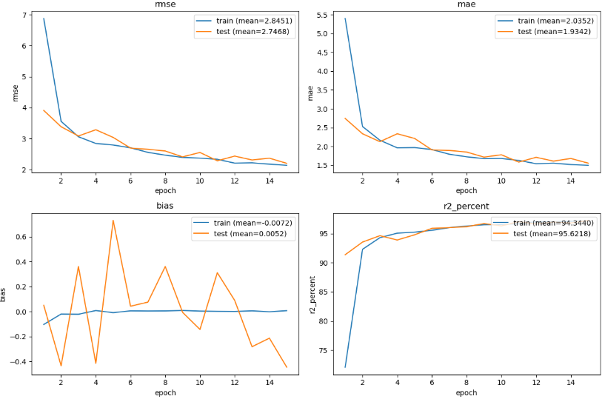
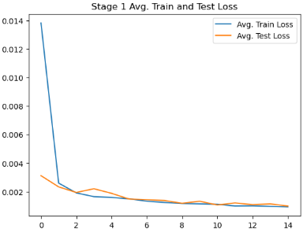
Loss plots and evaluation metrics
Stage 1
6

Slide 9
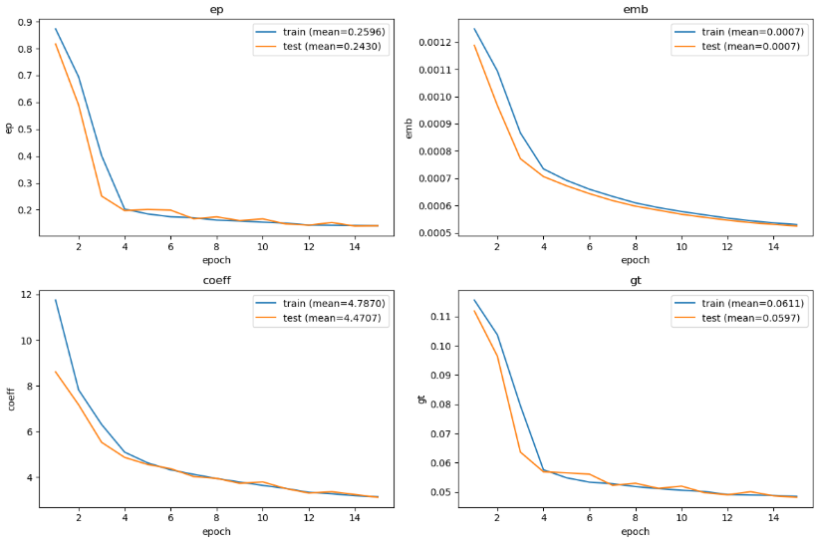
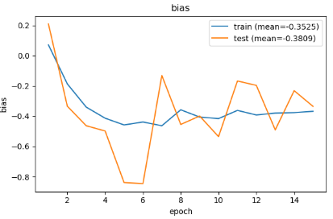
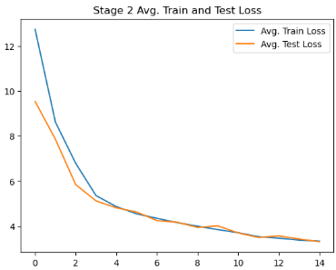
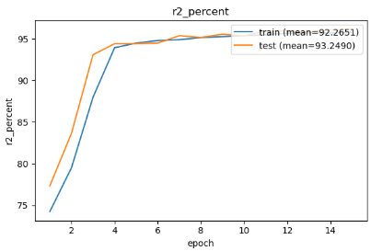
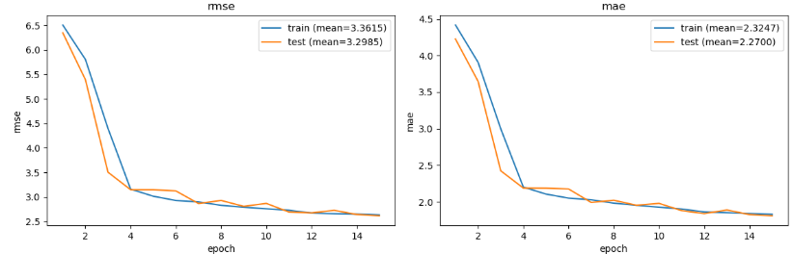
Loss plots and evaluation metrics
Stage 2
6

Slide 10
EVALUATION
Inference
Each of the three trained models is run at 4× super-resolution against the held-out test data of all three regions 9 model × region combinations in total.
Trained on ↓ / Evaluated on →
South Asia
Punjab
Karnataka
South Asia model
in-domain
cross-region
cross-region
Punjab model
cross-region
in-domain
cross-region
Karnataka model
cross-region
cross-region
in-domain
3 combinations — model evaluated on its own training region
6 combinations — model evaluated on an unseen region
Metrics reported: RMSE, MAE, R², Bias.
7

Slide 11
Evaluation
Trained on | South Asia (test) |  |  |  | Punjab (test) |  |  |  | Karnataka (test)
 | RMSE | MAE | R² % | Bias | RMSE | MAE | R² % | Bias | RMSE | MAE | R² % | Bias
South Asia model | 2.33 | 1.65 | 95.8 | -0.24 | 8.13 | 7.16 | 2.4 | 5.13 | 3.27 | 2.64 | 0.0 | 1.52
Punjab model | 25.52 | 22.20 | 0.0 | -21.32 | 1.78 | 1.35 | 82.3 | 0.63 | 35.94 | 35.78 | 0.0 | -35.78
Karnataka model | 19.10 | 16.72 | 0.0 | -11.63 | 19.92 | 18.35 | 0.0 | -17.42 | 0.93 | 0.75 | 70.1 | 0.20
Diagonal (in-domain)
Off-diagonal (cross-region)
R² 82–96%, RMSE 0.9–2.3 K showing strong, comparable to the resolution zero-shot behavior reported in the original paper.
R² collapses to 0% in all 6 combinations; RMSE / bias errors reach 20–36 K. Showing model barely extrapolates on foreign region domain.
8

Slide 12
Findings
The original paper's zero-shot claim is about resolution, not spatial domain and this distinction explains the collapse.
Zero-shot super-resolution
Domain generalization
(failure)
Compounding failure
Although, an effort was made to use global normalization for coordinates domain as [-1,1] and all coordinates bounds for all three datasets lie absolutely in it. It although aligned the coordinates in output but still failed to super resolve. It’s because the SIREN learned the geospatial knowledge of a particular domain of dataset it was trained on. Hence, the super resolution wasn’t cross-region generalized.
The branch network has no explicit notion of location either. So, it also produces out-of-distribution coefficients for spatial patterns unlike training. Trunk and branch fail together, giving collapse rather than graceful degradation.
A model trained on a fixed coordinate domain (e.g. the unit square) reconstructs accurately at grid resolutions never explicitly seen because the SIREN trunk is a continuous function of coordinates, not a fixed-resolution grid.
9

