Slide 1
Control Systems Project
SYED FAHD ALI
Section C, DCSE
21PWCSE1992
8th January, 2024

Slide 2
Introduction to Project

Slide 3
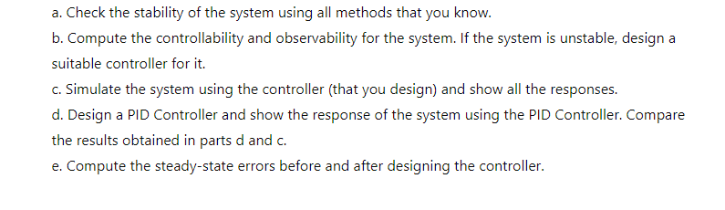
Project Required Tasks

Slide 4
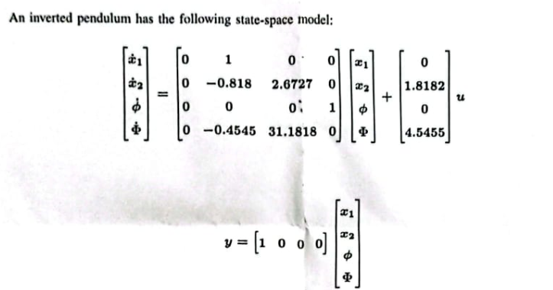
Space State Representation of System

Slide 5
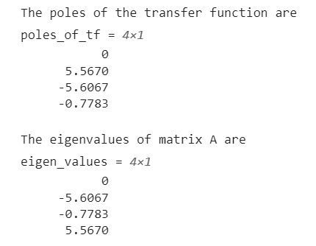
Stability Analysis of the System (1)
Eigen values of the system are :
λ1 = 0
λ2 = 5.5670
λ3 = -5.5670
λ4 = -0.7783
Poles of the system are :
λ1 = 0
λ2 = 5.5670
λ3 = -5.5670
λ4 = -0.7783
% Method 1- poles of tf
[n,d]= ss2tf(A,B,C,D)
poles_of_tf= roots(d);
disp('The poles of the transfer function are’)
poles_of_tf

Slide 6
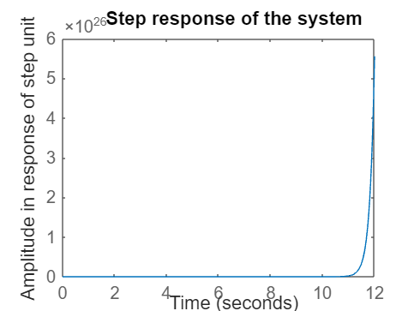
Stability Analysis of the System (3)
The step response of the system is:
step(A,B,C,D)
title('Step response of the system')
ylabel('Amplitude in response of step unit');

Slide 7
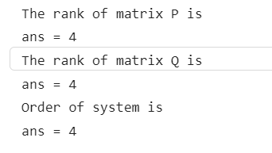
Controllability Analysis
% Completing Pre requisites
P=[B A*B A*A*B A*A*A*B];
Q=[ C;
C*A;
C*A*A;
C*A*A*A
];
disp('The rank of matrix P is')
rank(P)
disp('The rank of matrix Q is')
rank(Q)
disp('Order of system is')
size(A,1)
%both are 4 = order of matrix A
%System is controllable

Slide 8
Observability Analysis

Slide 9
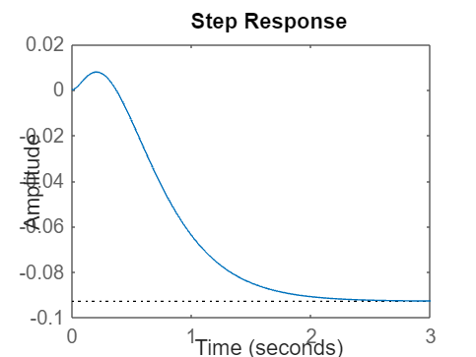
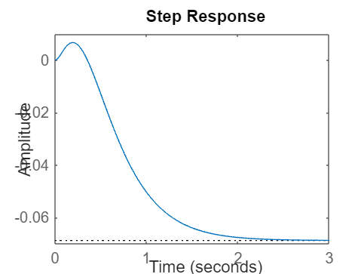
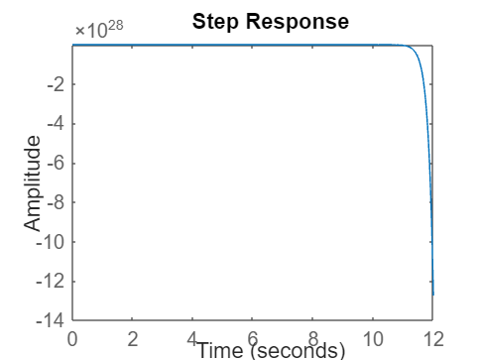
Controller Design
State Feedback Controller
Response
Observer Feedback Controller
Response
PID Controller
Response

Slide 10

Results (1)
DC gain before Controller:
DC gain after Controller:
dc_gain_before_controller = dcgain(A,B,C,D)
dc_gain_sfc = dcgain(A_clp,B_clp,C_clp,D_clp)
dc_gain_obs = dcgain(A_clp2,B_clp,C_clp,D_clp)
dc_gain_pid = dcgain(sys_now)

Slide 11
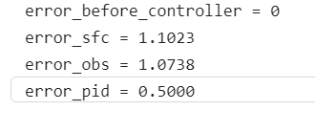
Results (2)
Steady-state errors before, and after controller:
error_before_controller = 1/(1+dc_gain_before_controller)
error_sfc= 1/(1+dc_gain_sfc)
error_obs= 1/(1+dc_gain_obs)
error_pid= 1/(1+dc_gain_pid)

