Slide 1
VelocityGo
A Smart Ride‑Hailing System
Built with C++ & SFML

Slide 2
Project Overview
VelocityGo is a desktop‑based ride‑hailing application.
It simulates real platforms like Uber & Careem using Data Structures.

Slide 3
Key Features
• Rider & Driver Dashboards
• Shortest Path Routing (Dijkstra)
• Nearest Driver Matching
• Animated Ride Tracking
• Persistent Ride History

Slide 4
Technologies Used
• Language: C++
• Graphics: SFML
• Algorithms: Dijkstra
• Storage: File Handling (TXT)

Slide 5
Data Structures Used
• Vector – locations, drivers
• Graph – road network
• Priority Queue – driver selection
• Unordered Map – authentication
• Structs & Classes – encapsulation

Slide 6
Routing Algorithm
The Islamabad map is represented as a weighted graph.
Dijkstra’s Algorithm finds the shortest route
between pickup and drop‑off locations.

Slide 7
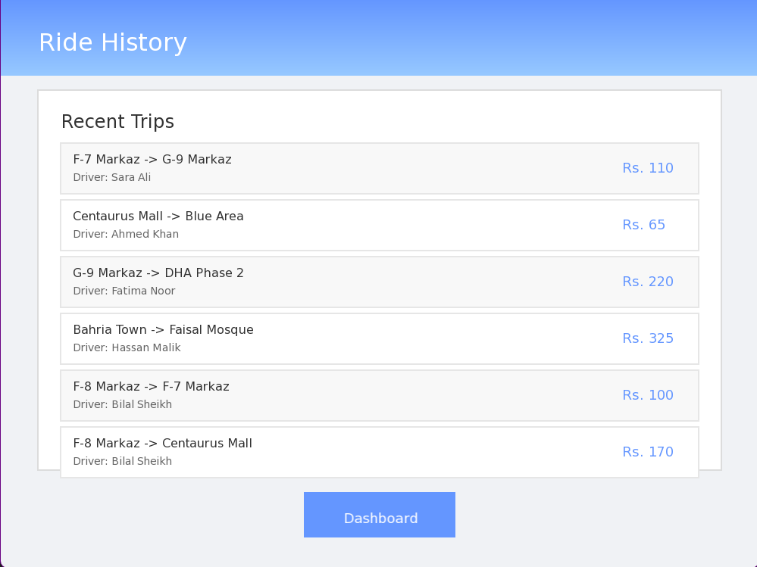
Ride History Screen
Displays recent trips with pickup, drop‑off, driver name and fare.

Slide 8
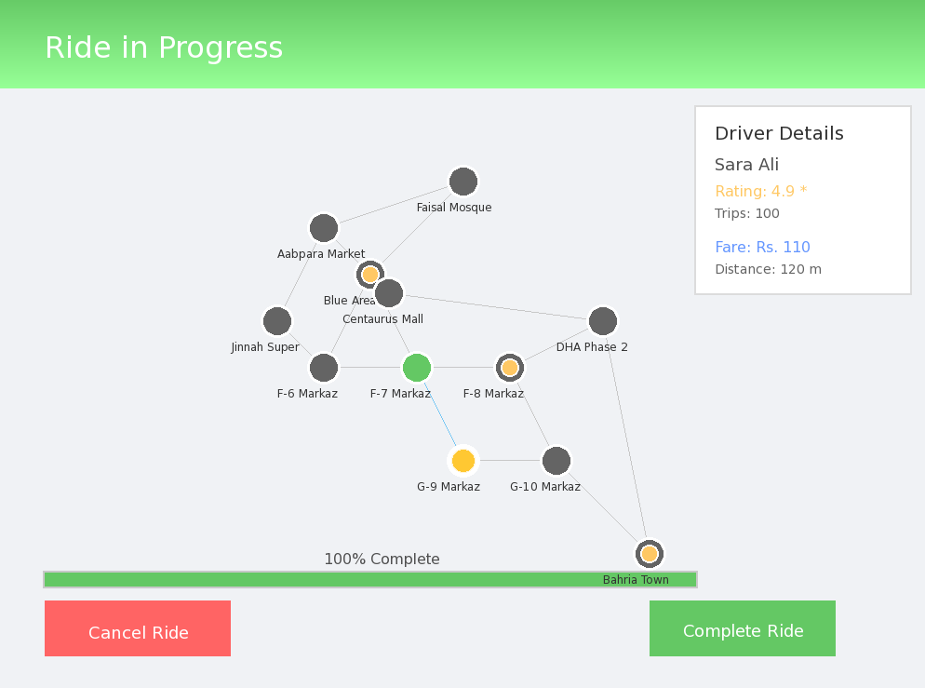
Live Ride Tracking
shows animated car movement, route path,
driver details, fare and progress bar.

Slide 9
File Handling
• users.txt – user accounts
• ride_history.txt – completed rides
Ensures persistent storage across sessions.

Slide 10
Limitations & Future Scope
Limitations:
• Desktop‑only
• Static map
Future Enhancements:
• GPS & real maps
• Online database
• AI driver matching

Slide 11
Conclusion
VelocityGo successfully demonstrates
real‑world application of Data Structures & Algorithms
combined with modern graphical UI.

