Slide 1
CSE7000 - INTERNSHIP A Presentation on BENKYO – AI-Powered Study Assistant
Student Details
Name | Syed Haamid Khaleelulla
Roll No | 20241CSE0168
Section | CSE
Under the Supervision of,
Ms. Radhika Sreedharan &
Mr. Kumaravel Thangavel — Assistant Professors
Presidency School of Computer Science and Engineering
Presidency University
Name of the Program: B. Tech (CSE)
Name of the HoD: Dr. Nagaraja S R
Name of the Program Internship Coordinator: Ms. Vidhya Rengasamy
Name of the School Internship Coordinators: Dr. Bhuvaneshwari Patil

Slide 2
Content
About the Internship Program
Working Domain & Technology Stack
Objectives of the work
Methodology Used
Results
Conclusion

Slide 3
About the Internship Program
Program: Intensive AI GPU Summer Internship Program (Summer 2026) — a self-paced, skill-based technical program rather than a placement at a host company.
Focus: Building practical, end-to-end AI systems using GPU-accelerated large language models.
Duration: 12 days, 01 June 2026 – 12 June 2026, at Presidency University, Bengaluru.
Chosen project: Benkyo — an AI study assistant that applies Retrieval-Augmented Generation (RAG) to a real, everyday student problem: turning lecture slides, PDFs and notes into an interactive study tool.

Slide 4
Working Domain & Technology Stack
Domain: Retrieval-Augmented Generation (RAG) applied to AI-assisted education / study tools.
Backend: FastAPI, SQLAlchemy over SQLite.
AI / Retrieval: FAISS vector store, sentence-transformers (all-MiniLM-L6-v2), Groq-hosted Llama-3.3-70B-Versatile LLM.
Document parsing: PyMuPDF (PDF), python-pptx, python-docx, Tesseract OCR for scanned images.
Frontend: React (Vite), Tailwind CSS, custom UI/animation component library.

Slide 5
Objectives of the Work
Design a multi-format ingestion pipeline extracting text from PDF, PPTX, DOCX, TXT/Markdown and scanned images (OCR).
Build a chunking + embedding pipeline with a per-session FAISS vector store for semantic search.
Implement a RAG-based Q&A endpoint returning grounded answers with citations to filename, page and snippet.
Build AI-generated quizzes, active-recall flashcards and structured markdown study notes on the same pipeline.
Implement progress analytics that tracks quiz scores and flags weak topics (below 60% accuracy).
Build a responsive, polished React frontend with a custom UI/animation component library.

Slide 6
Methodology — RAG System Architecture
Ingestion: Documents parsed and cleaned with format-specific extractors (PyMuPDF, python-pptx, python-docx, Tesseract OCR).
Chunking: Text split into overlapping, 500-token-based chunks.
Embedding: Chunks embedded using the sentence-transformers all-MiniLM-L6-v2 model.
Indexing: Embeddings stored in a per-session FAISS vector store with disk persistence.
Retrieval + Generation: Relevant chunks retrieved at query time and passed to the Groq-hosted Llama-3.3-70B-Versatile LLM to generate grounded answers, quizzes, flashcards and notes.
Stack: FastAPI + SQLAlchemy/SQLite backend; React (Vite) + Tailwind CSS frontend.

Slide 7
Methodology — 12-Day Work Progress
Day 1–2: Requirements gathering, tech-stack selection, and project skeleton setup.
Day 3–4: Built the multi-format extraction layer (PDF, PPTX, DOCX, OCR fallback).
Day 5–6: Implemented the chunker, embeddings service, and per-session FAISS vector store.
Day 6–7: Built the RAG-based coursework Q&A endpoint with citations.
Day 8–9: Built quiz, flashcard and structured notes generators.
Day 9–10: Built the progress/analytics router with weak-topic flagging.
Day 10–11: Built the React frontend — Chat, Quiz, Flashcards, Notes and Progress pages.
Day 11–12: End-to-end testing, bug fixes, and report/documentation write-up.

Slide 8
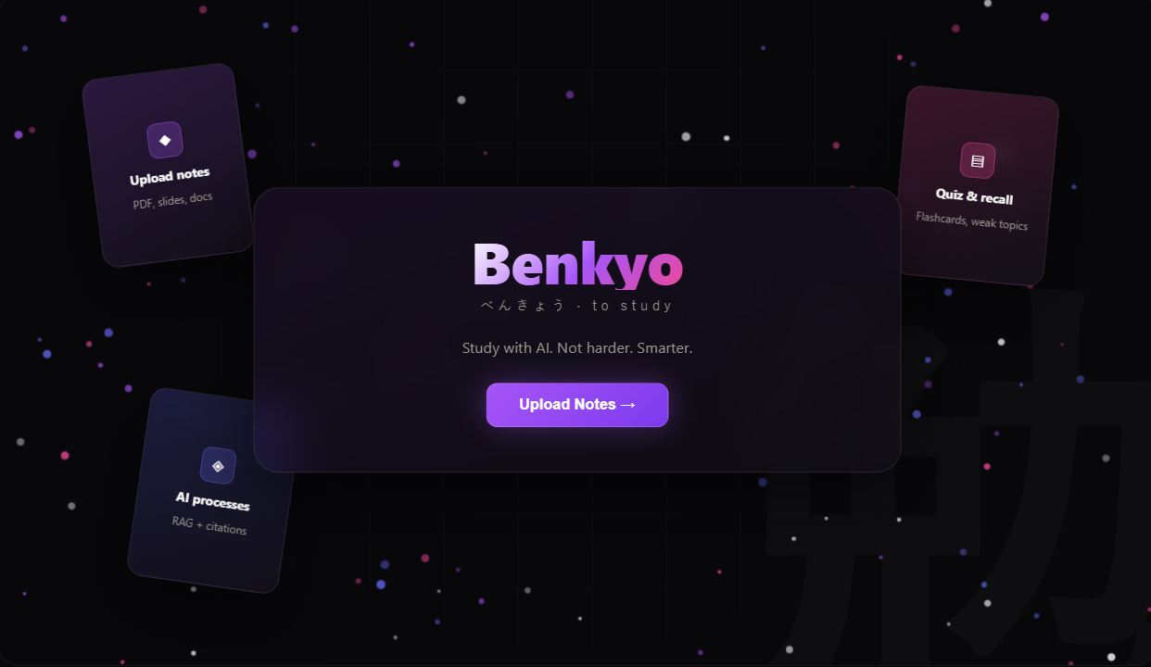
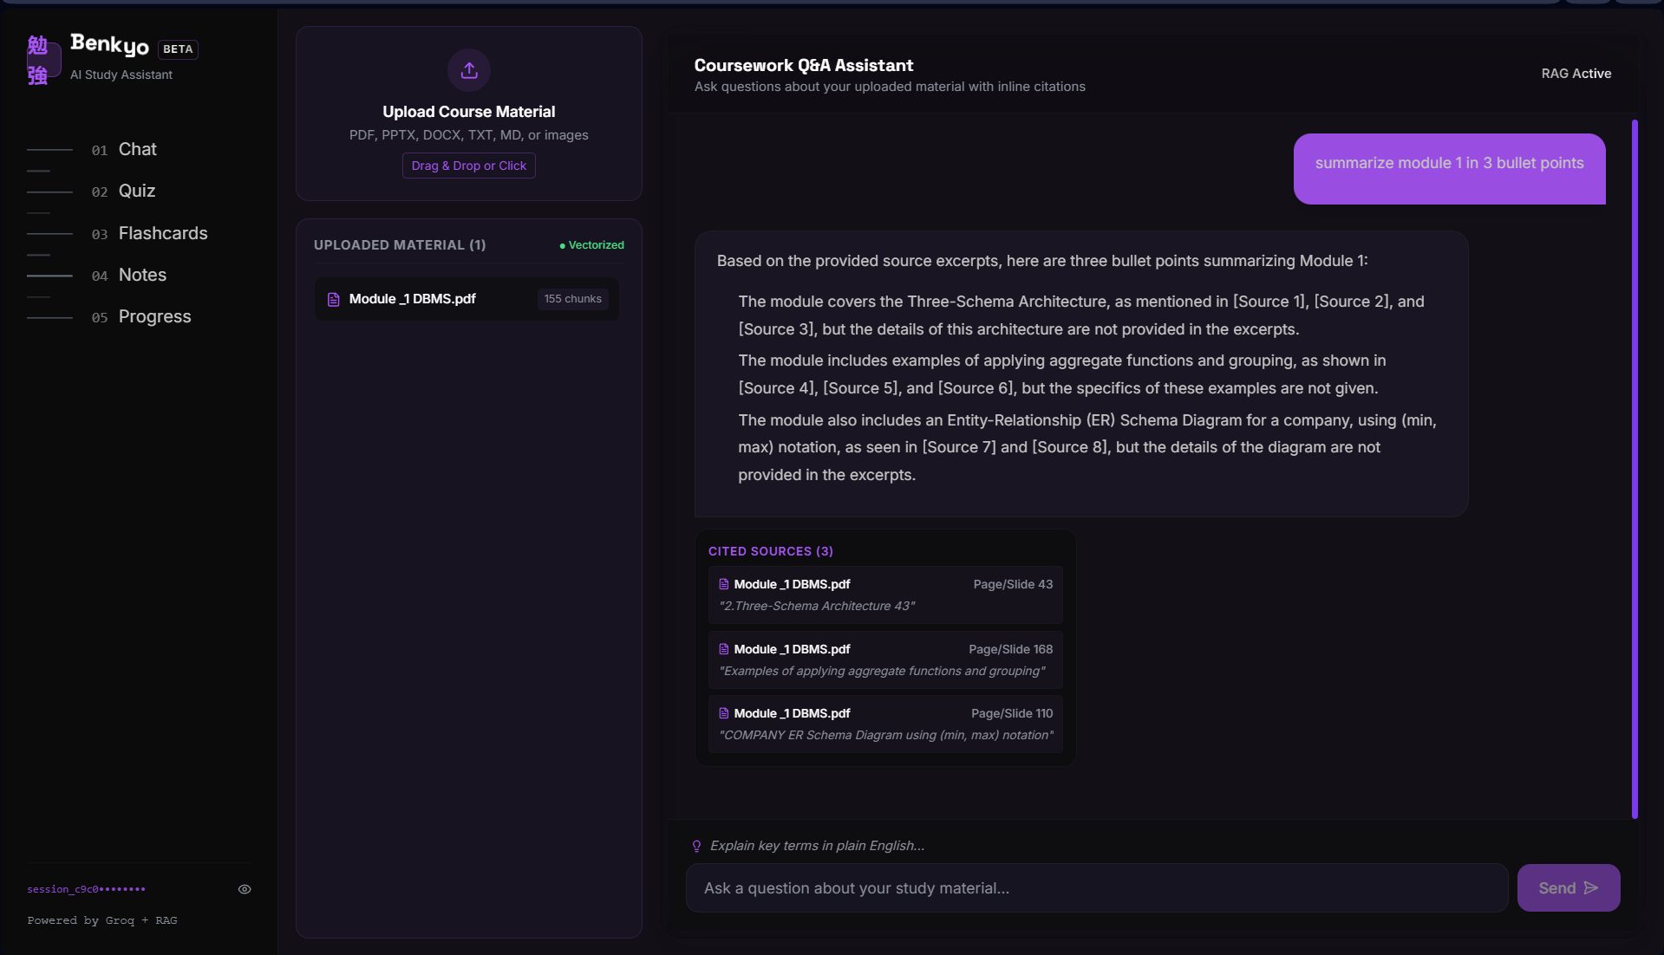
Results — Landing Page & Coursework Q&A
Benkyo delivers a polished, RAG-grounded study experience across five core tools.
Benkyo landing page
Coursework Q&A — grounded answers with inline citations

Slide 9
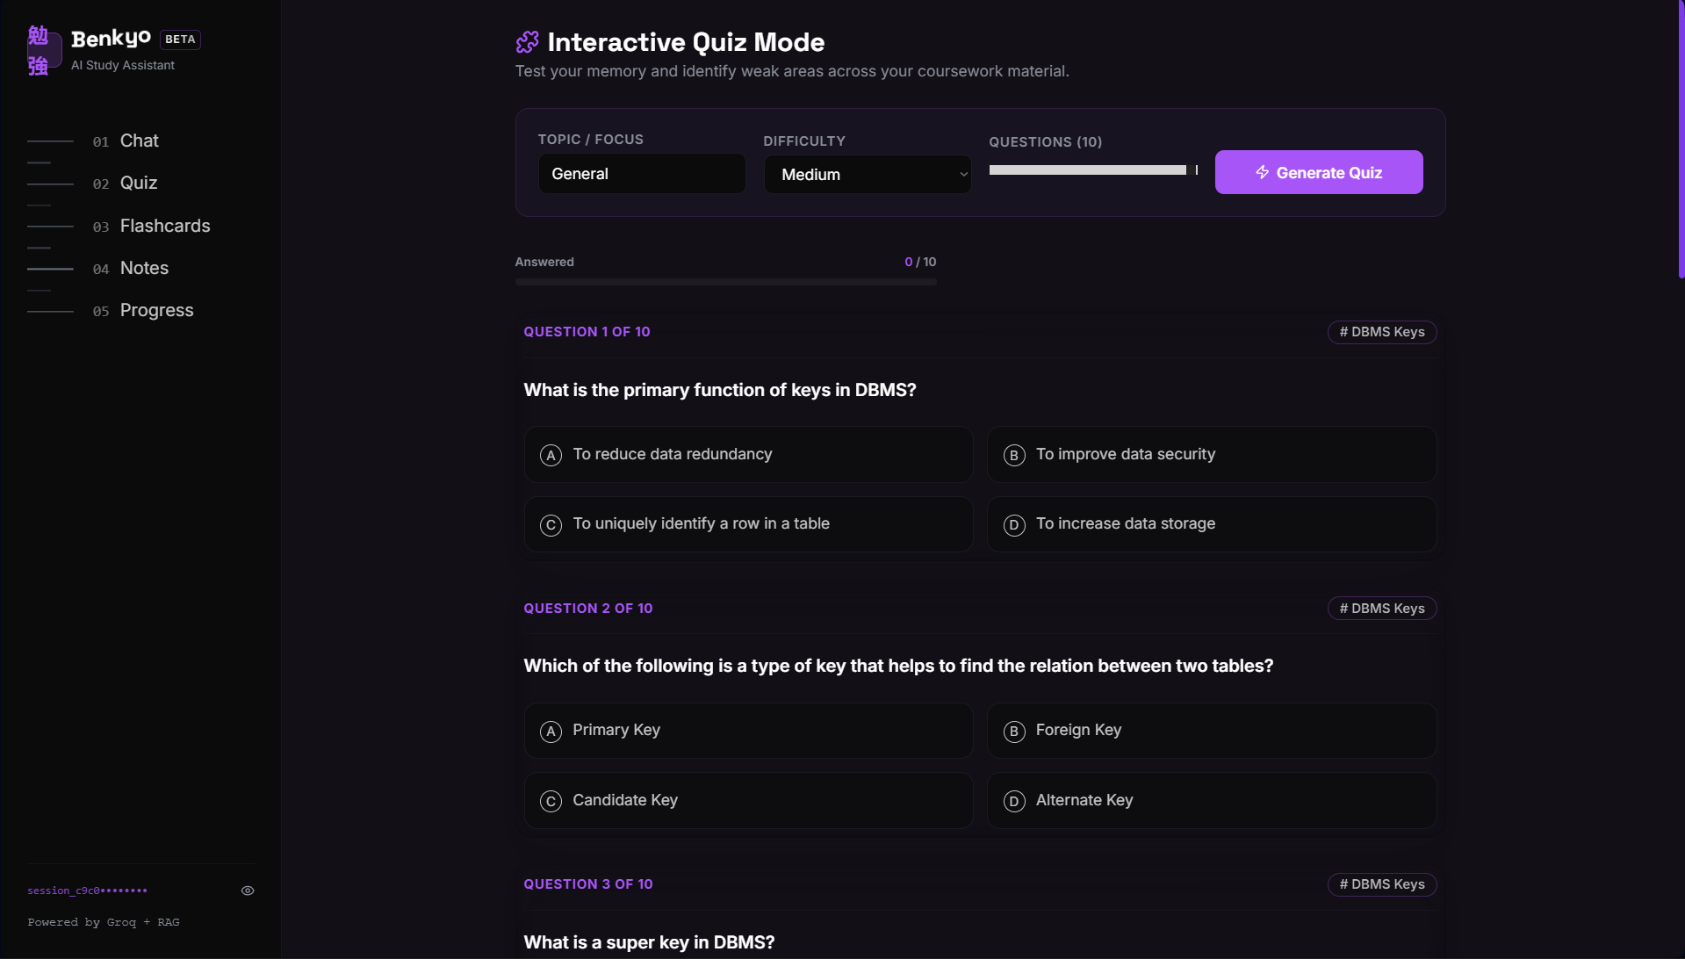
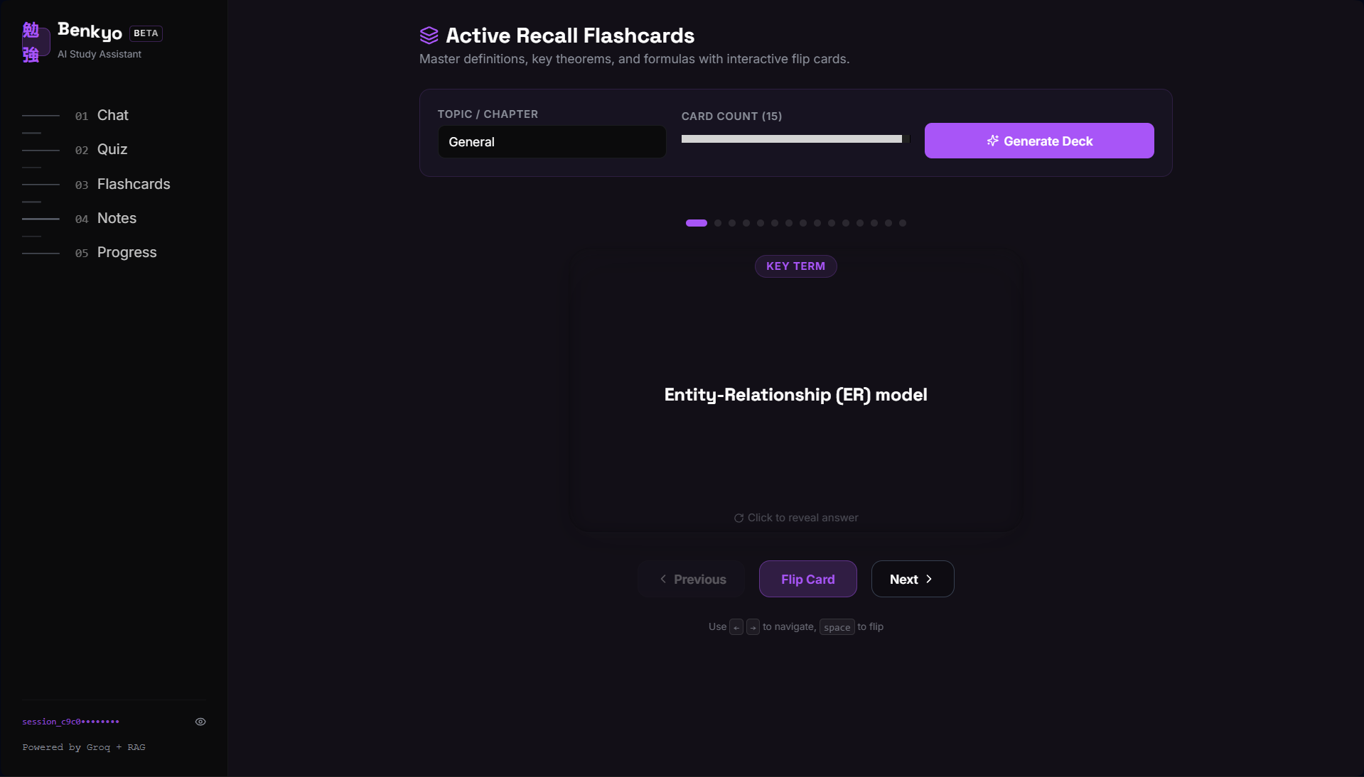
Results — Interactive Quiz & Flashcards
Auto-generated quizzes and flashcards reuse the same retrieval pipeline for active recall.
Interactive Quiz Mode — adjustable difficulty & topic tags
Active Recall Flashcards — 3D flip-card decks

Slide 10
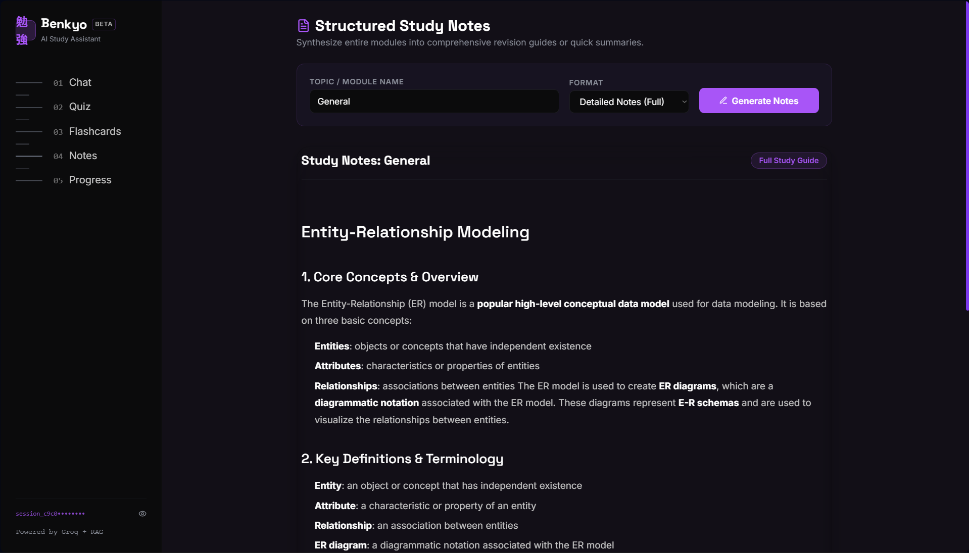
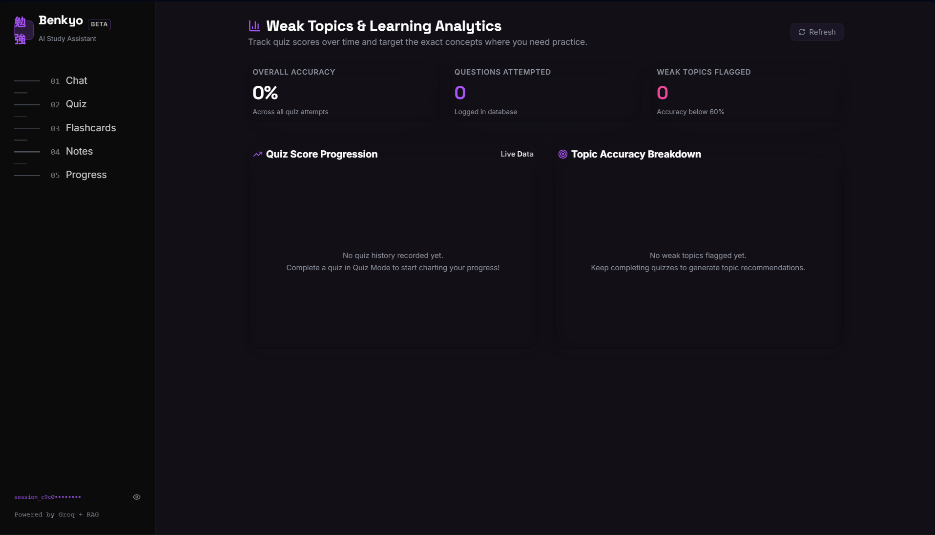
Results — Study Notes & Weak-Topic Analytics
Structured notes and a progress dashboard round out the study workflow.
Structured Study Notes — generated markdown guide
Weak Topics & Learning Analytics dashboard

Slide 11
Conclusion
Delivered hands-on experience building a complete, production-shaped AI application — ingestion, vector search, RAG, a multi-feature FastAPI backend, and a polished React frontend — within a 12-day timeframe.
Working with heterogeneous formats (PDF, PPTX, DOCX, text, scanned images) showed how much extraction quality upstream affects citation accuracy and answer quality downstream.
Building the RAG pipeline end to end clarified trade-offs between chunk size, retrieval count, and prompt design for accurate, well-grounded answers.
Working within free-tier hosting highlighted the need for persistent storage (FAISS index) and graceful degradation (OCR fallback).
Strengthened practical skills in RAG, vector search, full-stack design, and GPU-accelerated LLM APIs; resulted in a genuinely usable study tool extensible with multi-user accounts and spaced repetition.

Slide 12
Q&A

Slide 13
Thank you !!

