Slide 1
UART
UART Protocol
Working of UART
UART configuration
Application of UART

Slide 2
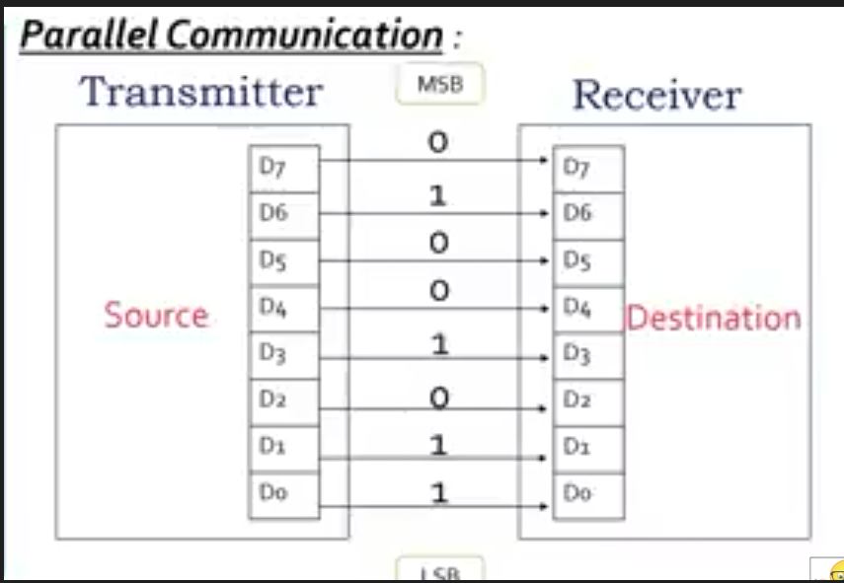
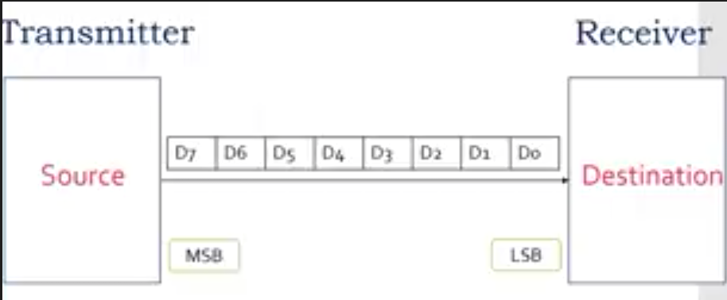
UART
Basics concepts:
parallel communication: multiple wires are used to convey binary information.
Serial communication: over a single wire onlyu
a single bit at a time and transmission of data
by sending all the bits sequentially.

Slide 3
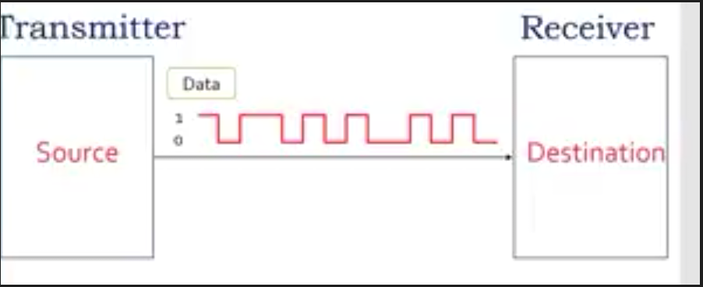
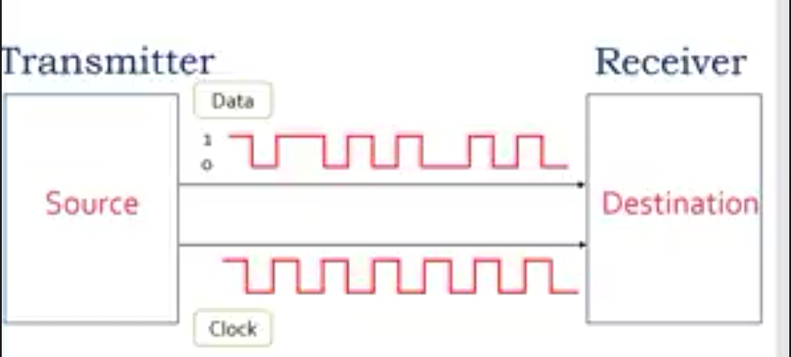
Asynchronous serial communication: there is no clock signal
Synchronous serial communication: here clock signal is shared between transmitter and receiver in order to synchronize the data

Slide 4
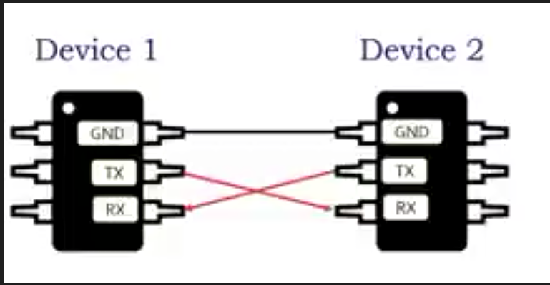
UART – Universal asynchronous receiver transmitter, serial and two wire communication protocol
Data synchronization in UART:
Baud rate – measure of speed of data
transfer(bits per second)
standard baud rate is configured in both
devices.
Start and stop bit

Slide 5
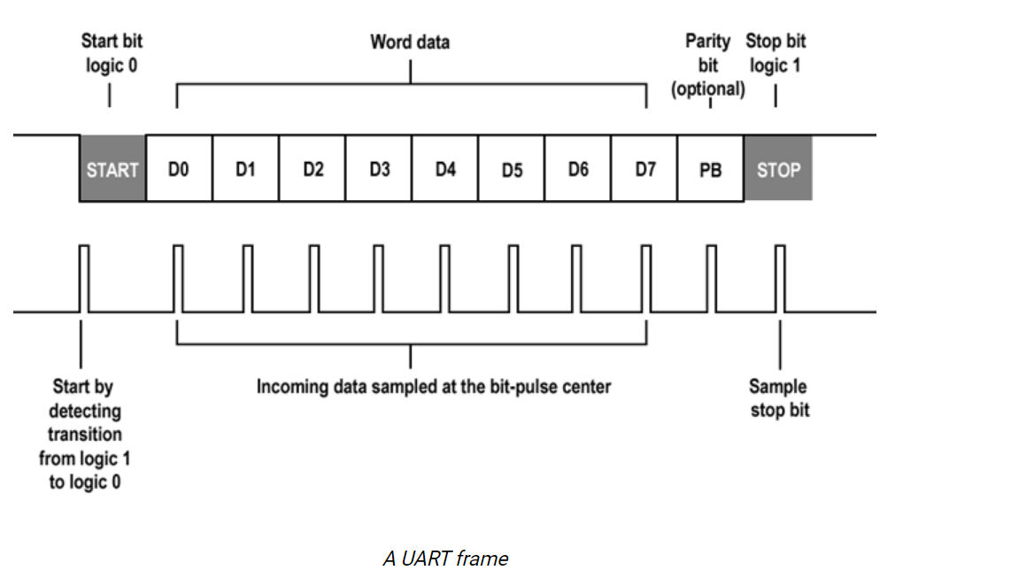
UART Framing:

Slide 6
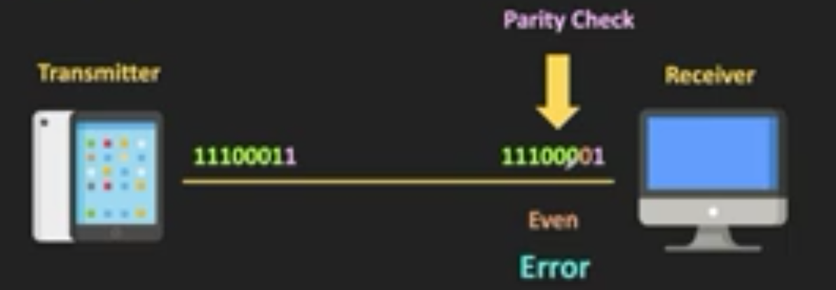
Error detection: due to external noise or interference sometimes few bits get corrupted
Odd parity: total no: of 1’s in the code, including the parity bit should be odd. eg:10110011
Even parity: total no: of 1’s in the code, including the parity bit should be even. eg:10110010

Slide 7
UART configuration:
Simplex : one way communication
example : radio station - will broadcast and the listeners can only receive the broadcast
2. Half duplex: can happen in both direction but not at same time
example : walkie-talkie
3. Full duplex: can happen in both direction at same time
example : telephonic conversation

Slide 8
Advantages :
Only uses two wires
No clock signal is necessary
Provide error detection by parity bit check
Cost and size will be much lesser compare to the parallel communication.

Slide 9
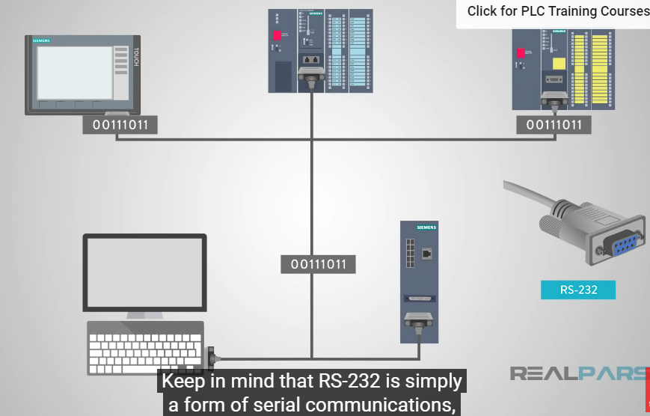
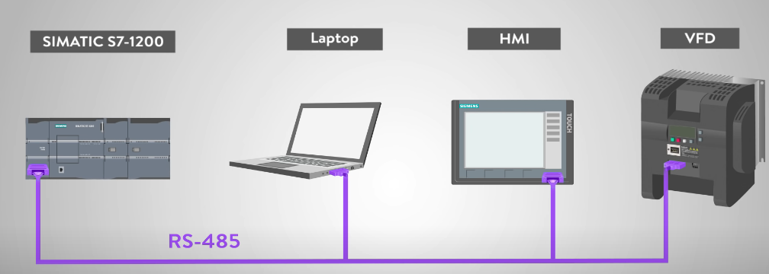
Application of UART
RS232 and RS485

Slide 10
RS232 DB-9 pins
Difference between RS232 And RS485
Data carrier detect(DCD)
Received data(RXD)
Trasmitted data(TXD)
Data terminal ready(DTR)
Signal ground(GND)
Data set ready(DSR)
Request to send(RTS)
Clear to send(CTS)
Ring indicator(RI)
Voltage sys: based differential
No:of drivers :1-1 tx rx, 32-32 tx rx
Line con : point-point , multidrop
Max dis : 15M/50FT,1200M/3000FT
Data txm : 1M bit/s , 10M bit/s

Slide 11
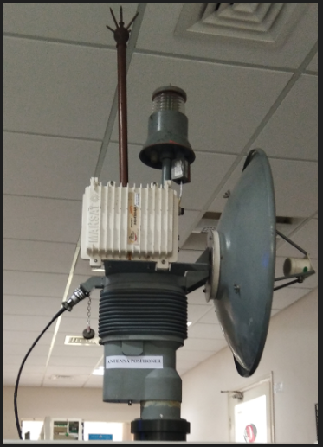
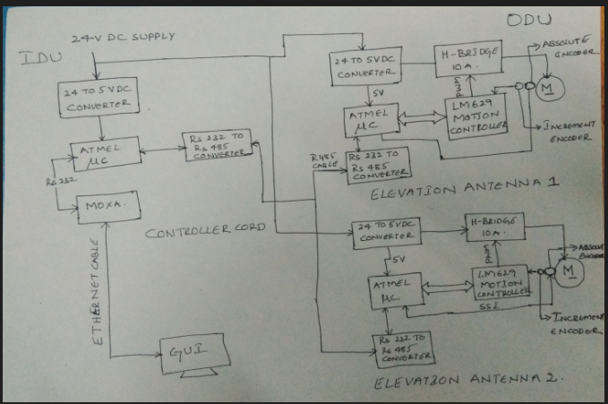
Real time application of UART:

Slide 12
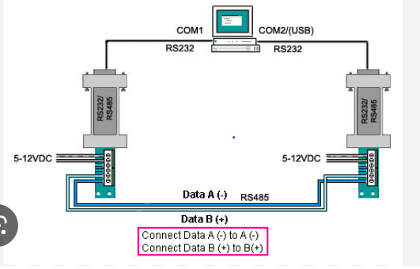
RS232 To RS485 converter provide conversion between serial network and other media, convert RS232 signals to RS485 signals vice versa without changing pcs hardware or software

Slide 13
UART 1 – RS485,ODU,Antenna 1,2 and 8Mhz,19200bps
UART 2,3 – RS232(GUI,Ethernet),IDU Controller card,8Mhz,9600bps
Program on uart protocol:
//uart.h
#include<stdio.h>
#define MINBAUDRATE 2400
#define MAXBAUDRATE 115200UL
typedef enum
{
FAILED = 0;
SUCESS = 1;
BAUD_UART_ERROR = 2
}Status;

Slide 14
typedef enum
{
UART_0 =0;
UART_1 =1;
UART_0_1 = 2
}UART;
Void usart_putchar(uint8_t data); void usart_pstr(uint8_t *s);
void 16_t usart_putchar_printf(uint8_t var,FILE*Stream);
Uint8_int usart_init(uint 32_t baudrate,uint8_uart_no);
Uint8_t usart0_send(uint8_t tx_buf[],uint16_t len);
Void usart0_rcv(uint8_t *rx_buf);
Uint8_t usart1_send(uint8_t tx_buf[],uint16_t len);
Void usart1_rcv(uint8_t *rx_buf);

Slide 15
//Uart.c
#include<avr/io.h>
#include “uart.h”
#include “macros.h”
#include “stdutils.h”
Unit8_t usart_init(uint 32_t baudrate, unit8_t uart_no)
{
uint32_t baud_prescale =0;
if((baudrate>=MINBAUDRATE)&&(baudrate<=MAXBAUDRATE)&&(uart_no))
{
baud_prescale = ((F_CPU)/(baudrate*16UL)-1)
}
else
{
return BAUD_RATE_ERROR;
}

Slide 16
Switch(uart_no)
{
case 0:
UBRR0H = (baud_prescaler>>8);
UBRROL = baud_prescale;
UCSROC = ((0<UMSELO)|(0<<UPM0)|(0<<USBS0)|(1<<UCSZ01)|(1<<UCSZ00));
UCSR0B = ((1<<RXENO)|(1<<TXENO)|(1<<RXCIEO);
break;
case 1:
UBRR1H = (baud_prescaler>>8);
UBRR1L = baud_prescale;
UCSR1C = ((0<UMSEL1)|(0<<UPM1)|(1<<UCSZ11)|(1<<UCSZ10));
UCSR1B = ((1<<RXEN1)|(1<<TXEN1)|(1<<RXCIE1);
` break;

Slide 17
case 2:
UBRR0H = (baud_prescaler>>8);
UBRROL = baud_prescale;
UCSROC = ((0<UMSELO)|(0<<UPM0)|(0<<USBS0)|(1<<UCSZ01)|(1<<UCSZ00));
UCSR0B = ((1<<RXENO)|(1<<TXENO)|(1<<RXCIEO);
UBRR1H = (baud_prescaler>>8);
UBRR1L = baud_prescale;
UCSR1C = ((0<UMSEL1)|(0<<UPM1)|(1<<UCSZ11)|(1<<UCSZ10));
UCSR1B = ((1<<RXEN1)|(1<<TXEN1)|(1<<RXCIE1);
break;
default :
break;
}
return success;
}

Slide 18
Uint8_t usart0_send(uint8_t tx_buff[],uint16_t len)
{
uint 16_t i;
uint8_t status = 0;
if(len<=0)
status = FAILED;
else
{
for(i=0;i<len;i++)
{
while((UCSR0A) &(1<<UDRE0)==0);
UDR0 = tx_buf[i];
}
status = SUCCESS;
}
return status;
}

Slide 19
Void usart0_rcv(uint8_t *rx_buf)
{
while(*rx_buf!=‘\0’)
{
while(!(UCSR0A)&(1<<RXC0));
*rx_buf = UDR0;
rx_buf++;
}
}
Void usart_putchar(uint8_t data)
{
#ifdef debug_uart0_printf
while((UCSR0A)&(1<<UDRE0)==0);
UDR0 = data;
#endif
#ifdef debug_uart1_printf
while((UCSR1A)&(UDRE1)==0);
UDR1 = data;
#endif;
}

Slide 20
Void usart_pstr(uint8_t *str)
{
while(*str!=‘\0’)
{
usart_putchar(*str);
str++;
}
}
Uint16_t usart_putchar_printf(uint8_t var,FILE *stream)
{
if(var == ‘\n’)
usart_putchar(‘\r’);
usart_putchar(var);
return 0;
}

