Slide 1







IBM Data Science Capstone Project Battle of Neighborhoods Finding a better place in North York Canada
Syed Sulaiman
29 June 2021

Slide 2



OUTLINE
Executive Summary
Introduction
Methodology
Results
Visualization – Charts
Clusters
Discussion
Findings & Implications
Conclusion

Slide 3

EXECUTIVE SUMMARY
The aim of this project is to help people in finding better alternatives for their neighborhoods based on the number of various facilities available their.
It will help people making smart and efficient decision on selecting great neighborhood out of numbers of other neighborhoods in North York, Toronto Canada.

Slide 4

INTRODUCTION
According to Aristotle "man is a social animal , who live in a society" , so what is society? in simple words society is nothing but the surrounding environment in which a person live his life. during his life cycle a person is not only influenced by the people's but also by the surrounding environment.
these surrounding environments in other words neighborhoods having adequate venues and facilities plays a vital role in easing the life of a person.

Slide 5

METHODOLOGY
• Data Sources:
• Data Link Used to fetch data : https://en.wikipedia.org/wiki/List_of_postal_codes_of_Canada:_M
• GeospatialCoordinates.csv • Data Exploration and Cleaning
Foursquare API • Python Libraries Pandas
• Data Visualization • Matplotlib Library • Folium Library

Slide 6
Problem Which Tried to Solve:
The prime objective of the project is to help in decision making by suggesting the best neighborhood available in a new city to the persons who are willing to relocate. suggestions will be based on the number of factors such as
Hotels , malls, transport services, connectivity to airport, markets theaters, gyms etc.
Sorted list of accommodations in terms of housing prices
Sorted list of schools in terms of location, fees, rating and reviews

Slide 7
Some important libraries used in this project are as follows:
Pandas: For creating and manipulating data frames.
Folium: Python visualization library would be used to visualize the neighbourhood's cluster distribution of using interactive leaflet map.
Scikit Learn: For Machine learning clustering techniques such as k-means clustering.
JSON: Library to handle JSON files.
XML: To separate data from presentation and XML stores data in plain text format
Beautiful Soup and Requests: To handle http requests, and web scraping.
Matplotlib: Python Plotting Module.

Slide 8
Data Description:
Data Link Used to fetch data such as Postal code, Borough and Neighborhood : https://en.wikipedia.org/wiki/List_of_postal_codes_of_Canada:_M
Using GeospatialCoordinates CSV data file which contains list of Postal Code Latitude and longitude for North York.

Slide 9
Foursquare API Data:
Foursquare Api is a platform which provides information about nearby places in neighborhoods, using developers account here we are exploring venues in surroundings and help us in finding data about different venues in different neighborhoods of that specific borough. In order to gain that information we will use "Foursquare" locational information. Foursquare is a location data provider with information about all manner of venues and events within an area of interest. Such information includes venue names, locations, menus, ratings , reviews and even photos. As such, the foursquare location platform will be used as the sole data source since all the stated required information can be obtained through their API.

Slide 10
Contd.
The data retrieved from Foursquare contained information of venues within a specified distance of the longitude and latitude of the postcodes. The information obtained per venue as follows:
1. Neighborhood
2. venue
3. Neighborhood Longitude
4. Neighborhood Latitude
5. Name of the venue e.g. the name of a store or restaurant
6. Venue Latitude
7. Venue Longitude
8. Venue Category

Slide 11

DISCUSSION
In this project we are exploring the neighborhoods in North York Toronto in order to help these newcomers in selecting proper neighborhood according to their needs and one which is similar to their native place. The features include are housing price and better school according to ratings, crime rates of that particular area, transportation, emergency services, water resources, sewers and recreational facilities

Slide 12
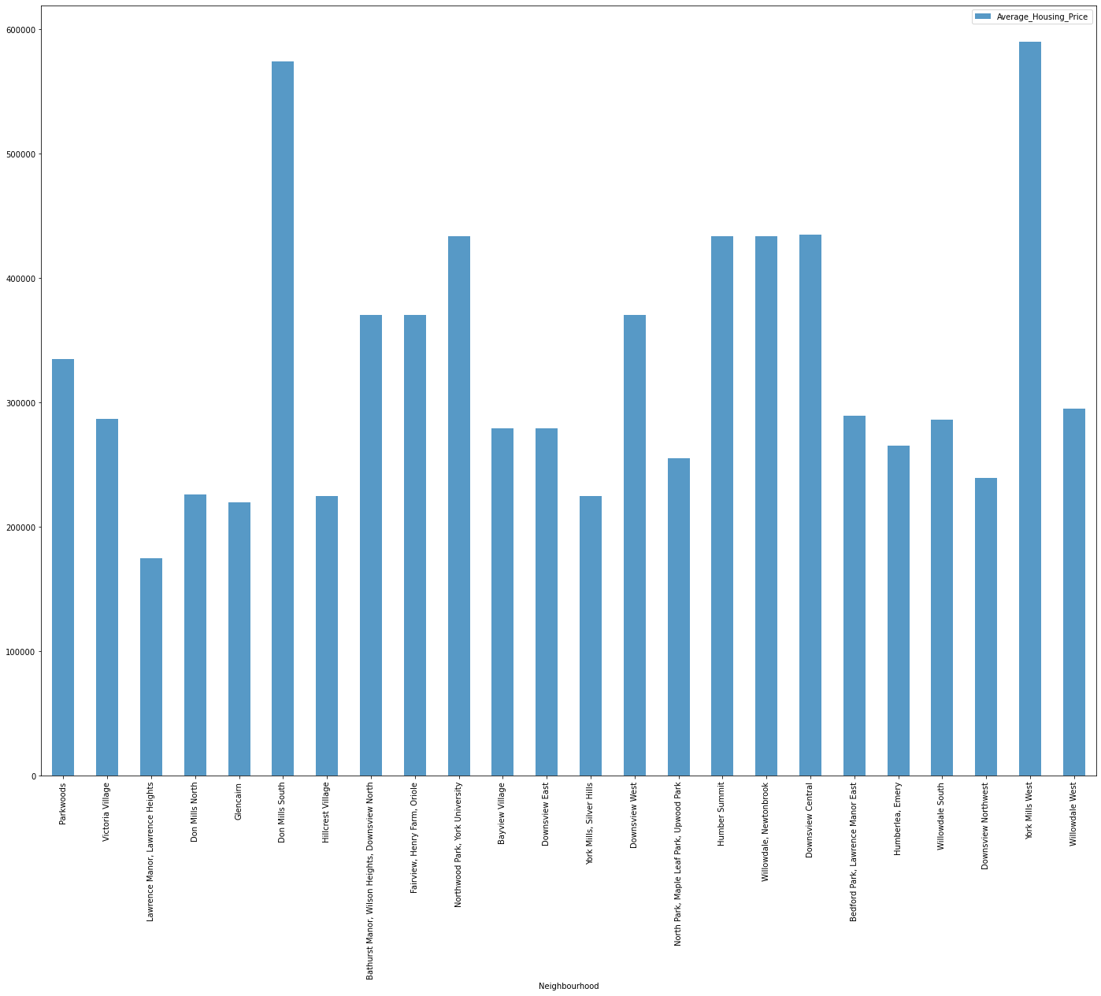
Avg Housing price in North York Neighbors

Slide 13
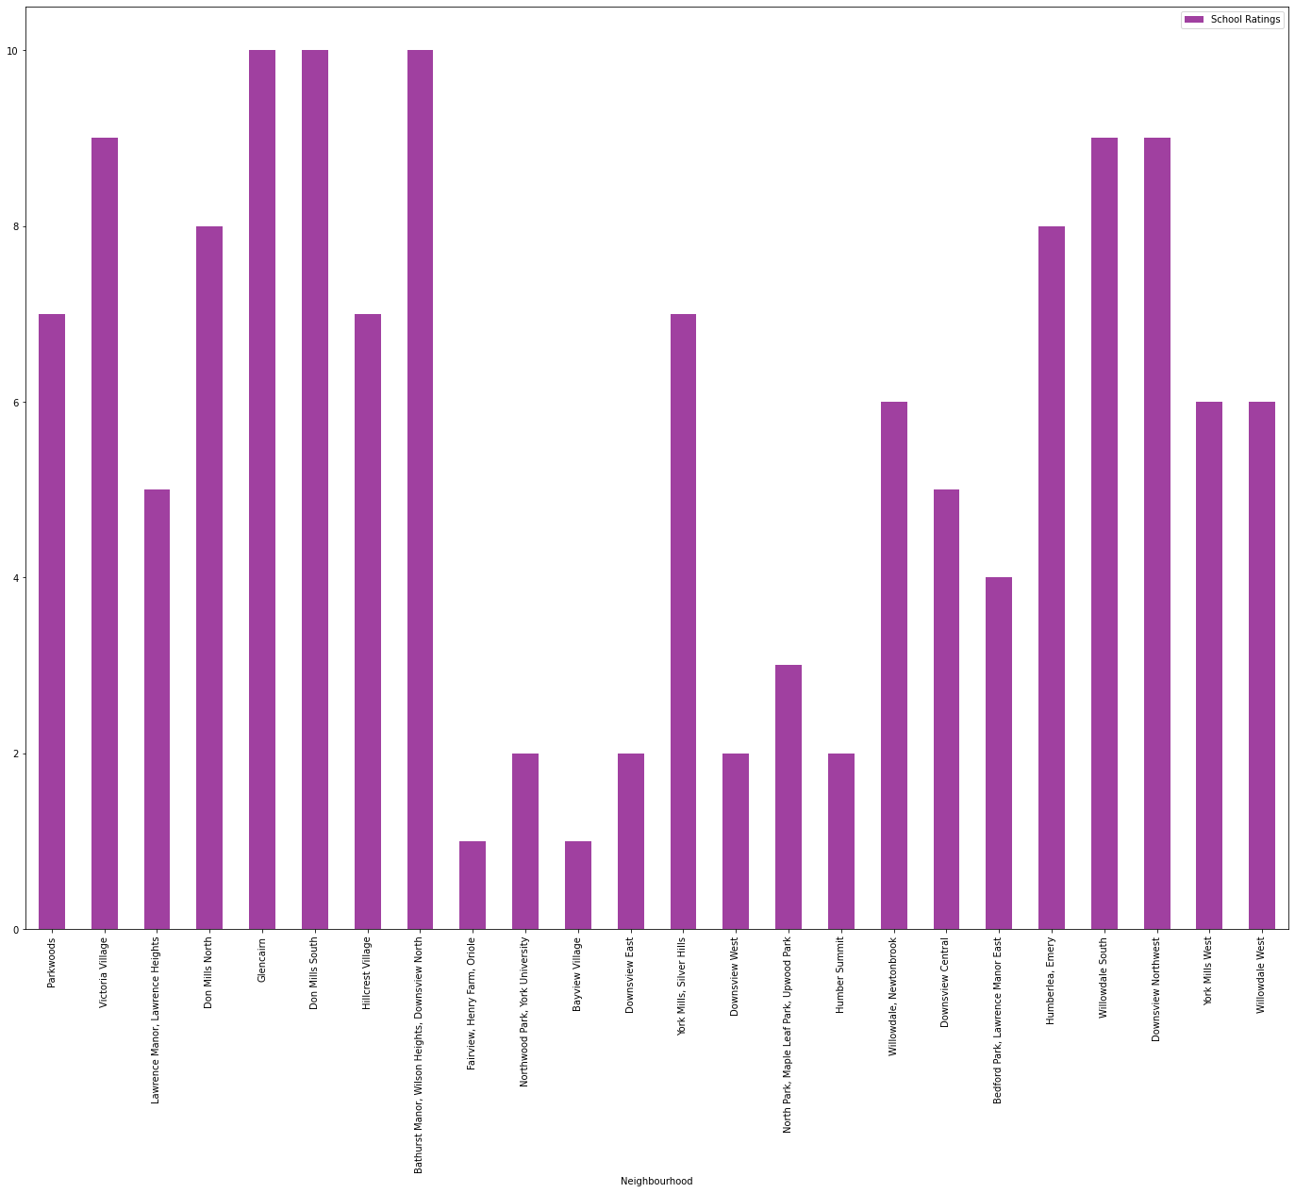
Top School Ratings in North York neighbors

Slide 14

CONCLUSION
Conclusion: In this project, using k-means cluster algorithm I separated the neighborhood into 10(Ten) different clusters and for 103 different latitude and longitude from dataset, which have very-similar neighborhoods around them. Using the charts above results presented to a particular neighborhood based on average house prices and school rating have been made.

