Slide 1

AGRI AIUTO
S.Ishrath Unnisa [154G1A0533] Batch No: A2
K.Bhavitha [154G1A0514]
G.Bhuvaneswari [154G1A0516] Project Guide:
P.Baba Fakruddin [154G1A0508] G.Hemanth Kumar Yadav M.Tech
Assistant Professor
Srinivasa Ramanujan Institute of Technology
Department of Computer Science & Engineering

Slide 2
Abstract
The "AGRI AIUTO" application delivers the detail information about which crop to grow in which season and which crop is suitable for that particular soil in which the farmer wishes to start. This application helps the farmer to choose the perfect pesticide in order to maintain a healthy crop and also provides the climatic conditions so that we can select the seasonal crop to get benefited. User sends their problem by uploading the image and any other user can respond through text or image. Now-a-days mobile being a common device, with this application we aim to make it friendly for farmers.

Slide 3
Contents:
Introduction
Problem Definition
Proposed System
Modules
Design
Implementation
Requirements
References

Slide 4
Introduction
Agriculture is the most healthful, useful and noble employment of man.
We need agriculture to satisfy our hunger and thirst, good or bad people on this planet who earn their livelihood by agriculture.
AGRI AIUTO is a mobile application built by keeping the farmers in mind and also a common man who want to grow crops for his daily needs.

Slide 5
Problem Definition
Agri Aiuto is to keep a farmer updated with all the information related to crop, pesticides ,insecticides, Merchant and Climatic conditions.
Agri Aiuto helps the farmers to interact with the experts and take suggestions from them.

Slide 6
Proposed System
User Authentication by mobile number for flexibility.
It provides the information about which crop to grow in which soil based upon the season to gain profit.
Storing the list of the crop in favorites for revisiting them.
It provides information about the merchants.
Information about the pesticides and their usage.
Suggestions from other individuals either by text message or image.
App requires an Active Internet Connection for fetching the information.

Slide 7
Continued…
Making the user understand the information using Text to Speech.
Weather Forecasting based on the region.

Slide 8
Modules
User:
Login with Username, Mobile number, Email and Verify the OTP.
Selecting the Language.
Selection of crop and view the details and store crop detail in favorites .
Selection of Merchants and viewing their details and user can register his details.

Slide 9
Continued…
Selection the date for viewing the weather.
Selection of Pesticide and viewing their details.
Upload the text or image for suggestions and responding to the other users.

Slide 10
Continued…
Admin:
Login with Username, Mobile number, Email and Verify the OTP.
Selecting the Language.
Updating the data about the crop, merchants, pesticides and season.
Uploading and giving message to the suggested person.

Slide 11
Continued…
Expert:
Login with Username, Mobile number, Email and Verify the OTP.
Register as a Expert and enter the details.
Provide solutions to the users either by sending text message and uploading image.

Slide 12
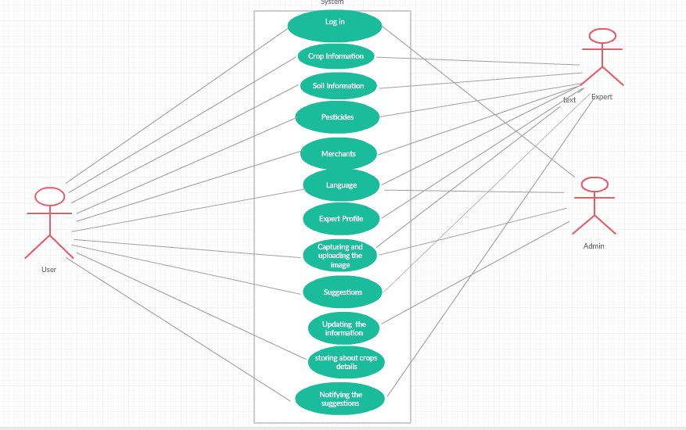
Design Use Case Diagram

Slide 13
Authentication code
Verifying Mobile Number:MainActivity.java
public class MainActivity extends AppCompatActivity {
EditText editphone;
Button otpButton;
String codeSent;
@Override
protected void onCreate(Bundle savedInstanceState) {
super.onCreate(savedInstanceState);
setContentView(R.layout.activity_main);
editphone=findViewById(R.id.enter_number);
otpButton = findViewById(R.id.but_otp);
otpButton.setOnClickListener(new View.OnClickListener() {
@Override
public void onClick(View v) {
sendVerificationCode();
}
});
}

Slide 14
private void sendVerificationCode() {
String number = editphone.getText().toString();
if (number.isEmpty()) {
editphone.setError("Phone number is required");
editphone.requestFocus();
} else if (number.length() < 10) {
editphone.setError("Please enter a valid phone");
editphone.requestFocus();
}else if (number.length() > 13) {
editphone.setError("Please enter a valid phone");
editphone.requestFocus();
}else{
Intent intent = new Intent(MainActivity.this, CodeVerficationActivity.class);
startActivity(intent);
}
}
}

Slide 15
Verifying OTP:CodeVerificationActivity.java
public class CodeVerficationActivity extends AppCompatActivity {
EditText editCode;
Button signIn;
@Override
protected void onCreate(Bundle savedInstanceState) {
super.onCreate(savedInstanceState);
setContentView(R.layout.activity_code_verfication);
editCode=findViewById(R.id.enter_code);
signIn=findViewById(R.id.signInbtn);
verifySignInCode();
signIn.setOnClickListener(new View.OnClickListener() {
@Override
public void onClick(View v) {
submit();
}
});
}

Slide 16
private void verifySignInCode() {
Random random=new Random();
int i=(int)(5000*random.nextDouble());
editCode.setVisibility(View.INVISIBLE);
NotificationManager n=(NotificationManager)getSystemService(NOTIFICATION_SERVICE);
NotificationCompat.Builder builder=new NotificationCompat.Builder(this);
builder.setSmallIcon(R.mipmap.ic_launcher);
Intent i1=new Intent(this,MainActivity.class);
PendingIntent p=PendingIntent.getActivity(this,0,i1,0);
builder.setContentIntent(p);
builder.setSmallIcon(R.drawable.agri);
builder.setContentText("Your OTP :"+i);
builder.setContentTitle("Notifications");
builder.setSubText("Yes i got the Otp Number");
n.notify(1,builder.build());
editCode.setVisibility(View.VISIBLE);
}
public void submit() {
if (isValidPhone(editCode.getText().toString())) {
Toast.makeText(getApplicationContext(), "Phone number is valid", Toast.LENGTH_SHORT).show();
Intent i2=new Intent(this,LanguageActivity.class);

Slide 17
startActivity(i2);
} else {
Toast.makeText(getApplicationContext(), "Phone number is not valid", Toast.LENGTH_SHORT).show();
}
}
private boolean isValidPhone(String s) {
if (TextUtils.isEmpty(s))
{
return false;
}
else
{
return android.util.Patterns.PHONE.matcher(s).matches();
}
}
}

Slide 18
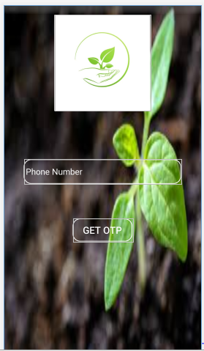
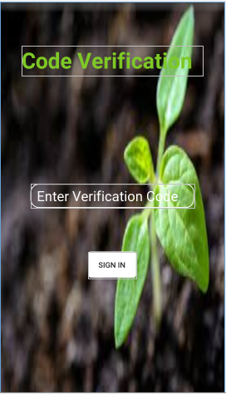
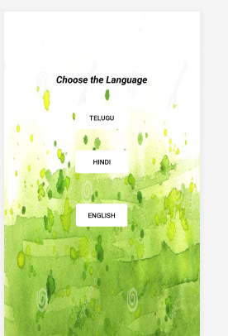
Screens

Slide 19
Requirements
Hardware requirements:
RAM Capacity: 8GB or 6GB.
Hard disk Capacity:2 GB or 4GB.
Processor:i3 or above.
Software requirements:
Operating Systems – Windows7/8/10(32-bit or 64-bit).
Platform – Android Studio 3.3.
Programming in- Java(Backend), Extensible Markup Language(XML- Frontend).

Slide 20
References
https://ieeexplore.ieee.org/document/6965213/
http://ieeexplore.ieee.org/document/7358528/
http://ieeexplore.ieee.org/abstract/document/8073690/

Slide 21
Comments
Software Model
Domain Knowledge
Abstract change
Firebase Justification

Slide 22
Thank you
Queries
?

