Slide 1





GROUP MEMBERS 1. Syed Issam Bukhari (group leader) 2. Bilal Abbasi 3. Osama Khan 4. Mahnoor Shafiq 5. Farzana Sharifi 6. Mawra Iqbal

Slide 2
HOSTEL MANAGEMENT SYSTEM
FINAL PROJECT

Slide 3
INTRODUCTION
Hostel Management System is a customize and user-friendly software for hostel which provide all the information of hostel, like Hostel room information, It helps admin to manage
Student record
Mess record
Visitor record
etc.

Slide 4
PURPOSE
To replace the existing system which is much more time consuming.
To provide quick and efficient means for gathering the student information like room, fees & finally check-in and check out report of student.

Slide 5
SCOPE
The software product “Hostel Management System” will be an application that will be used for maintaining the records in an organized manner and to replace old paper working system. The Hostel Management System is designed for hostel like (Schools and Universities).

Slide 6
Advantages of this system:
There are following benefits of system
Provide Security
Data redundancy can be avoided
Easy to handle, Update and keep record.
Data can be saved easily

Slide 7

ERD (Entity Relationship Diagram)

Slide 8
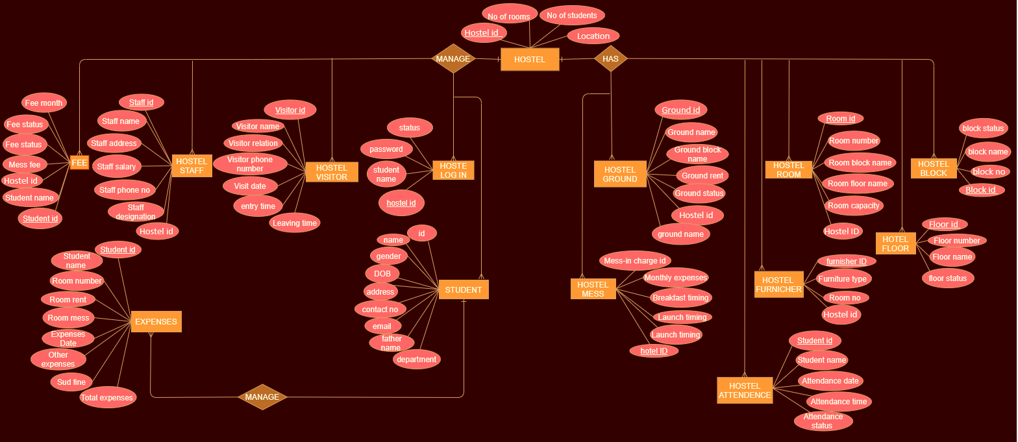

Slide 9
1.hostel login table
create database HostelManagement;
use HostelManagement;
create table Hostel_login (
studentid int,
studentname varchar (70),
studentpassword varchar (90),
studentstatus varchar(80),
Primary key (studentid));
insert into Hostel_login(studentid,studentname,studentpassword,studentstatus)
values
(21,'hassan','hassan123','active'),
(22,'noman','nomi3','active'),
(23,'asad','pakistan786','non active');

Slide 10

2.hostel table
create table Hostel(
Hostelid int,
Noofrooms int,
Noofstudents int,
Location varchar(90),
primary key (Hostelid));
insert into Hostel(Hostelid,Noofrooms, Noofstudents,Location)
values
(321,25,50,'complex abbotabbad'),
(322,30,60,'Mansehra'),
(323,15,40,'Damtorh’);
Select * from Hostel;

Slide 11
3.hostl floor table
create table Floor (
Floorid int,
Floornumber int ,
Floorname varchar(90) ,
Floorstatus varchar(90),
primary key (Floorid));
insert into Floor(Floorid,Floornumber,Floorname ,Floorstatus)
values
(221,5,'shaheen','Availble'),
(222,6,'iqbal','Availble'),
(223,7,'quid','Not Availble');
Select * from Floor;

Slide 12
4.hostel block table
create table HostelBlock(
Blockid int,
Blocknumber int,
Blockname varchar(70),
Blockstatus varchar(70),
Primary key (Blockid));
insert into HostelBlock(Blockid ,Blocknumber ,Blockname ,Blockstatus)
values
(231,1,'salman','Availble'),
(232,2,'iqbal','Not Availble'),
(233,3,'quid','Availble');
select * from HostelBlock;

Slide 13
5.hostel room table
Create table HostelRoom(
Hostelid int,
Room_id int,
Room_number int,
Room_block_name varchar (90),
Room_floor_name varchar (90),
Room_capacity varchar (90),
Room_status varchar (90),
primary key (Room_id),
Foreign key (Hostelid) REFERENCES Hostel(Hostelid));
insert into HostelRoom(Hostelid,Room_id,Room_number,Room_block_name ,Room_floor_name ,Room_capacity ,Room_status)
values
(321,51,44,'salman','shaheen','2 Seater', 'Availble'),
(322,52,45,'iqbal','iqbal','single Seater','Not Availble'),
(323,54,46,'quid','quaid','3 Seater','Availble');
select * from HostelRoom;

Slide 14
6.hostel ground table
Create table Ground(
Hostelid int,
Groundid int,
Groundname varchar (70),
Groundblockname varchar(80),
Groundrent float,
Groundstatus Varchar(80),
Groundtimming varchar(90),
primary key (Groundid),
Foreign key (Hostelid) REFERENCES Hostel(Hostelid));
insert into Ground(Hostelid,Groundid,Groundname,Groundblockname,Groundrent,Groundstatus,Groundtimming)
values
(321,1,'football','salman',5000,'Availble','9:00 AM to 4:00 PM'),
(322,2,'cricket','iqbal',10000,'Not Availble','9:00 AM to 8:00 PM'),
(323,3,'hockey','quaid',12000,'Availble','11:00 AM to 3:00 PM');
select * from Ground;

Slide 15
7.Hostel mess table
create table Mess(
Hostelid int,
Mess_incharge_id int,
Monthlyexpences float,
Breakfast_timing Varchar(90),
Launch_timing varchar (90),
Dinner_timing Varchar (90),
primary key (Mess_incharge_id),
Foreign key (Hostelid) REFERENCES Hostel(Hostelid));
insert into Mess(Hostelid,Mess_incharge_id,Monthlyexpences,Breakfast_timing,Launch_timing,Dinner_timing)
values
(321,12,525.50,'9:00 AM to 11:00 AM','12:00 PM to 2:00 PM','9:00 PM to 10:00 PM'),
(322,13,1000,'9:00 AM to 10:00 AM','12:00 PM to 3:00 PM','7:00 PM to 8:00 PM'),
(323,14,7000,'8:00 PM to 10:00 AM','12:00 PM to 2:30 PM','8:00 PM to 9:45 PM');
select * from Mess;

Slide 16

8.Hostel furniture table
Hostel furniture table
create table furniture(
Hostelid int,
Furniture_id int ,
Furniture_type varchar(90),
Room_No int,
primary key (Furniture_id),
Foreign key (Hostelid) REFERENCES Hostel(Hostelid));
insert into furniture(Hostelid,Furniture_id,Furniture_type,Room_No)
values
(321,25,'Metras',51),
(322,30,'Metras',52),
(323,15,'Bed',54);
select * from furniture;

Slide 17

9.hostel attendance table
create table attendance(
Studentid int,
Student_name varchar(90),
Attendance_date date,
Attendance_time Varchar(90),
Attendance_status varchar (90),
primary key (Studentid));
insert into attendance(Studentid,Student_name,Attendance_date,Attendance_time,Attendance_status)
values
(1,'issam','2020-5-24','9:00 AM','present'),
(2,'mahnoor','2020-5-24','8:00 AM','present'),
(3,'bilal','2020-5-24','8:45 AM','Absent');
select * from attendance;

Slide 18
10.hostel visitor table
create table visitor(
Visitorid int,
Visitorname varchar (90),
Visitorphonenumber varchar(90),
Visitorrelation varchar(90),
Visitdate date,
Entrytime varchar (90),
Leavingtime varchar(90),
primary key (Visitorid));
insert into visitor(Visitorid,Visitorname,Visitorphonenumber,Visitorrelation,Visitdate,Entrytime ,Leavingtime)
values
(1,'hassan','03070751356','brother','2020-5-24','4:00 PM','4:30 PM'),
(2,'abbasi','03493004173','father','2020-6-4','3:00 PM','3:30 PM'),
(3,'bukhari','03100917499','brother','2020-8-19','2:00 PM','3:00 PM');
Select * from visitor;

Slide 19
11.Hostel staff table
create table staff(
Hostelid int,
Staffid int,
Staffname varchar(90),
Staffaddress varchar(90),
Staffsalary float,
Staffphoneno varchar(90),
Staffdesignation varchar(90),
primary key (Staffid),
Foreign key (Hostelid) REFERENCES Hostel(Hostelid));
insert into staff(Hostelid,Staffid,Staffname,Staffaddress,Staffsalary,Staffphoneno,Staffdesignation)
values
(321,1,'aman','abbotabbad',50000,'03159577102','clerk'),
(322,2,'salman','peshawar',60000,'03100917799','warden'),
(323,3,'haris','multan',70000,'03159777112','manager');
select * from staff;

Slide 20
12.student table
create table Student_information(
Hostelid int,
Room_id int,
Studentid int,
Studentname varchar(90),
Studentgender varchar(90),
StudentDob varchar(90),
Studentaddress varchar(90),
Studentcontactnumber varchar(90),
Studentemail varchar(90),
Studentfathername varchar(90),
Parentscontactnumber varchar(90),
Studentdepartment varchar(90),
primary key (Studentid),
Foreign key (Hostelid) REFERENCES Hostel(Hostelid),
foreign key (Room_id) REFERENCES HostelRoom(Room_id));
Insert into Student_information
(Hostelid,Room_id,Studentid,Studentname,Studentgender,StudentDob,Studentaddress,Studentcontactnumber,Studentemail,Studentfathername,Parentscontactnumber,Studentdepartment)
values
(321,51,44,'salman','male','2000-6-4', 'lahore','03129877102','salman@gmail.com','bukhari','03159567187','physics'),
(322,52,45,'iqbal','male','1999-6-4','multan','03169567102','iqbal12@yahoo.com','syed','03099567165','biology'),
(323,54,46,'hassan','male','1998-6-4','pindhi','03119557302','hassan32@hotmail.com','iqbal','03169567155','databse');
Select * From Student_information;

Slide 21
13.student expenses table
create table Student_Expenses(
Studentid int,
Studentname varchar (90),
Roomnumber varchar (90),
Roomrent float,
Roommess float,
ExpensesDate varchar (90),
Otherexpenses float,
Studentfine float,
Totalexpenses float,
primary key (Studentid));
insert into Student_Expenses
(Studentid,Studentname,Roomnumber,Roomrent,Roommess,ExpensesDate,Otherexpenses,Studentfine,T otalexpenses)
Values
(32,'noman','5D',5000,3500,'2020-6-4',7600.65,600,16700.65),
(33,'asad','6C',4000,3500,'2020-12-7',6600,600,14700),
(34,'salman','9E',5500,3500,'2020-8-8',7000,1000,17000);
select * from Student_Expenses;

Slide 22
14.student fee table
create table student_Fee(
Hostelid int,
Studentid int,
Studentname varchar(80),
Feemonthly float,
Feestatus varchar(80),
Remainingdues float,
Messfee float,
primary key (Studentid),
Foreign key (Hostelid) REFERENCES Hostel(Hostelid));
insert into student_Fee (Hostelid,Studentid,Studentname,Feemonthly,Feestatus,Remainingdues,Messfee)
values
(321,1,'aman',27000,'Paid',67000,3500),
(322,2,'salman',26000,'UnPaid',68000,3000),
(323,3,'sonu',37000,'Paid',57000,4000);
select * from student_Fee;

Slide 23
Thank You !!!

