Slide 1
FinRelief AI
Automated Debt Diagnostics & Creditor Settlement Advisory
Capstone Project Review & Technical Demonstration
Presenter: Syed Jafar Moinuddin | B.Tech Computer Science & Engineering
Institution: Vishnu Institute of Technology, Bhimavaram
Architecture: Python (FastAPI) • SQLite (SQLAlchemy) • Google Gemini 2.5 Flash • TOTP 2FA
Notes:
Good morning, esteemed panel. Today I am presenting FinRelief AI, a working prototype platform designed to provide objective debt health diagnostics and automated creditor settlement guidance for distressed borrowers in India. This review covers our decoupled architecture, deterministic calculation engine, cloud AI with local rule-based fallback, OWASP-aligned security controls, and empirical benchmark testing.

Slide 2
Distressed Borrowers Lack Objective, Affordable Debt Advisory
Core Consumer Hurdles in India & Target Demographic
Core Consumer Challenges
• Private counseling firms charge 15%–25% upfront fees.
• Borrowers lack transparent legal benchmarks and realistic settlement targets.
• Negative cash flow drives severe psychological anxiety and debt compounding.
• Predatory collection agencies exploit consumer ignorance of legal rights.
Target User Profile (India)
• Salaried and self-employed individuals with multiple unsecured credit accounts.
• Monthly EMI commitments exceeding 40% of gross monthly earnings.
• Accounts 30 to 180+ days delinquent seeking structured settlement.
• Borrowers seeking private, structured recovery without expensive intermediaries.
2/10
Notes:
In India, unsecured consumer credit card and personal loan debt has grown rapidly. Distressed individuals face high interest rates and aggressive collection tactics. Commercial credit counselors charge steep commissions that indebted users cannot afford. FinRelief directly targets salaried and self-employed individuals with high Debt-to-Income ratios, offering them a transparent, objective self-service tool to assess debt health and prepare negotiation strategies.

Slide 3
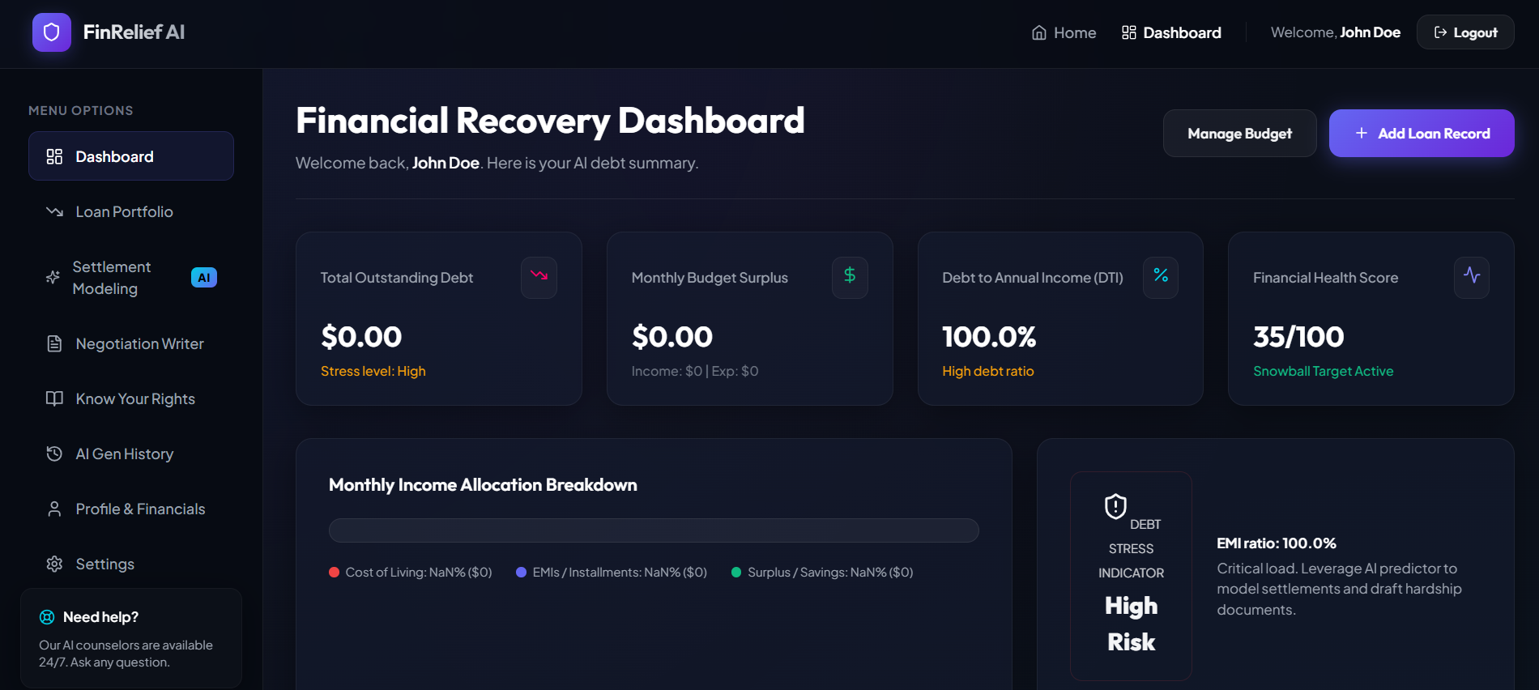
Autonomous Self-Service Web Platform for Debt Diagnostics
Working Prototype: Data Ingestion to Actionable Settlement Roadmap
Three Core Capabilities
• Instant Health Scoring:
Real-time computation of cash surplus, DTI, and 1–100 health score.
• Heuristic Settlement Targets:
Calculates realistic ~40%–50% lump-sum benchmarks for negotiations.
• Automated Hardship Letters:
Generates structured communication drafts tailored by tone for creditors.
• Educational FDCPA Library:
Direct legal rights references protecting borrowers from harassment.
3/10
Notes:
FinRelief solves this challenge with a lightweight, accessible web application. The platform provides three core features: First, deterministic health scoring computed through clean mathematical formulas. Second, heuristic debt settlement predictions. Third, automated hardship communication drafting powered by Generative AI. Live demo flow: Demonstrate user login, viewing real-time surplus, and tracking multiple loan accounts on the dashboard.

Slide 4
Decoupled Architecture with High-Availability AI Fallback
FastAPI Asynchronous Gateway & Resilient Multi-Tier Infrastructure
Client Presentation Layer
• Single-page application (HTML5/CSS/JS).
• Responsive glassmorphism design system.
• Bearer JWT auth header injection.
• Interactive Chart.js visualizations.
FastAPI Application Core
• Asynchronous Python 3.10 REST gateway.
• Strict Pydantic v2 schema validation.
• OAuth2 Password flow & PyOTP 2FA.
• SlowAPI endpoint rate limiting.
Dual-Engine AI Coordinator
• Primary: Google Gemini 2.5 Flash SDK.
• Automated circuit-breaker monitor.
• Fallback: Deterministic local rule engine.
• Instant failover in under 0.1 ms.
Persistence Architecture & Decoupled State
• SQLite Database: Managed via SQLAlchemy ORM with 6 relational models (Users, Loans, AIHistory, Profiles, Settlements, Negotiations).
• Concurrency Hardening: Configured PRAGMA journal_mode=DELETE, synchronous=NORMAL, and 30s connection timeout to eliminate locks.
• Modular Decoupling: Deterministic math runs entirely in Python prior to any external AI invocation.
4/10
Notes:
Our architecture is cleanly decoupled into presentation, API, persistence, and AI tiers. The frontend communicates strictly through authenticated REST requests. The FastAPI backend validates all inputs using Pydantic schemas before executing business logic. Notice the Dual-Engine AI coordinator: external LLM generation is completely isolated from core financial math, ensuring that if Gemini fails, the application remains fully functional.

Slide 5
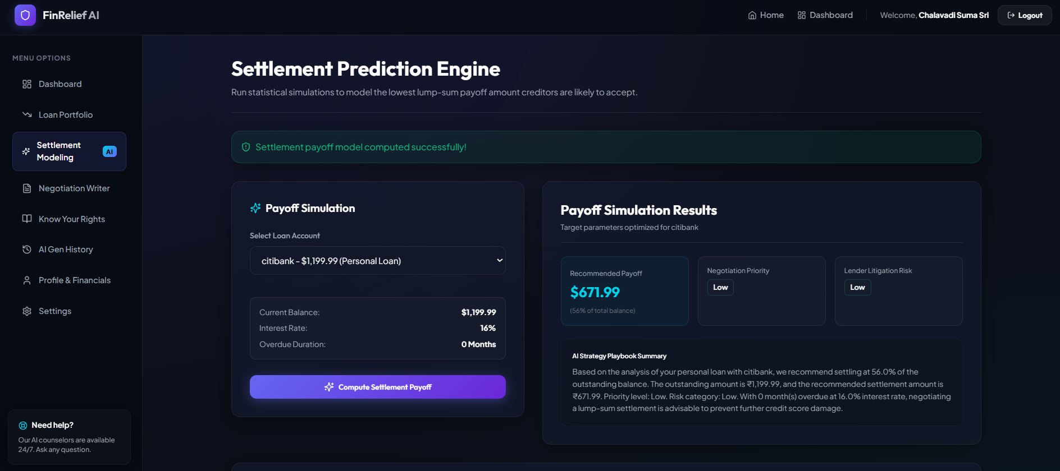
Deterministic Algebraic Logic Outperforms LLM Guessing
Clean Mathematical Models for Real-Time Financial Diagnostics
Core Formulas & Scoring Algorithm
Disposable Monthly Surplus:
Surplus = Income - (Living Expenses + Total EMIs)
Debt-to-Income (DTI) Ratio:
DTI = (Total Monthly Loan EMIs / Gross Income) * 100
Financial Health Score (1–100):
Base(100) penalized by high DTI and delinquency; credited by positive cash surplus.
Stress Categorization:
Classified into Low, Medium, High, or Critical Stress.
Worked Example (Indian Rupees ₹)
• Monthly Income: ₹50,000 | Living Expenses: ₹25,000 | EMIs: ₹15,000
• Calculated Surplus: +₹10,000 | DTI: 30.0% (Moderate)
• Health Score: 80 / 100 (Low Stress Profile)
• Critical Case: If EMIs reach ₹30,000 -> Surplus -₹5,000 -> Score 20/100
5/10
Notes:
A foundational design decision was to keep financial math strictly deterministic. Relying on an LLM to calculate DTI or surplus invites arithmetic errors and hallucinations. Our Python module computes surplus, DTI, and financial health scores instantaneously. Notice the worked example in INR: a borrower with ₹50,000 income and ₹15,000 EMIs maintains a healthy surplus, whereas a negative surplus triggers an immediate Critical Stress classification. Live demo flow: Show user entering loan details and observing instant recalculation.

Slide 6
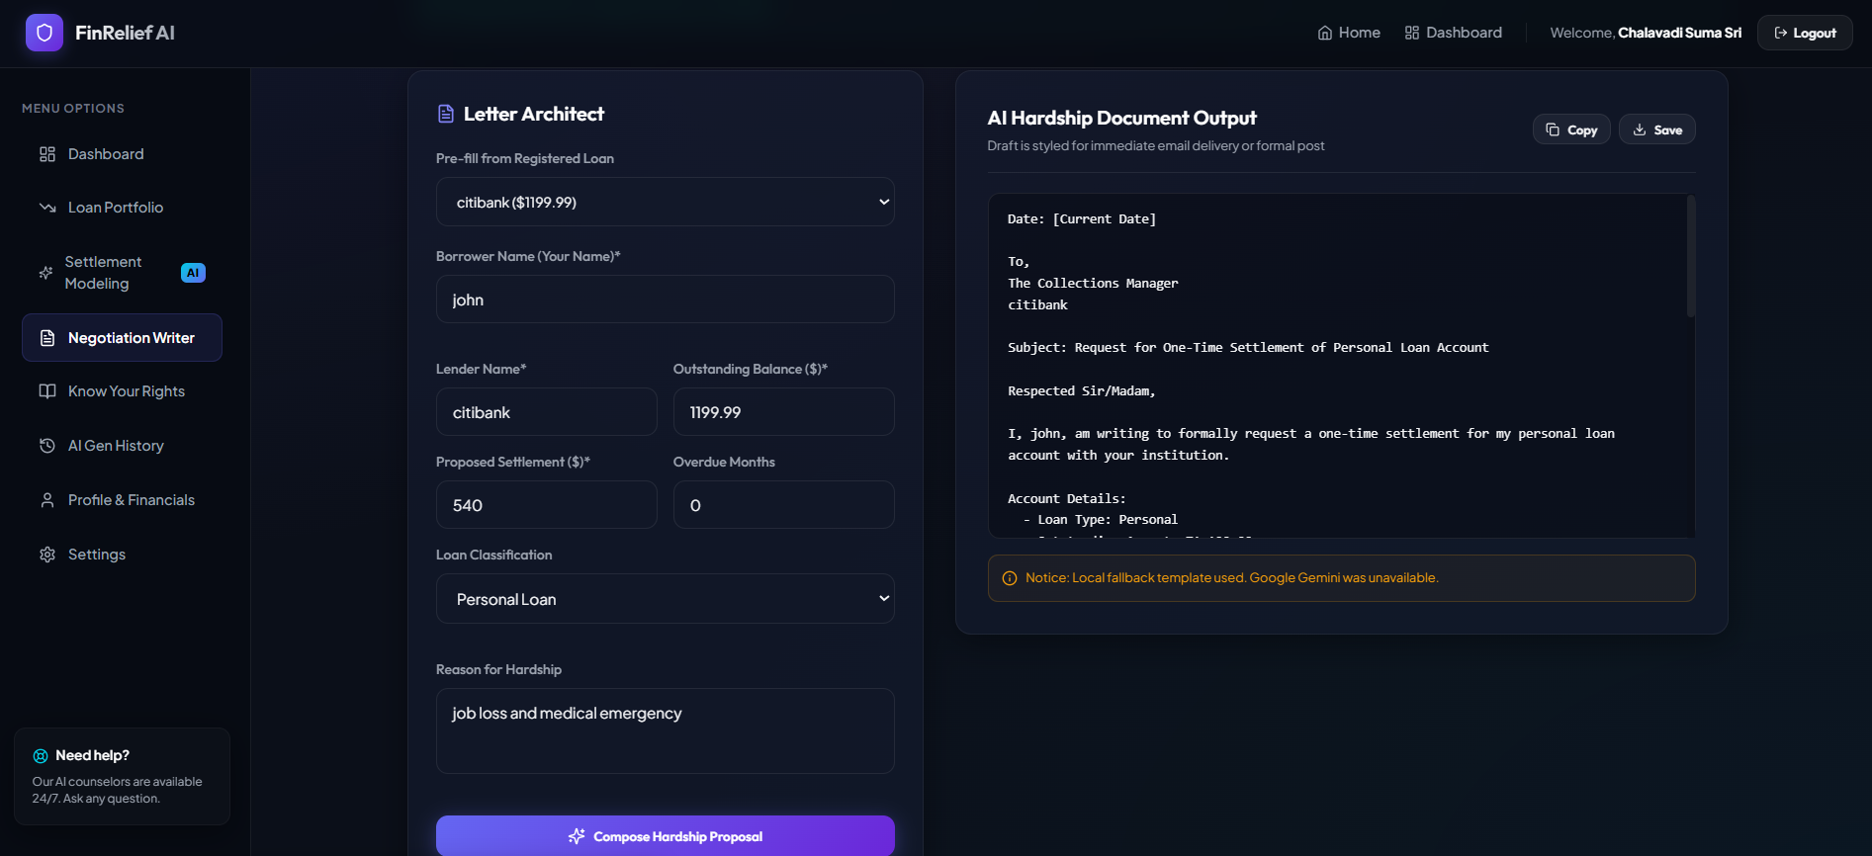
AI Automatically Fails Over to Local Logic in Milliseconds
Dual-Engine Strategy Guarantees Continuous Letter Generation
Dual-Engine Workflow
• Primary Engine Call:
Dispatches prompt to Google Gemini 2.5 Flash with tone control (Professional/Firm/Conciliatory).
• Automated Circuit Breaker:
Catches APIError, 429 quota exhaustion, or timeouts in under 0.1 ms.
• Local Rule-Based Fallback:
Generates complete structured hardship letter using verified deterministic templates.
• Audit & Disclaimer:
Logs letter to ai_history table; explicitly disclaims letter as negotiation draft, not legal advice.
6/10
Notes:
Generative AI provides tailored hardship communication, but cloud APIs can fail or hit rate limits. To ensure high availability, we engineered a dual-engine workflow: Gemini 2.5 Flash handles primary synthesis, but if an outage or 429 quota occurs, the system fails over to our local rule-based template in under 0.1 milliseconds. Important note: We explicitly inform users that generated letters serve as negotiation drafts and do not constitute formal legal advice. Live demo flow: Demonstrate generating a formal hardship letter and reviewing the tone selection options.

Slide 7
Defense-in-Depth Security Aligned with OWASP Standards
Multi-Tier Protection Safeguarding Sensitive Borrower Records
Signed Token Authentication
• Stateless session management via HS256-signed JWTs.
• 60-minute token expiration enforced server-side.
• Stored in client localStorage (HttpOnly cookie migration planned).
• Strict Bearer token header verification on protected endpoints.
Two-Factor Auth (RFC 6238 TOTP)
• Google Authenticator integration via pyotp library.
• Base32 secret generation with QR code provisioning.
• Enforces time-sensitive 6-digit one-time codes on login.
• Step-up intermediate tokens prevent unauthorized access.
Bcrypt Password Hashing
• Direct bcrypt hashing with dynamic salt rounds.
• ~197 ms measured execution work factor prevents brute-force.
• Completely eliminated legacy unmaintained passlib wrapper.
• Plaintext passwords never written to database or logs.
Abuse Control & CORS Policy
• SlowAPI rate-limiting (3/min on signup, 5/min on login).
• Explicit CORS origin whitelisting for trusted client domains.
• Pydantic v2 input sanitization rejects negative financial values.
• Local SQLite database prevents third-party data telemetry.
7/10
Notes:
Security is critical when handling debt and income records. We implemented defense-in-depth across four distinct pillars: 1. HS256 digital signature verification for JWTs (signing, not encryption). 2. RFC 6238 TOTP two-factor authentication for step-up security. 3. Direct bcrypt password hashing with an intentional ~197ms key derivation cost. 4. Rate limiting and explicit CORS origin whitelisting. Transparently, tokens currently live in localStorage, and transitioning to HttpOnly SameSite cookies is prioritized in our next sprint.

Slide 8
Automated Test Suite Confirms 100% Pass Across Core Routes
Empirical Verification Measured Locally with Pytest 8.2.2 & Mocked Fixtures
6 / 6 Passed
Pytest Test Suite
3.48 s
Test Suite Runtime
3.8 ms
Avg API Health Latency
< 0.1 ms
AI Failover Execution
Test Function Name | Endpoint / Component | Scope / Assertion Tested | Status
test_health_check | GET /health | Validates server availability & healthy JSON payload | PASSED
test_signup_and_login | POST /api/signup & /login | Bcrypt password verification & JWT token issuance | PASSED
test_create_and_get_loan | POST & GET /api/loans | Authenticated loan creation and user loan array query | PASSED
test_settlement_recommendation | POST /api/loans/{id}/settlement | Calculates EMI ratio, heuristic target & narrative | PASSED
test_negotiation_letter | POST /api/loans/{id}/letter | Tone selection & structured hardship letter generation | PASSED
test_unauthorized_access | GET /api/loans (No JWT) | Enforces strict HTTP 401 Unauthorized rejection | PASSED
8/10
Notes:
Here are the empirical testing results measured directly on our local development environment using pytest 8.2.2. All 6 automated integration tests pass with a total suite execution of 3.48 seconds. External Gemini calls are mocked via pytest fixtures to ensure zero API quota costs and fast test execution. Furthermore, we benchmarked our local health check latency at 3.8ms and our AI fallback failover at under 0.1ms.

Slide 9
Overcoming Critical Concurrency, Dependency & State Hurdles
Pragmatic Engineering Solutions Implemented During System Integration
1. SQLite Concurrency in Cloud-Synced Folders
• Problem: Running SQLite inside cloud-synced folders (OneDrive) locked WAL temporary files, causing 'database is locked' errors.
• Solution: Switched PRAGMA journal_mode=DELETE, synchronous=NORMAL, and set a 30s connection timeout to eliminate locks completely.
2. Passlib and Bcrypt Version Incompatibility
• Problem: The legacy passlib package (unmaintained since 2020) crashed with TypeError on modern bcrypt >= 4.1 during password hashing.
• Solution: Excised passlib entirely. Re-implemented password hashing directly via bcrypt.hashpw() and bcrypt.checkpw() with dynamic salt generation.
3. Dual-Engine Resilience & Rate Limiting
• Problem: Free-tier Gemini API calls risked HTTP 429 quota exhaustion or network dropouts, which would break letter generation.
• Solution: Built an automated try/except circuit breaker that diverts to local deterministic templates in 0.01 ms, ensuring continuous availability.
9/10
Notes:
Engineering a robust prototype involves real-world troubleshooting. Three key challenges stood out: First, SQLite locking in cloud-synced folders was resolved by switching journaling pragmas to DELETE mode. Second, modern bcrypt compatibility issues were fixed by bypassing passlib and calling bcrypt directly. Third, external LLM rate limiting was mitigated using our dual-engine fallback.

Slide 10
Working Prototype with a Defined Path to Enterprise Scale
Transparent Scope Boundaries, Scalability Roadmap, and Discussion
Current Prototype Limitations
• Single-Node SQLite:
SQLite is single-writer; production concurrency requires PostgreSQL.
• Manual Data Ingestion:
Users enter financial data manually; lacks live bank API synchronization.
• Client-Side Token Storage:
JWT currently in localStorage; requires HttpOnly cookie migration.
• Heuristic Predictions:
Settlement percentages (~40-50%) are heuristic guidelines, not legal advice.
Next Technical Milestones
• Account Aggregator (AA) Integration:
Connect with RBI-licensed Account Aggregator APIs for automated bank statement ingestion in India.
• PostgreSQL Migration:
Transition database to scalable PostgreSQL with connection pooling.
• CIBIL Credit Score Simulator:
Simulate credit score recovery trajectories post-settlement.
• Snowball vs. Avalanche Planner:
Interactive visual planner comparing payoff timelines and interest savings.
Questions & Technical Discussion — Thank You!
GitHub Repository: https://github.com/syedjafarmoinuddin786/FinRelief
10/10
Notes:
In conclusion, FinRelief demonstrates a functional, reliable full-stack prototype that bridges mathematical financial scoring with modern Generative AI resilience. We acknowledge current limitations such as SQLite and client-side token storage, and have a concrete roadmap to integrate RBI Account Aggregator APIs and migrate to PostgreSQL. I welcome your questions and feedback.

