Slide 1
KanchiLUG presents
Learn python with us
Session 12
By
Syed Jafer

Slide 2
Agenda
Tuple
    Declaring
    Data Types
    Built Ins ( len, in, not in, max, min, any, all)
    Accessing Elements
    Adding Values
    Removing Values
    Sorting
    Copy

Slide 3
Tuple
A tuple is a collection which is ordered, unchangeable.
Tuple is an immutable collection of both mutable and immutable .

Slide 4
Tuple - Declaring
() - Curly Brackets
tuple() - Constructor
data = ( ‘d1’, ‘d2’, ‘d3’ )

Slide 5
Tuple
Ordered
Unchangeable
Contains duplicate values
indexed

Slide 6
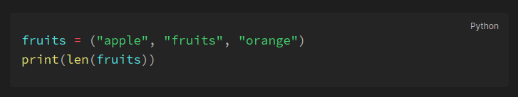
Tuple – Length
To determine how many items a tuple has, use the len() function

Slide 7
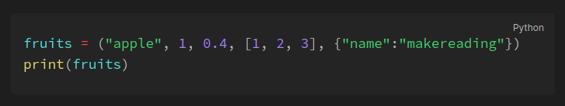
Tuple – Data Types
Tuple items can be of any data type or a combination of data types.

Slide 8
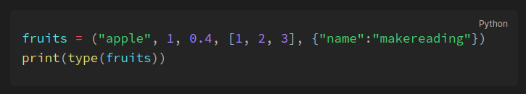
Tuple – type()
Tuple are defined as objects with the data type 'tuple'

Slide 9
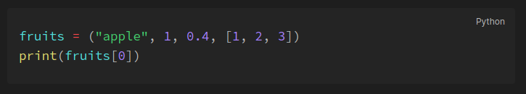
Tuple – Indexing
Tuple items are indexed.

Slide 10
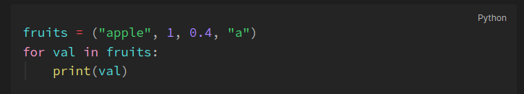
Tuple – For Loop

Slide 11
Tuple – in & not in
In – Element present in the set.
Not in – Element not present in the set.

Slide 12
Adding Values to Tuple
Adding values to a Tuple is not possible.
Workaround: We can convert the tuple to list and add values to the list, then convert back to the tuple

Slide 13
Tuple Removal – del
Del will delete the object itself.
fruits = (‘apple’, ‘orange’, ‘banana’)
del fruits
print(fruits)

Slide 14
Copy – Indirect Copy
Convert to list
Convert the list to tuple.

Slide 15
Mathematical Functions

Slide 16
    A
    B

Slide 17


Slide 18
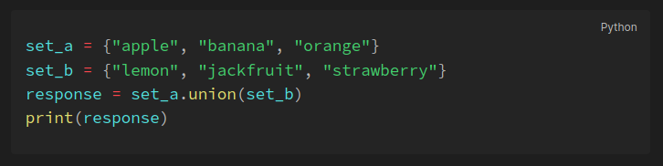
Sets - Union
Union of two sets will return all the items present in both sets (all items will be present only once). This can be done with either the | operator or the union() method.

Slide 19
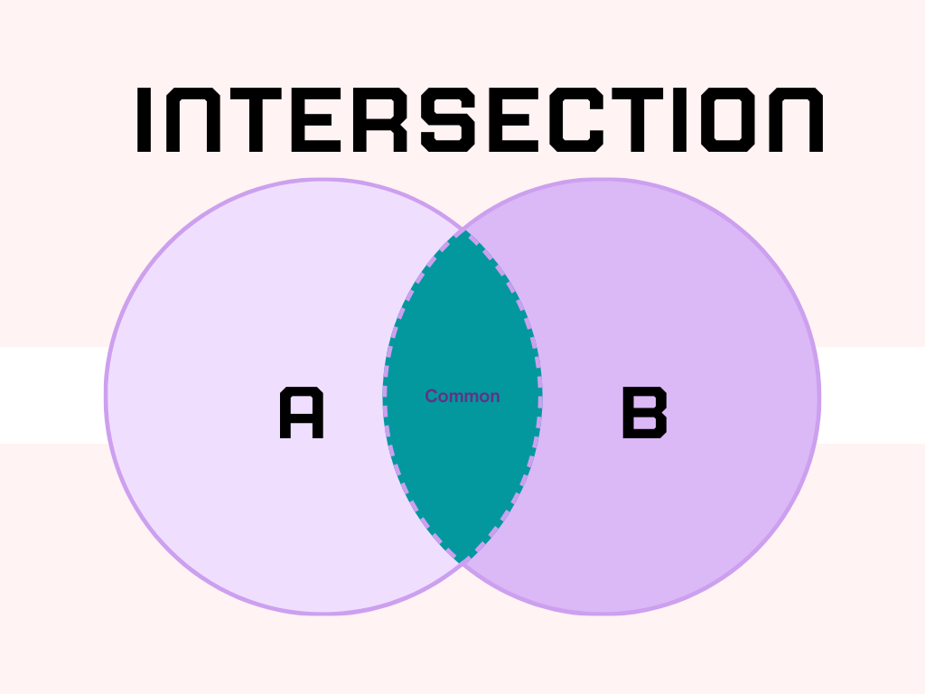

Slide 20
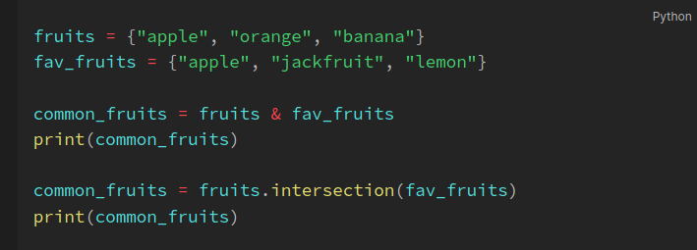
Sets - Intersection
The intersection of two sets will return only the common elements in both sets. The intersection can be done using the & operator and intersection() method.

Slide 21
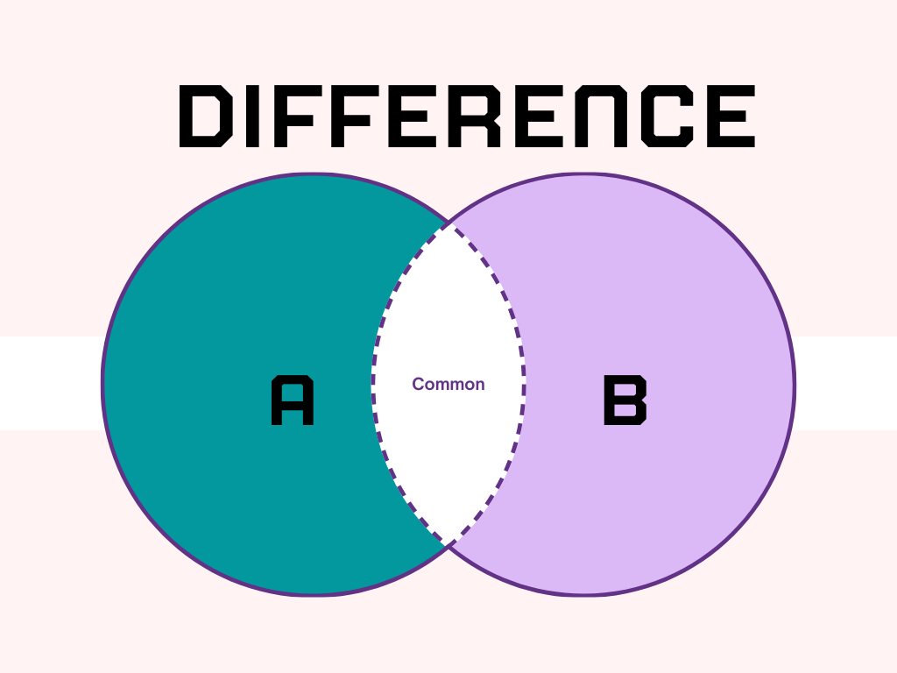

Slide 22
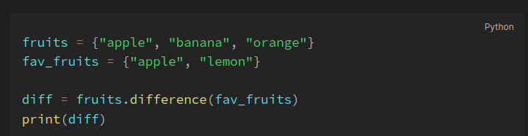
Sets - Difference
The difference operation will return the items that are present only in the first set i.e the set on which the method is called. This can be done with the help of the - operator or the difference() method.

Slide 23
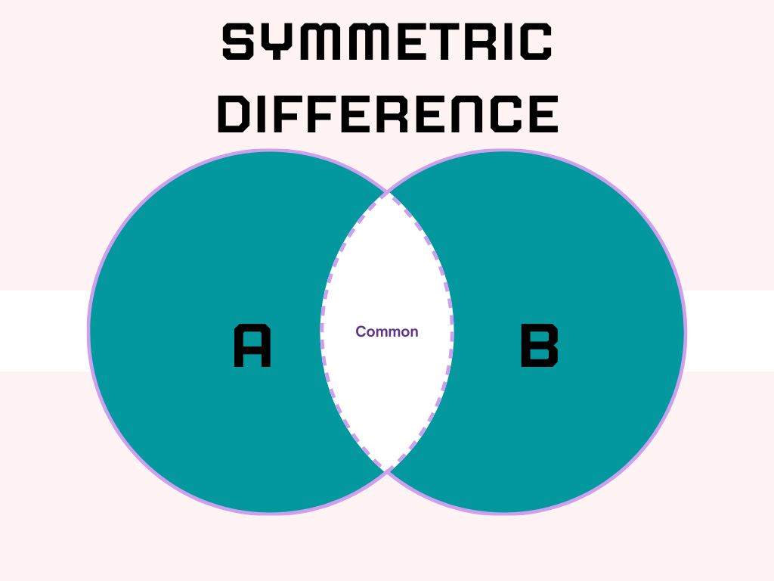

Slide 24
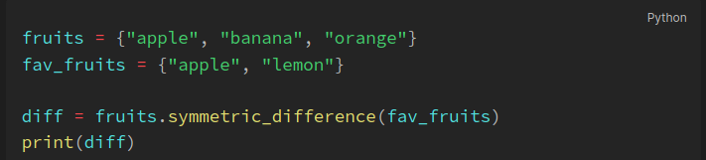
Sets - Symmetric difference
The Symmetric difference operation returns the elements that are unique in both sets. This is the opposite of the intersection. This is performed using the ^ operator or by using the symmetric_difference() method.

Slide 25
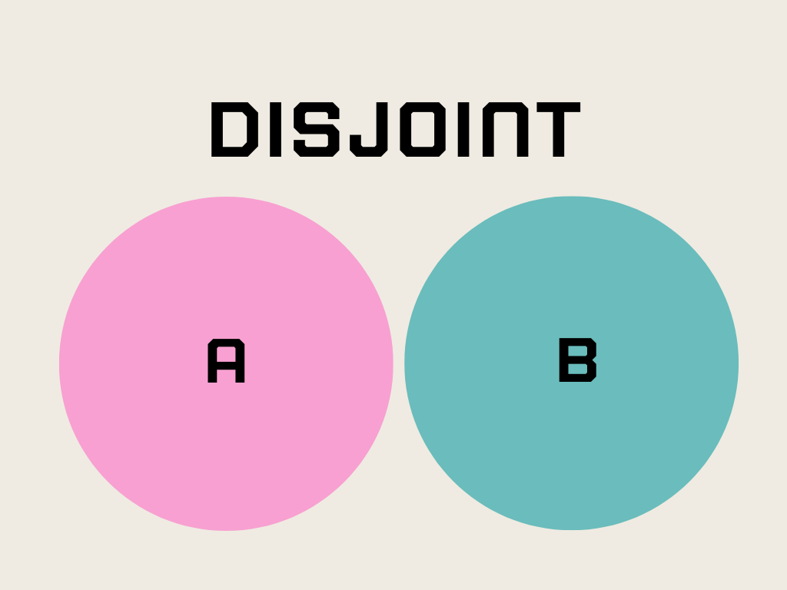

Slide 26
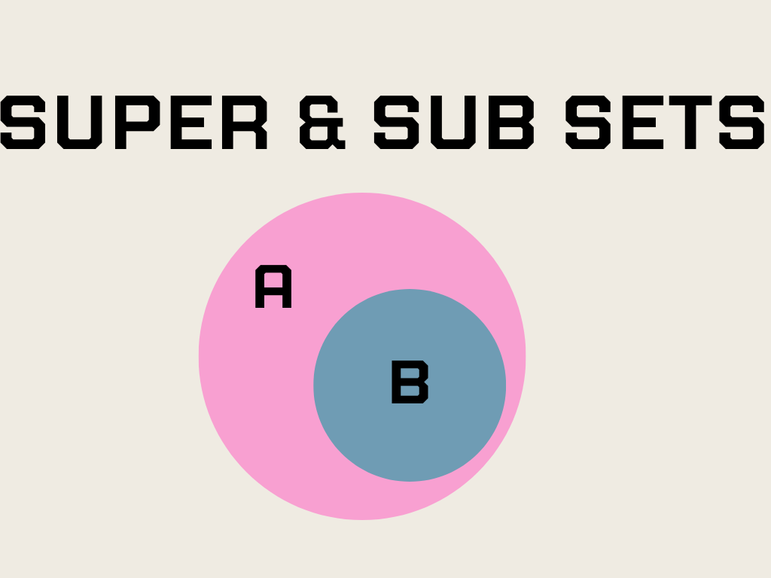

Slide 27
Q & A

